Slide 1
Research Design
6
Department of Information Management
CYCU
CK Farn
mailto: ckfarn@gmail.com
2023.10

Slide 2

Notes on Funneling Exercise
Mostly centered at the Data (raw data) level
  factual information (as measurements or statistics) used as a basis for reasoning, discussion, or calculation
The objective is to have a “landscape” understanding of a certain area
  Which area?
  How is the “profile” looks like?

Slide 3
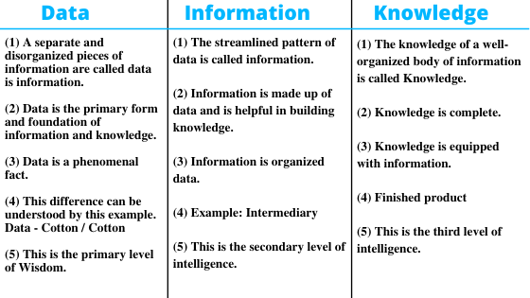
Data, information and knowledge

Slide 4
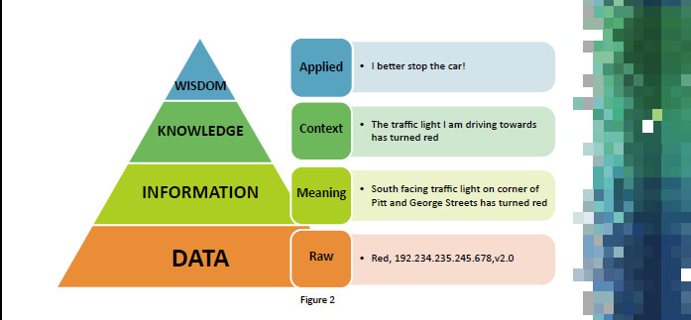
Data, information and knowledge ₂

Slide 5
Research Design
TOC
The basic stages of research design
The major descriptors of research design
The major types of research designs.
The relationships that exist between variables in research design and the steps for evaluating those relationships
Eliminating threats to validity
Determining appropriate research design

Slide 6

What Is Research Design?
Blueprint
Plan
Guide
Framework
Notes:
There are many definitions of research design. Research design is the blueprint for fulfilling research objectives and answering questions. Its essentials include 1) an activity and time-based plan, 2) a plan based on the research questions, 3) a guide for selecting sources and types of information, 4) a framework for specifying the relationships among the study’s variables, and 5) a procedural outline for every research activity.

Slide 7
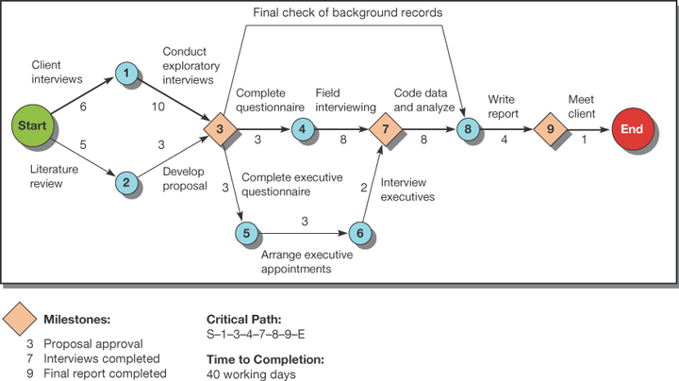
Tools Used in Designing Research: CPM (critical path method)
Notes:
Exhibit 6-2 provides one project management tool: critical path method (CPM). In a CPM chart:
The nodes represent major milestones.
The arrows suggest the work needed to get to the milestones.
More than one arrow pointing to a node indicates all those tasks must be completed before the milestone has been met.
Usually a number is placed along the arrow showing the number of days or weeks required for that task to be completed.
The pathway from start to end that takes the longest time to complete is called the critical path.

Slide 8
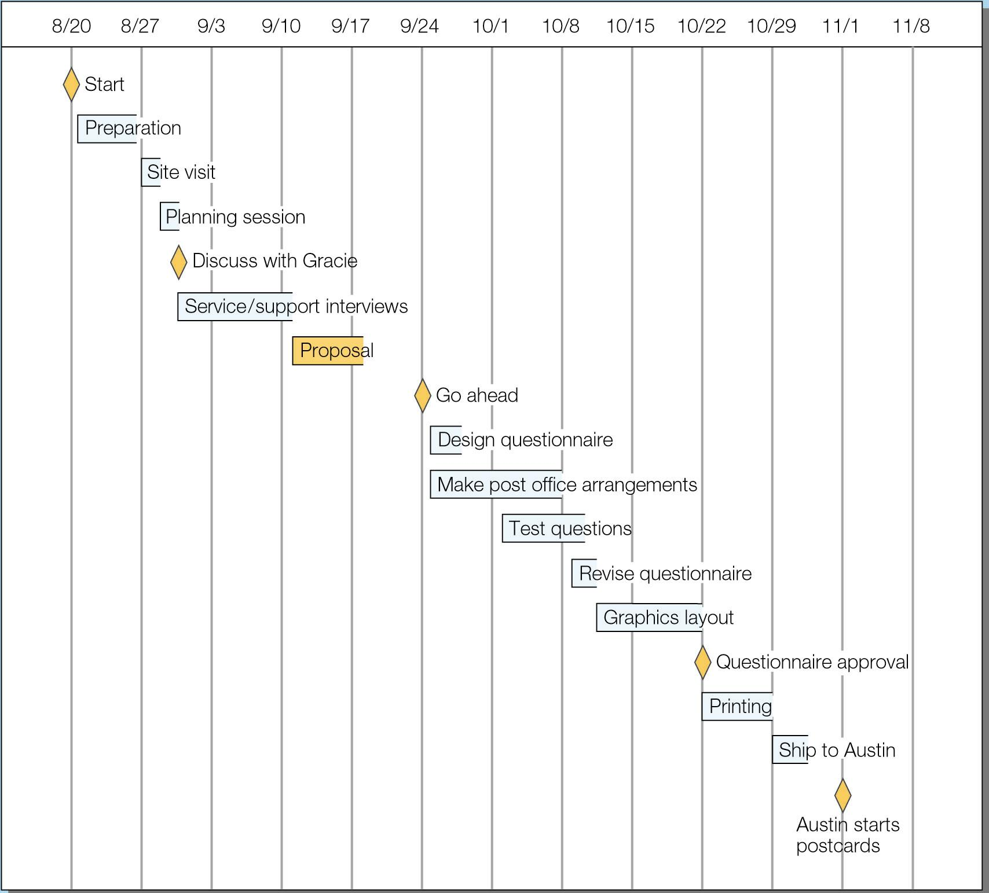
Tools Used in Designing Research: Gantt Chart
Project Plan in Gantt chart format
Notes:
A Gantt chart ( Exhibit 5-11, MindWriter project) is a common project planning tool that reveals summary tasks, benchmarking milestones, and detailed tasks against a time frame for the overall project. Tasks may be color coded to indicate a particular team member’s responsibilities. Many project-management software packages include Gantt charting.
The chart may be used to monitor projects to keep them on time, as well as to alert the client or manager to steps requiring their approval—and what happens to the project’s schedule if approval is not forthcoming when it is needed.

Slide 9
Descriptors of Research Design
Question Crystallization
Perceptual Awareness
Data Collection Method
Descriptors
Purpose of
Study
Experimental Effects
Research Environment
Time Dimension
Topical Scope
Notes:
Exhibit 6-3 information is presented here in a discussion format.
The degree to which the research question has been crystallized
Exploratory study
Formal study
The method of data collection
Monitoring
Communication Study
The power of the researcher to produce effects in the variables under study
Experimental
Ex post facto
The purpose of the study
Reporting
Descriptive
Causal-Explanatory
Causal-Predictive
The time dimension
Cross-sectional
Longitudinal
The topical scope—breadth and depth—of the study
Case
Statistical study
The research environment
Field setting
Laboratory research
Simulation
The participants’ perceptional awareness of the research activity
Actual routine
Modified routine

Slide 10
Degree of Question Crystallization
Exploratory Study
Loose structure
Expand understanding
Provide insight
Develop hypotheses
Notes:
The degree to which the research question has been crystallized or structured is the first descriptor of research design. There are two options.
Exploratory studies are used when the research question is still fluid or undetermined. The goal of exploration is to develop hypotheses or questions for future research.
Formal studies are used when the research question is fully developed and there are hypotheses to be examined.

Slide 11
Explore: Formation of Constructs
Conceptual Level
X
Y
Inference: Causal relationship
Abstraction,
Conceptualization
x
y
Observation
Analysis: Association
Observation
Operational Level

Slide 12

Approaches for Exploratory Investigations
Participant observation
Film, photographs
Projective techniques
Psychological testing
Case studies
Ethnography 民俗誌
Expert interviews
Document analysis
Proxemics and Kinesics 肢體語言學
Notes:
The objectives of exploration may be accomplished with qualitative and quantitative techniques, but exploration relies more heavily on qualitative techniques. Qualitative techniques are non-quantitative data collection used to increase understanding of a topic. Qualitative refers to the meaning, definition, analogy, model, or metaphor characterizing something, while quantitative assumes the meaning and refers to a measure of it.
There are many approaches useful for exploratory investigations of management questions. Several such approaches are listed in the slide. These techniques are expanded upon in Chapter 8.

Slide 13

Desired Outcomes of Exploratory Studies
Established range and scope of possible management decisions
Established major dimensions of research task
Defined a set of subsidiary questions that can guide research design
Discovery of Laws, and preliminary examination of its plausible causes
Notes:
An exploratory study is finished when the researchers have achieved the objectives listed in this and the next slide.

Slide 14
Desired Outcomes of
Exploratory Studies (cont.)
Developed hypotheses about possible causes of management dilemma
Learned which hypotheses can be safely ignored
Concluded additional research is not needed or not feasible

Slide 15
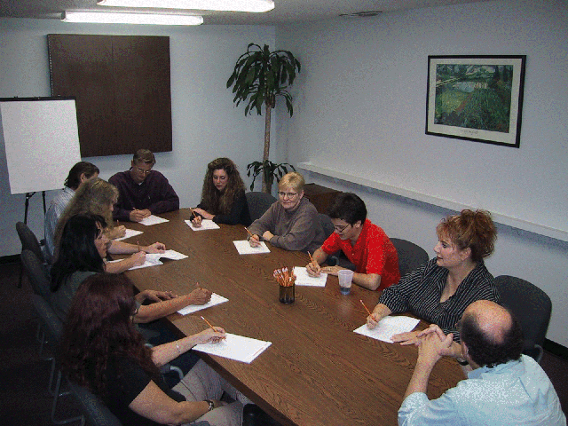
Commonly Used Exploratory Techniques
Secondary Data Analysis
Experience Surveys
Focus Groups
Notes:
While there are several types of exploratory techniques possible these are the three techniques with the widest applications for business researchers.
Secondary data analysis is also called a literature search. Within secondary data exploration, researchers should start first with an organization’s own data archives. The second source of secondary data is published documents prepared by authors outside the sponsor organization.
Experience surveys are semistructured or unstructured interviews with experts on a topic or a dimension of a topic.
Focus groups are discussions on a topic involving a small group of participants led by a trained moderator.

Slide 16

Face-to-face interaction—one of the best ways to learn from participants.
Notes:
This ad for Delve, a marketing research firm, points out the importance of primary data.

Slide 17
Experience Surveys
What is being done?
What has been tried in the past with or without success?
How have things changed?
Who is involved in the decisions?
What problem areas can be seen?
Whom can we count on to assist or participate in the research?
Notes:
Experience surveys are sometimes called expert interviews or key informant surveys. Even though the term survey is in the name, it is not a closed-ended, structured survey. Rather, experience surveys are interviews designed to extract as much information as possible from the expert’s knowledge. Broad questions guide the discussion. Several questions that could be used in an experience survey are listed in the slide.
Some examples of groups who might be identified for an experience survey include potential car buyers, dealer sales representatives, advertising columnists, and automotive industry analysts.

Slide 18
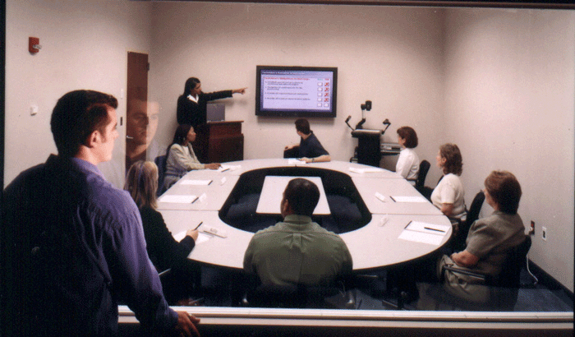
Focus Groups
Group discussion
6-10 participants
Moderator-led
90 minutes-2 hours
Notes:
Focus groups are widely used in business research. They are led by a trained moderator and typically include 6-10 participants. Mini-focus groups with just 3 people are increasingly common. The facilitator uses group dynamics principles to focus or guide the group in an exchange of ideas, feelings, and experiences on a specific topic.
Focus groups can take place in a variety of settings, but many take place in a focus group room equipped with one-way window and recording devices.

Slide 19
Degree of Question Crystallization
Exploratory Study
Loose structure
Begins with observations
Expand understanding
Provide insight
Develop hypotheses
Formal Study
Precise procedures
Begins with hypotheses
Answers research questions
Notes:
The degree to which the research question has been crystallized or structured is the first descriptor of research design. There are two options.
Exploratory studies are used when the research question is still fluid or undetermined. The goal of exploration is to develop hypotheses or questions for future research.
Formal studies are used when the research question is fully developed and there are hypotheses to be examined.

Slide 20
Theory Confirmation
Conceptual Level
X
Theory: Causal relationship
Y
Empirical Confirmation of relationship
Operationalization
x
y
Observation,
Measurement,
Manipulation
Statistical Conclusion
Observation,
Measurement
Operational Level

Slide 21


Data Collection Method
Monitoring:
觀察、資料蒐集
行為
Communication:
詢問
態度、看法、瞭解程度
Notes:
Method of data collection distinguishes between monitoring and communication processes. Monitoring processes are studies in which the researcher inspects the activities of a participant or the nature of some material without eliciting responses from the participant. Examples of monitoring include traffic counts, library searches, and counting cars in a parking lot.
In a communication study, the researcher questions the participants and then collects their responses by personal or impersonal means.The collected data may result from 1) telephone or interview conversations, 2) self-administered or self-reported instruments sent through the mail, dropped-off in convenient locations, or transmitted electronically, 3) instruments presented before and/or after a treatment or stimulus condition in an experiment.

Slide 22

The Time Dimension
Cross-sectional
Longitudinal
Notes:
Cross-sectional studies are studies conducted only once. They seek to reveal a snapshot at one point in time. Longitudinal studies include repeated measures over an extended period of time. Therefore, longitudinal studies can track changes over time. Despite this advantage, longitudinal studies are expensive and time-intensive.

Slide 23
The Topical Scope
Statistical Study
Breadth
Population inferences
Quantitative
Generalizable findings
Case Study
Depth
Detail
Qualitative
Multiple sources of information
Notes:
The topical scope refers to the breadth (what properties will be measured) and depth (at what level will the properties be measured) of the study in question.
A statistical study is designed for breadth rather than depth. It attempts to capture a population’s characteristics by making inferences from a sample’s characteristics and then testing resulting hypotheses.
A case study places more emphasis on full contextual analysis of a few events or conditions and their interrelations. Case studies rely on qualitative data and emphasize the use of results for insight into problem-solving, evaluation, and strategy.
While case studies are not considered “scientific,” they do play an important role in challenging theory, providing new hypotheses, and offering new ideas on constructs.

Slide 24
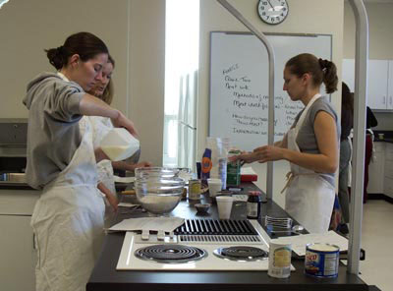
The Research Environment
Field conditions
Lab conditions
Simulations
Notes:
Designs also differ as to whether they occur under actual environmental conditions. Field conditions mean that the research occurs in the actual environmental conditions where the dependent variable occurs. Under laboratory conditions, the studies occur under conditions that do not simulate actual environmental conditions. In a simulation, the study environment seeks to replicate the natural environment in a controlled situation. For instance, a lab set up as a kitchen would serve as a simulation of a consumer’s own kitchen.

Slide 25

Purpose of the Study
Reporting
Descriptive
Casual -Explanatory
Causal -Predictive

Slide 26
Descriptive Studies
Who?
How much?
What?
When?
Where?
Notes:
The purpose of the study asks whether the research is concerned with describing the population’s characteristics or with trying to explain the relationships among variables. Descriptive studies discover the answers to the questions who, what, when, where, or how much.

Slide 27

Descriptive Studies
Descriptions of population characteristics
Estimates of frequency of characteristics
Discovery of associations among variables
Notes:
In contrast to exploratory studies, more formalized studies are typically structured with clearly stated hypotheses or investigative questions. Formal studies serve a variety of research objectives such as those listed in the slide.
The third objective, discovery of variable associations, is sometimes labeled a correlational study, which is a subset of descriptive studies. Correlation is the relationship by which two or more variables change together, such that systematic changes in one accompany systematic changes in the other.

Slide 28
Experimental Effects
Ex Post Facto 事後 Study After-the-fact report on what happened to the measured variable
Experiment
Study involving the manipulation or control of one or more variables to determine the effect on another variable
Notes:
Causal studies are differentiated by their ability to control and manipulate variables.
Causal studies may be experiments or ex post facto studies.
Experiments are studies involving the manipulation of one or more variables to determine the effect on another variable. For example, direct marketers can use split tests on mailings to test which mailing resulted in the highest response rate.
Ex post facto designs are evaluations made after-the-fact based on measured variables.

Slide 29
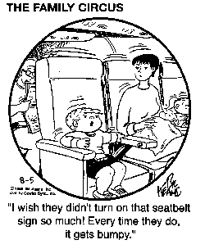
Causal Studies
Symmetrical
Reciprocal
Asymmetrical
Notes:
People without scientific training may think that a correlation is causation. However, just because two things change together does not imply a cause-and-effect relationship. The essential element of causation is that some external factor produces a change in the dependent variable: A produces B. Empirically, we never demonstrate causality with certainty because we do not prove causal linkages deductively. Empirical research conclusions are based on inferences or inductive conclusions. These conclusions are probability statements, based on what we observe and measure and what we conclude is likely to happen.
There are three possible relationships that can occur between two variables. These are named in the slide. A symmetrical relationship is one in which two variables vary together but we assume the changes in neither variables are due to changes in the other.
A reciprocal relationship exists when two variables mutually influence or reinforce each other.
With asymmetrical relationships, we postulate that changes in one variable (independent variable) are responsible for changes in another (dependent variable). Exhibit 8-3 describes the four types of asymmetrical relationships and is provided on the next slide.

Slide 30
Understanding Casual Relationships
Property
Behavior
Response
Disposition
Stimulus
Notes:
Exhibit 8-3 details…relationship but students need to understand the foundations:
A stimulus is an event or force (e.g., drop in temperature, crash of stock market, product recall, or explosion in factory).
A response is a decision or reaction.
A property is an enduring characteristic of a subject that does not depend on circumstances for its activation (e.g., age, gender, family status, religious affiliation, ethnic group, or physical condition).
A disposition is a tendency to respond in a certain way under certain circumstances (e.g., attitudes, opinions, habits, values, and drives).
A behavior is an action (e.g., consumption habits, work performance, interpersonal acts, and other kinds of performance).

Slide 31
Asymmetrical Casual Relationships
Stimulus-Response
Property-
Behavior
Property-
Disposition
Disposition-Behavior
Notes:
Exhibit 8-3 details the four types of asymmetrical causal relationships.
A stimulus-response relationship refers to an event or change that results in a response from some object. An example is a change in commission structure that leads to a higher level of agent sales.
A property-disposition relationship refers to an existing property that causes a disposition. An example is the relationship between age and attitudes about saving.
A disposition-behavior relationship refers to a disposition that causes a specific behavior. An example is the relationship between moral values and shoplifting.
A property-behavior relationship refers to an existing property that causes a specific behavior. An example is the relationship between age and sports participation.

Slide 32
Types of Asymmetrical Causal Relationships
Relationship Type | Nature of Relationship | Examples
Stimulus-response | An event or change results in a response from some object. | A change in work rules leads to a higher level of worker output. A change in government economic policy restricts corporate financial decisions. A price increase results in fewer unit sales.
Property-disposition | An existing property causes a disposition. | Age and attitudes about saving. Gender attitudes toward social issues. Social class and opinions about taxation.
Disposition-behavior | A disposition causes a specific behavior. | Opinions about a brand and its purchase. Job satisfaction and work output. Moral values and tax cheating.
Property-behavior | An existing property causes a specific behavior. | Stage of the family life cycle and purchases of furniture. Social class and family savings patterns. Age and sports participation.

Slide 33

Evidence of Causality
Covariation between
A and B
Time order of events
No other possible
causes of B
Notes:
When testing causal hypotheses, we seek three types of evidence:
Covariation between A and B.
Do we find that A and B occur together in the way hypothesized?
When A does not occur, is there also an absence of B?
When there is more or less of A, does one also find more or less of B?
2. Time order of events moving in the hypothesized direction.
Does A occur before B?
3. No other possible causes of B.
Can one determine that C, D, and E do not covary with B in a way that suggests possible causal connections?

Slide 34

Participants’ Perceptional Awareness
No deviation perceived
Deviations perceived
as unrelated
Deviations perceived as
researcher-induced
Notes:
The usefulness of a research design is reduced when people in a disguised study perceive that research is being conducted. Participants’ perceptions can influence the outcomes of research. This was first discovered in the 1920s when researchers at the Hawthorne plant of the Western Electric Company found that participants reacted favorably to receiving attention.
There are three levels of perception to consider and these are highlighted in the slide.
Mystery shopping sometimes provides an example of the third level of perception. Mystery shopping involves individuals who pose as customers and visit retail or service organizations to observe and measure specific behaviors or circumstances. If a retail sales associate knows that she is being observed and evaluated, she is likely to modify her performance.

Slide 35
Strength of research design
(methodology)
Strong design
  Able to ensure internal validity of the results
  e.g. laboratory experiments
Weak design
  Ex post facto analysis, natural observation, interviews

