Slide 1

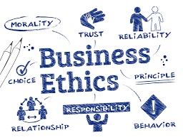
Business Ethics
By Gloria Chen
2023

Slide 2
目錄
CONTENTS
01
02
03
04
Define Business Ethics
Why you care?
Why Law Cannot Replace Business Ethics
Society's Expectations for Business Ethics

Slide 3
Define Business Ethics
PART 1

Slide 4
Define Business Ethics
Business ethics from different prospectives
01
Basic ideas
Of Business Ethics
Key components of business ethics

Slide 5

01
Definition of Business Ethics
Introduction to Business Ethics
1
2
The Relationship Between Business Ethics and Morality
3
Carroll's Pyramid of Corporate Social Responsibility.
Business ethics
4
EGS，Environment, Social, Governance
5
Business Ethic Theories-You should know

Slide 6
Business Ethics
It involves examining ethical dilemmas and making choices that are morally right and socially responsible.
Business ethics address issues such as
  Fairness
  Honesty,
  Integrity,
  Respect for human rights,
  Environmental sustainability,
  The overall impact of business practices on society.
Like finance and marketing, ethics has become an essential business function. But why?

Slide 7
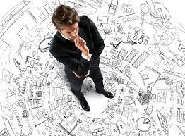
If I disregard business ethics and focus solely on strategy, wouldn't I make more money?
Environmental degradation
Bribery and corruption
Exploitation of labor
Exaggerated advertising
& deceiving consumers
This is all for the sake of doing business!

Slide 8
The reasons for why you should care about business ethics
Brand recognition and growth
Increased ability to negotiate
Increased trust in products and services
Customer retention and growth
Attracts talent
Attracts investors

Slide 9

https://www.youtube.com/watch?v=UAZ8Ts9CC6I

Slide 10

https://www.youtube.com/watch?v=NdOUvP_nZX0

Slide 11
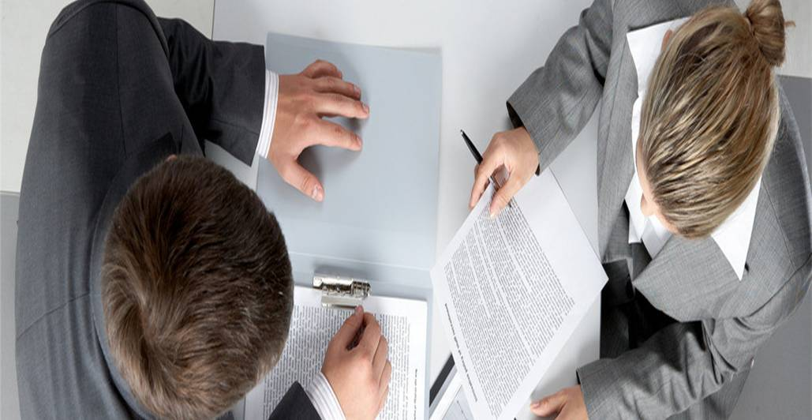
01
The Relationship Between Business Ethics & Moral
01
02
03
Definition and Scope
Decision-Making and Accountability
Impact and Stakeholder Consideration

Slide 12
Business Ethics VS Moral
Definition:
What is the difference between business ethics and personal morals, and how do they influence decision-making in the business context?
Scope:
Should business ethics be tailored to fit cultural norms and practices, or are there universal moral principles that should be consistently applied in all business settings?

Slide 13
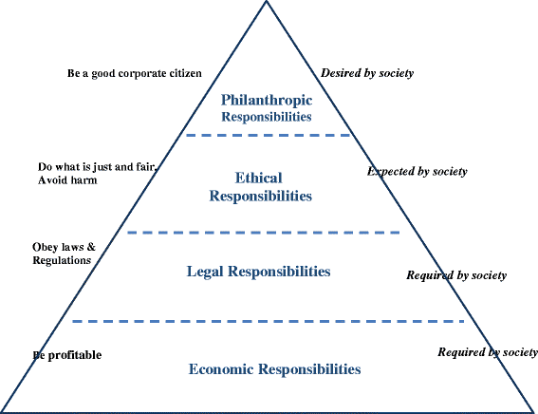
Carroll's Pyramid of Corporate Social Responsibility

Slide 14


Slide 15
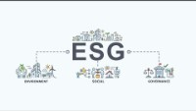
https://www.youtube.com/watch?v=AkbGz3CYvqE&t=142s

Slide 16


Slide 17
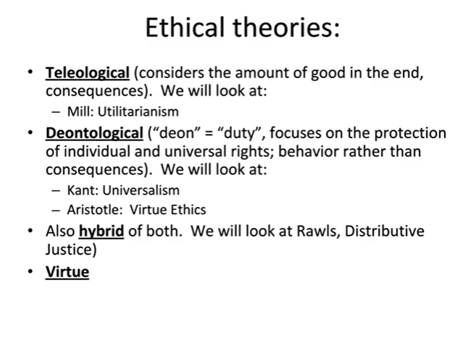
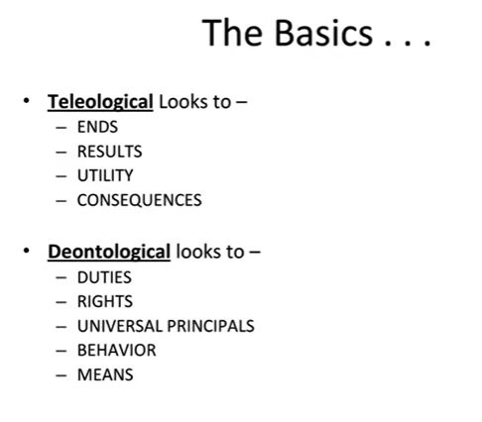
https://capture.dropbox.com/JHLUQUwwW6EXPMrN

Slide 18
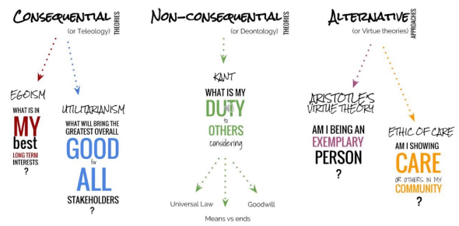

Slide 19
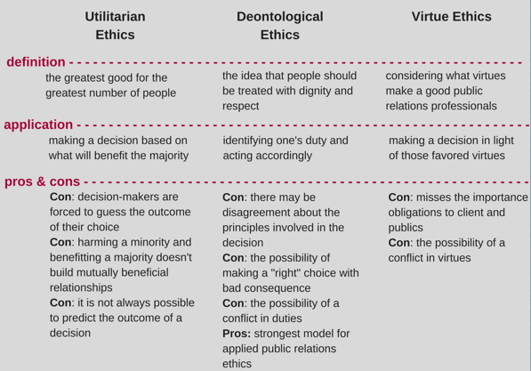

Slide 20
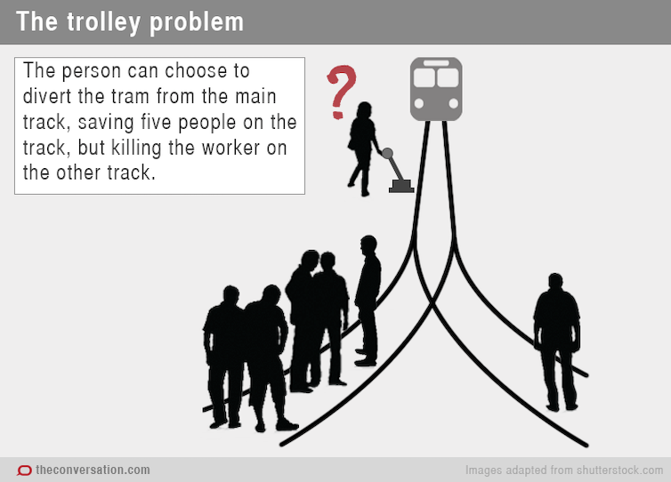

Slide 21
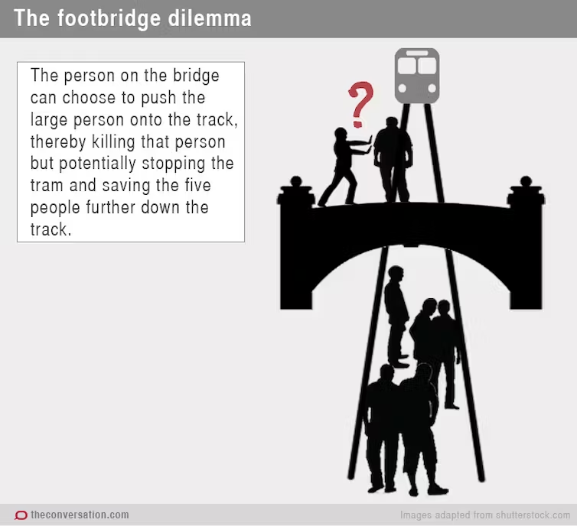

Slide 22
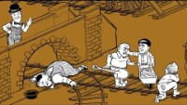
https://www.youtube.com/watch?v=bOpf6KcWYyw&t=89s

Slide 23
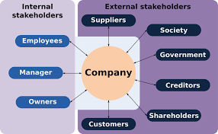
Stakeholder Theory
A broader and more comprehensive perspective
Moral responsibilities
Impact of stakeholders

Slide 24
Why you care?
PART 2

Slide 25
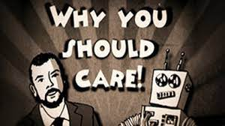

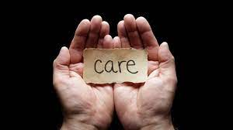
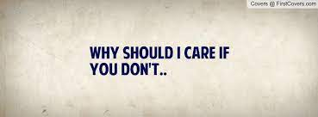
Why you care?
Why should we care about
business ethics?

Slide 26
In recent years, there have been significant cases of corporate
misconduct and business ethics issues.
1
2
3
Ethic
Enron
WorldCom
Parmalat
6
5
4
Mitsubishi Motors
Royal Dutch Shell
Volkswagen

Slide 27
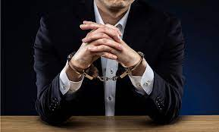
Regarding the misconduct
Who?
Who is the mastermind behind the misconduct?
Who are the victims?
Who should be held responsible?
What are the motives of the perpetrators (rulebreaker)?

Slide 28
The reasons?
What are the reasons leading to the occurrence of the misconduct?
Legal loopholes?
Inadequate law enforcement?
Distorted behavioral incentives?
Culture prospect?
Is the occurrence of the misconduct an individual act or a collaborative effort?
Is there a culture of corruption within the organization?
Is corporate ethics being neglected?
Are these misconduct cases isolated incidents or a widespread phenomenon?
What are the short-term and long-term impacts of the misconduct on society?
How can we prevent these misconduct cases from happening again?

Slide 29
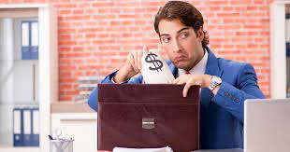
Unethical business practices-related items.
Individual self-interest infringes upon the common good of the public.
Evil deeds erode morality.
Greed buries conscience.
Abuse of power violates justice.
Values become distorted.
Ignorance towards morality.
Numb and indifferent towards morality.
Lacking the ability to grasp ethics in situations of moral ambiguity and ethical conflicts.

Slide 30

Reasons for corporations neglecting social responsibility.
Ethics and profitability are mutually exclusive.
As long as a company is not breaking the law, it is acceptable for it to act immorally.
Using public relations skills and online relationships can resolve any issues.
Concerns about ethics should be the responsibility of society and the government.

Slide 31

Several popular myths about ethics in business.

Slide 32
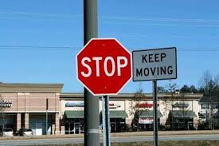
1)Business & ethics are inherently contradictory, and the term "business ethics" or "corporate ethics" is an oxymoron. (contradicted)

Slide 33
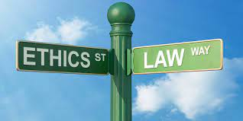
2) Business ethics is not equivalent to simply obeying the law
Not all actions can or should be regulated by the law

Slide 34
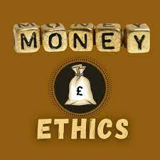

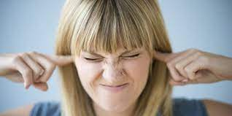
3)
Business and ethics are unrelated

Slide 35
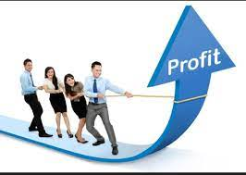
4) The "Profit First, Ethics Later" theory

Slide 36
Why Law Cannot Replace Business Ethics
PART 3

Slide 37

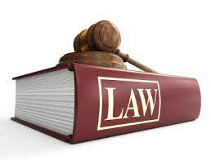
Relying solely on the law is insufficient to restrain corporate behavior that harms society
Because
Business is closely intertwined with society
The law can only provide corporations with the minimum level of restraint

Slide 38

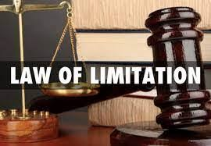
Why can't the law restrain a company's ethics?
The issue of time lag in legislation
Limitations in legislation
Challenges in law enforcement

Slide 39
Society's expectations of corporate ethics
PART 4

Slide 40

Taking Care of Employee Welfare:
Providing competitive compensation packages and ensuring employee safety.
Offering excellent retirement plans and healthcare benefits to employees.

Slide 41
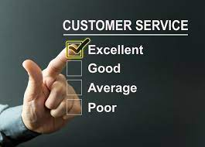
Providing Good Customer Service:
Being honest and reliable in all interactions with customers.
Ensuring product safety and high-quality standards.
Offering fair pricing for products.

Slide 42

Environmental Responsibility:
Protecting the surrounding environment and minimizing the company's environmental footprint.
Engaging in more local activities or sponsoring community outreach in the area.
Supporting social initiatives and charitable causes.
Working towards reducing or eliminating pollution.

Slide 43

https://www.youtube.com/watch?v=ByFHADqt_KU

Slide 44


