Slide 1
HW4_11204604_HongTseWen.pptx [Reference Data]
Seminar on Information Management CYCU

Slide 2
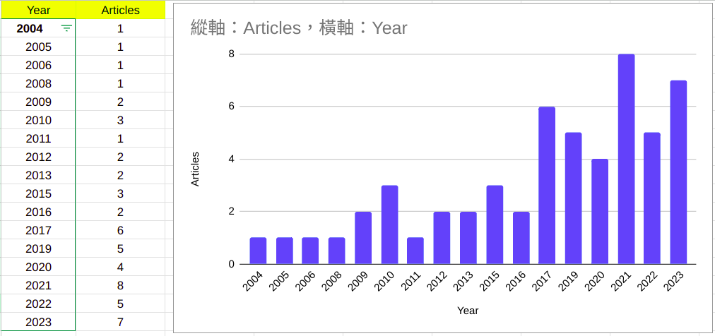
1.Distribution of publication years

Slide 3
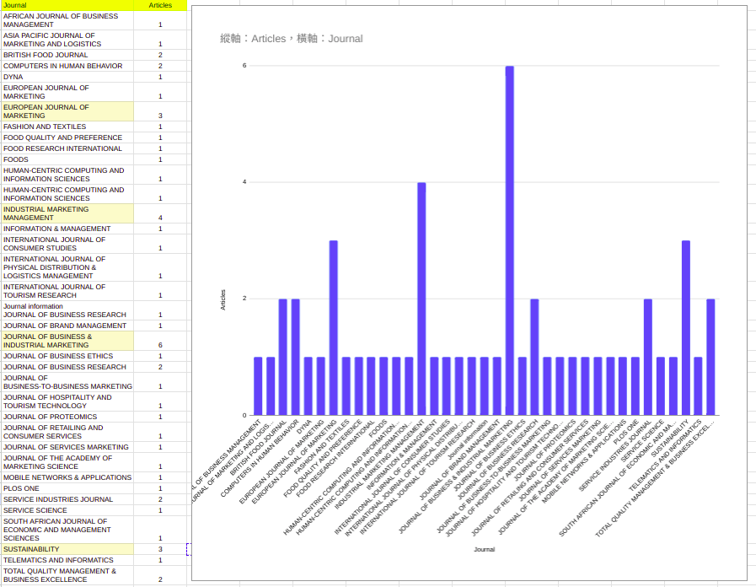
2.
Distribution of sources (journal)

Slide 4
3.Are there author names that appears frequently? Countries? Affiliated universities?
Feng Chia University, Taiwan:
1.Ho, CW (Ho, Ching-Wei)
2.Wang, YB (Wang, Yu-Bing)
3.Ha, HY (Ha, Hong-Youl)
Appears in 3 articles:
Re-purchase intentions and virtual customer relationships on social media brand community
Does Social Media Marketing and Brand Community Play the Role in Building a Sustainable Digital Business Strategy?
Re-purchase intentions and virtual customer relationships on social media brand community
Konyang University, South Korea:
4.Kim, G (Kim, Gimun)
Appears in 2 articles:
Determinants of consumer attitudes and re-purchase intentions toward direct-to-consumer (DTC) brands
A study of factors that affect user intentions toward email service switching

Slide 5
4.Distribution of keywords
1 Customer satisfaction
2 Repurchase intention
3 Loyalty
4 Relationship quality
5 Perceived value
6 Trust
7 Commitment
8 Service quality
9 B2B
10 Structural equation modelling
11 Relationship marketing
12 Business-to-business marketing
13 Online shopping
14 Innovation
15 Brand loyalty
16 Social media
17 Internet
18 E-commerce
19 Marketing strategy
20 Trust propensity

Slide 6
Appendix: (renew) Assignment #3:
1.Topic: Relational bonding strategies, customer satisfaction, and loyalty in the Industrial Lubricant market
2.Interested in: Investigate the influence of relational bonding strategies on customer satisfaction and loyalty.
3.Dependent variables are "customer satisfaction" and "customer loyalty." These variables are what I trying to understand and explain in the context of the Industrial Lubricant market.
4.Question:
-The impact of Social bonding strategies on customer loyalty.
-The effects of Financial bonding strategies on customer satisfaction.
-The impact of Technical service on customer satisfaction.
-The impact of Educational training service on customer satisfaction.

