Slide 1
Critical barriers in implementing reverse logistics in the Chinese manufacturing sectors
By: Muhammad D. Abdulrahman, Angappa Gunasekaran, NachiappanSubramanian
Professor : Professor Cheng-Wen Lee
Name : Fu,Mao-Wen
Date of Presentation : 19 December 2023

Slide 2
Presentation outline
Introduction & Theoretical Background
Model of the Research & Research Methods
Methodology & Hypothesis
Result discussion and analysis
Comprehensive analysis of research framework
Several area within the paper that require to improve and future research

Slide 3
Introduction & Theoretical Background
Reverse logistics is important for sustainable development and environmental protection.
Reverse logistics helps firms reduce waste, conserve resources, and improve their environmental performance.
Implementing reverse logistics in China is challenging due to a lack of awareness, understanding, and infrastructure.
This paper identifies the critical barriers to implementing reverse logistics in China and develops a theoretical model to help firms overcome these challenges.
The four critical barriers are management, finance, infrastructure, and policy-related challenges.

Slide 4
Model of the research
The model includes four key barriers to implementing reverse logistics in China: administrative, financial, infrastructure and policy-related challenges. These barriers were discovered through a comprehensive literature review and empirical study of Chinese manufacturing firms.

Slide 5
Model of the research (contd.)
four main obstacles | Challenges include
management related | Lack of awareness and understanding of reverse logistics practices, lack of support from senior management, and lack of employee training and education.
finance | Lack of financial resources, lack of financial incentives, and lack of cost-benefit analysis.
infrastructure | Lack of logistics infrastructure, lack of information technology infrastructure and lack of reverse logistics service providers.
policy related | Lack of government support, lack of regulations and standards, and lack of environmental awareness.

Slide 6
Methodology
This article uses survey methods to collect information on Chinese manufacturing companies. The enterprise sample was selected from cities in key coastal areas of China. Industries selected for the study include automotive, steel/construction, electronics/computers, textiles, plastics and paper/paper products. Data collected from the survey are analyzed using statistical methods. The results of the empirical study are then used to develop the theoretical model. The research method used in this article is rigorous and systematic. The empirical evidence and theoretical model presented in this article can help companies develop effective strategies to implement reverse logistics in their operations.

Slide 7
Hypothesis
Hypothesis | The statement
1 | Management, financial, policy, and infrastructure barriers significantly impede RL implementation in the Chinese manufacturing sectors.
2 | RL implementation positively affects environmental performance and economic performance of firms in China.
3 | The proposed theoretical model can help overcome RL barriers and improve RL implementation in the Chinese manufacturing sectors.

Slide 8
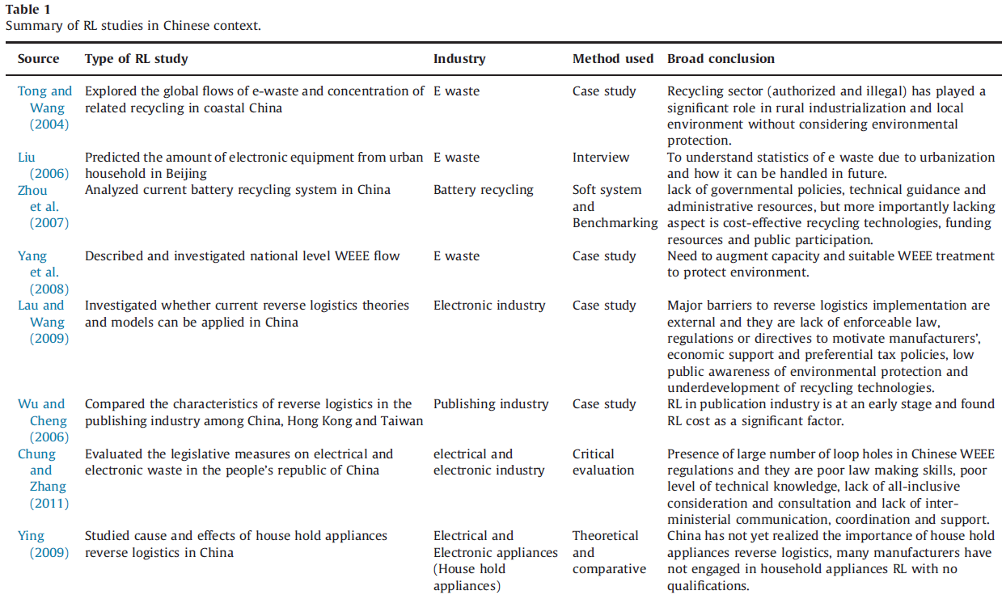
Research Methods

Slide 9
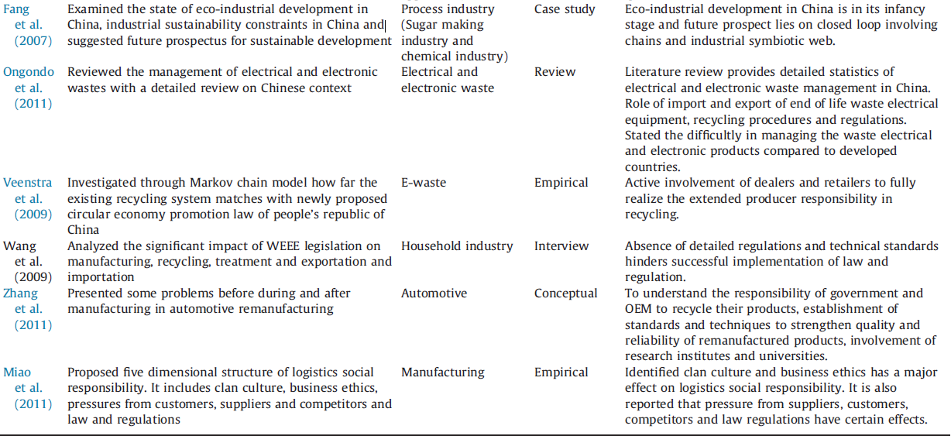
Research Methods (contd.)

Slide 10
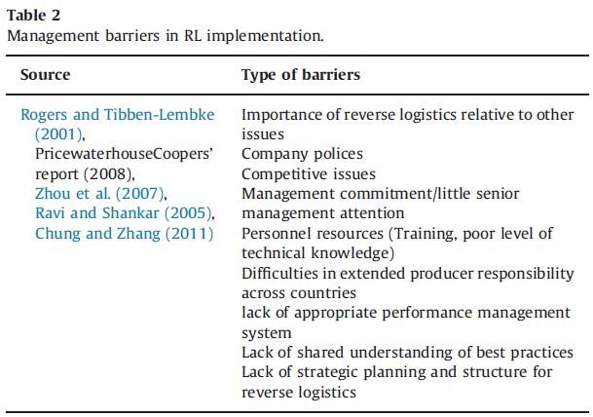
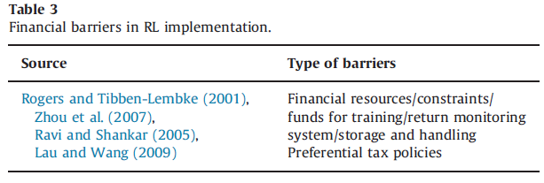
Research Methods (contd.)

Slide 11
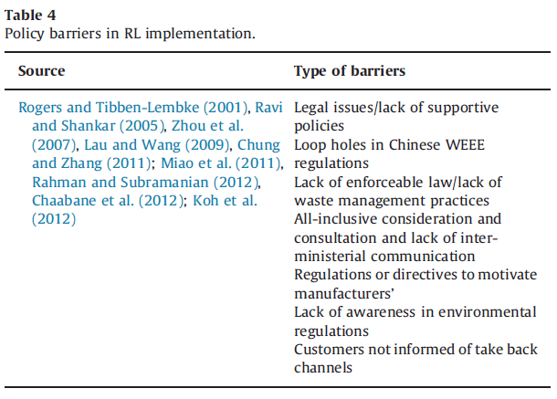
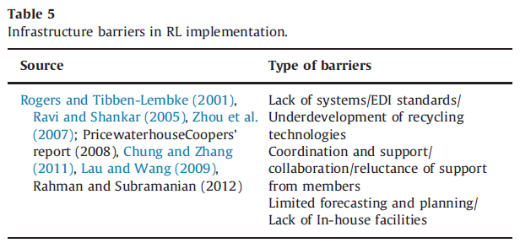
Research Methods (contd.)

Slide 12
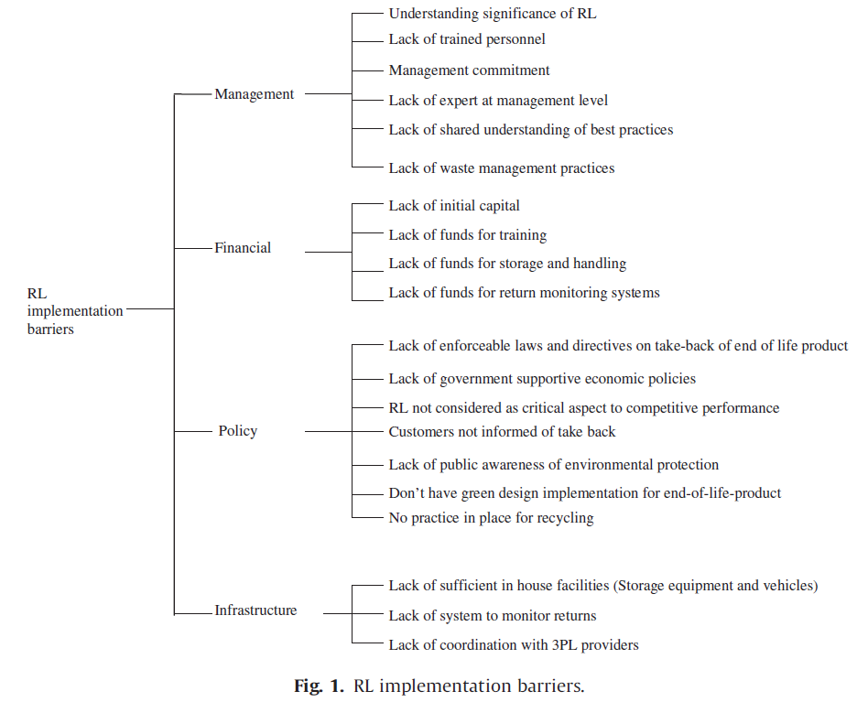
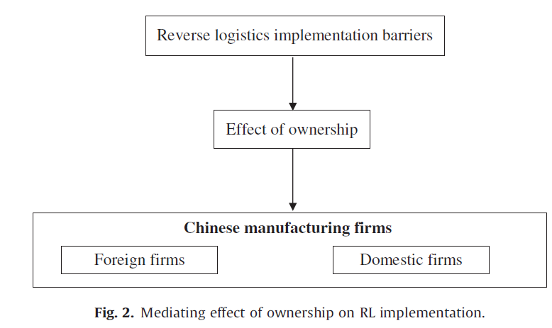
Research Methods (contd.)

Slide 13
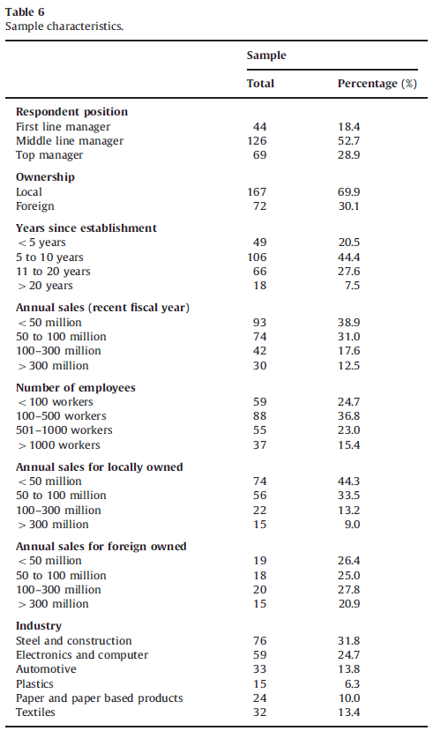
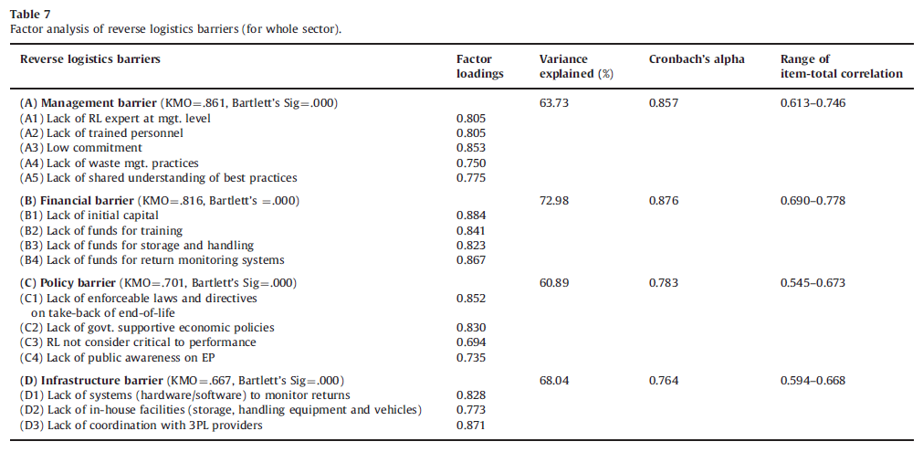
Research Methods (contd.)

Slide 14
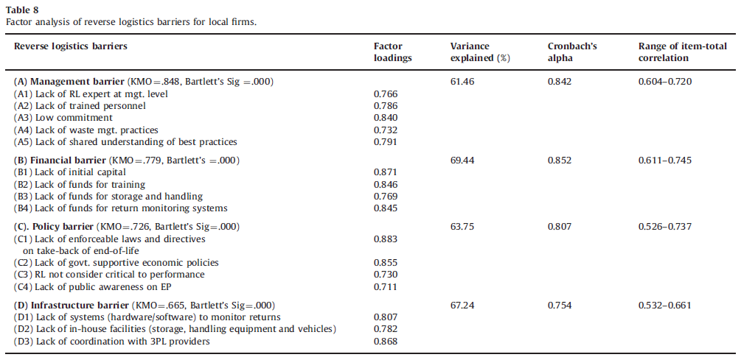
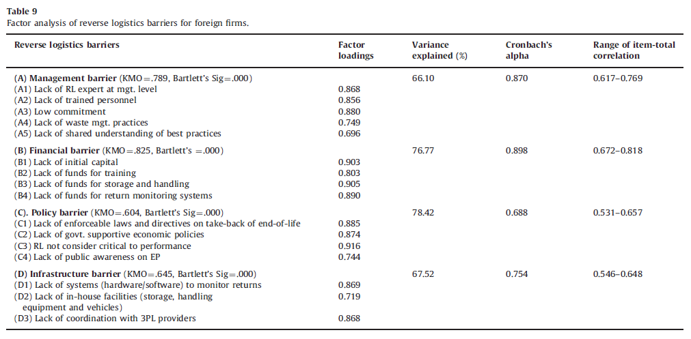
Research Methods (contd.)

Slide 15
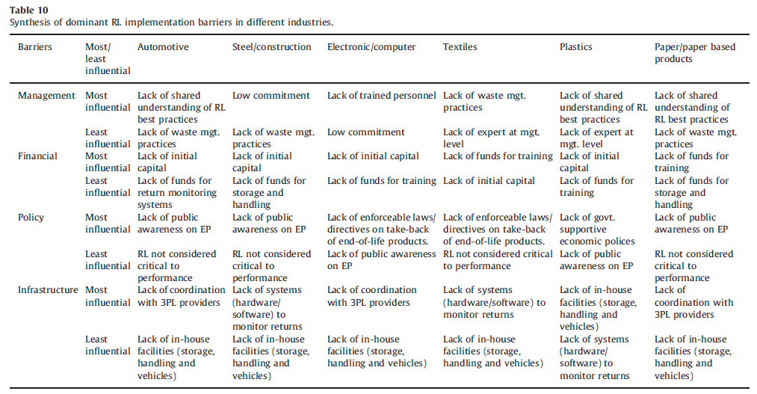
Research Methods (contd.)

Slide 16
Result discussion and analysis
Analyzing the differences in reverse logistics obstacles faced by enterprises in different industries and ownership groups increases the persuasiveness of the research conclusions.
This research also provides a basis for enterprises to formulate targeted reverse logistics implementation countermeasures and has practical application value.
Provide reference for relevant government departments to formulate promotion policies and help create a good institutional environment. It also provides basic data and analysis framework for future related research and helps to dig deeper into research topics.

Slide 17
Result discussion and analysis (contd.)
This study aims to identify existing barriers in the implementation of reverse logistics in China's manufacturing industry.
To overcome these challenges, this research proposes a theoretical model that considers four main factors: management, finance, infrastructure and policy. The model also considers the impact of ownership on barriers to implementing reverse logistics.
Overall, this study provides valuable insights into the challenges and barriers faced by Chinese enterprises in implementing reverse logistics. The theoretical model proposed in the paper can help companies develop effective strategies to overcome these challenges and successfully implement reverse logistics.

Slide 18
Comprehensive analysis of research framework
Theoretical implications
Analysis of research framework
Managerial implications

Slide 19
Comprehensive analysis of research framework (theoretical and managerial implications)
Based on the research framework provided by the article, the following points are the main values ​​of this article:
This paper is framed by a literature review, theoretical model development, empirical research, and managerial implications. The literature review provides an overview of the concept of reverse logistics, global trends, and the current status of reverse logistics in China's manufacturing industry.
The empirical investigation and analysis is based on multiple industries and enterprise ownership types, and the data is comprehensive and rich, which increases the persuasiveness and reference value of the results.

Slide 20
Comprehensive analysis of research framework (theoretical and managerial implications) (contd.)
Fully discuss the differences in survey results of different industries and ownership enterprises, conduct in-depth analysis, and provide reference for management decision-making.
It provides a basis for enterprises and government departments to formulate countermeasures and suggestions to promote the implementation of reverse logistics, and has practical guiding significance.
It provides a theoretical basis and empirical reference for future related research, and plays a role in promoting research in this field.
Overall, this article constructs a comprehensive and rigorous research framework with rich and practical content, which is one of the important contributions to this research field.

Slide 21
Comprehensive analysis of research framework (theoretical and managerial implications) (Contd.)
Finally, managerial implications provide practical suggestions for companies to overcome the challenges and obstacles encountered in implementing reverse logistics in China. The theoretical model proposed in this paper can help enterprises develop effective strategies to overcome these challenges and successfully implement reverse logistics. Overall, the paper provides valuable insights into the challenges and opportunities of implementing reverse logistics in China's manufacturing industry.
This paper has some potential areas for future research and improvement. First, a more in-depth analysis of the impact of ownership on barriers to the implementation of reverse logistics across different industries could be conducted. Second, future research could explore the role of government policies and regulations in promoting the adoption of reverse logistics practices in China.

Slide 22
Several area within the paper that require to improve and future research
Furthermore, this paper focuses on the barriers to implementing reverse logistics in the manufacturing industry. Future research could expand the scope to include other industries such as retail and healthcare to gain a more comprehensive understanding of the challenges and opportunities of implementing reverse logistics in different sectors.
Finally, this article can further analyze the financial challenges faced by enterprises when implementing reverse logistics in China. Future research could explore the potential financial benefits of implementing reverse logistics practices and provide more specific recommendations to help businesses overcome financial barriers.

Slide 23
The things that we can learn from this paper
Financial barriers:
Lack of initial capital
Lack of funds for returns monitoring systems
Management barriers:
Low commitment to RL
Lack of RL experts
Infrastructure barriers:
Lack of laws and directives on take-back of products
Lack of returns monitoring systems
Lack of in-house facilities
Lack of coordination with third-party logistics providers

Slide 24
Thank you

