Slide 1

Accounting towards sustainability in production and supply chain
By: Roger Burrit, Stefan Schaltegger
Romi Ilham 羅汨 - 11204607 Chung Yuan Christian University

Slide 2

Table of Contents
Introduction
Background & research purpose
Scope of sustainable of supply chain management and accounting
Coverage
What is envisaged by an accounting for sustainability of production and supply chains?
Envision sustainability
Institutional development
Four aspect supply chain
How can accounting for sustainability of production and supply chains best be encouraged?
Sustainability support
Reporting on supply chain activities
Sustainability report

Slide 3

Introduction
Background & Research purpose
Landscape of business due to globalization has changes. Accounting need to adapt to these changes, particularly in the context of supply chain management
The paper aims to explore the potential role of accounting as a catalyst for sustainability in production and supply chains beyond the conventional corporate scope

Slide 4
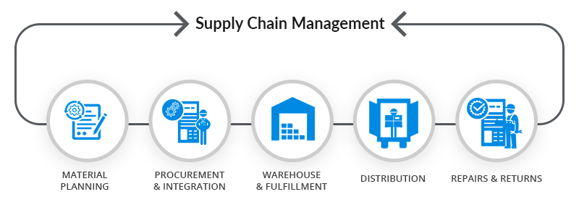
Scope of sustainable supply chain management and accounting
The scope of sustainable supply chain management and accounting is broad and complex.
The path to (corporate) sustainability accounting for supply chains is not well defined or bounded. At present the path is restricted because of scoping and definitional issues.
But the information provided raises the possibility of supporting movement to better future states for society and the environment if informed mind sets about business can be understood and improved supply chain management and accounting practices encouraged (Burritt & Schaltegger, 2010; Schaltegger & Burritt, 2005).

Slide 5
What is envisaged by an accounting for sustainability of production and supply chains?
Envision sustainability
The shift from a financial to a sustainability focus in accounting involves broadening the scope of traditional accounting to include environmental, social, and economic issues in an integrated manner. This shift recognizes that improving social and environmental performance does not necessarily come at the expense of economic performance.
The overall focus and aim of a pragmatically informed accounting for sustainability remains to identify and realize triple-win potentials. This shift from a financial to a sustainability focus in accounting is part of the ongoing development of accounting for improved sustainability contributions.
From financial to sustainability focus
Sustainability accounting, as proposed by Elkington (1998), challenges this narrow focus and calls for a broader consideration of corporate performance through sustainability accounting and reporting
Sustainability accounting also calls for accounting for the interrelationships between different sustainability perspectives, such as environmental, social, and governance aspects. This more encompassing approach to accounting is aimed at providing a more holistic view of a company's performance and impacts.
From accounting to sustainability accounting

Slide 6
What is envisaged by an accounting for sustainability of production and supply chains?
Contd.. (1)
The shift from internal production processes to production in supply chains involves expanding the scope of traditional production processes to include the entire supply chain, from suppliers to customers. This shift recognizes that production is not just a function of a single organization, but involves a network of entities that contribute to the creation and delivery of products or services.
In this broader view, production includes not just the activities of manufacturers who convert raw materials or semi-finished goods into final products, but also the services produced by organizations as they gather and convert factors of production (land, labor, capital, and entrepreneurship) into a product and sell it. In some industries, such as the fashion or sports apparel industry, the intangible value of the brand may even extend the value of the actual material product and be considered the key producer of economic value.
Internal production processes to production in supply chains
Supply chain management, in the context of sustainability, involves managing the supply chain relationships and functions towards sustainability outcomes, usually through collaboration. This includes functions such as research and development, procurement, supplier management, logistics, production, and accounting for sustainability.
The interrelationships and trade-offs between dimensions of sustainability are a vitally important part of sustainable supply chain management because sacrifices in one dimension can lead to larger than proportionate gains in other dimensions throughout the sustainable supply chain.
Supply chain management and sustainable supply chains

Slide 7
What is envisaged by an accounting for sustainability of production and supply chains?
Contd... (2)
A supply chain is defined as a set of three or more entities (organizations or individuals) directly involved in the upstream and downstream flows of products, services, finances, and/or information from a source to a customer. The three generic entities involved in a supply chain are the supplier, the producer (or the focal organization), and the customer.
On the other hand, supply networks are seen in terms of relationships between a set of active members within an organization's supply chains, as well as inactive members to which an organization relates, that can be called upon to actively contribute to a supply chain if a need arises. The emphasis is on the identification of and interrelationships between supply chain members and their salience, whether active or inactive participants.
Supply chains and supply networks
understanding of terms in the sustainability accounting for supply chain space is hedged about with the complexity of sustainability perspectives, broadened geographical scopes and confusion which accompanies new administrative technologies, with changes to be expected over time as the dynamics of sustainable supply chain management mature
--Envision

Slide 8
Institutional developments
Four aspects
Globalization and regionalisation
Tracking, communications and reporting
Globalization and regionalisation refer to the increasing interconnectedness of businesses and economies around the world.
Tracking, communications, and reporting in the context of supply chains involve the management and flow of information that parallels the transfer of production materials, intermediate and final products, and services between different parties in different countries.
Accounting in the context of new technologies and open communications between organizations and across borders is needed to reflect the changing context of data, information, and knowledge development and transfer. This is particularly important in the context of sustainable supply chains, where transparency and accountability are key.
Logistics
Integration
Logistics, in the context of sustainability, refers to the management of the flow of goods, services, and information between the point of origin and the point of consumption in a way that meets the requirements of customers and supports sustainability goals.
This includes transportation of products, both intermediate and final, which was not an issue for the majority of companies when production and sale took place locally, as suppliers and purchasers were located in close proximity to each other.
Integration, in the context of supply chain management and sustainability, refers to the coordination and collaboration of activities and information across different entities in the supply chain to achieve sustainability goals. This includes integrating environmental, social, and economic aspects into conventional internal company functions such as logistics, purchasing from suppliers, design and investment in production facilities, marketing to consumers, and waste management.

Slide 9


How can accounting for sustainability of production and supply chains best be encouraged?
Sustainability support
Environmental management accounting
Environmental accounting
Environmental accounting, introduced to enable managers to focus on impacts of the environment on business performance and impacts of the business on the environment, is a subset of accounting. t identifies and assesses environmental impacts and costs in terms of their significance as part of the cost structure of the business.
Costs of raw material supplies are regarded as business as usual, as inputs to a production or service process which are often seen as unexpectedly high. Different cost classifications are introduced in environmental accounting with the cost of building and maintaining links with environmental costs of suppliers being classed as “less tangible”, “relationship” or “image” costs.
Environmental management accounting is a subset of accounting that identifies and assesses environmental impacts and costs in terms of their significance as part of the cost structure of the business.
Environmental management accounting places special emphasis on the efficient use of resources and the minimisation of non-product output, such as wasted mineral resources, to preserve them for future generations of people

Slide 10


How can accounting for sustainability of production and supply chains best be encouraged?
Contd… (1)
Material flow cost accounting
Activity based costing
Activity-based costing is a method of assigning costs to products or services based on the resources that they consume. It's a more sophisticated kind of costing system that can provide more accurate cost information than traditional costing methods. Processes such as the Analytical Hierarchy Process and multi objective programming are used as a way to optimize selection of the cost drivers (Schniederjans & Garvin,1997). Chan et al. (2014) provide the latest thinking by suggesting a fuzzy Analytical Hierarchical Process in a supply chain setting for choosing the green design of a product.
Material flow cost accounting (MFCA) is a subset of environmental management accounting that focuses on the efficient use of materials in a company's production process. However, it is too early to assess the future benefit of MFCA as it is still in the early stages of development and application. Linking material flow cost accounting with environmental management accounting reveals potentials for expansion for methodological development and applications including supply chain accounting (Jasch, 2011; Jindrichovska & Purcarea, 2011; METI, 2007; Schrack & Prammer, 2013).

Slide 11
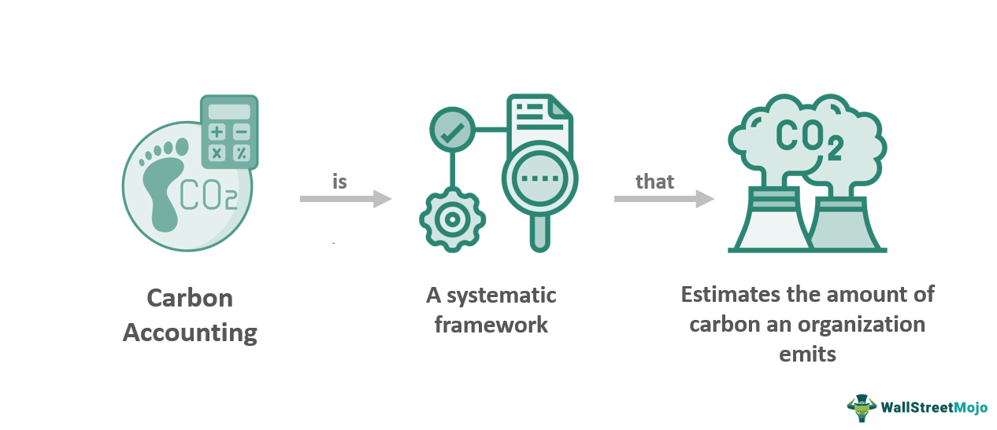

How can accounting for sustainability of production and supply chains best be encouraged?
Contd.. (2)
Water management accounting and
supply chain value added
Carbon accounting and eco-control
Carbon accounting is a subset of environmental management accounting that focuses on the measurement and management of carbon emissions associated with a company's activities. Eco-control is defined as the formalized procedures and systems that use financial and ecological information to maintain or alter patterns in environmental activity. This includes budgeting, resource allocation, performance reporting and evaluation, and incentives for employees to align their actions with the company's environmental goals. Carbon accounting and eco-control are tools that can help companies manage their environmental impacts and integrate sustainability considerations into their decision-making processes.
Water management accounting is a subset of environmental management accounting that focuses on the efficient use of water resources in a company's operations and supply chain.
In the context of supply chains, water management accounting can contribute to value added by improving the efficiency of water usage, reducing costs, and minimizing the environmental impacts associated with water consumption and disposal.

Slide 12


How can accounting for sustainability of production and supply chains best be encouraged?
Contd.. (3)
Sustainability balanced scorecard
The Sustainability Balanced Scorecard is a strategic performance management tool that expands the traditional balanced scorecard, which focuses on financial measures, to include environmental and social aspects. The Sustainability Balanced Scorecard emphasizes value to the business through performance in relation to financials, customers, internal processes, and learning and growth, as well as social and environmental aspects of the business. It also considers different levels of supply chain issues, such as supply policy, supply strategy, supply management, and supply operations.

Slide 13
Reporting on supply chain activities
Reporting on supply chain activities involves tracking and communicating all the material, service, information, and capital flow activities associated with transactions, transformations, and external events of companies in the cross-border supply chains. This includes the purchase of raw materials, the production of goods, the purchase of goods by consumers, and the recycling of finished products.
Accounting in the context of new technologies and open communications between organizations and across borders is needed to reflect the changing context of data, information, and knowledge development and transfer.

Slide 14
Conclusion and possible future directions
Conclusion
New Entity for Accounting: There is a recognition that the supply chain, unbounded by the legal fiction of corporate form, is a new entity for accounting. This involves moving from narrow accounting for firms in manufacturing or service industries towards broader measurement and disclosure required for supply chains.
Who Undertakes the Accounting: Research is needed into who undertakes the management and accounting for supply chains. This could help identify and understand the roles and responsibilities of different stakeholders in the supply chain.
These future directions could help to improve the sustainability of production and supply chains, and the role of accounting in facilitating this improvement.
Relevant Sustainability Accounting Information: The question of what sustainability accounting information is relevant to the supply chain decisions made by different managers remains for investigation. A start has been made in the environmental management accounting literature, but extension is needed.
Improved Education and Theoretical Foundations: Improved education of accountants by their professional bodies and universities in relation to skills in sustainable supply chains and supply chain networking is needed. Progress with the largely absent theoretical foundations for accounting for sustainable supply chain management is also required.
Development of Benchmarks: Development of ideal, technically achievable, and pragmatic benchmarks for comparing excellent, good, and poor performance of supply chains and supply networks in emerging, developing, and developed countries could assist this new research agenda.

Slide 15
謝謝
希望有用
Romi Ilham - 11204607 Chung Yuan Christian University

