Slide 1

Are logistics outsourcing partners more integrated in a more volatile environment?
by : Qiang Yang , Xiande Zhao
Presentation : 14 November 2023
Supervisor : Prof. Lee, Cheng-Wen
Name : Ignatius Reyner Giovanni
Class : Special Topic on Global Logistics

Slide 2
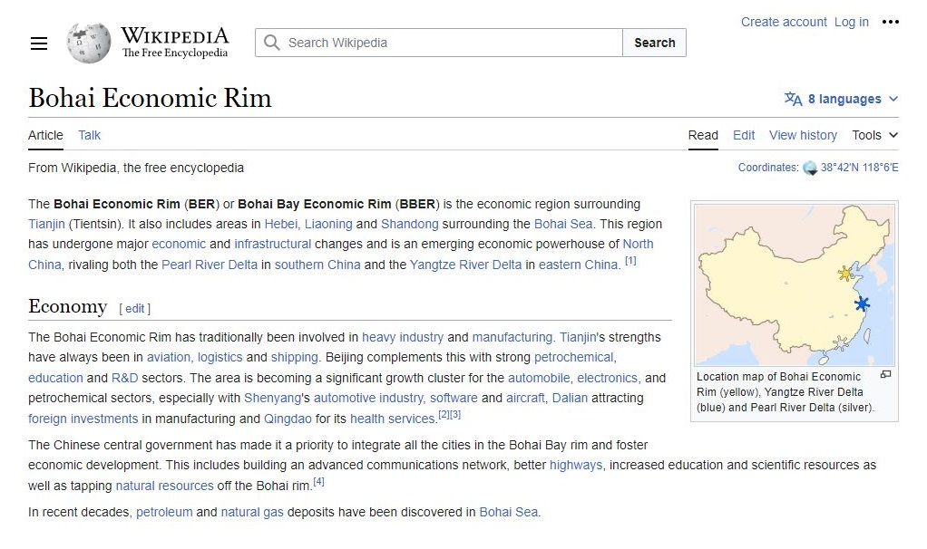
Primary hub for shipping, highways, aviation and communications

Slide 3
Introduction & Theoretical Background
The theoretical background of the study is based on transaction cost theory, which suggests that firms design their transaction structures based on the frequency, asset specificity, and uncertainty of their transactions. In the presence of high uncertainty, firms implement control mechanisms such as contracts and transaction-specific investments to increase control over transaction attributes and reduce risks and transaction costs.
The study conducted various tests to verify the reliability and validity of the data, including confirmatory factor analysis, average variance extracted (AVE) values, and discriminant validity tests. The hypotheses were tested using structural equation modeling (SEM) analysis.

Slide 4
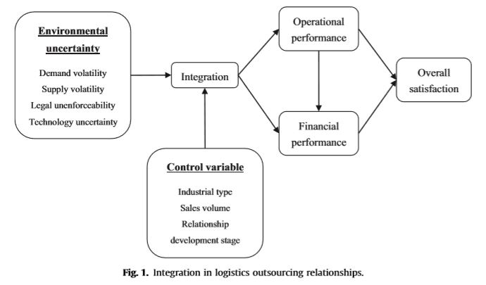
Logistics outsourcing relationship figure
Dependent Variable : integration, operational performance, financial performance, and overall satisfaction
Independent Variable: volatility, supply volatility, technology uncertainty, and legal unenforceability
Dependent Variable
Independent Variable
The model of this study, whose elements depicts the unified as above

Slide 5
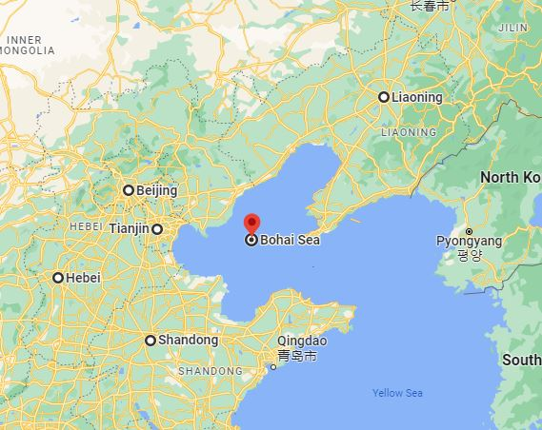
The hypotheses were testes using data from 5 selected district in the Bohai Rim region of China, including Hebei province, Liaoning province, Shandong province, Tianjin city and Beijing city.
Bohai Economic Zone is one of China’s three major economic zones, It accounts for 28,2% of China’s GDP and with more than 40 ports; the most concentrated business seaports area in China
Data collected within this region can well represent the logistics activities in China.

Slide 7
Hypotheses
1
Logistics outsourcing partners are more integrated in response to increased demand volatility in which they participate, ceteris paribus
2
Logistics outsourcing partners are less integrated in response to increased
supply volatility in which they participate, ceteris paribus
3
Logistics outsourcing partners are less integrated in response to increased technology uncertainty in which they participate, ceteris paribus
4
Logistics outsourcing partners are more integrated in response to increased legal unenforceability in which they participate, ceteris paribus
5a
Operational performance contributes to financial performance in logistics outsourcing relationships, ceteris paribus
5b
Through improved operational performance, integration provokes improved logistics outsourcing performance in terms of (a) financial performance and (b) overall satisfaction

Slide 8
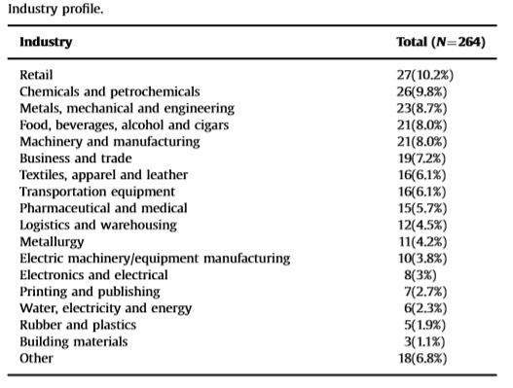
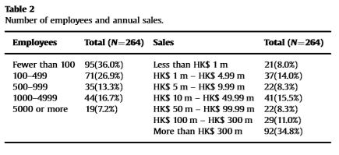
Research Methods
The median sales volume of the sample firms was around HK$ 100 mio, and firms with sales volumes of more than 300 mio were the highest proportion of all reporting firms. Sample was evenly divided between small (less than 100 employees, medium (100-999 e) and large firms (1000 or more employees)
highest proportion of companies were in retail (10.2%), chemical and petrochemicals (9.8%), and metals, mechanical, and engineering (8.7%) industries, followed by the food, beverages, alcohol and cigars (8.0%), and the machinery and manufacturing (8.0%) industries.

Slide 9
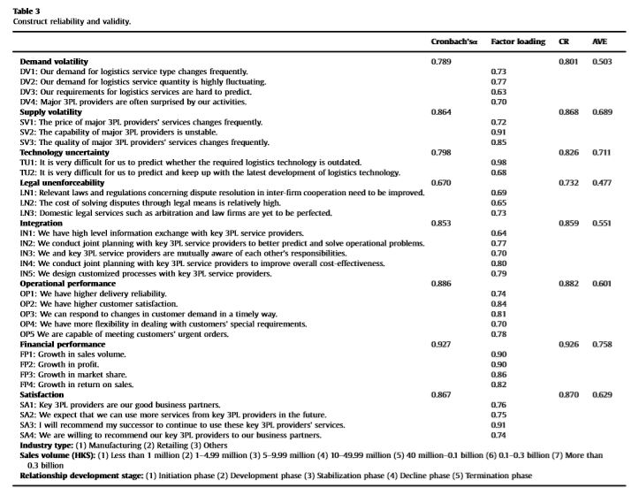
Research Methods

Slide 10
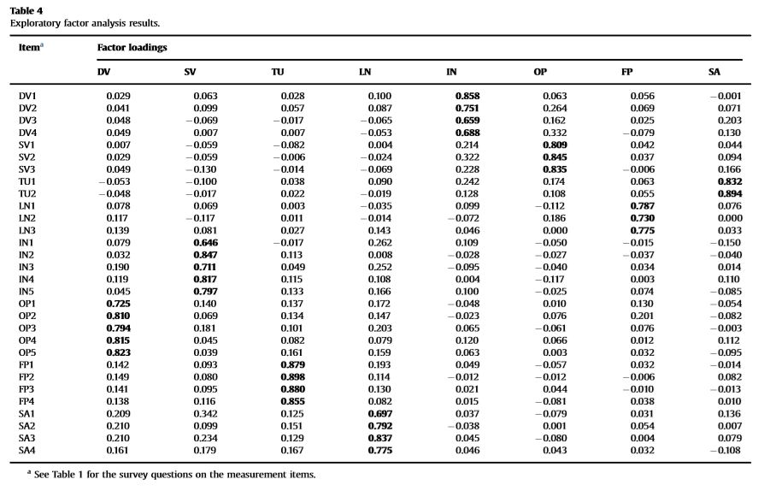
Result & Analysis

Slide 11
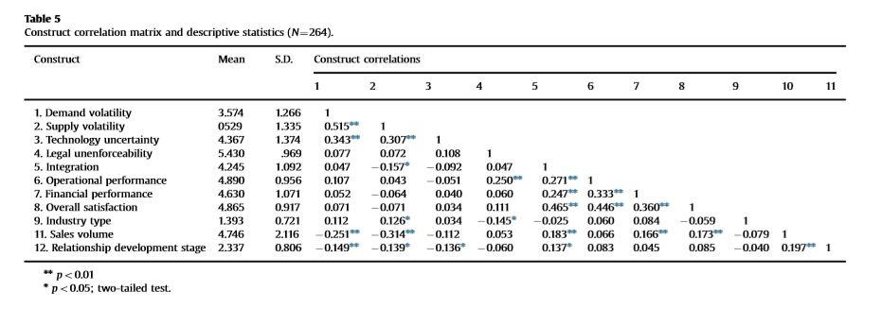
Result & Analysis

Slide 12
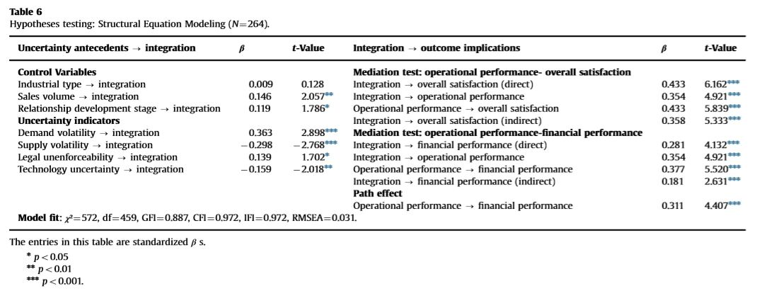
Result & Analysis

Slide 13
Result & Analysis (Comprehensive analysis of research framework)
Result of the study demonstrate 4 major findings,
Supply volatility & technology uncertainty inhibit integration between the client and the vendor in a logistics out-sourcing relationship whereas demand volatility and legal unenforceability promotes it
Integration between the client and the vendor significantly improves performance, in terms of operational performance, financial performance, and overall satisfaction
Operational performance also contributes to financial performance
Operational performance exerts a mediating effect between integration and the two fundamental performance indicators, financial performance and overall satisfaction

Slide 14
Comprehensive analysis of research framework (theoretical and managerial implications)
Theoretical implications
Transaction cost theory suggests that firms will design their transactions structures based on the frequency, asset specificity, and uncertainty of their transactions
The study confirm that the integration does work as an effective governance mechanism in response to different uncertainty indicators with different level, thus enriches transaction structure research within the framework of transaction cost theory and represents an innovation in inter-firm relationship management
control mechanisms may induce resentment between partners and require a large amount of prior input of time, money, and manpower.

Slide 15
Comprehensive analysis of research framework (theoretical and managerial implications)
Managerial implications
Relationship building with vendor firms becomes crucial for firms to outsource their logistics activities to reduce costs and better focus on their core business.
Integration is an effective solution for responding to external uncertainties in logistics outsourcing relationships and can improve operational, financial, and overall satisfaction performance
control mechanisms may induce resentment between partners and require a large amount of prior input of time, money, and manpower.
Operational performance is the first to be achieved, followed by financial performance and overall satisfaction
Future research could explore other governance mechanisms, such as contracts, specific investments, monitoring, relational norms, and personal ties, and how they vary in response to external uncertainties.

Slide 16
Several area within the paper that require to improve and future research
Limitations
Future research
Extends to other regions and industries to test the generalizability of the results
Longitudinal data to examine the dynamic nature of outsourcing relationships
Could take up these issues, offering both theoretical and empirical insights.
Limited just only in the Bohai Rim Region, region of China
This study is based on cross-sectional data, which limits the researcher to get the whole picture of causal interfaces
Integration is not always the best solution for responding to volatility.

Slide 17
Thank you
Let’s discuss ☺

