Slide 1
Chung Yuan Christian University
Business College
Multi-objective optimization of petroleum product logistics in Eastern Indonesia region.
Paper Presentation
Instructor : Prof. Cheng – Wen Lee
Student : Patrick A. Mendy
Date: 17, 2023.

Slide 2
Outline
1. Introduction
2. Literature review
3. Methodology
4. Empirical results and discussion
5. Conclusions and Contributions

Slide 3
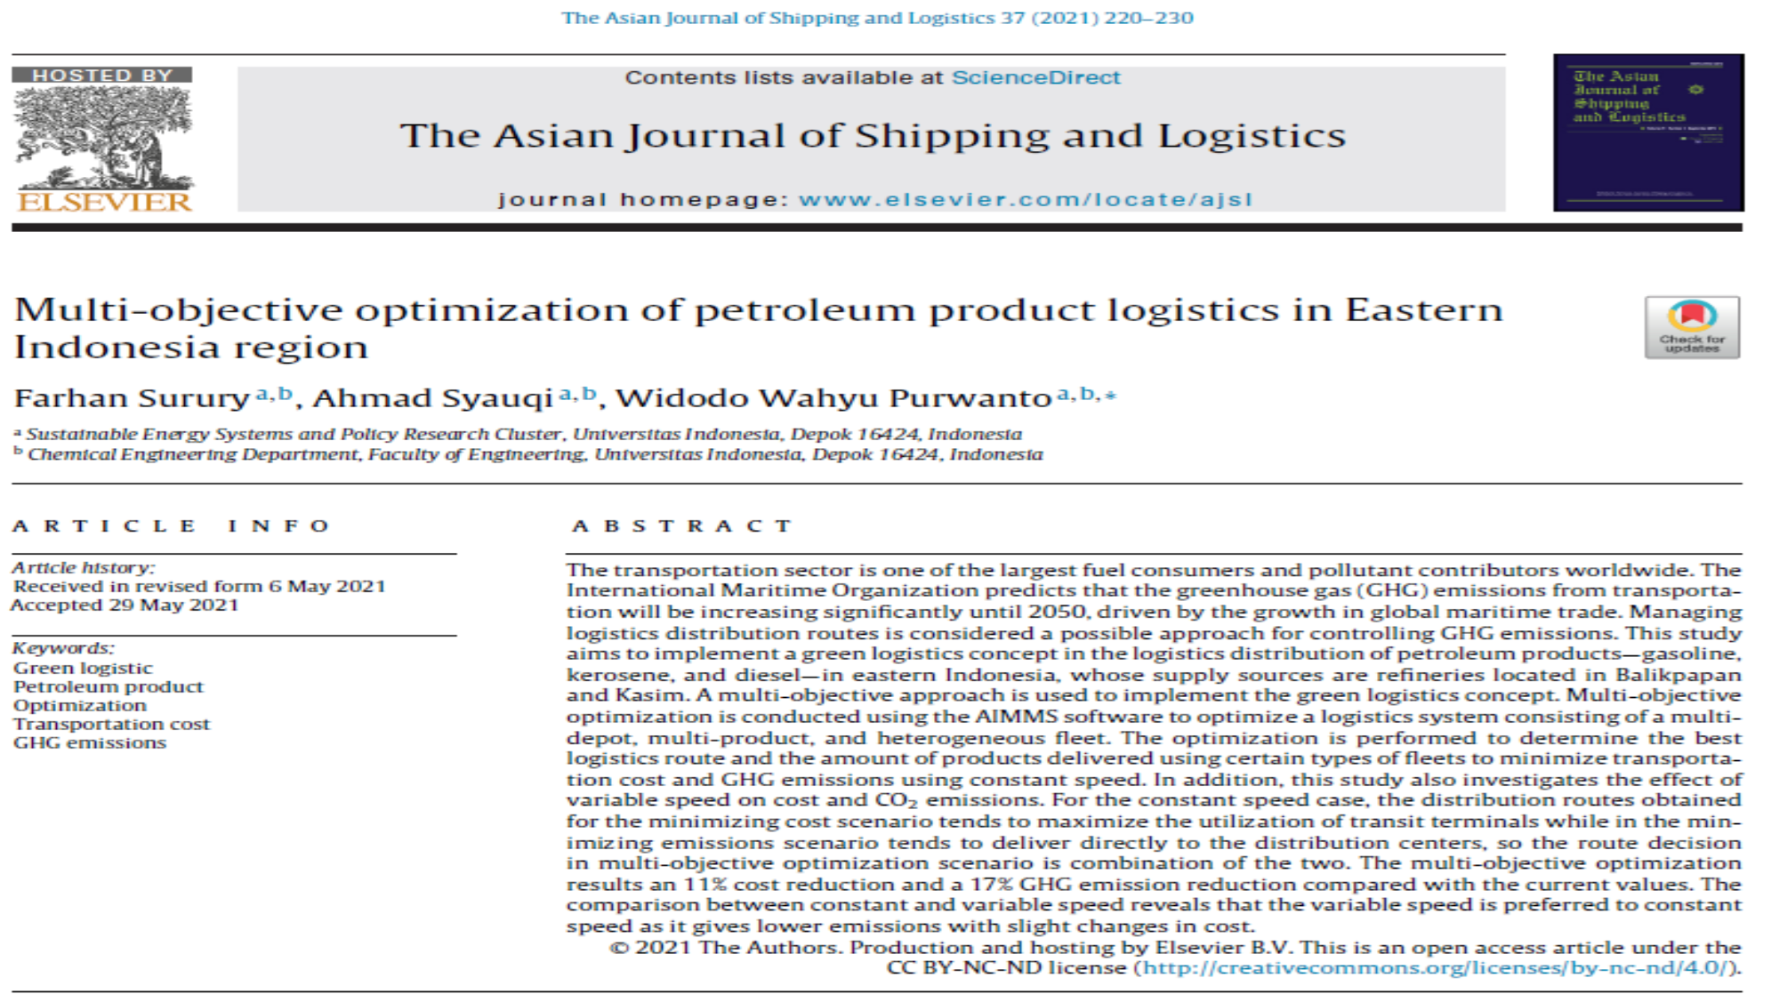

Slide 4
Abstract
In this article, a multi-objective approach is used to implement the green logistics concept in the logistics distribution of petroleum products in eastern Indonesia, whose supply sources are refineries located in Balikpapan and Kasim focusing on gasoline, kerosene, and diesel.
A multi-objective optimization approach is used to optimize the logistics system, considering factors such as transportation cost and greenhouse gas (GHG) emissions .
The optimization is performed using the AIMMS software to determine the best logistics route and the amount of products delivered using different types of fleets .

Slide 5
Introduction
The transportation sector is a major consumer of fuel and contributor to greenhouse gas (GHG) emissions globally .
The International Maritime Organization predicts a significant increase in GHG emissions from transportation by 2050, driven by global maritime trade growth .
Managing logistics distribution routes is seen as a potential approach to control GHG emissions .
This study focuses on implementing a green logistics concept in the distribution of petroleum products in eastern Indonesia, specifically gasoline, kerosene, and diesel .

Slide 6
Introduction
The study uses a multi-objective optimization approach to optimize a logistics system consisting of multiple depots, products, and a heterogeneous fleet.
The aim is to minimize transportation cost and GHG emissions by determining the best logistics route and the amount of products delivered using certain types of fleets.
The study also investigates the impact of variable speed on cost and CO2 emissions.
The results show an 11% cost reduction and a 17% GHG emission reduction compared to current values .Variable speed is preferred over constant speed as it leads to lower emissions with minimal changes in cost.

Slide 7
Literature Survey of the Paper
The paper does not provide a specific section dedicated to a literature survey. However, it does mention the prediction by the International Maritime Organization regarding the significant increase in greenhouse gas (GHG) emissions from transportation until 2050.
The study focuses on implementing a green logistics concept in the distribution of petroleum products in eastern Indonesia, which aligns with the broader literature on sustainable logistics and transportation.
The concept of multi-objective optimization in logistics is also mentioned, which is a well-established approach in the field of operations research and supply chain management.

Slide 8
Literature Survey of the Paper
While the paper does not explicitly cite specific literature sources, it is likely that the authors have drawn upon existing research and studies related to green logistics, transportation emissions, and optimization techniques in logistics.
Overall, the paper contributes to the existing literature by applying a multi-objective optimization approach to address the specific context of petroleum product logistics in eastern Indonesia, aiming to reduce transportation cost and GHG emissions.

Slide 9
Methods used in this paper
The study utilizes a multi-objective optimization approach to implement a green logistics concept in the distribution of petroleum products in eastern Indonesia.
The optimization is conducted using the AIMMS software, which is used to optimize a logistics system consisting of a multi-depot, multi-product, and heterogeneous fleet.
The objective of the optimization is to determine the best logistics route and the amount of products delivered using certain types of fleets, with the aim of minimizing transportation cost and greenhouse gas (GHG) emissions.
The study also investigates the effect of variable speed on cost and CO2 emissions, comparing it with constant speed scenarios.

Slide 10
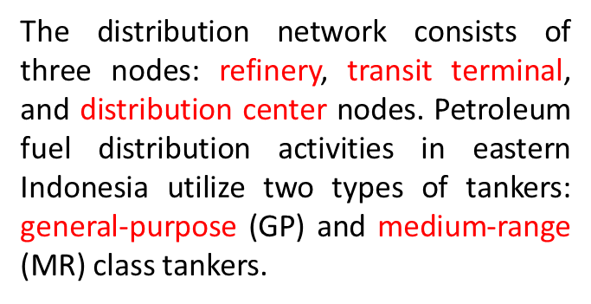
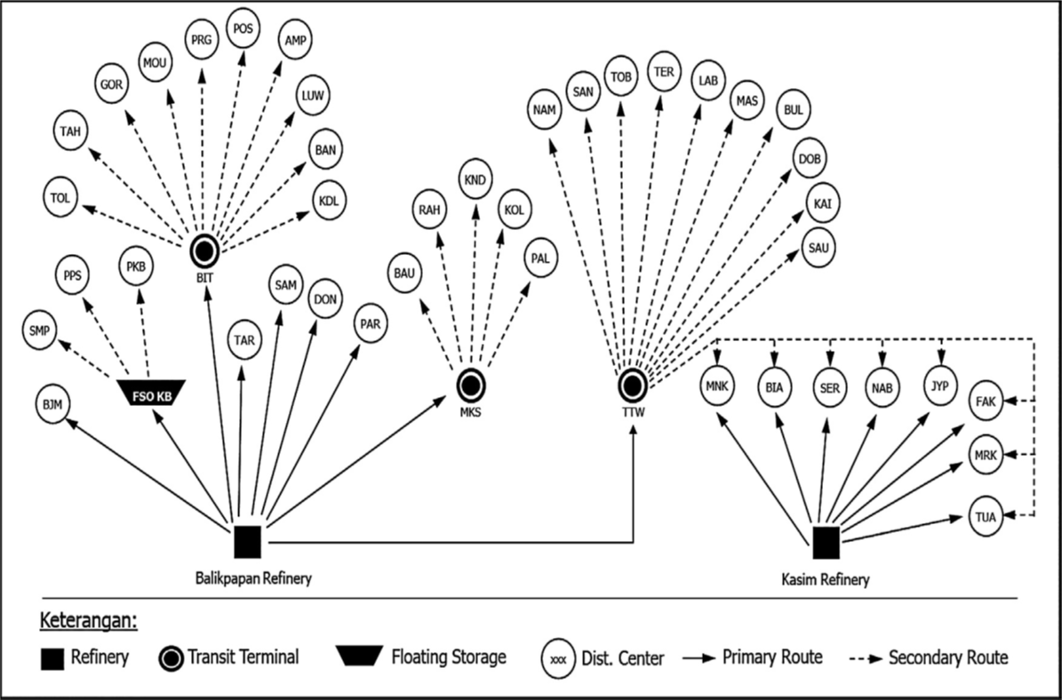
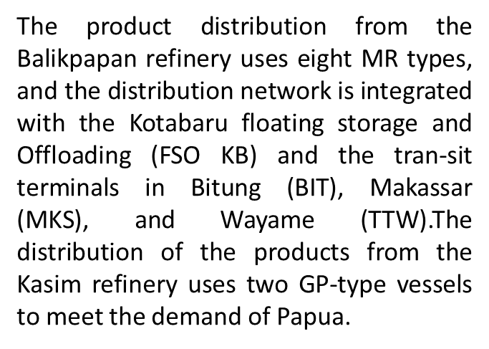
Methodology

Slide 11
Methodology
The demand of each distribution center is listed in Table 1.
The distances, tanker sizes, and tanker speeds listed in Table 2.
The assumptions used to perform the optimization are as follows: (a) the tankers are heterogeneous, (b) the tankers only park at the departing node, (c) each tanker returns to the departing node, (d) each tanker is loaded only at the departing node, (e) the customer demand is satisfied by one vehicle visit, (f) the transportation cost is proportional to the travel time, (g) the tanker speed is constant, (h) the tanker capacity is limited, and (i) each tanker is chartered for five years.

Slide 12
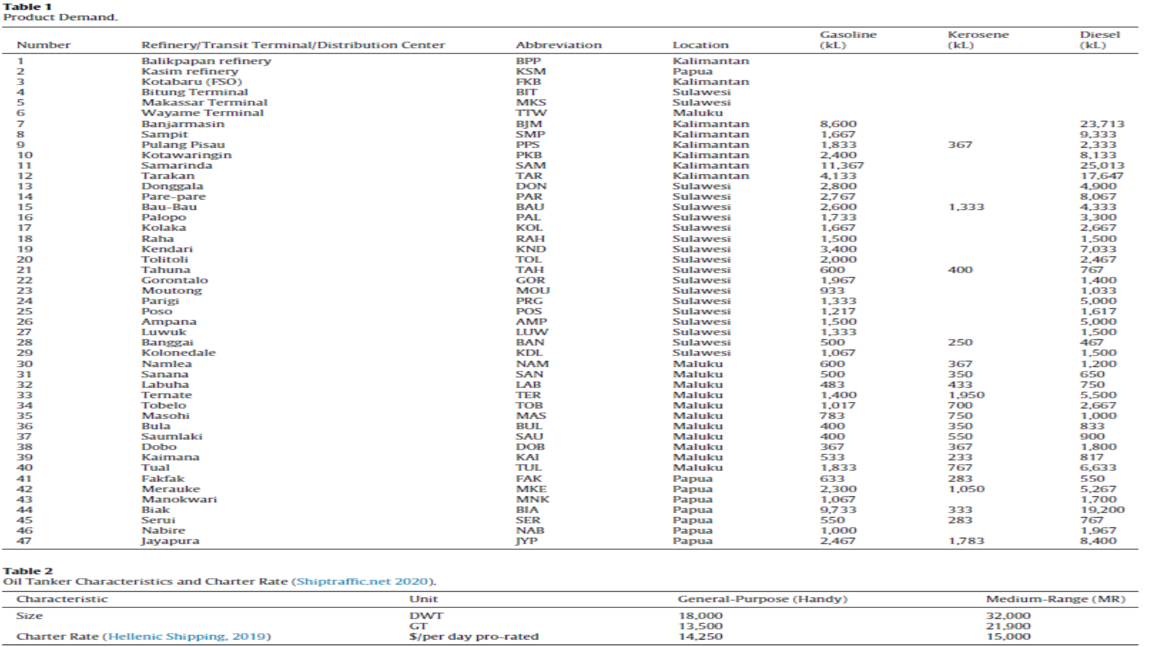

Slide 13
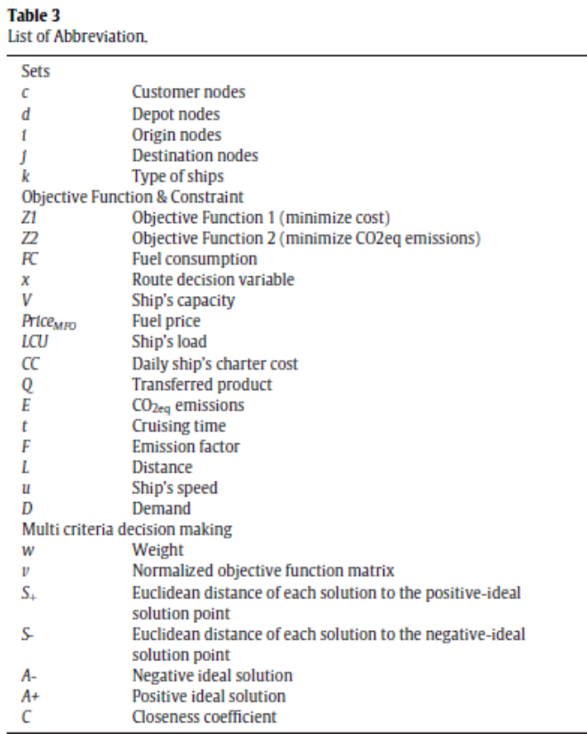
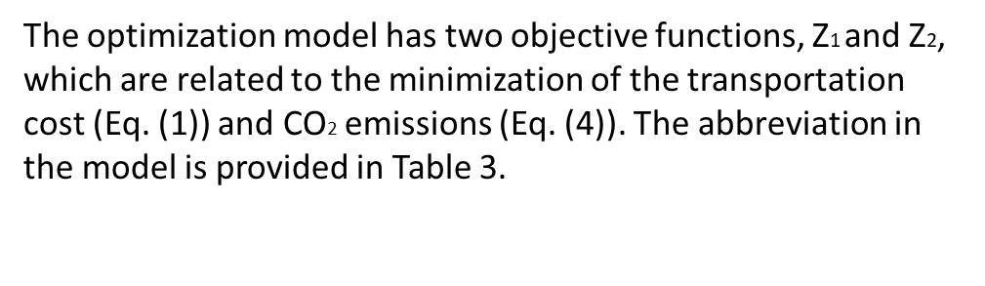
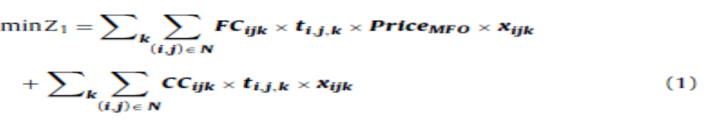
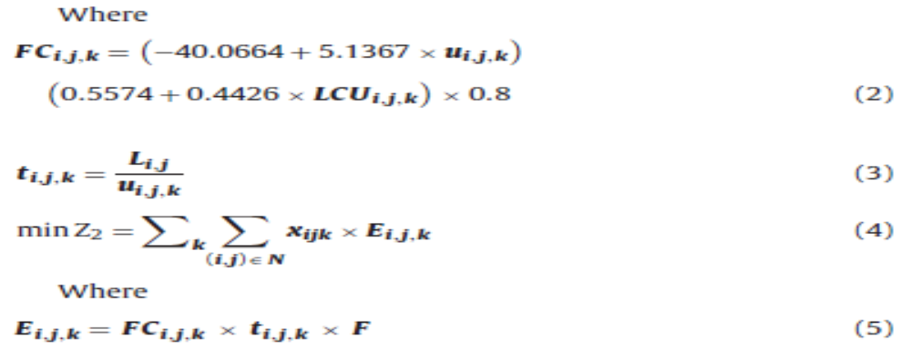
Mathematical model

Slide 14
Mathematical model
The first objective is the minimization of the total cost which is defined by Eq. (1). The total cost includes two terms i.e., fuel cost and charter cost. The first term is the fuel cost which is calculated by computing fuel consumption as a function of the ship’s speed and load (Eq. (2)).
The second objective is CO2 emissions (Eq.4 taken from Hickman et al.,1999), the emission that is accounted only the direct emissions from logistic activities.
Both objectives are conflicting in terms that if one objective is to be minimized then the other will be maximized, hence MOO needs to be performed to select the optimal point from these conflicting objectives.

Slide 15
Mathematical model
The ɛ-constraint method is selected to perform MOO due to its simplicity, able to depict the whole non-dominated solution in a feasible region, and does not need weighting.
The ɛ-constraint method is performed by optimizing one objective and make the other as a constraint with the value of ɛ. The process is repeated with different values of ɛ until the Pareto frontier is formed.
Subsequently, the optimal point from a set of optimal point in the Pareto frontier is chosen using the TOPSIS method which is carried out based on the concept that the chosen point is the one that is closest to the positive ideal solution (i.e. the combination points of the best value from both objectives) and farthest to the negative ideal solution (i.e. the com-bination point of the worst value from both of the objectives).

Slide 16
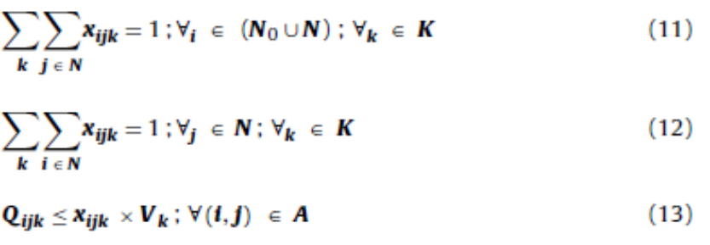
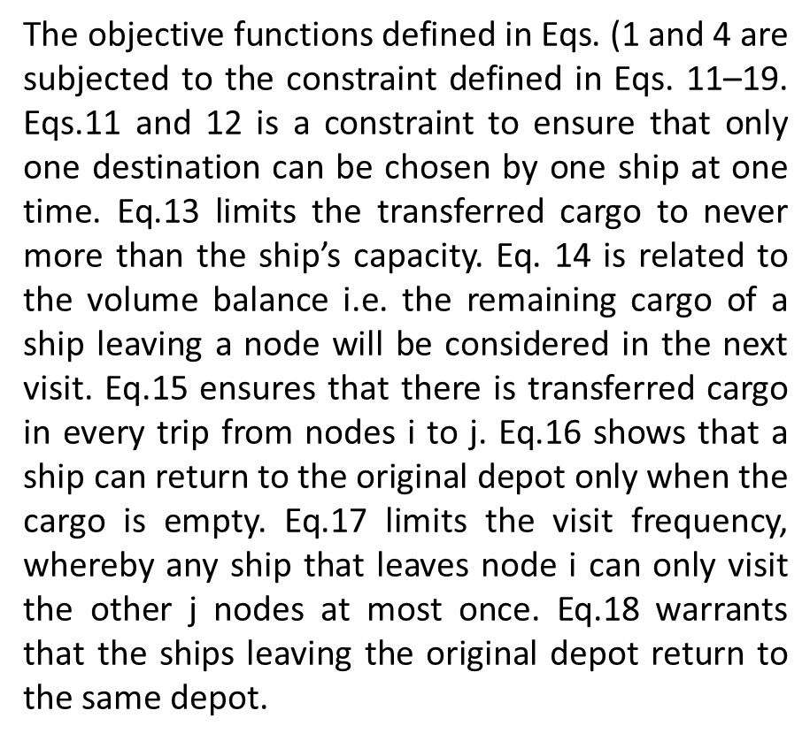
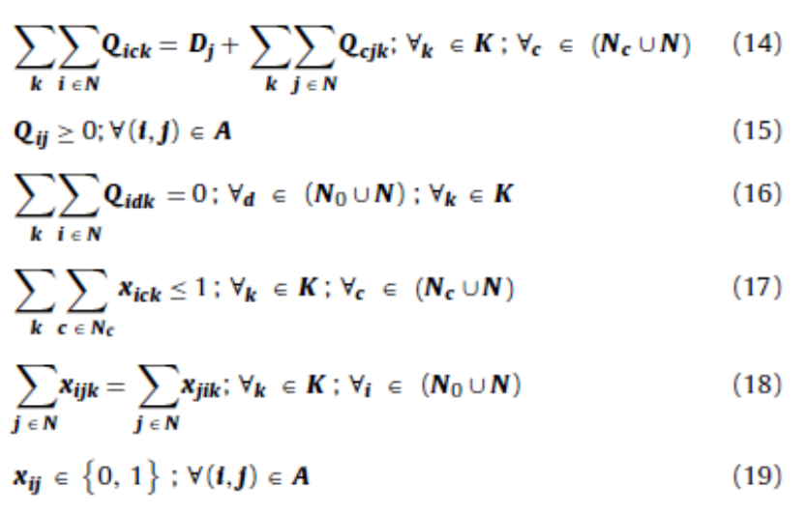
Mathematical model

Slide 17
Results & discussion
First, an optimization model of transport costs and CO2 emissions is developed. Subsequently, the index modules, parameters, and limitations/constraints are set. The initial step of the optimization is to perform a route search by minimizing the transportation cost (Z1). Subsequently, minimization of the CO2 emissions (Z2) is continued using the same method as that used for the Z1optimiza-tion.
Based on the Z1 and Z2 optimization results, the relationship between the transportation cost and CO2 emission is analyzed.

Slide 18
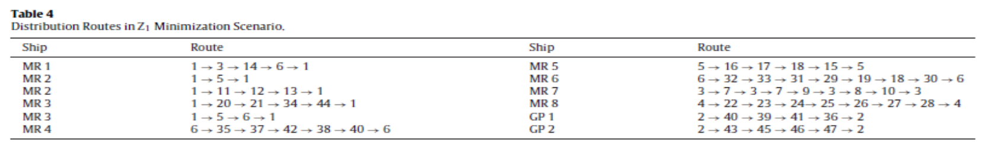
Constant speed case
Transportation cost and CO2 emission in Z1 minimization scenario
The distribution route in the Z1 minimization scenario tends to maximize the utilization of a transit terminal (locations 3–6). MR ships 4–8 are dedicated to the transit terminals as departure and return points. The supplies from the Kasim refinery (location 2) are transferred directly to the distribution centers in northern and southern Papua.
Based on the optimum routes mentioned above, the charter cost constitutes approximately 63% of the total transportation cost.

Slide 19
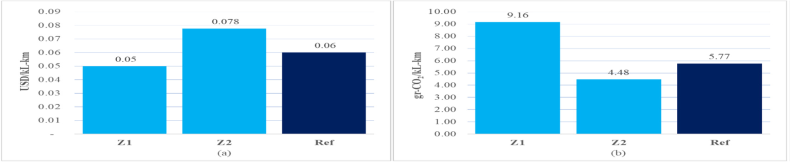
Transportation cost and CO2 emissions in Z2 minimization scenario
In this scenario, the tankers prefer to deliver directly from the Balikpapan refinery (location 1) to the distribution centers. The transit terminal locations (locations 3–6) are only utilized as sources of supply to meet the small portion of demand from the distribution centers. Hence, only MR ships 5–8 are dedicated to the transit terminals as the departure and return points. Concurrently, the supply route from the Kasim refinery (location 2) is the same as that for the Z1 minimization scenario.

Slide 20
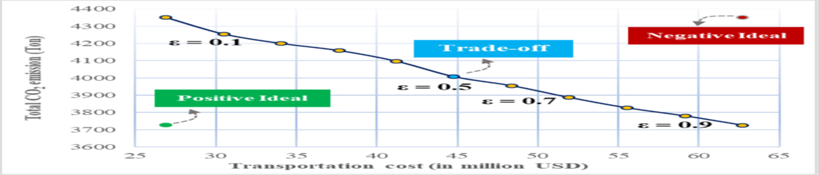
MOO scenario
Scenario Based on the results of the single-objective optimization, it can be concluded that the two objective functions are conflicting. The study shows that the total cost is optimal by maximizing the utilization of transit terminal while the emission is minimized when the shipping is direct. Thus, MOO is conducted to obtain the best possible solution that are compromised with each objective i.e. the trade off point.

Slide 21
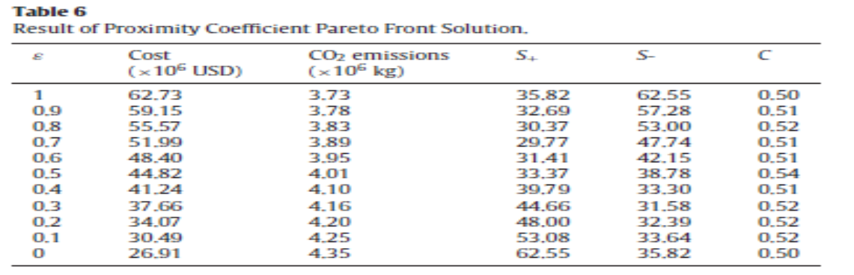
MOO scenario
The ideal positive point on the Pareto curve is (26.91; 3725),and the ideal negative point is (62.7; 4350). The trade-off value is obtained at ɛ= 0.5 based on the largest closeness coefficient (Ci)obtained using the TOPSIS method. The Ci value indicates that the trade-off point has the smallest Euclidean distance to the ideal positive point (Si+) and the farthest distance to the negative-ideal point(Si-), as can be inferred from Table 6:

Slide 22
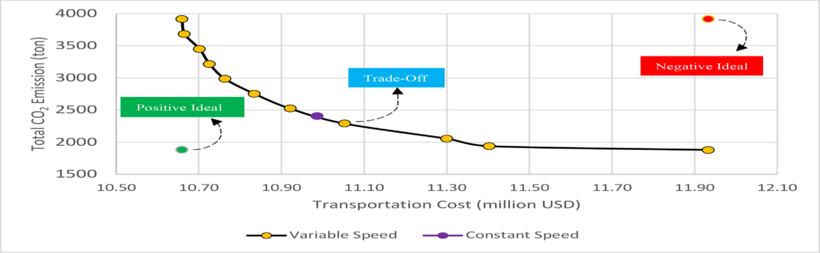
Variable speed case
The trade-off point is selected for the variable speed case, compared to the constant speed, variable speed emits less emission with slightly higher cost. The total cost of the variable speed option only costs 0.6% more than constant speed but emits 4.8% fewer emissions.

Slide 23
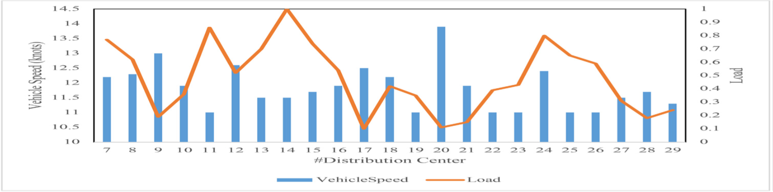
Variable speed case
In variable speed case, speed is inversely proportional to load (depicted in Fig. 11) meaning when the load of the ship is still high the speed is kept low to minimize the fuel consumption which leads to minimizing both objectives, and when the load of the ship is low, the speed can be maximized to minimize the cost, or the speed can be kept low to minimize emission.

Slide 24
Conclusion
In this study, the green logistics concept was analyzed by per-forming MOO of petroleum product logistics in a multi-depot system with a heterogeneous fleet. A trade-off between two conflicting objectives transportation cost and CO2 emissions was studied. In addition, a comparison of cost and emissions between the variable and constant speed of ships is investigated. The optimization yielded optimum logistics distribution routes and the amount of products delivered.
For the constant speed case, the distribution routes obtained show that the minimizing cost scenario tends to maximize the utilization of transit terminals while the minimizing emissions scenario tends to deliver directly to the distribution centers, so the route decision in the MOO scenario is the combination of the two. In the minimizing cost scenario, the transportation cost intensity managed to be lower than the current transportation cost i.e. 0.05 USD/kL-km compared to 0.06 USD/kL-km and in the minimizing emissions scenario gives 4.48 g CO2/kL-km, it is lower than the current value i.e. 5.77 g CO2/kL-km.

Slide 25
Conclusion
Whereas the MOO gives a com-promises solution of cost and emissions with cost and emission intensity of 0.0573 USD/kL-km and 4.77 g CO2/kL-km corresponding to 11% and 17% cost and emission reduction compared to the current value.
The comparison between constant and variable speed reveals that the variable speed is preferred to constant speed as it gives lower emissions with slight changes in cost.
Contributions:
Implementing a green logistics concept in petroleum product distribution.
Achieving a reduction in transportation cost and GHG emissions.

Slide 26


