Slide 1



Operations Research for green logistics
– An overview of aspects, issues,
contributions and challenges
Lecturer : Director Professor Li Speaker : Student of Yu-Ting Zhou

Slide 2
Outline
01
introduction
02
Transportation
Mode choice
Equipment choice and efﬁciency
Intermodal transport
Fuel choice and carbon intensity
03
Products and inventories: life cycle
Life cycle impacts
The storage of products also has an impact on the environment
04
Facilities
05
Supply and transport chain design
Sourcing
Facility location
Transport speed
Production concepts
Transportation: means and route
Transportation concepts
06
Product recovery and closed loop supply chains
Supply chain planning and control
07
Pricing and emission trading
Supply chain planning
Procurement

Slide 3
Outline
08
Operational control of supply and transport chains
09
Metrics
Speciﬁc OR methods: multi-criteria decision making
10
11
Conclusions

Slide 4
1. introduction
Operations Research (OR) is described as the following science: Professional Presentation
BETTER (THE SLOGAN OF THE INFORMS ASSOCIATION) BECAUSE IT IS PRIMARILY CONCERNED WITH MINIMIZING THE COST OF EXISTING PROCESSES.
However, in today's society, it's not just profits that matter, many people, companies, and governments care about the sustainability of profits. In this review, we will highlight its (possible) contribution to green logistics, which is aimed at reducing environmental externalities, mainly related to greenhouse gases, emissions, noise and accidents in logistics operations, and therefore establishing a sustainable balance between the economy, the environment and social objectives.

Slide 5
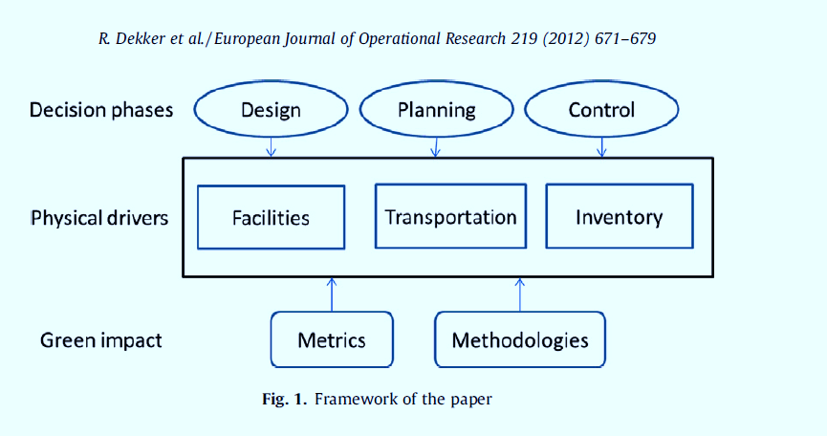

Slide 6
2.Transportation
In terms of the environment, transportation is the most obvious aspect of the supply chain. CO2 emissions from transportation
Structural factors that affect mode segmentation, business factors, operational factors, and functional factors that affect load factors.
Extrinsic factors influencing the carbon intensity of fuels.
Extrinsic factors influencing the carbon intensity of fuels.
We respectfully examine four types of transportation options for fund-raising supported transportation. Modes, i.e., mode selection (or mode segmentation), use of intermodal transportation, equipment selection, and fuel selection. Business factors are discussed in later sections.

Slide 7
2.1.Modechoice
One of the main options for shipping is the mode of transport, which is the mode of transport. Transportation by plane, ship, truck, rail, barge or pipeline.
Each mode has different characteristics in terms of cost, transportation, time, accessibility, and environmental performance.
In fact, the options are limited, as the mode of transportation is often determined by the type of product (e.g. liquid, bulk or packaged) and the distance to be traveled.
In the case of intercontinental supply chains, the main options are air and sea freight. For continental chains, mainly between trucks, planes, trains or offshore vessels.
Road transport is the largest contributor to these emissions, although emissions have been significantly reduced in recent years. If rail transport and inland waterway shipping continue to stifle innovation, the gap will narrow even further. It seems that only sustainable innovation will help profitability will succeed.

Slide 8
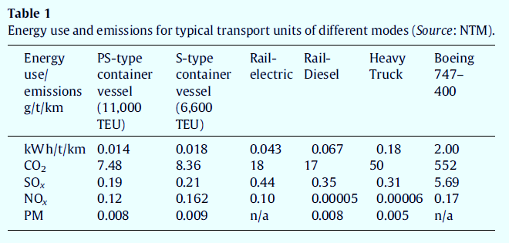

Slide 9
2.2.Intermodal transport
Closely related to the choice of mode of
transport is the use of a single transport
load unit in multiple transports, such as
the container method, known as multimodal
transport.
One of the main factors in the inefficiency of transportation is the handling of goods at transshipment points. The introduction of containers significantly reduces this inefficiency. Nowadays, many of the goods that are shipped through intercontinental chains are transported in containers. The land is partly for this chain by truck, rail or inland barge.
The rise of new forces facilitating the integration of inland vessels, rail and road (inland) container terminals can save thousands of kilometers of truck miles in congestion-sensitive areas, thereby reducing environmental impact.
This also applies to Chinese chains. Disadvantages of multimodal transport: One feature of transport is that it requires more coordinated transport than a single mode. Some papers on the value of visibility can be found in multimodal transport, but few papers deal with environmental issues, such as Bauer et al. (2010)。 Goel (2010) proposes a transportation model that combines transportation and route selection to improve on-time delivery performance.
A multimodal transport node that connects the airport to the high-speed rail network. Macharis
and Bontekoning (2004) argue that the study of multimodal freight transport is an emerging research, and that different types of models are needed in the field compared to those applied to unimodal transport.

Slide 10
2.3Equipment choice and efﬁciency
Once the mode of transport has been chosen, a decision must be made on the type and size of the transport unit. This decision impacts capacity, speed, economics, and environmental performance.
However, this is only a significant tactical/operational issue if the utilization or load factor still exists. The new equipment is also more energy-efficient.
However, the problem is that there is too much money tied up in equipment that lasts for decades, and this has changed so much that the cost is high.
To do this, they determine the ratio of production to transportation energy use, understand the major commodity categories in the United States through life cycle analysis, and spatial analysis of U.S. freight patterns.
Claiming that they can reduce energy use patterns by redesigning processes, they advocate shifting more freight to energy-efficient models.

Slide 11
2.4. Fuel choice and carbon intensity
The fourth aspect of green mobility is the choice of fuel. Modern gasoline is cleaner as compared to old gasoline. In the 1990s and the first decade of the 21st century, refineries focused on removing lead additives from gasoline so that air quality would be better. Biofuels based on corn or organic waste can be easily blended with standard gasoline. However, wider use requires a modified engine, which is quite expensive. To date, very few OR papers have been devoted to this aspect. However, OR models can play an important role in assessing the performance of green adaptation to biofuels.
Transportation and public travel and using Lagrange relaxation based heuristic algorithms to find workable solutions. This work can also be easily scaled by minimizing the use of fossil fuels.
The engines of electric vehicles have almost no emissions, and the emissions from the power station can be controlled, so they are very environmentally friendly. However, their scope is limited, so for the transportation of goods requires a change in the mode of operation of intermediate cargo transshipment. For this reason, they are popular in cities where transport cities are combined with internal or external transit stations.
Apps can be cheaper than trucking. To compensate for short distances dense power supply networks must be set up, possibly in conjunction with battery replacement. Finally, fuel selection is also important for ships, as coastal states may impose restrictions on fuel types. Visiting ports for cheap refueling can be an incentive for route design.

Slide 12
3. 3. Products and inventories: life cycle
Life cycle impact
It is important because it indicates the resources required to manufacture the product. This can be energy, but there are other scarce resources, such as water. Companies like Tesco, Walmart, and Carrefour have started to show carbon footprints (i.e., the total amount of CO2 emitted (in part) of the production and transportation of their products. Effect: Consumers can choose the carbon footprint of the product based on this. Labels look easier than they actually are. The chain that led to the product must be investigated as a whole and distribution issues must be resolved.
After the end of the product's use
Residual value can be recovered without the need to bury or incinerate the residue to recover energy. In this way, part of the carbon footprint of the input product can be reused. Recycling often involves reverse logistics, which will be discussed in detail in Section 6. We would like to point out that this aspect also complicates LCA.
The storage of products also has an impact on the environment
The storage of products also has an impact on the environment, although this impact is not as pronounced as the transportation of the product. Inventory carrying costs play a big role in supply chain design, and the more concentrated the storage, the less the storage cost. The environmental storage footprint includes cooling/refrigerated or heated storage of food products (for certain oils) and evaporation during storage. The supply of tomatoes in the Dutch winter is an obvious example of choice. They may come from distant warm countries, but in this case a lot of transportation is required. On the other hand, they may also be produced in greenhouses across the country, but in this case energy is required to heat them. Therefore, it is clear that complex calculations are required to determine which option is optimal from an environmental point of view.

Slide 13
4. Facilitie
A facility is a node in a transportation network
Warehouses, ports and terminals
Facilities are the third driver of the supply chain. We will take a more holistic view than Chopra and Meindl (2010) and include transportation facilities. Therefore, in addition to distribution centers, we also consider airports, train stations, and ports with container terminals.
As a result, it often becomes a bottleneck. The use of wave systems on the arrival and departure of aircraft can even exacerbate the situation. Such systems are used to provide a short connection time for transshipment goods or passengers. However, it can cause a peak to be reached, which can lead to long waits if there is any disturbance. In general, waiting has a negative impact on the environment. The aircraft that had to wait before landing flew on the waiting route. Ships that have to wait offshore can drop anchor and emit much less. Trucks waiting at the container terminal may also keep their engines running.
Most distribution centers use electrical equipment (e.g., forklifts) because there are no direct emissions involved (McKinnon et al. 2010) and short distances. However, diesel equipment is mostly used in container terminals where the distances are long and the equipment has to cope with harsh environmental conditions (short trips, multiple starts, etc.). Therefore, internal mobility is also an important driver of emissions, and if they can be reduced, it is good for the environment.

Slide 14
5. Supply and transport chain design
In this section, we'll show how to specify the driver in the previous section, ie. Transportation and facilities can be combined in the supply chain or transportation chain to ensure that customer requirements are met. We'll consider how each driver should make a choice and therefore address the following aspects:
01
Define the production and distribution concept.
purchase：
Decide on the type, number, and location of facilities.
Where (and in which country) do we get our products?
02
03
Choice of mode of transportation.
04
Choice of shipping speed. The choice of transportation concept.

Slide 15
5.1. purchase
The procurement of products directly determines the need for transportation. The availability of many cheap products from Asia has created a huge shipping flow to Europe and the United States. Nearby alternatives, such as Mexico in the United States and Turkey in the European Union, can also be used. Salary differentials are the main drivers of product cost differences, but many other factors also play a role.

Slide 16
5.2. Production concepts
The concept of production shows how production is organized. A well-known concept is the just-in-time (JIT) concept, which states that inventory should be minimized and shipments should only meet short-term needs. Repackaging is another option. For example, wine or beer can be transported in large quantities and bottled locally.

Slide 17
5.3. Facility location
OR has a whole set of studies within the location of the facility, primarily regarding the number and location of distribution centers (DCs). As traffic into data centers tends to consolidate in units where trucks are fully loaded and outbound traffic tends to be smaller, the number of DCs has a big impact on transportation efficiency. The environmental aspects of supply chain design and facility siting have received considerable attention lately.

Slide 18
5.4. Transportation:
means and route
Once a purchasing decision has been made, the means and means of procurement must be chosen as the mode of delivery. There is also a trade-off between inventory and shipping. There are several options regarding transport: such as direct routes versus indirect routes and the choice of ports to enter a continent.

Slide 19
5.5. Transport speed
During the 2008/2009 economic crisis, when there was an oversupply of container ships, one of the easiest actions to take was to slow down the speed of ships from 26 knots per hour to 21 knots, resulting in different schedules, but also significant savings in fuel costs and therefore emissions. This is called slow steaming.

Slide 20
5.6. Transportation concepts
An important transport concept is consolidation, especially in the less-than-truckload (LTL) sector. In this case, small shipments are combined with large shipments to achieve efficiency at the scale of long-distance transportation. The disadvantage of this type of transportation is that it takes time to consolidate the goods, which means that timely planning becomes more difficult.

Slide 21
6. 6. Product recovery and closed loop supply chains
Many products are not completely consumed at the time of use, and almost all of them have some residual value. Reverse logistics encompasses all the logistics activities required to unlock this value through product recycling.
It involves collecting waste items, inspecting and sorting them, and then taking some recovery actions, which can be simple cleaning, complex disassembly, and finally a remanufacturing process and remarketing output.
The quality of the recycled items may not be guaranteed, and the cleaning process may cause contamination. In addition, a large amount of transportation may be required to produce a large enough volume for the recycling or remanufacturing process. However, in general, reverse logistics and closed-loop supply chains are considered environmentally friendly

Slide 22
7. 7. Supply chain planning and control
On the tactical side, the time frame is a quarter to a year, and some key decisions must be made, such as forecasting, production capacity planning, inventory control, and marketing operations, including pricing strategies.
What can e-tailers learn from airline pricing by stimulating them Customers can choose a delivery window that is close to where the customer has placed a delivery order.
Supply chain planning includes the development of capacity plans for medium time frames. At this stage, transportation, warehousing capacity, inventory, etc. are already planned.
A major stimulus for green behaviour is the environmental aspects of inclusive procurement or tendering processes.

Slide 23
8. Operational control of supply and transport chains
While strategic choices seem to dictate most environmental impacts, there is also a lot of room for environmental improvement in day-to-day operations, especially with operating room approaches. We would like to mention the selection assignment such as equipment, route navigation, and vehicle routing. We want to pay attention to the possibility of equipment pooling and speed optimization, both at the tactical level and at the operational level。

Slide 24
9. Metrics
An important element of using environment optimization is the use of metrics. By measuring the environmental effect, it is clear and different alternatives can be compared. Aronsson and Huge-Brodin (2006) identified measuring emissions as one of the most important methods for estimating environmental impacts. In addition, metrics can also be used to transmit the impact of goods and services in the supply chain, as they show the environmental impact of the various participants in the supply chain.

Slide 25
Speciﬁc OR methods: multi-criteria decision making
Most applications of OR tools focus on operational efficiency. This directly means less activity (transport, etc.) and therefore fewer emissions. However, things are not always easy and trade-offs must be made, such as when it comes to procurement. The Multi-Criteria Decision Making (MCDM) approach can often assist in such situations. Some researchers apply multi-objective optimization.

Slide 26
Conclusions
Operations research is often associated with cost minimization. However, this has a significant impact on the environment, although this is often unrecognized. Environmental advocates often call for technological change, such as a shift from petroleum fuels to electric vehicles. However, in all systems, the way it operates is an important determinant of environmental performance. For example, reducing the speed of container ships from 26 to 18 knots can reduce fuel consumption by 30%. Therefore, the fact that OR has made and will make an important contribution to the environment, but it is often implicit, has become evident from this review. It would be even better if OR emphasized its value to the environment. New models are needed to address the many decisions needed to improve the environment.

Slide 27

THANK YOU
Insert the Subtitle of Your Presentation

