Slide 1
Impact of demographic characteristics of procurement professionals on sustainable procurement practices: Evidence from Australia
By: Mansi Mansi, Rakesh Pandey
—
Yelly Fitria - 11004612

Slide 2
Introduction
The United Nations Environment Programme (UNEP) (2015) defines sustainable procurement (SP) as “a process whereby organisations meet their needs for goods, services, works, and utilities in a way that achieve value for money on a whole life basis in terms of generating benefit not only to the organisation, but also to society and the economy, whilst minimising damage to the environment”
Walker et al. (2012, p. 203) state the research potential exists in further understanding SP, such as “understanding how individual values influence sustainability” and “the factors affecting the extent to which organisations engage in sustainable procurement”

Slide 3
Introduction
SP practices is primarily important for two reasons
The demographic characteristics of procurement professionals may potentially leverage an important insight into understanding just who inside an organisation is inclined towards SP practices and which demographic characteristic are key in this regard.
There is thus far no reliable evidence showing that internal drivers, such as the behavioural attributes, personality traits and socio-demographic characteristics of purchasing and supply professionals, influence the accomplishment of sound SP practices.

Slide 4
Introduction
This study does not intend to distinguish various SP practices undertaken by procurement professionals, but rather focuses on the demographic characteristic of procurement professionals and their impact on SP practices.
Zsidisin and Siferd (2001) emphasise that purchasing personnel have a strong capacity to influence price, material purchased quality and delivery, equipment selection, use of energy, emissions, investment recovery and other facets of production and delivery. Strategic buying and purchasing, negotiating, and contracting, cost reduction and building strategic relationship. it is worthwhile investigating whether the demographic characteristics of procurement professionals have any impact on their SP practices

Slide 5
Introduction
Majority of the universities in Australia is publicly owned, and received $14 billion funding from the government in 2014 for improving infrastructure support and the quality of education (Department of Education, 2014)
Explore the SP practices inside Australian universities primarily for three main reasons
  Australian universities spend a huge amount of money on procurement activities (specific amount spent activities is publicly unavailable) →AUD $20,000 for purchasing day to day (Monash University)
  Most of the SP studies have only carried out from an organisational perspective, and there are only a few SP studies conducted within the non-industrial sectors.Purchasing and Supply literature has not examined the SP practices inside the education and non-market sector → 26 per cent of employment & 18 per cent service provided by government
  Australian government spends approximately 7.1% of GDP on education and the majority of Australian universities are public universities funded by the government, and thus have a strong potential to influence SP practices.

Slide 6
Introduction
The study examines the procurement professionals who are purchasing in a more sustainable way and in particular looks at their key demographic characteristics
attention will help understand the procurement function
identify just who in an organisation may be likely to purchase in a more sustainable manner

Slide 7
Literature review and theory building
There is a body of literature which suggests that procurement specific skills (such as technical skills, behavioural skills, generic skills. broad financial skills) of procurement professional contribute to organisational performance (Cousins et al., 2006; Giunipero et al., 2006; Large and Gimenez, 2006; Tassabehji ad Moorhouse, 2008) → the literature is fails to recognise the direct impact of demographic characteristic of procurement practices.
The literature suggests that, from the consumer perspective, studies have addressed individual values, personal attitude, ethnicity, normative pressure and cognitive bases, including functional background and educational qualification, and their influence on environmentally friendly purchasing (Becker et al., 1981; Stern et al., 1993; Kempton et al., 1995; Schlegelmilch et al., 1996; Diamantopoulos et al., 2003; Johnson et al., 2004; Poortinga et al., 2004; Han et al., 2011; Fisher et al., 2012) → the literature provides a strong indication that demographic characteristics, social and individual values and personal attitudes have the potential to influence individuals in their decision making regarding the purchase of goods and services.

Slide 8
Literature review and theory building
Sebastian and Davison (2011) recognise the demographic characteristics of procurement professionals, including other personal factors such as beliefs and values, in understanding characteristic of procurement professionals.
Hall (2012) finds that the demographic characteristics of marketing officers have little or no impact on marketing index scores. With there being no clear indication whether demographic indices affect organisational purchasing process, the current study builds upon the literature (Diamantopoulos et al., 2003; Johnson et al., 2004; Poortinga er al., 2004; Han et al., 2011; Fisher et al., 2012) and extends is by focusing on the demographic characteristics of procurement professionals.

Slide 9
Literature review and theory building
Supporting the demographic characteristic and their organisational influence, Manner (2010) finds that the demographic characteristics of CEOs have a considerable impact on a firm’s corporate social performance. Overall, demographic characteristics act as a determinant in deciding organisational objectives
Carlsson and Karlsson (1970, p. 717) “each age-level reacts to the environmental forces called “stimulus pressure” by changing in the aggregate, but younger people change faster than older people”.
Chan (1996) finds that age is a strong indicator of environmentally friendly purchasing, and that young respondents are more likely to engage in eco-friendly purchasing.

Slide 10
Literature review and theory building
H1. There is a difference between young and mature procurement professionals in their SP practices.
H2. There is a difference between female and male procurement professionals in their SP practices.
H3. There is difference between highly educated and less educated procurement professionals in their SP practices.
H4. Top-level procurement professionals are positively associated with SP practices.
H5. Procurement professionals with long working tenures are positively associated with SP practices

Slide 11
Research Methodology
Data Collection
Procurement professional or their equivalents who participate in diverse procurement actions, decisions and activities (planning, negotiating, purchasing, contracting,selecting and similar) within 39 Australian universities.
503 procurement professionals from the 39 Australian university website
Surveys via post were sent from June 2011 to September 2011
224 was returned (approx 45% return rate) and considered to be valid for this research.

Slide 12
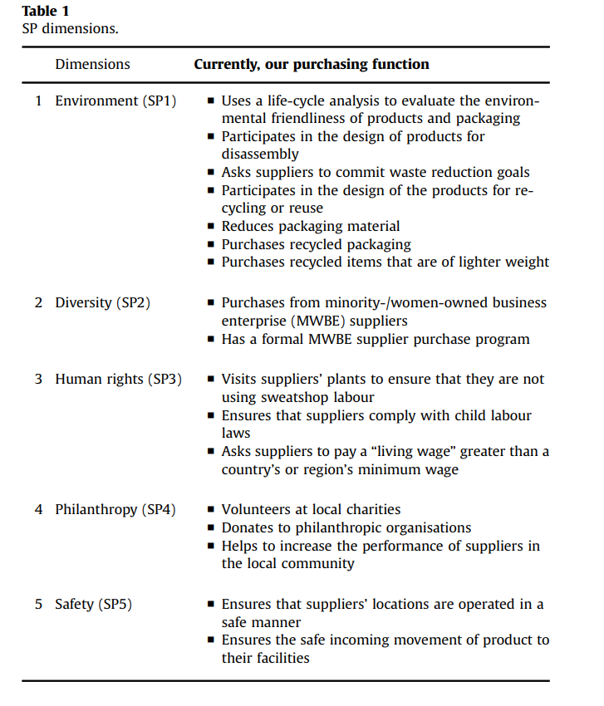
SP Measurement
This study uses the scale developed by Carter and Jennings (2004) - the Purchasing Social Responsibility Scale - which has an internal consistency = .85 and is widely accepted within the procurement literature (Walker and Brammer, 2009; Brammer and Walker, 2011; Lau, 2011)
The cronbach’s alpha value for the scale in this study is.935 thus confirming that the scale is highly reliable

Slide 13
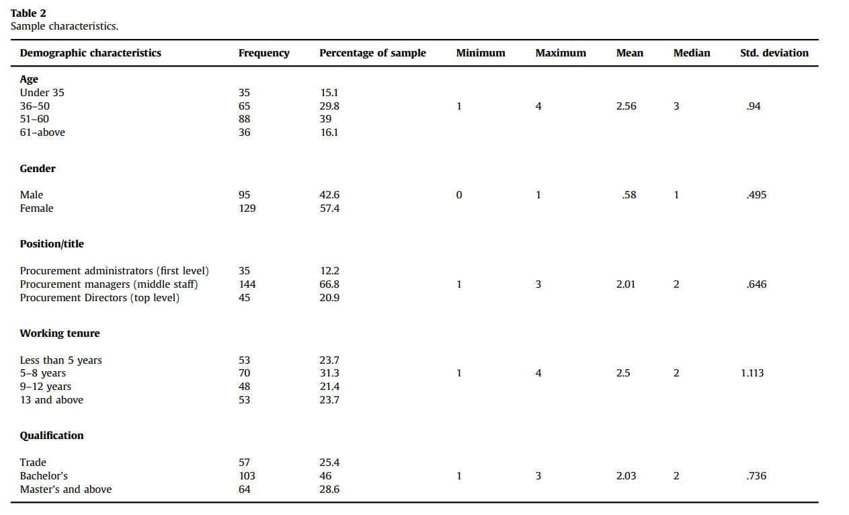
Sample

Slide 14
Sample
For hypothesis testing, in addition to a series of ANOVA tests, the authors ran a series of multiple regression analyses by estimating the following regression model:

Slide 15
Dependent Variable
SP1
Safety
Practices Environment
SP5
The five dimension of SP
SP2
Philanthropy
Diversity
SP4
SP 3
Human Rights

Slide 16
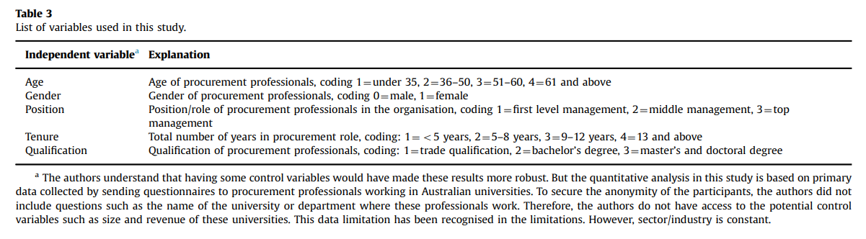
Independent Variables

Slide 17
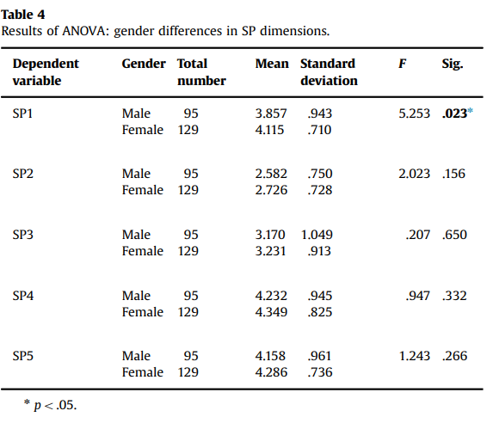
Analysis and results
H1. rejected (results not shown)
H2. is only partially supported by ANOVA and regression analysis

Slide 18
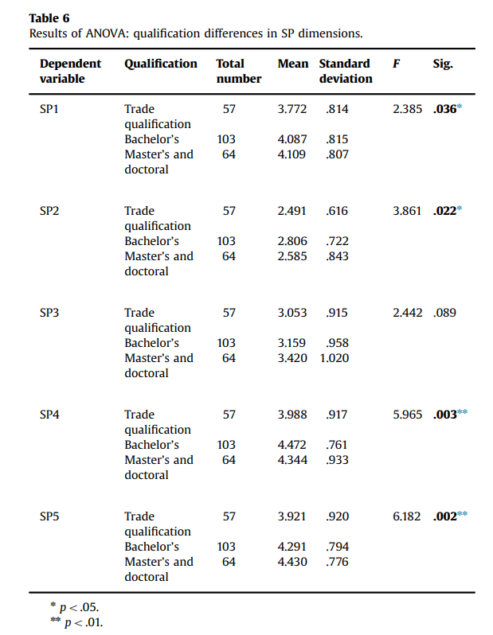
Analysis and results
H3 . confirming that procurement professionals having master’s and doctoral qualifications are more concerned about the environment, philanthropic activities (such as charity and donations) and safety issues in dealing with procurement practices.

Slide 19
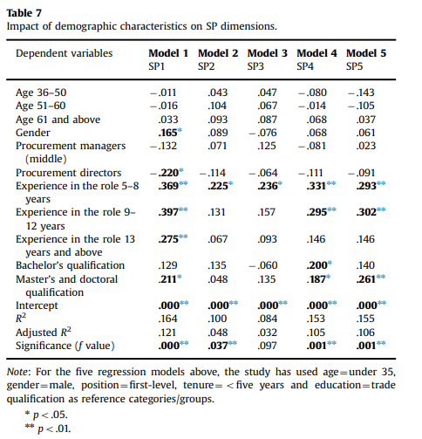
Analysis and results
H4. (β= -.220, p=.013), suggesting that top-level procurement professionals are less associated with environment-related SP practices compared with first-level and middle-level procurement managers. Thus, this hypothesis is not supported.

Slide 20
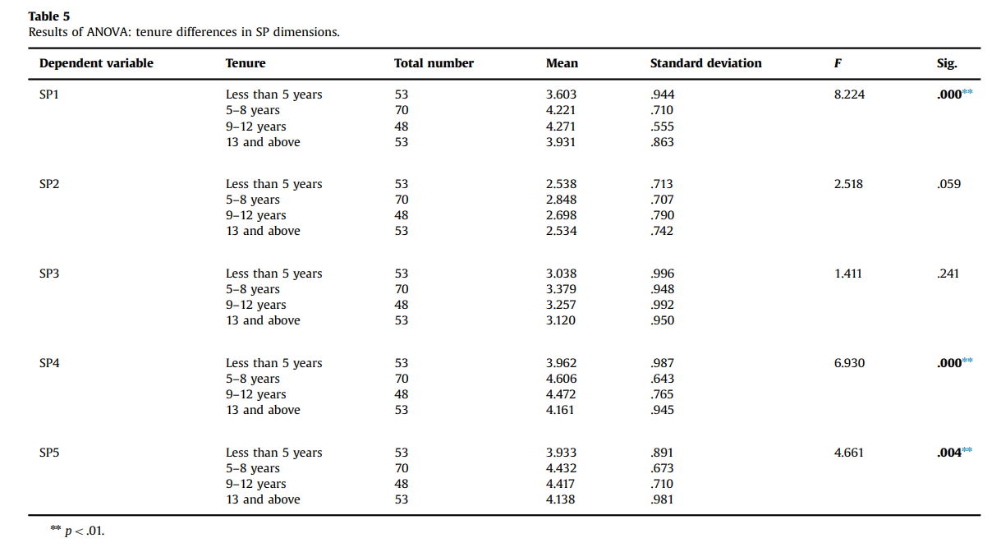
H5.is partially supported.

Slide 21
Discussion
The current study provides evidence that male and female procurement professionals differ in their responses and that women can be considered active in purchasing recycled packaging, waste-reduction goals and using life-cycle analysis (elements of the environment dimension, SP1).
This finding accords with the literature (Webster, 1975; Mainieri et al., 1997; Straughan and Roberts, 1999; Homburg and Giering, 2001; Williams, 2003; Stephenson, 2004; Liu et al., 2012) that finds women are more inclined towards environmentally friendly purchasing. However, findings should be interpreted with caution and cannot be extrapolated to show that male procurement professionals are not environmentally friendly.

Slide 22
Discussion
The current study accords with the literature (Thomas and Simerly, 1994; Manner, 2010) and provides evidence that with longer working tenures, there is a greater opportunity for professionals to acquire knowledge about and experience with their role and responsibility.
This study provides evidence that the working tenure of procurement professionals can be seen as a measurement of their awareness or knowledge of SP practices.

Slide 23
Discussion
Surprisingly, the position of top-level procurement professionals has a negative relationship with environment and is contrary to some of the literature (Carter et al., 1998)
First-level procurement professionals devote more time to environmental and philanthropic issues inside the organisation, whereas top-level procurement professionals look after broader and more strategic aspects of SP practices (such as policy making).

Slide 24
Discussion
In this study, analysis of the age of procurement professionals does not establish any effect on the dimensions of SP practices.
Hambrick and Mason (1984) state that there is a possibility that with age the tendency to grasp and implement new ideas declines and that there are other commitments in life which are important. This finding is not consistent with the literature (Anderson and Cunningham, 1972; Carlsson and Karlsson, 1970; Samdahl and Robertson, 1989).

Slide 25
Discussion
Another important finding is that the qualifications of procurement professionals in this study do positively impact the environment and safety dimensions of SP practice.
This finding confirms that qualified procurement professionals are more active in purchasing recycled packaging, setting waste-reduction goals and using life-cycle analysis significantly, and tend to ensure that suppliers’ locations are operated in a safe manner and with safe incoming movement of products and services.

Slide 26
Discussion
Another important finding is that the qualifications of procurement professionals in this study do positively impact the environment and safety dimensions of SP practice.
This finding confirms that qualified procurement professionals are more active in purchasing recycled packaging, setting waste-reduction goals and using life-cycle analysis significantly, and tend to ensure that suppliers’ locations are operated in a safe manner and with safe incoming movement of products and services.
This finding is in line with the finding of previous studies (Hines et al., 1987; Chan, 1996; Roberts, 1996; Paço and Raposo, 2009) that education influences awareness of environmental concerns

Slide 27
Discussion
Contrasted with this, Samdahl and Robertson (1989) find that environmentally friendly behaviour is more prevalent in less educated and low-income respondents in the US. Thus, mixed results show that the education of respondents is a strong predictor of environmentally friendly purchasing.
Unlike Schaper’s (2002) study, this study finds that demographic characteristics, particularly gender, position, tenure and qualification, do predict sustainable environmentally friendly behaviour, philanthropy and safety practices

Slide 28
Concluding Remarks
The contribution of this study to the existing purchasing and supply literature is the confirmation that the demographic characteristics of 224 procurement professionals affect their sustainable procurement (SP) practices; to date, this has not been studied to this extent or in this context in the literature

Slide 29
Concluding Remarks
This study has several important implications.
First, the study implies that the demographic characteristics of procurement professionals impact socially responsible purchasing, and particularly that the qualifications and tenure of procurement professionals are likely to have a strong impact on environmental, safety and philanthropic activities
This study further implies that there is room for top-level procurement professionals (such as procurement directors) to undertake environmentally friendly procurement activities, particularly green buying, reducing packaging material and committing to waste-reduction goals.
Female procurement professionals are more likely to be associated with environmentally friendly activities

Slide 30
Concluding Remarks
This study has several important implications.
has implications for procurement scholars who approach the sustainability crisis by integrating demographic dimensions
The five SP dimensions in this study are limited to the purchasing social responsibility (PSR) scale. It is possible that procurement professionals find it difficult to distinguish between “agree” and “strongly agree” and either response could simply indicate neutrality
Also, some disclosures were kept anonymous to protect the identity of procurement professionals and the sector is uniform.

Slide 31
Future studies
Future studies may want to extend the dimensions of SP. In this work, demographic characteristics have not been studied in conjunction with procurement strategy and portfolios.
Future studies can build upon this demographic data and extend the research to a new level
Investigate why (or why not) the age of procurement professionals has implications for their decision making in the workplace.
focus on the values and attitudes of procurement professionals and their role in environmentally friendly activities could broaden the area

Slide 32
Limitation
Limitations in statistical techniques exist, the contribution of this study lies in the successful confirmation of the effect of the demographic characteristics of procurement professionals on the dimensions of SP in the Australian higher education sector

Slide 33


