Slide 1


Measuring the Logistics Performance of Internal Hospital Supply Chains –
A Literature Study
Course: Special Topics on Global Logistics Management
Professor: Dr. CHENG-WEN LEE
Student: Benjamin Lee
Date: 5 Dec. 2023

Slide 2
Outline
Introduction
Inventory management
Distribution and scheduling
Multi-criteria decision-making
Conclusion

Slide 3
Introduction
Characteristics of internal supply chain in hospitals(Lewis MO et al., 2010)
  complexity
  uniqueness
  operational challenges
    such as
    extremely expensive products and medical devices used in operating rooms
    difficult inventory tracking due to the urgency of treatments
    unpredictable demand for medical supplies
Many different types of supplies are stored in multiple storage rooms within the hospital and many processes interact to contribute to the achievement of high- quality patient care (Sarno D. 2014).
It is beneficial to have effective logistics practices in a hospital for controlling and distributing the supplies to patient care units.

Slide 4
Introduction(Cont’d)
The cost of logistics operations has increased, ranging between 20% up to 45% of the total hospital operating budgets, partly due to the considerable amount of wastes in healthcare supply chain processes (Landry S et al., 2000)
The operating theatre, in particular, turned into a major cost driver for a hospital, with the medical supplies and equipment used in the operating rooms taking up 40% to 60% of the hospital supply expenditures.
The healthcare sector exhibits special features that directly affect the quality of patient care.
  non-availability of materials may postpone a surgical procedure
  possibly results in planning trouble and/or hazard of patient’s health
  hidden stocks or overstocking of supplies in patient care locations increase costs and cause supply chain inefficiencies

Slide 5
Introduction(Cont’d)
Healthcare Supply Chain Management (SCM)
  information
  supplies
  finances
involved with the acquisition and movement of goods and services from the supplier to the end user in order to enhance clinical outcomes while controlling costs( De Vries J et al., 2011).
The companies that make up the supply chain need to interact and cooperate in order to fulfill the purposes of the logistics processes (Balcazar-Camacho DA et al., 2016).
The ultimate goal is to achieve “a well-coordinated system that delivers care with great efficiency and quality, at reasonable cost, matching the resources for care to where (and when) they are needed most” ( Hall R. 2012).

Slide 6
Introduction(Cont’d)
scope of this article
  internal hospital supply chain processes, and more specifically medical supply logistics in the operating room environment
focus on inventory control and distribution of medical supplies and equipment to ensure availability and cost containment
internal supply chain processes are performed within the hospital and include product and information flows from receiving, replenishing, picking, etc.
functions of the internal supply chain
  Purchasing
  Inventory
  distribution
  consumption
In this article, the focus will be on inventory and distribution management in the operating theatre.

Slide 7
Introduction(Cont’d)
Hospital supply chain strategy
key steps to strategic healthcare SCM
  improve collaboration with vendors
  align with physicians
  focus on integration
  automate the supply chain
  adopt more and better standards
  use process improvement methodologies
the right supply chain key performance indicators (KPIs) should be defined to track performance and evaluate the implementation of the supply chain strategy.

Slide 8
Introduction(Cont’d)
Hospital supply chain strategy
Healthcare SCM is concerned with five domains in order to get integrated supply chain processes( Chandra C. et al., 2004)
  demand can be managed by using forecasting techniques and by standardizing supplies
  effective order management practices should be in place by consolidating purchases
  supply chain actors should participate in GPO (Group Purchasing
  organization agreements to reduce the number of suppliers
  adopting automated point-of-use distribution, minimizing Stock-Keeping Units (SKUs), maximizing inventory turnover rates, increasing non-stock items, etc. all contribute to integrated management savings

Slide 9
Introduction(Cont’d)
Methodology of this article
  The methodology used in this study was an extensive search of the journal articles that describe the internal supply chain of a hospital.
  Keywords
    Hospital materials management
    Hospital supply chain management
    Operations research/management healthcare
    Operating theatre logistics
    Medical supplies operating theatre
    Hospital inventory management
    Internal distribution hospital
    Integrated hospital supply chain
    MCDM healthcare
    Performance indicators hospital supply chain

Slide 10
Introduction(Cont’d)
Methodology of this article
  articles were screened to determine
    (1) if it concerned internal supply chain management
    (2) wether the application or literature fits in the hospital environment
    (3) if it was related to performance measurement of the logistics activities in a hospital
  A total of 99 articles were assessed in this review.
  Tables 1 and 2 include the articles that address performance measurement in inventory and distribution management respectively
  This paper focuse on inventory (table.1) and distribution (table.2) management, and operational performance in the operating room supply chain.
  The objective of this article is to present existing research on performance measurement in the internal hospital supply chain (e.g. inventory management, distribution activities), and more specifically in the operating room since it is critical to the patient care process and it has become a major cost center of the hospital.

Slide 11
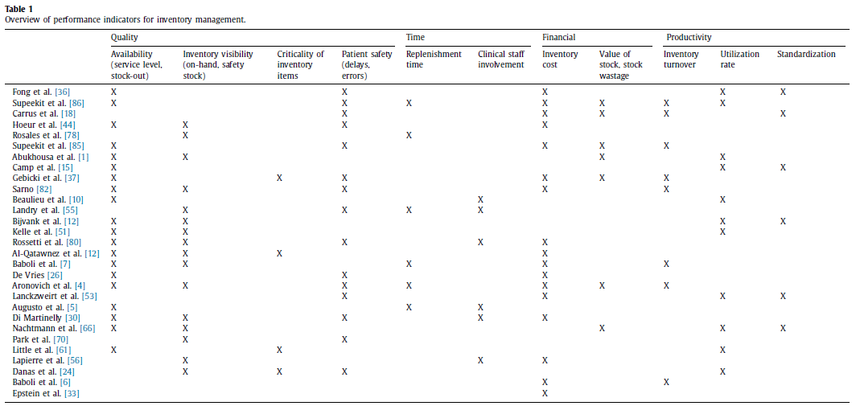
Introduction(Cont’d)
Methodology of this article
Table 1 presents an overview of the four types of performance indicators –quality, time, financial and productivity –for inventory management activities which are retrieved from literature.

Slide 12
Invenyory management
Inventory management constitutes the key lever to realize efficiency improvements while satisfying healthcare service levels (Volland J et al 2016).
One of the biggest challenges in healthcare supply chain management is balancing costs with the right amount of inventory to sustain quality and timely patient care (Abukhousa E et al., 2014).
Current practices in healthcare organizations rely on surplus planning of resources to deal with complex and lastminute changes in the operating room planning and hence, produce stock wastages due to poor planning, not understanding appropriate inventory levels and not monitoring budgetary guidelines (Abukhousa E et al., 2014).
Forecasting techniques, inventory management, simulation and optimization algorithms provide solution approaches to control inventory in hospital warehouses. New technologies and automation (e.g. RFID, bar- coding) can point to new supply chain capabilities and help healthcare providers overcome the biggest inventory and distribution management barriers of product variability, charge capture inaccuracies, complicated workflows, etc. [Cardinal health, 2015).
There is a growing need for technologies that provide end-to-end supply chain visibility, resulting in lower inventory and cost, improved patient service, improved tracking, shorter delivery times, and lean and proactive supply chain partners (Dittmann JP et al., 2015) .

Slide 13
Invenyory management
Inventory management in hospital
Four types of materials are used in the operating room
  The medical consumables or disposables (e.g. surgical drapes, gloves, suture, syringes, bandage, etc.), often combined into custom procedure trays (CPTs), are the most frequently used items taking up the majority of the storage space.
  Procedure-specific surgical supplies are often stored at point-of-care locations (e.g. operating rooms).
  The sterile, reusable supplies which are organized into surgical instrument trays.
  The high-cost, slow-moving materials are often held in consignment with the vendor or supplier.
The inventory system is characterized by centralized and decen- tralized storage areas, whereby the hospital central storage room replenishes the lower-level (decentral) point-of-use locations (e.g. operating rooms) [12,26] .
A general rule of thumb states that maximum 20% of the supplies should be stored in the operating room, with the remaining inventory in the central storage room (Park KW et al.,2009) .
The operational efficiency of hospital supply chain processes can be improved by focusing on replenishment of inventories based on product consumption and independent of the level of product variability.

Slide 14
Invenyory management
Inventory management in hospital
Rossetti et al. [2012] list a number of periodic and continuous inventory policies, such as reorder point/reorder quantity policy or two-bin Kanban system, reorder point/order-up-to policy, PAR (Periodic Automatic Replenishment ) level system, etc.
Using data standards in barcodes allows for automatically updated inventory replenishment systems upon scanning, increased inventory accuracy and increased visibility throughout the supply chain, with major cost and inventory savings (Dittmann JP, 2015)
A hybrid inventory policy combines periodic and continuous replenishments and it will result in a reduction in cost, nventory and number of replenishments at point-of-use locations (Rosales CR et al., 2015).
Another way to control inventory in the operating room is to apply lean management tools and conduct a waste analysis. Lean principles can streamline processes, reduce costs, reduce waste, improve quality and increase satisfaction among patients, healthcare providers and staff (Womack J et al., 2005) .

Slide 15
Invenyory management
Inventory management in hospital
Information technology and technological innovations enable decision-making throughout the supply chain, improve productiv- ity, lower costs and improve patient safety.
The Materials Management Information System (MMIS) typically supports inventory management. Automatic identification and data capture technologies, such as barcoding and RFID, help systems identify products, and capture and store information. The use of barcodes is widespread among hospitals, but it has limitations since it requires personnel time for scanning with manual cycle counts to match supply usage and inventory levels, and hence human accuracy
Hospitals should evaluate the medical effectiveness of the new technologies as well as the cost before adoption. In addition, the logistical performance (e.g. fill rate, supply chain cost) should be evaluated for various levels of cost in order to take advantage of technological advances.

Slide 16
Invenyory management
Inventory classification
The ABC analysis is a traditional approach to classify items in a hospital inventory based on Pareto’s principle of “vital few and trivial many.
  "A items" with very tight control and accurate records, "B items" with less tightly controlled and good records, and "C items" with the simplest controls possible and minimal records.
  This method classifies items in terms of one single criterion and does not consider other attributes of each item, such as size, consumption, obsolescence characteristics, order frequency, functionality, etc.
VED analysis classifies items into three categories based on their criticality for the operation.
  Vital
  Essential
  Desirable

Slide 17
Invenyory management
Inventory classification
Molenaers et al. [2011] develop a classification scheme based on item criticality to rationalize the efficiency of the inventory policy of spare parts for maintenance purposes. They combine a decision diagram and Analytical Hierarchy Planning (AHP) to determine the criticality level of a spare part based on relevant criticality criteria (e.g. equipment criticality, logistics characteristics and probability of failure). The criticality level can be used as a justified basis for holding these items in stock and to determine service level requirements.
Nicholson et al., [2004] suggest to use the criticality of items as a starting point to determine the desired service levels for each item.
Danas et al. [2006] adopt the multi-attribute spare tree analysis (MASTA) approach for spare parts inventory for production machines from Braglia, Grassi and Montanari [2004] and apply it to a hospital pharmacy environment. They identify four major categories –patient treatment criticality, supply characteristics, inventory problems and usage rate –and their corresponding characteristics .
Al-Qatawneh and Hafeez [2] develop a multi-criteria classification system depending on the criticality, cost and usage value of items to assign different service level percentages to items and hence to optimize the overall inventory cost and to ensure the availability of items that are critical for patient care.

Slide 18
Invenyory management
Performance measurement for inventory systems
The financial performance indicators cost identify the supply chain cost drivers and help move toward a more efficiently managed supply chain [Aronovich D et al., 2010).
  inventory holding cost
  value of stock
  average response cost
The inventory costs are estimated to be between 10% and 18% of net revenues (Jarett PG ,1998) .
Epstein and Dexter [2000] categorize the inventory costs into five types of costs: ordering, shipping, purchasing, storage and opportunity costs.
An optimized inventory management system will result in an improved workflow of all employees, improved control of both inventory and waste, significant cost savings, increased trace- ability, data collection and accurate case costing.
Table 1 presents an overview of the four types of performance indicators –
  Quality
  Time
  financial and productivity

Slide 19
Distribution and scheduling
A mismatch between demand and supply often results in hospital waiting times, due to the lack of planning, coordina- tion and communication in delivering healthcare services.
The hospital material managers are responsible for having medicines and other medical supplies available at the health facility, while being aware of the distribution costs (Little J et al., 2008) .

Slide 20
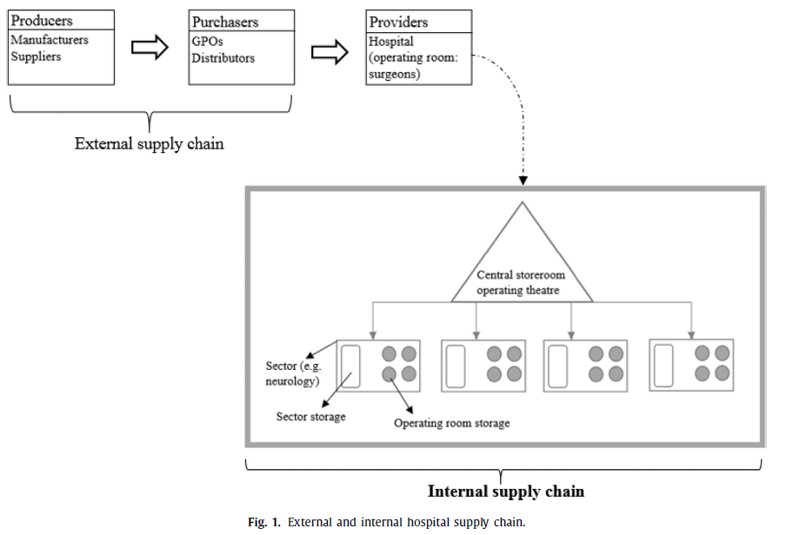
Distribution and scheduling
Internal distribution and scheduling activities
Figure 1 shows an overview of the external and internal supply chain with the as- sociated actors
The external supply chain processes include transactions with distributors, GPOs and manufacturers upstream in the supply chain in order to save money on procurement
This study focuses on the internal supply chain processes including product and information flows from receiving, replenishing, picking, etc. within the hospital.
The objective is to optimize the service delivery in terms of costs, quality, time and flexibility to increase patient’s and personnel’s satisfaction and the economical return
One of the most important issues is to look at the supply chain from an integrated perspective
In order to achieve a high-performing supply chain, various departments in the internal supply chain (e.g. central sterilization, pharmacy, operating room, material management, etc.) must be efficient and integrated which requires a thorough operational planning and coordination.

Slide 21
Distribution and scheduling
Internal distribution and scheduling activities
Integration results in streamlined, cost-effective processes characterized by optimal usage of space, reduced cost, standardization, and fewer cancellations or delayed interventions.
Applying barcode scanning or RFID technologies to identify the pharmaceuticals or medical supplies allows materials managers to speed the distribution, to efficiently control recalled products, notifications to patient billing, clinical record systems, and to improve the traceability of supplies.
Balance should be made between inventory costs, ordering costs, and the costs of implementing the new technology. Surgical procedures require a great variety of medical supplies which are stored in multiple storage areas.

Slide 22
Distribution and scheduling
Internal distribution and scheduling activities
The supply department also has to make scheduling decisions related to inventory (e.g. how often and when should each medical care unit be visited).
The delivery frequency is important to hospital material managers as it influences the effort needed for material management activities. They should simplify or standardize the flows of materials, control the inventory and ensure safety and availability of medical supplies
Automated dispensing machines (ADM), based on a hybrid inventory system, can be implemented to store and deliver pharmaceuticals. This system reduces the time spent by nurses to manage supplies, reduces dispensing errors (e.g. wrong dose, wrong product, non-dispensing), simplifies the dispensing process, increases material traceability, increases personnel satisfaction, etc.

Slide 23
Distribution and scheduling
Internal distribution and scheduling activities
By means of the material requirements planning (MRP) method, medical information is retrieved to pull medical unit replenishments and pharmacy orders with suppliers. This will result in a more frequent delivery schedule, exploiting the advantages of a central stock while assuring a high service level to patients.
A streamlined hospital material management process (e.g. patient management, medical unit inventory management, centralized management) might lead to reduced costs (ordering, purchasing, warehousing, handling, transportation, distribution, stock-out costs), reduced stock points at patient care locations, improved efficiency, materials traceability, information sharing, and increased patient safety, while simplifying the activities accomplishment by hospital personnel.

Slide 24
Distribution and scheduling
Performance measurement of distribution system
By streamlining the supply chain, the costs of internal distribu- tion can be reduced. Effective inventory control lowers the cost of internal distribution by improving inventory turnovers and hence, it reduces time and labor associated with inventory management (e.g. ordering, handling stock-outs, etc.)
The performance of the internal hospital distribution activities can be evaluated on several factors, such as
  on-time delivery of supplies
  response time to urgent requests
  Errors
  Waste
  satisfaction of patient and personnel
  streamlined organization

Slide 25
Distribution and scheduling
Performance measurement of distribution system
  The Supply Chain Operation Reference (SCOR) model addresses, improves and communicates SCM activities within and between all involved stakeholders (Lenin K, 2014) . It can be used to define the current logistics processes, get benchmarks or best-practices and define performance measures.
  Di Martinelly [2009] apply the Porter-SCOR modeling approach to the hospital supply chain and define reliability, responsiveness, flexibility, costs and assets as five types of performance indicators.
  Rossetti and Selandari [2001] use the AHP model to formulate the hospital delivery system and select three groups of performance indicators –
    Technical
    Economic
    Qualitative
  related to the distribution process to decide on the replacement of a human-based delivery system by mobile robots to distribute phar- maceuticals.

Slide 26
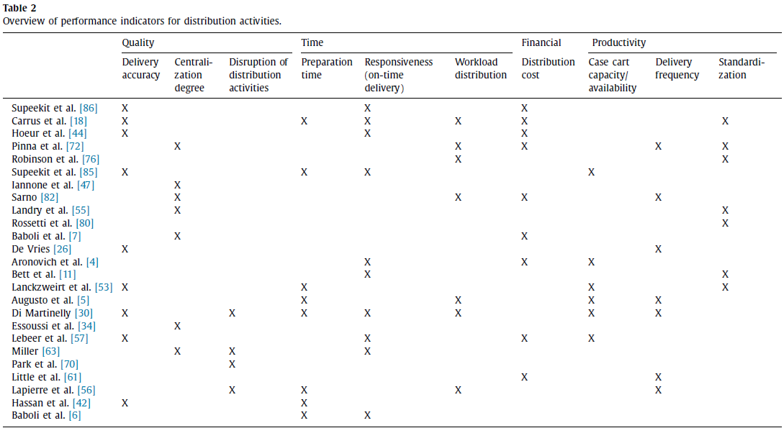
Distribution and scheduling
Performance measurement of distribution system
Table 2 shows an overview of indicators identified in literature to measure the performance of distribution activities.

Slide 27
Distribution and scheduling
Performance measurement of distribution system
The organization of the internal transportation for pharmaceuticals in a hospital is complex, as different types of pharmaceuticals need to be delivered from different storage areas to various point-of-use locations, and different actors (e.g. warehouse employees, nurses, etc.) are involved (Lebeer S et al., 2009).
The internal transportation system can be quantified by incorporating the hospital lay-out and corresponding distances, flow dimensions such as time and quantity, and resources (e.g. case carts and personnel along with their associated costs).
The performance of the distribution activities can be evaluated based on several criteria, such as
  cost
  ergonomics for personnel
  lead time
  reliability of timely and correct deliveries
  traceability of supplies
  walking distances

Slide 28
Distribution and scheduling
Performance measurement of distribution system
An optimized pharmaceutical supply chain will result in decreased stock-out rates, reduced picking time, reduced storage costs and traceability of pharmaceuticals.
Sarno [2014] considers the logistics costs related to pharmacy management policies in terms of personnel and physical resources (transportation resources, inventory costs).
Augusto and Xie [2005] develop a supply and transportation planning in order to balance workloads for both pharmacy assistants and transporters, while respect- ing the availability constraint of having a mobile medicine closet at each medical unit.
Banerjea–Brodeur et al., [1998] model the linen distribution as a periodic vehicle routing problem to determine the routing and frequency of linen delivery to care units by respecting the constraints of carts sizes and linen availability.

Slide 29
Multi-Criteria Decision-Making
The four main stakeholders in the healthcare environment include (Little J et al.,2008)
  medical staff
  materials management staff
  department managers
  patients
The existence of conflicting interests and power relationships among the stakeholders result in a multi-dimensional character of the inventory and internal distribution system in healthcare operations.
The different expectations and perceptions of the stakeholders complicate the performance definition in the healthcare sector. The performance indicators reflect the conflicting hospital objectives depending on the different stakeholders’ perspectives (Di Martinelly C,2009).

Slide 30
Multi-Criteria Decision-Making
Multi-criteria decision-making (MCDM) can be applied as a quantitative approach to assess a number of alternatives on multiple criteria in order to find the best choice.
Relative weights are assigned to the criteria in order to represent their importance as a quantitative measure and to prioritize the indicators by using the Analytical Hierarchy Process (AHP) or the extended Analytical Network Process (ANP) method.
Rossetti and Selandari [2001] perform a multi-objective analysis to improve the performance of hospital delivery systems. They use the AHP model to evaluate the replacement of a human-based delivery system by automation alternatives by selecting a set of performance measures, including the economic, technical and qualitative indicators.
Hoeur et al. [2015] develop a framework to quantitatively measure healthcare logistics activities’ effectiveness and efficiency, and they use the ANP model to determine interrelationships between and to prioritize the performance indicators. They identify inventory management and information and technology management to be the most critical components in healthcare logistics. However, they did not take into account the internal distribution processes within the hospital.
Toward Sust Oper Supply Chain Logist Syst 2015:37–50 .
Toward Sust Oper Supply Chain Logist Syst 2015:37–50 .

Slide 31
Multi-Criteria Decision-Making
In the healthcare context, MCDM is a useful approach because it takes multiple, often conflicting, quantitative and qualitative criteria into account in order to make justifiable decisions (Lebeer S et al., 2009).
Biased attitude of the decision maker results in subjectivity when identifying the alternatives, criteria and their weights.
Group decision-making methods like consensus may be used to avoid this.

Slide 32
Conclusion
The literature study above is situated in the domain of supply chain management in healthcare, and more specifically at the internal hospital supply chain in the operating room environment. The internal supply chain is unique and differs from other industries.
Interaction between clinical, material and information flows is essential for improving operational performance of the logistics processes and to obtain an integrated supply chain.
Integration and streamlining the supply chain is required to increase efficiency while guaranteeing high quality patient care. However, a lack of visibility of end-to-end performances of logistics processes, low product traceability, internal distribution problems, low ability to manage product utilization and a lack of data standardization make it challenging for logistics managers to achieve supply chain excellence

Slide 33
Conclusion
From the literature, it can be summarized there are several objectives and criteria for inventory and distribution management in hospitals. However, a methodological approach is missing for selecting relevant KPIs to measure the performance of the internal supply chain. Further research in this field will focus on the development of a general framework to measure the performance of the internal logistics flow in hospitals, and more specifically in the operating theatre, in terms of time and cost savings, etc. while guaranteeing a high service level to patients. In developing the framework, the AHP or ANP methodology can be used to simplify the complex multi-criteria decision problem by determining the relationship and prioritizing between the logistics performance indicators. However, different performance indicators will be important depending on the hospitals’ or stakeholders’ preferences. The framework serves as a guideline when selecting relevant performance indicators aligned with the logistics and medical-oriented objectives.

