Slide 1



Chung Young Christian University
Business College
Building global logistics competence with Chinese OEM suppliers
Student: Ehsan ullah
Date: Dec 4 , 2023

Slide 2
Outline
Introduction
Background and hypotheses
Research Method
Results
Discussion
Limitations and Future research

Slide 3

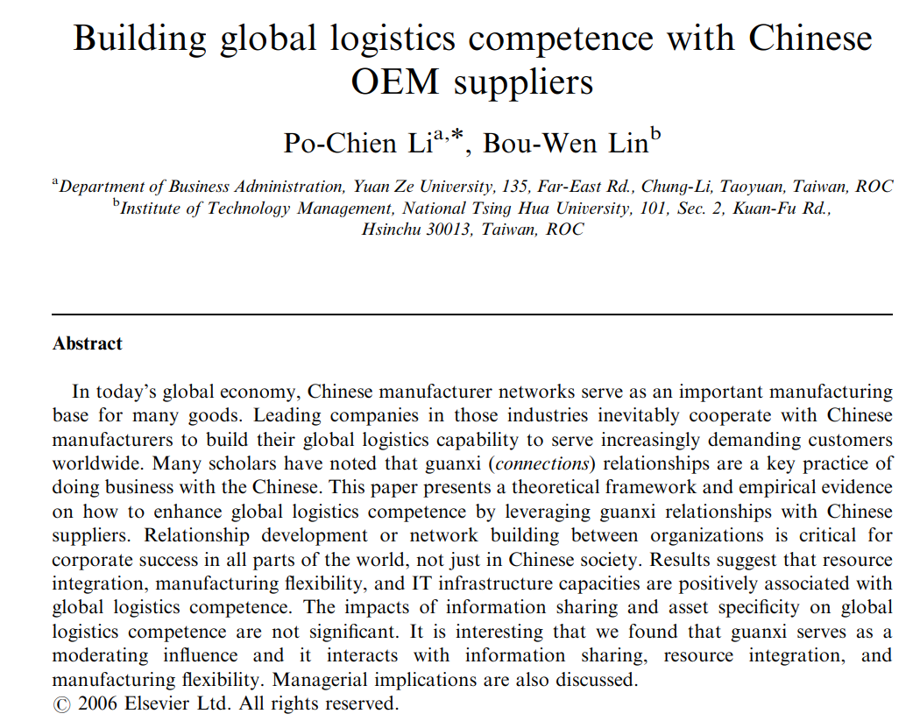
Introduction:

Slide 4
Introduction:
Global logistics is a complex inter-organizational process. Thus, to build global logistics competence poses a major challenge for manufacturing-based companies.
In today’s world economy, Chinese manufacturer networks serve as important production bases for many goods ranging from sport shoes and umbrellas to cellular phones and notebook computers.
Many scholars have noted that guanxi (or connections)relationships are a key business practice in China.

Slide 5
Introduction:
Unfortunately, little empirical work has been done to investigate the role of guanxi in the logistics and supply chain literature.
This paper presents a theoretical framework and empirical evidence on how to enhance global logistics competence by leveraging guanxi relationships with Chinese Suppliers.

Slide 6
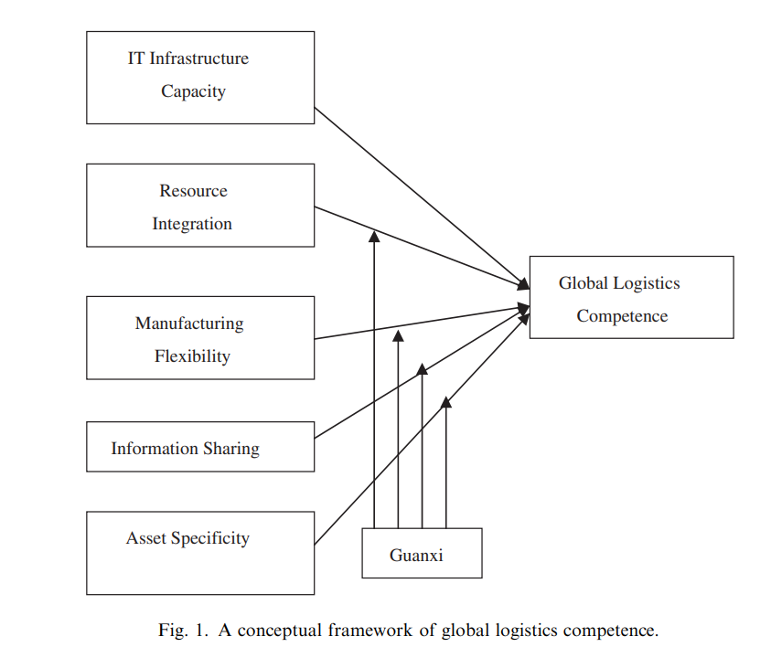
Background and hypotheses
Theoretical Framework:

Slide 7
Background and hypotheses
Theoretical framework:
five factors influencing global logistics competence have been identified:
Independent variables:
IT Infrastructure
Resource sharing
Information sharing
Asset specificity
Manufacture flexibility
Dependent variables:
logistics competence
Moderator:
Guanxi

Slide 8
Background and hypotheses
Global logistics competence:
Global logistics competence is an important strategic asset for manufacturing firms to compete in the current global environment.
Stank and Lackey suggest that logistics competence should include positioning, integration, agility, and measurement. Of these, positioning is the selected strategic and structural approach to guide logistical operations
Morash et al. suggest that logistics capabilities should include delivery reliability, post-sale customer service, responsiveness to the target market, delivery speed, pre-sale customer service, widespread distribution coverage, selective distribution cover-age, and low total cost distribution.

Slide 9
Background and hypotheses
Guanxi in Chinese supply networks:
Vanhonacker suggested, ‘‘Guanxi, or personal connection, is powerful stuff, and it can divide the loyalties of the sales and procurement people your company depends on.
Guanxi relationships are characterized by mutual trust and the willingness to engage in activities that engender mutual benefits. The art of using guanxi can in many cases enhance transaction efficiency in long-term business relationships.
Luo identified guanxi as being: transferable, reciprocal, intangible, essentially utilitarian rather than emotional, and virtually personal.

Slide 10
Background and hypotheses
IT infrastructure capacity:
Byrd and Turner define IT infrastructure as ‘‘shared IT resources consisting of a technical physical base of hardware, software, communications technologies, data, and core applications and a human component of skills, expertise, competencies, commitments, values, norms, and knowledge that combine to create IT services that are typically unique to an organization’’
Advanced information and process technologies enable manufacturers to facilitate quick, frequent, and accurate information transfer among members of a supply chain.

Slide 11
Background and hypotheses
IT infrastructure capacity:
Chou et al. investigate whether different degrees of IT involvement lead to different processes that can lead to different outcomes, finding that IT intensity is positively associated with firm’s decision-making performance.
Dewan et al. show that Internet commerce technologies and advanced manufacturing technologies offer significant advantages to early adopters, who gain can market share and profits.
Hypothesis:
H1: The IT infrastructure capacity of an industry network relates positively to the network’s global logistics competence.

Slide 12
Background and hypotheses
Cross-organizational resource integration:
Organizational integration is ‘‘the quality of the state of collaboration that exists among departments that are required to achieve unity of effort by the demands of the environment’.
Wisner and Tan maintain that the essence of ‘‘integrated logistics systems’’ is to manage inventories through strong partnerships with suppliers and transportation, distribution, and delivery services in order to replace high inventory levels with frequent communication and sophisticated information technologies to provide coordination and synergy.
H2. The level of cross-organizational resource integration of an industry network relates positively to the network’s global logistics competence.

Slide 13
Background and hypotheses
Manufacturing flexibility:
Sethi and Sethi suggest that both infrastructure and organizational factors strongly influence the level of flexibility.
Chandra shekar and Schary claim that supply chains can achieve organizational flexibility in two ways: through organic change or through modularity.
Vickery et al provide empirical evidence that performance in various dimensions of supply chain flexibility can be directly related to overall firm performance.
The following hypothesis is proposed:
H3: Manufacturing flexibility of an industry network relates positively to the network’s global logistics competence.

Slide 14
Background and hypotheses
Information sharing:
Penrose first recognized the role of knowledge in business management, stressing that knowledge is the important intangible resource for the growth of the firm.
et al provide empirical evidence that there is a positive relationship between information sharing, integration and overall supply chain performance.
We hypothesize that information sharing leads to superior global logistics performance:
H4: The level of information sharing in an industry network relates positively to the network’s global logistics competence.

Slide 15
Background and hypotheses
Asset specificity :
specific assets can enhance efficiency of inter firm cooperation and integration to achieve greater supply chain performance.
Bucklin and Sengupta explore the role of asset specificity, uncertainty, and frequency on power imbalances in co-marketing alliances. The relationship between asset specificity and firm performance is not conclusive.
Therefore, the following hypothesis can be tentatively proposed:
H5:The level of relationship-specific investment in an industry network relates negatively to the network’s global logistics competence.

Slide 16
Research method :
Sample and Materials:
Several studies have used anagram tasks to study goal setting behavior (Locke & Latham, 1990).
we used a modified version of Vance and Colella’s (1990) anagram task.
We adapted this task to examine the link between goals and unethical behavior.
We recruited 70 participants for a pilot study, our pilot participants performed this word creation task nine times with different combinations of letters, and we used results from this pilot study to identify our performance goal.

Slide 17
Research method :
Sample and Materials:
Data were gathered through surveys mailed to qualified informants in Taiwan’s manufacturers
From this database, we selected manufacturers in electronics, chemicals, and materials with 200 or more employees.
The 117 returned surveys, 104 were complete and used for regression analysis.

Slide 18
Research method :
Procedures:
All variables have been standardized. The Cronbach a value of those question items is 0.828, indicating that the measure is quite reliable.
IT infrastructure capacity, resource integration, manufacturing flexibility, asset specificity, information sharing, and Guanxi, are 0.79, 0.80, 0.82, 0.81, 0.77, and 0.84, respectively.
An a level of 0.7 or above is generally acceptable .
The multiple regression technique seems to be an appropriate method for data analysis.

Slide 19
Results :
Model A includes only the direct effects of five independent variables: IT infrastructure capacity, resource integration, manufacturing flexibility, information sharing, and asset specificity.
Of these, only resource integration, asset specificity, and IT infrastructure capacity have significant effects on global logistics competence. Here, the F-value and R2 are 7.76 and 0.284, respectively.
Model B adds guanxi as an independent variable. The F-value and R2 of regression Model B are 6.53 and 0.288, respectively, indicating that the effect of guanxi is not significant.

Slide 20
Results :
In fact, the empirical studies do not have consistent results on the effect of guanxi on performance.
In the third model, the interaction terms between guanxi and the other four independent variables were included.
Here, the F-value and R2 of regression Model C are 6.06 and 0.395, respectively, indicating that the interaction terms significantly improve the explanatory power on global logistics competence.
We therefore accept Model C as a better model to explain global logistics competence.

Slide 21
Results :
Model C includes interaction effects of guanxi with resource integration, manufacturing flexibility, information sharing, and asset specificity.
Here, the R2 value is significantly improved from 0.28 to 0.39, and the main effects are unchanged for resource integration and IT infrastructure capacity.
The main effect of manufacturing flexibility becomes significant, which is consistent with the literature.
The negative effect of asset specificity becomes insignificant when including the interaction effects of guanxi culture.

Slide 22
Results :
The most interesting result of the interaction model is that there is a very high level of negative interaction effects of guanxi and information sharing.

Slide 23
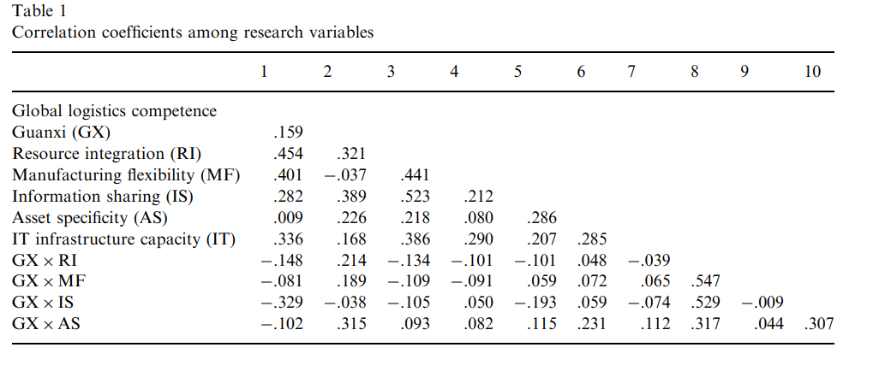
Results :

Slide 24
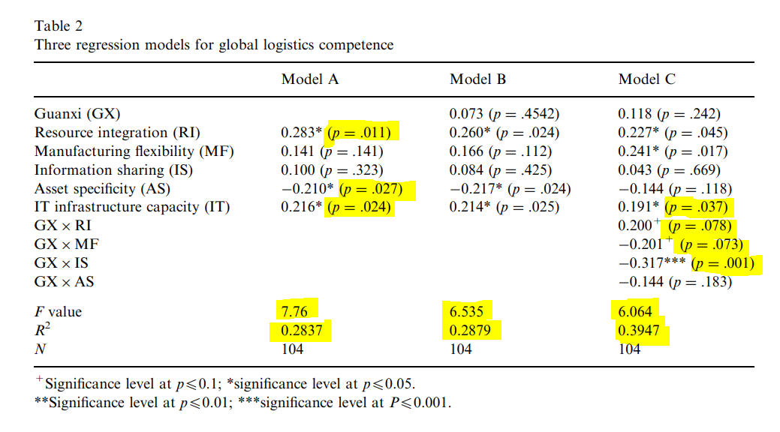
Results :

Slide 25
Discussion :
These results are consistent with previous findings in the literature [15]. However, the main effects of information sharing and asset specificity do not significantly affect global logistics competence in the Chinese supply networks.
Though guanxi itself does not directly affect global logistics competence, it does mitigate the effects of information sharing and manufacturing flexibility, which theoretically have major impacts on global logistics competence.
However, guanxi strengthens the effect of resource integration on global logistics competence and asset specificity becomes unimportant when taking guanxi into account.

Slide 26
Discussion :
Guanxi culture could interact with information sharing, resource integration, and manufacturing flexibility.
These findings are useful for managers dealing with interfirm partnerships and supply chain management.
Accelerated by the advancement of new information and communication technologies, global sourcing, global production and global logistics have become a new trend in business practice.

Slide 27
Limitations and future research
The findings presented in this paper were limited to analyses of self-reported survey data, the causal relationships between those findings and financial performance are beyond the scope of this research.
The causal relationships between global logistics competence, supply chain effectiveness, and financial performance are also significant topics for future research.
Future research should investigate the potential cultural impacts on inter firm partnership and supply chain integration.

Slide 28


