Slide 1
Introduction To WEKA
Dr. Chin-Hui Lai
Department of Information Management, CYCU
Email: chlai@cycu.edu.tw

Slide 2
Outline
What is Weka?
Starting Weka
Data Preprocessing
Association Rule Mining
Apriori algorithm

Slide 3


What is Weka?
Weka is a data mining and machine learning suite developed at University of Waikato in New Zealand
Weka stands for Waikato Environment for Knowledge Analysis
Learning resources:
Books: https://www.cs.waikato.ac.nz/~ml/weka/book.html
Workbench: https://www.cs.waikato.ac.nz/ml/weka/Witten_et_al_2016_appendix.pdf
Online course: Weka 3 - Data Mining with Open Source Machine Learning Software in Java (waikato.ac.nz)
Course matrial: https://www.cs.waikato.ac.nz/ml/weka/mooc/advanceddataminingwithweka/

Slide 4
What is Weka?
Weka is a collection of machine learning algorithms for data mining tasks.
contains tools for data preparation, classification, regression, clustering, association rules mining, and visualization
Supports deep learning method (i.e. Deeplearning4j)
https://deeplearning.cms.waikato.ac.nz/
Includes multiple (5) interfaces
We will focus on the explorer interface
Does not require any programming

Slide 5
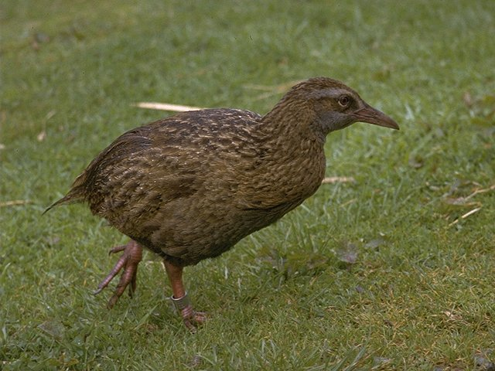

WEKA is also a bird
Found only on the islands of New Zealand, the Weka is a flightless bird with an inquisitive nature. The name is pronounced like this, and the bird sounds like this.
https://www.cs.waikato.ac.nz/ml/weka/index.html
Copyright: Martin Kramer (mkramer@wxs.nl)

Slide 6
Why Weka?
There are many options on what data mining suite or toolkit one can use
Weka has the following advantages:
Easy to learn
Free and open-source
Easy to download and runs on many platforms (e.g. Mac OS, Windows, Linux)
Does not require programming knowledge
This is important since a few students may not have much programming experience

Slide 7
Weka Disadvantages
Weka is not as flexible as other tools that are programming based
If you are programming anyway you can combine capabilities more flexibly and write code to do things not supported by Weka
Tools based on Python or R have large ecosystems

Slide 8
WEKA: the software
Data mining software written in Java
distributed under the GNU Public License
Used for research, education, and applications
Main features:
Comprehensive set of data pre-processing tools, learning algorithms and evaluation methods
Multiple interfaces that do not require programming
Experimenter can compare learning algorithms

Slide 9
Downloading Weka
There are several versions of WEKA:
As of Aug 2022 the stable version is 3.8.6
Many of these slides are based on older version and will look different from what you see
Weka runs on all major platforms
Download Weka from here:
https://waikato.github.io/weka-wiki/downloading_weka/
Use the latest stable version (3.8.6 as of Aug 2022)
There is plenty of documentation
https://waikato.github.io/weka-wiki/documentation/

Slide 10
Starting Weka

Slide 11
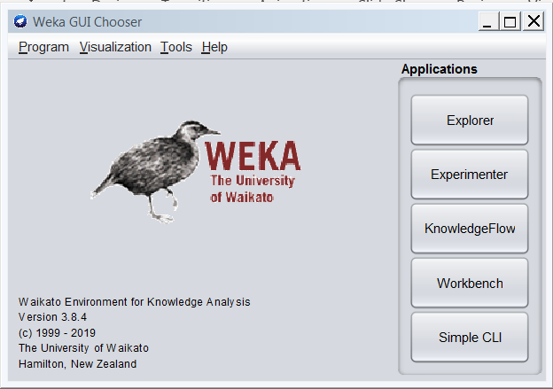
Starting Weka
Run Weka 3.8.6 (with console)
Different version if a new stable version released
May want to create a shortcut on your desktop
This is the GUI Chooser Window

Slide 12
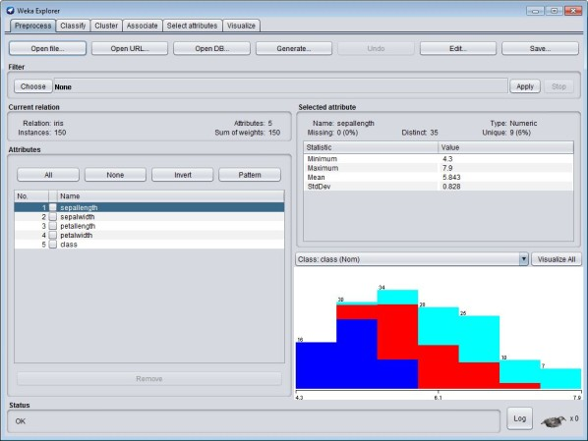
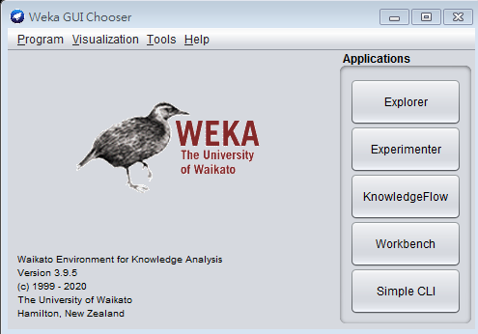
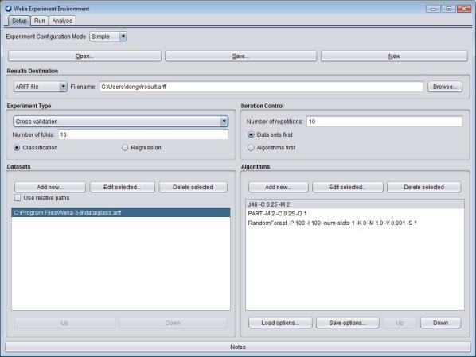
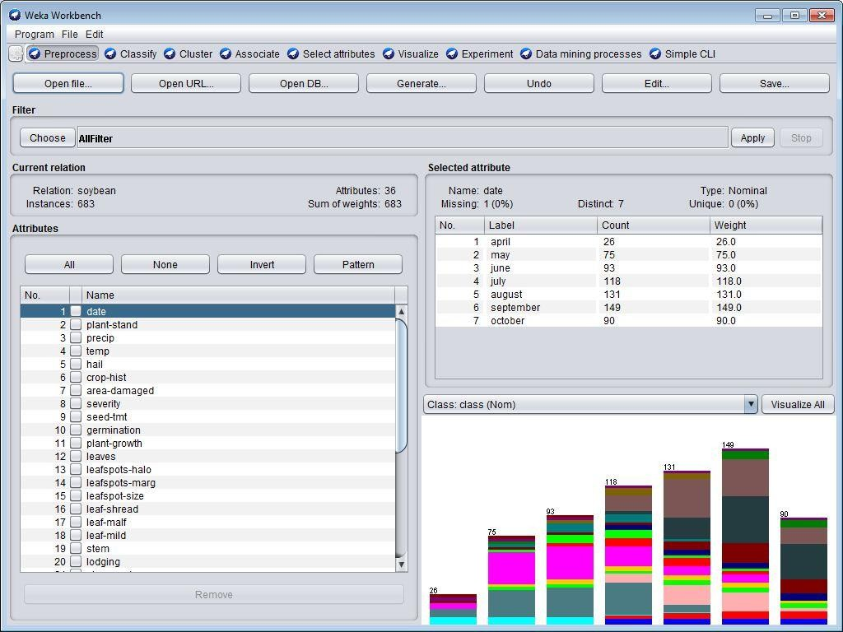
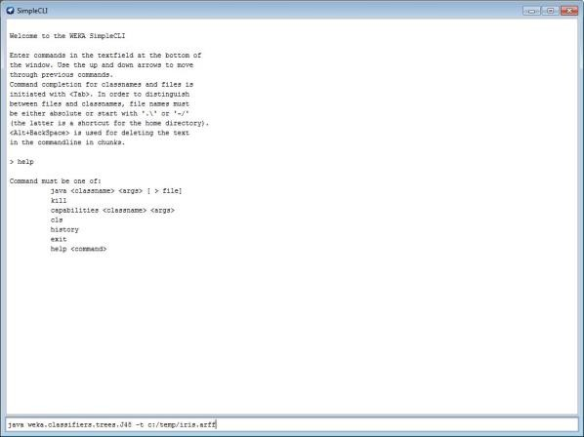
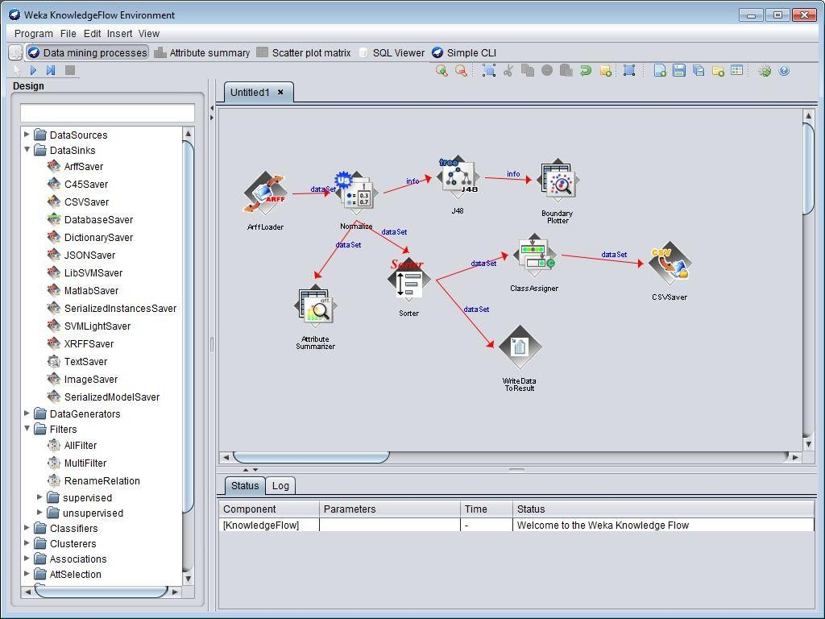
Weka Interface

Slide 13
The Weka Interfaces
Explorer
Enables you to apply multiple actions but does not explicitly model them
Experimenter
Run many experiments in controlled manner and compare results
KnowledgeFlow
Like Explorer but each step is represented as a node in a graph, so flow explicitly represented
Workbench
Combines all GUI interfaces into one
Simple CLI (command line interface)
No GUI so can use shell scripts to control experiments
Similar to using Python where each command is a function
https://www.softwaretestinghelp.com/weka-tutorial/#Graphical_User_Interface_Of_WEKA

Slide 14
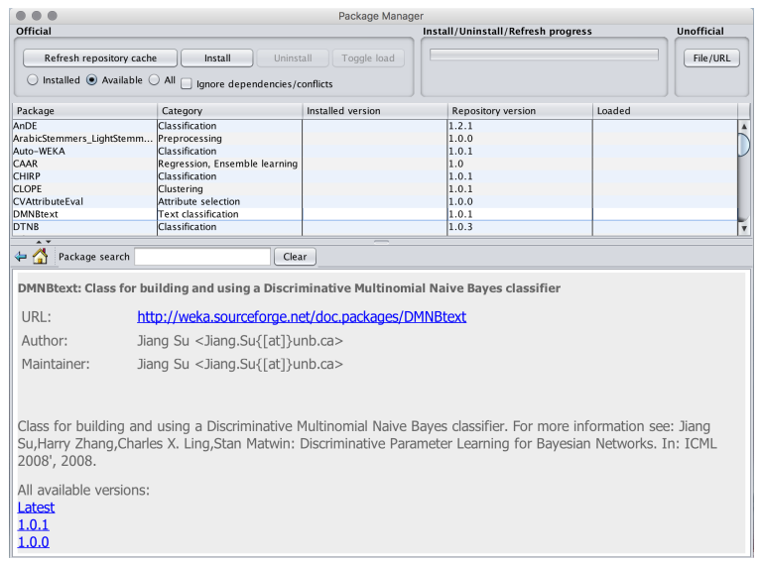
The package management system
allows the user to browse for, and selectively install, packages of interest

Slide 15
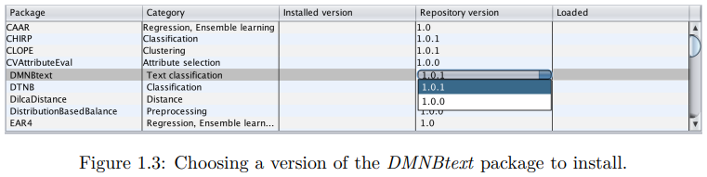
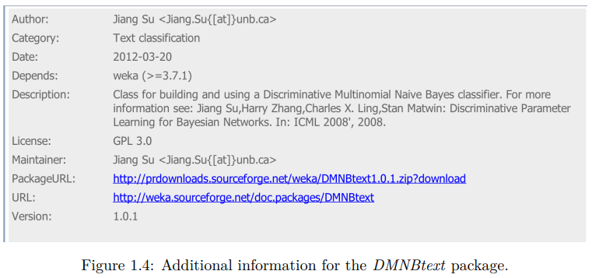
The package management system

Slide 16
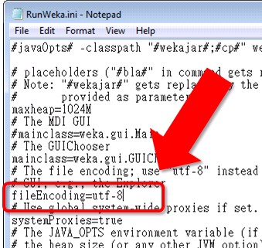
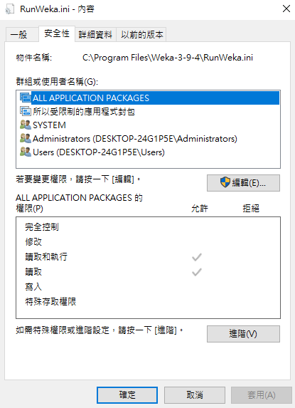
Weka cannot read Chinese data
In Windows OS
Open the installed folder (default)
C:\Program Files\Weka-[version number]
Open RunWeka.ini by using text editor (make sure you have the editing permission)
Change fileEncoding=Cp1252 into fileEncoding=utf-8
Save the file and restart the weka
Change the permission of the file “RunWeka.ini”
Show the file properties for the file
Set the editing permission in security tab

Slide 17
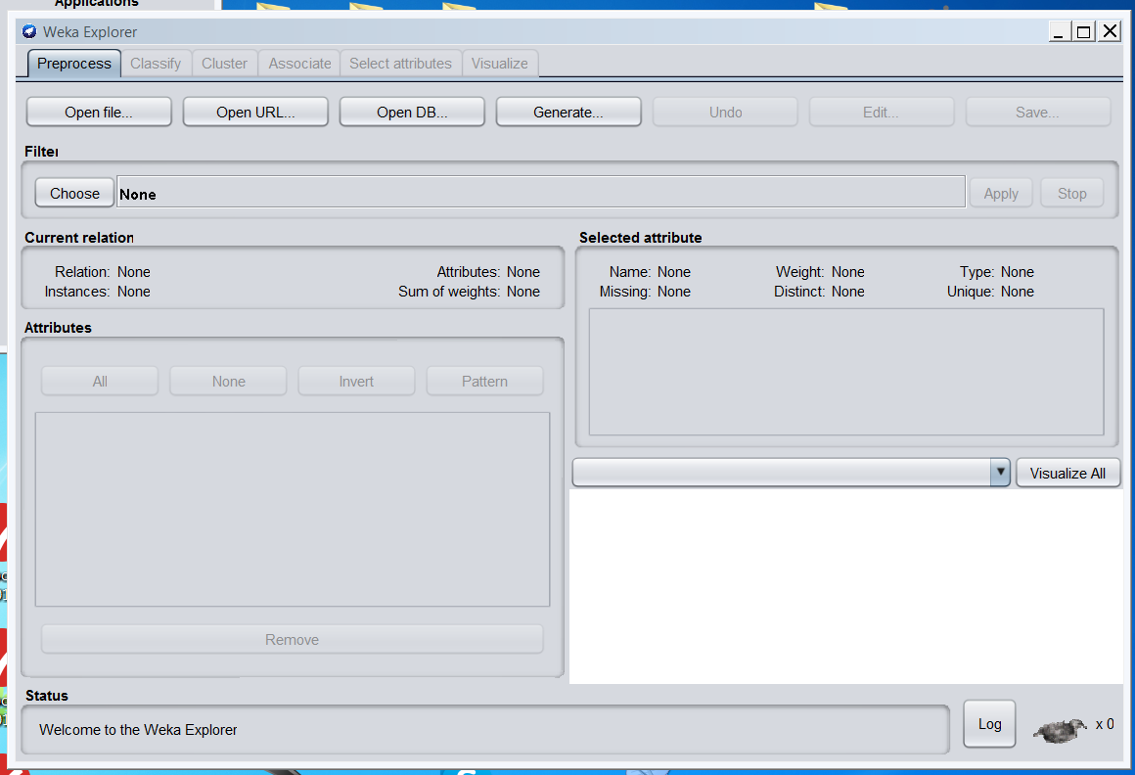
Start the Explorer
Click on “Explorer “ Button in the GUI Chooser Window

Slide 18
The tabs on Weka explorer
Preprocess: Choose and modify the loaded data.
Classify: Apply training and testing algorithms to the data that will classify and regress the data.
Cluster: Form clusters from the data.
Associate: Mine out the association rule for the data.
Select attributes: Attribute selection measures are applied.
Visualize: 2D representation of data is seen.
Status Bar: The bottommost section of the window shows the status bar. This section shows what is happening currently in the form of a message, such as a file being loaded. Right-click on this, Memory information can be seen, and also Run garbage collector to free up space can be run.
Log Button: It stores a log of all actions in Weka with the timestamp. Logs are shown in a separate window when the Log button is clicked

Slide 19
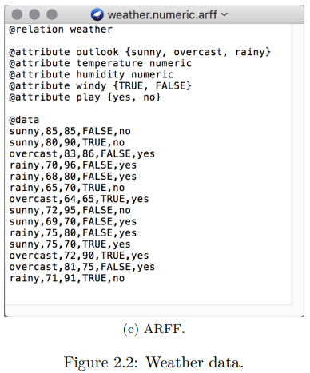
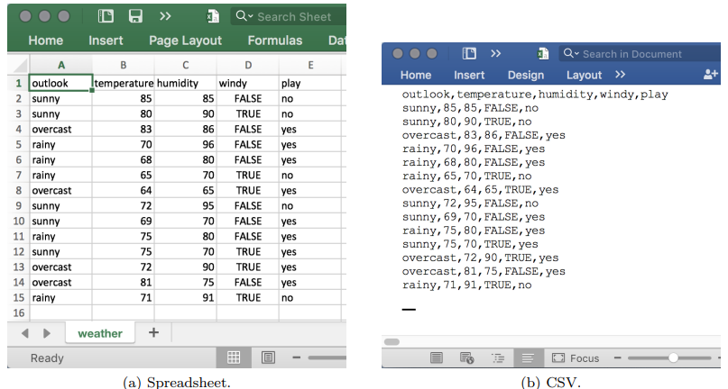
Importing Data
Data can be imported from various formats:
ARFF, CSV
Using JDBC(Java Database Connectivity) to connect to the relational database (SQL)
You will most often import data in csv if not already prepared for WEKA

Slide 20
Importing Data
Weka steps
Make sure Explorer “PreProcess” tab is selected
Click “Open File…” or “Open URL…”
Set the extension appropriately (default is .arff) and navigate to the file and select it
If first line has feature names they are used
If no feature names then generic names are generated
Add feature names if missing or models won’t be interpretable

Slide 21
Weka ARFF File Format
ARFF= Attribute Relation File Format
Weka ARFF files include two main parts:
Specification of the features
The actual data
Files are “flat files” usually comma separated
Other tools use a separate file for each part
C4.5 decision tree tool, which was once very popular, had a “names” and “data” file
I find the single file format odd, since specification is short but actual data can be millions of lines

Slide 22
Weka ARFF Example

Slide 23

Dataset
Weka’s dataset
In the installed folder (C:\Program Files\Weka-3-8-6\data)
The data are in ARFF format
UCI Machine Learning Repository
https://archive.ics.uci.edu/ml/

Slide 24
Reading in the Iris Dataset
We start with the well-known Iris data set
Weka probably installed it so search for “iris”.
Open it using “Open File” or “Open URL”
Weka immediately shows stats about the features and how they are distributed

Slide 25
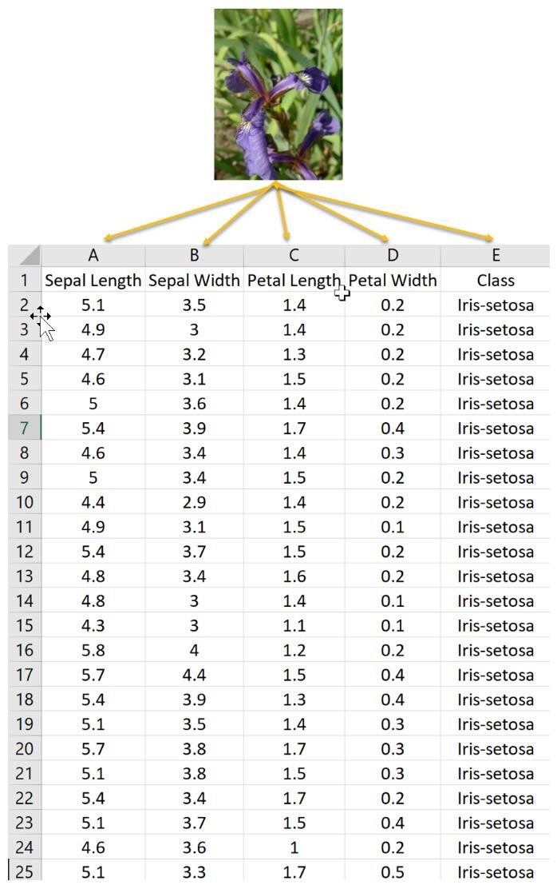
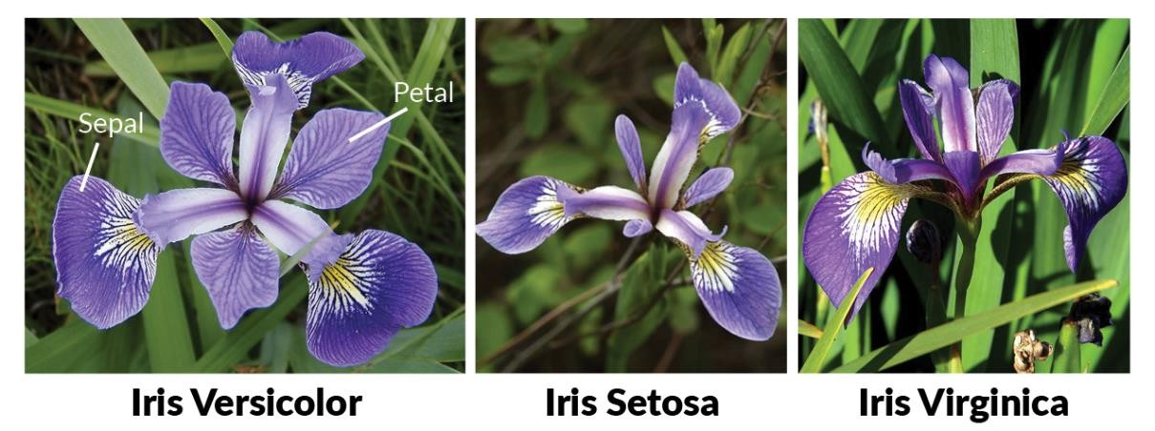
The Iris dataset
4 attributes
sepal length (花萼長)
sepal width (花萼寬)
petal length (花瓣長)
petal width (花瓣寬)
1 class (3 class names)
Iris Setosa
Iris Versicolour
Iris Virginica
Total: 150 instances

Slide 26
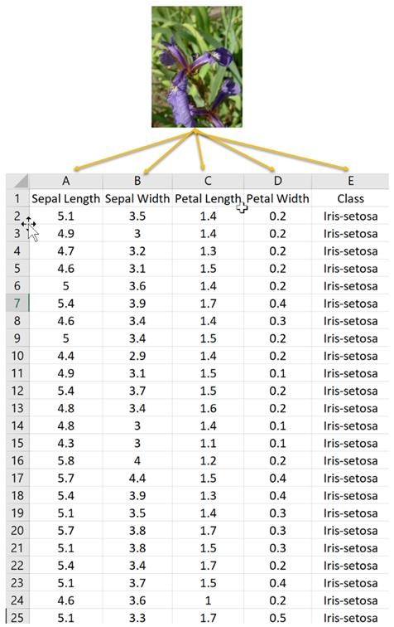
The Iris dataset
Features
Attribute
Class
Instance

Slide 27
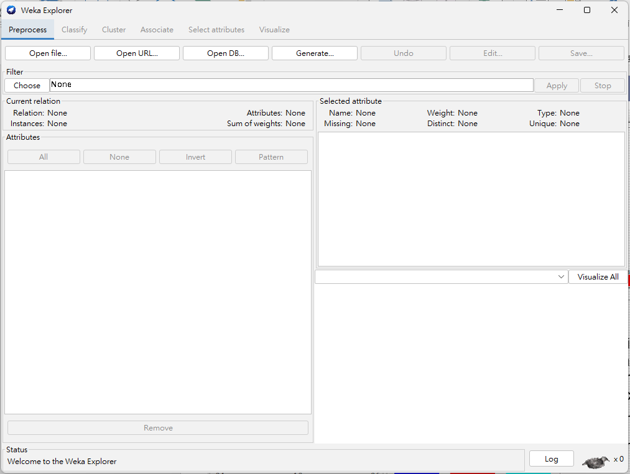

Slide 28
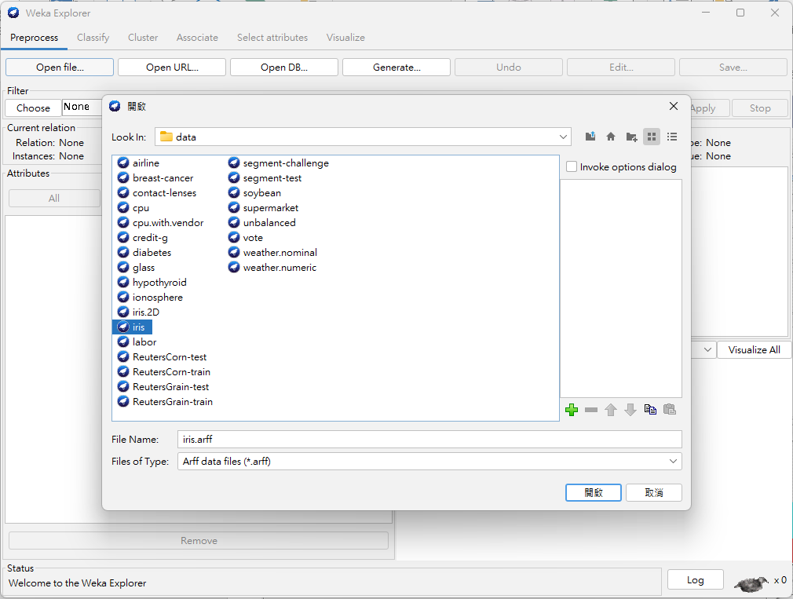

Slide 29
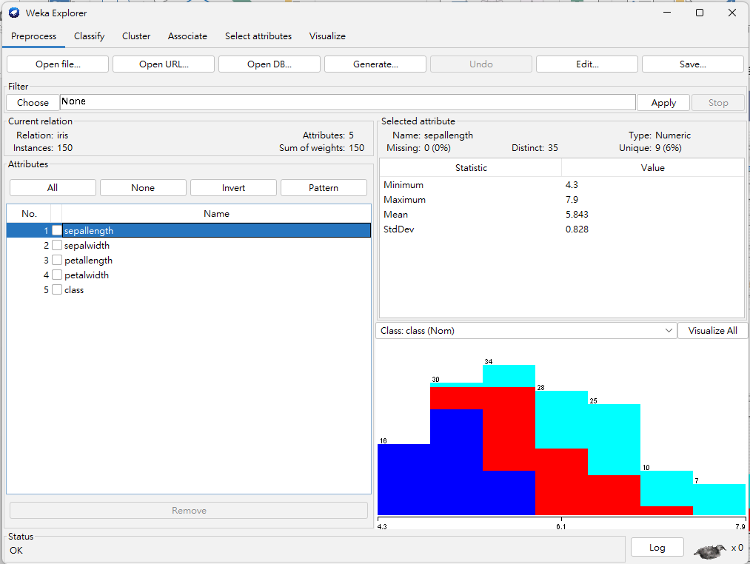
Distribution of sepallength with colors representing 3 class values

Slide 30
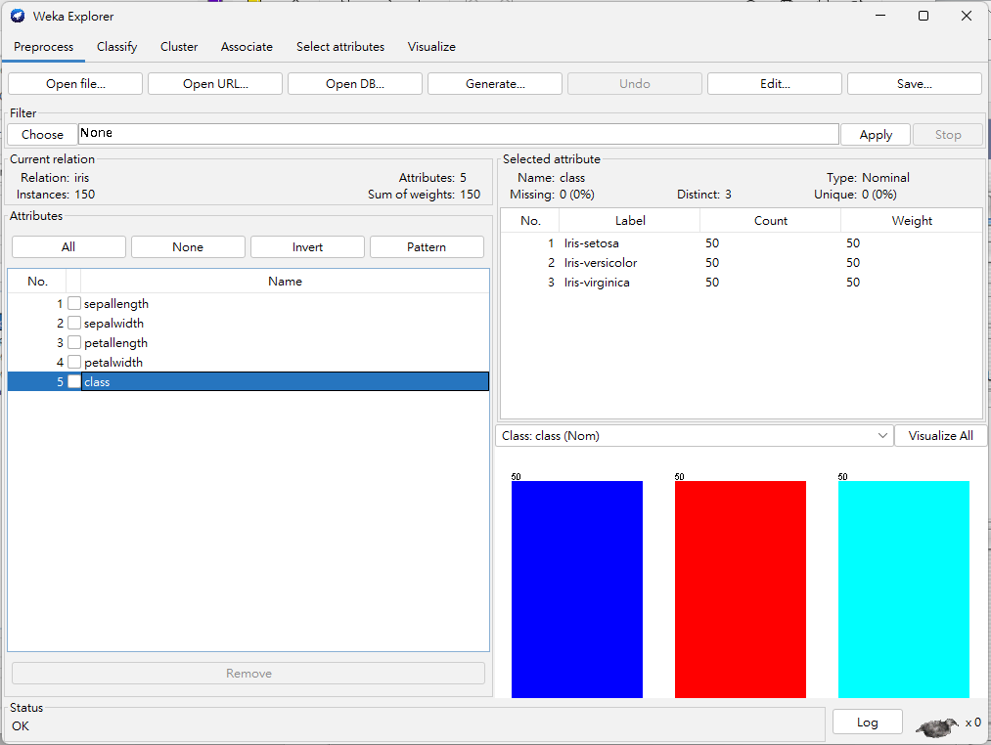
Distribution of the 3 classes, which are evenly distribute

Slide 31
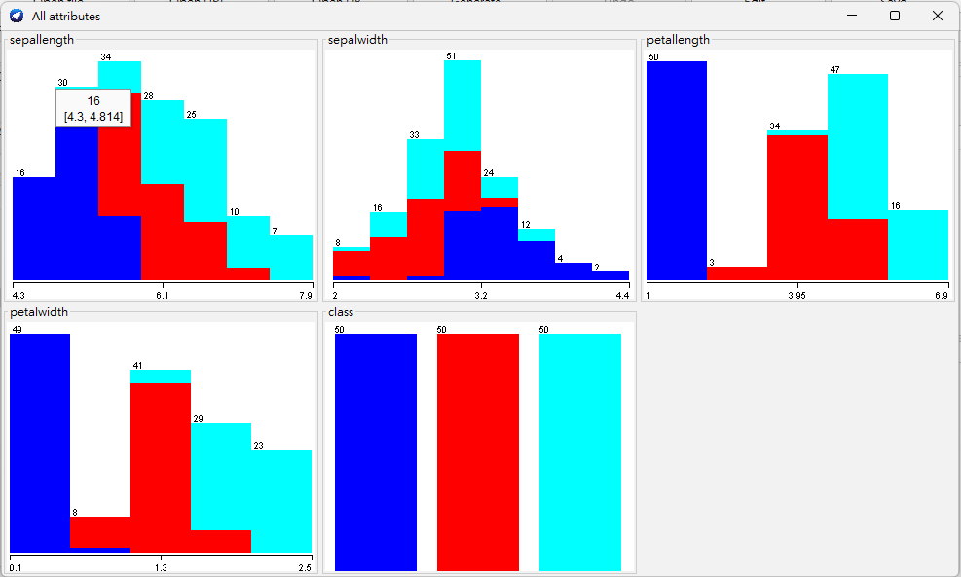
Visualization of all feature values with class information. This makes it clear that most features are useful for distinguishing classes.

Slide 32
Data Preprocessing

Slide 33
Preprocessing Filters
Pre-processing tools in WEKA called “filters”
Many preprocessing filters available:
Discretization
Normalization
Resampling
Feature selection
Feature transformation
Many more
Know what available so can use it when needed
We will focus on Discretization

Slide 34
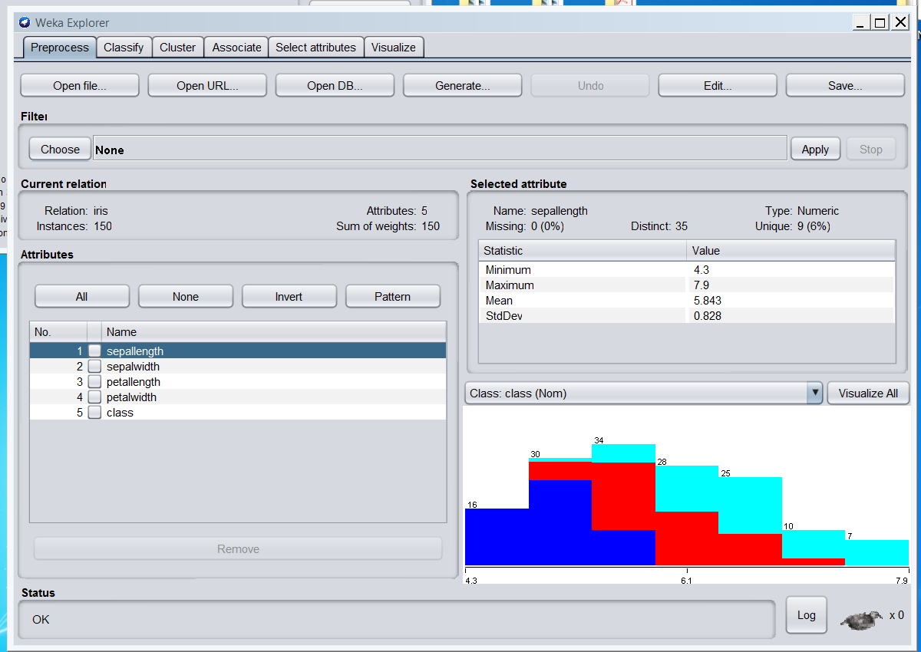
Clicking on this will bring up a list of all of the filters, organized into a hierarchy. Click on each folder to expand the list. There are dozens of choices

Slide 35
Discretization
Discretization: numerical feature → categorical
In preprocess tab select “Choose”, expand “unsupervised” then “attribute”
Select “Discretize” filter
Note discretize applies to attributes not instances
Note: there is a version under the “supervised” folder but it works differently and has different options

Slide 36
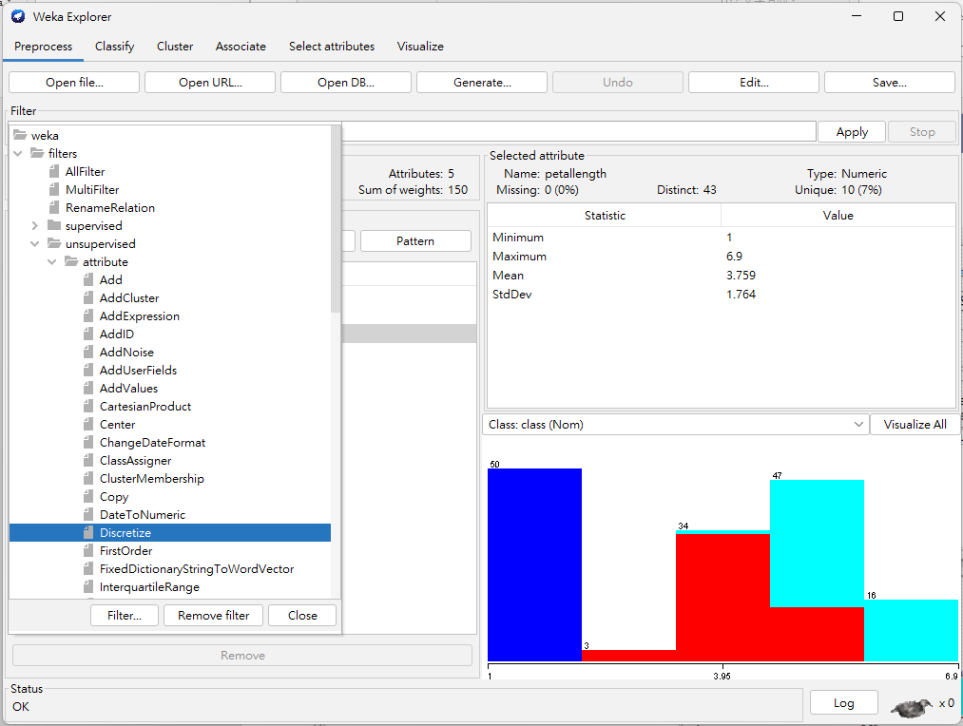

Slide 37
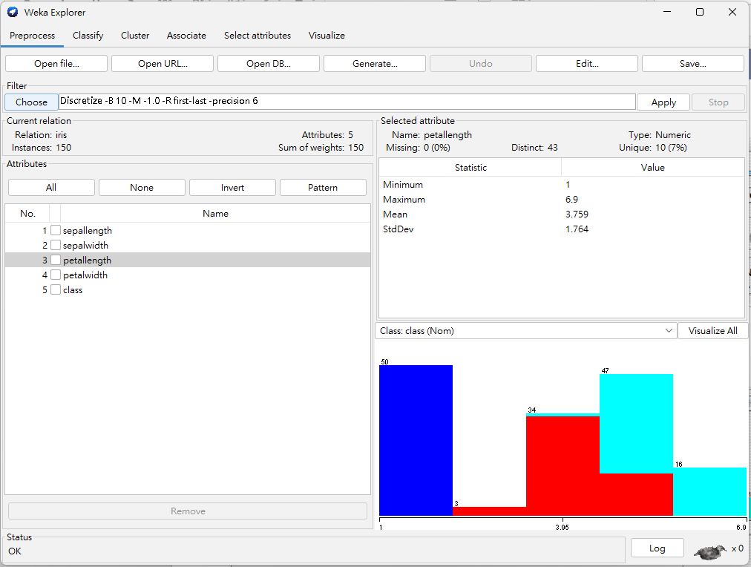
This shows the command line with options. Click within this region to bring up a window with the options and more info

Slide 38
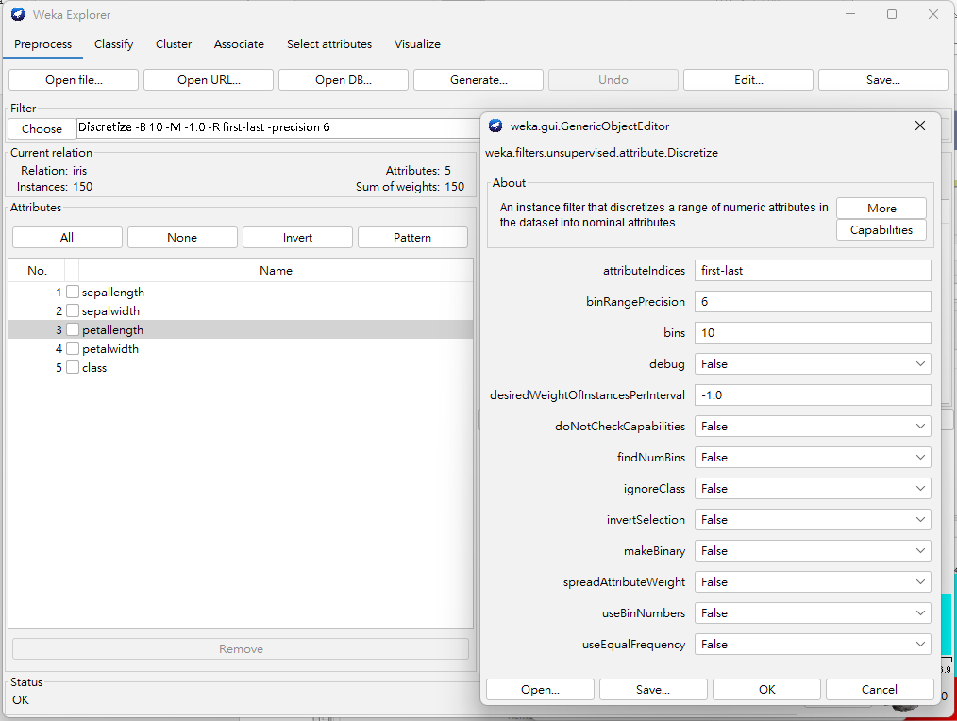
Create 10 equal frequency bins
Will do for all numerical features given “attributeIndices” value
1) Toggle to “True”

Slide 39
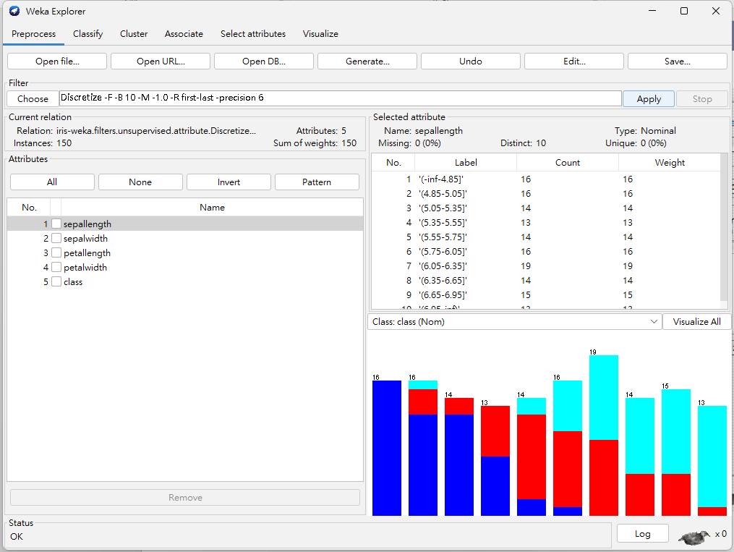
Can use undo to undo the last command
Note there are 10 bins
Frequencies not equal but as close as possible

Slide 40
Data Preprocessing Review
You should now be able to:
Import data into Weka
Visualize the features and how they relate to class
Have an idea of the preprocessing facilities (filters) in Weka and be able to apply them

Slide 41
Association Mining: Apriori Algorithm

Slide 42
Explorer: finding associations
WEKA contains an implementation of the Apriori algorithm for learning association rules
Works only with discrete data
Can identify statistical dependencies between groups of attributes:
milk, butter ⇒ bread, eggs (with confidence 0.9 and support 0.3)
Apriori can compute all rules that have a given minimum support and exceed a given confidence

Slide 43
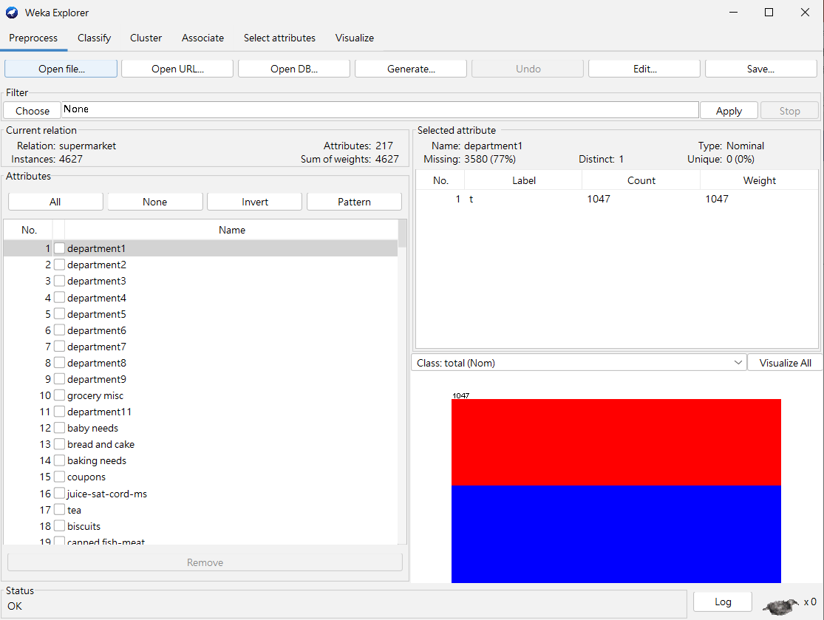
Loading data- supermarket.arff

Slide 44
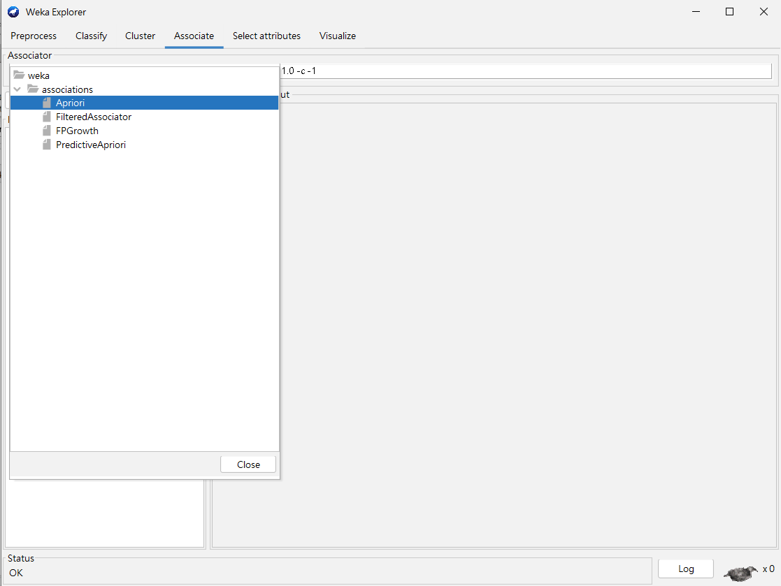
Associate- choosing Apriori

Slide 45
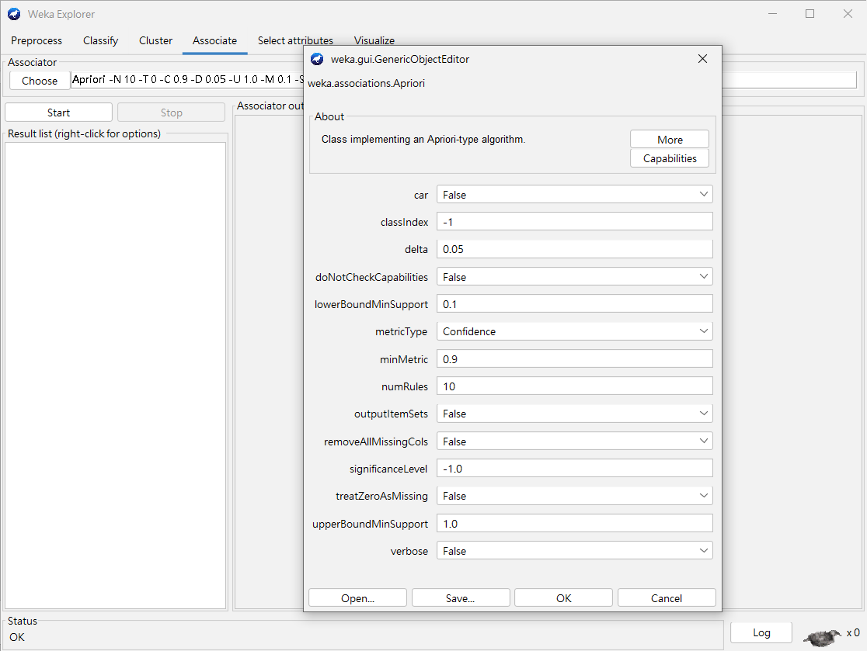
Setting parameters

Slide 46
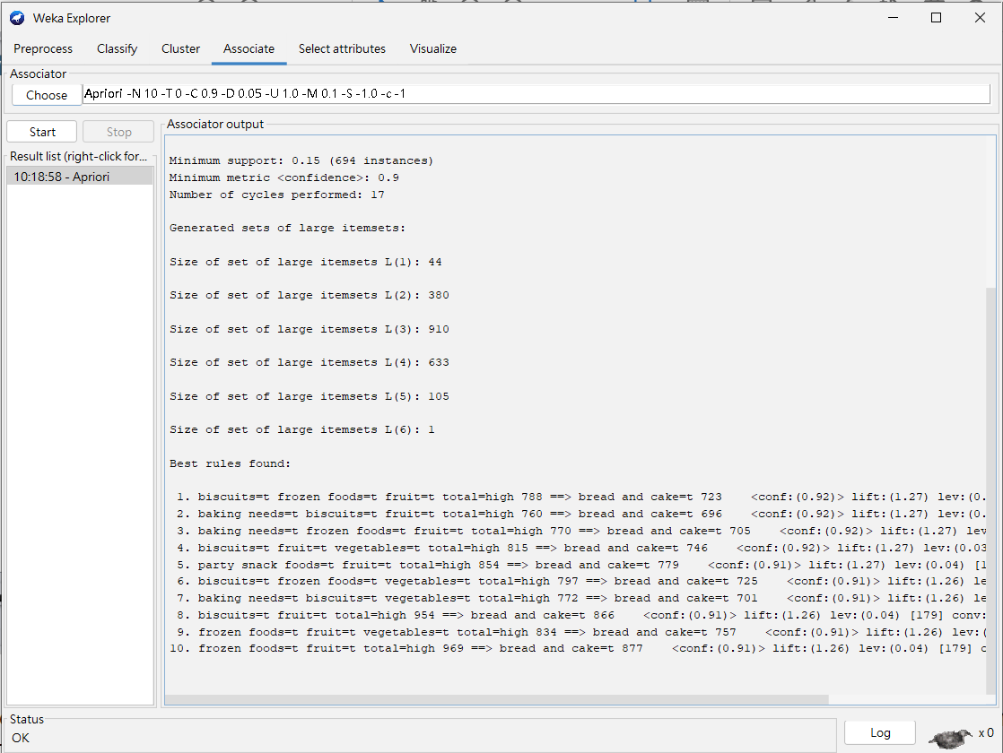
Generating association rules

Slide 47
Hands-on Lab

