Slide 1
Chapter4 Fitting a Model to Data
Data Science For Business
Professor: C.H. Lai
Student: 11204604 Tse Wen Hong
Nov. 14, 2023 [gDoc]
Notes:
Professor Lai and classmates, good morning.
What I want to report today is Chapter 4 Fitting a Model to Data.
Now, I will use 26 slides to share with you what I have learned.

Slide 2
Chapter.4 Fitting a Model to Data
Fundamental concepts:
Finding “optimal” model parameters based on data; Choosing the goal for data mining; Objective functions; Loss functions.
Exemplary techniques:
Linear regression; Logistic regression; Support-vector machines.
Notes:
Predictive modeling is finding a model of the target variable using other attributes.
In Chapter 3, we built a Supervised Segmentation Model by recursively finding informative attributes.
We produced the model structure and parameters from the data.

Slide 3
Chapter.4 Fitting a Model to Data
A common case is where the structure of the model:
a parameterized mathematical function, or
equation of a set of numeric attributes.
Parameter learning or Parametric modeling:
specifies the form of the model and the attributes
to tune the parameters so that the model fits the data as well as possible
Notes:
In this chapter, we are going to learn:
Another method to specify the Model Structure and find the Best Parameters from the data.
This is called parameter learning or parametric modeling.
Many techniques use this method, such as linear regression.
We will see different models for different tasks, such as predicting numeric, binary, or likelihood values.

Slide 4
Index
1.Classification via Mathematical Functions
-1 Linear Discriminant Functions
-2 Optimizing an Objective Function
-3 An Example of Mining a Linear Discriminant from Data
-4 Linear Discriminant Functions for Scoring and Ranking Instances
-5 Support Vector Machines, Briefly
2.Regression via Mathematical Functions
3.Class Probability Estimation and Logistic “Regression”
* Logistic Regression: Some Technical Details
4.Example: Logistic Regression versus Tree Induction
5.Nonlinear Functions, Support Vector Machines, and Neural Networks
6.Summary
Notes:
In this chapter, we will divide it into 6 subsections to introduce,
which is, as you see
1.Classification via Mathematical Functions
2.Regression via Mathematical Functions
3.Class Probability Estimation and Logistic “Regression”
4.Example: Logistic Regression versus Tree Induction
5.Nonlinear Functions, Support Vector Machines, and Neural Networks
6.Summary

Slide 5
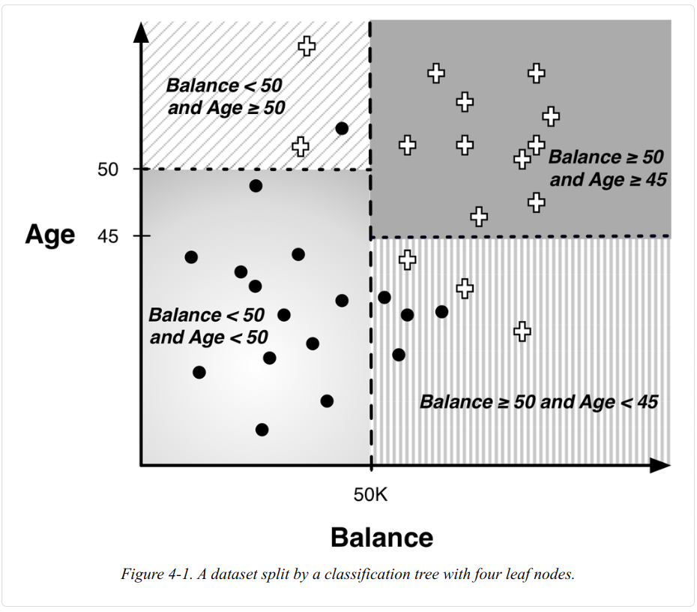
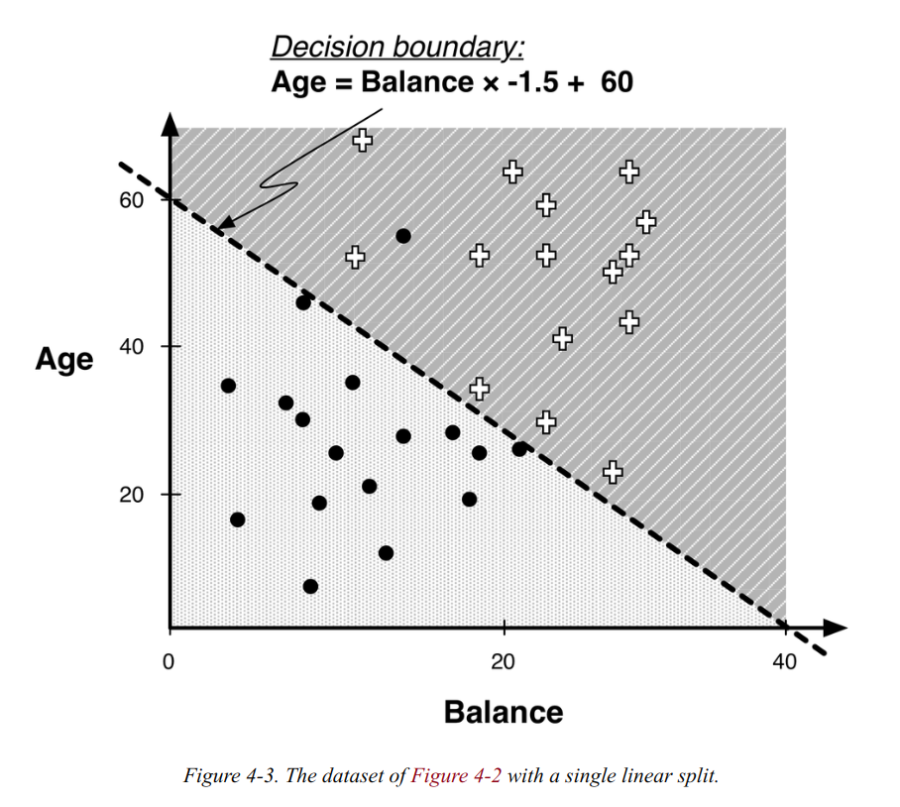
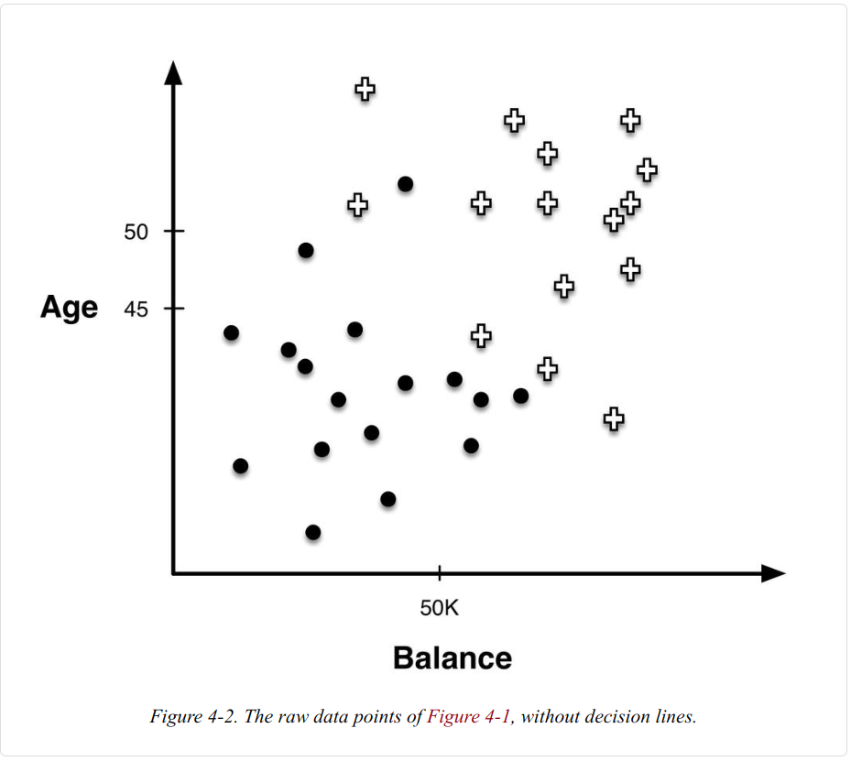
1-1 Linear Discriminant Functions
Entropy helps us to set up the boundaries that partition the instance space into similar regions. and the homogeneous regions helps to predict the target variable of a new, unseen instance by determining which segment it falls into.
however, there are other, possibly better, ways to partition the space.
This is called a linear classifier and is essentially a weighted sum of the values for the various attributes.
Notes:
We saw in Chapter 3 how to split the space into regions by boundaries that are perpendicular to the axes (Figure 4-2).
(use entropy to measure homogeneity and choose boundaries. We predict the target variable of a new instance by its region.)
另一種可能更好的方法:
But there are other, maybe better, ways to split the space.
For example, we can use a straight line that is not perpendicular to the axes (Figure 4-3) to separate the classes almost perfectly.
This is a linear classifier, which is a weighted sum of the attribute values.

Slide 6
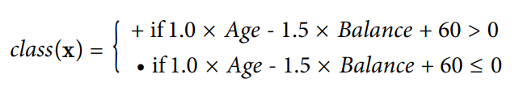
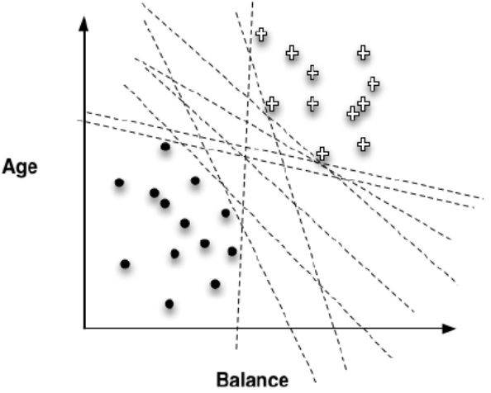
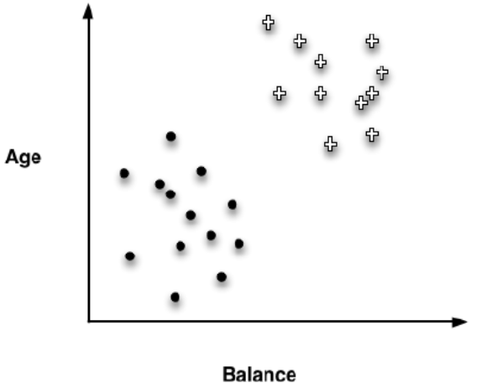


1-1 Linear Discriminant Functions
Can use format y=mx+b (m is the slope and b is the y intercept, when x=0) to describe the line as: Age=(-1.5)×Balance+60, then we can:
Get classification function :
and a general linear model
But there are many different possible linear boundaries can separate the two groups of points, How to find out the BEST ONE, the Optimal Fitting one?
Notes:
There are many different possible ‘linear boundaries’ can separate the two groups of points,
how to find out the BEST ONE, the Optimal Fitting one?
in the other words: how to Optimizing an Objective Function ?

Slide 7
1-2 Optimizing an Objective Function
What to optimize？
what should be our goal or objective in choosing the parameters?
what weights should we choose?
If choose by experience, to creating an objective function that matches the true goal of the data mining:
Several remarkably effective choices would be:
SVM - Support Vector Machine
Linear Models for Regression
Logistic Regression
Note that logistic regression is not actually used for traditional regression tasks.
Instead, logistic regression is utilized for estimating the probability of class membership in classification tasks, which makes it highly useful for many applications.
Notes:
Linear regression, logistic regression, and support vector machines are all very similarinstances of our basic fundamental technique: fitting a (linear) model to data.
The keydifference is that each uses a different objective function

Slide 8
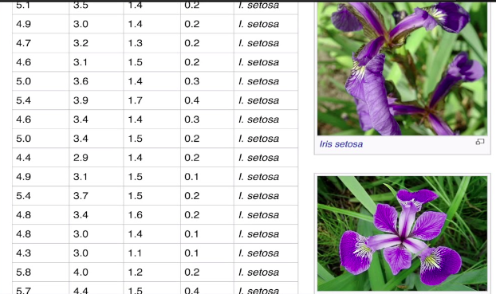
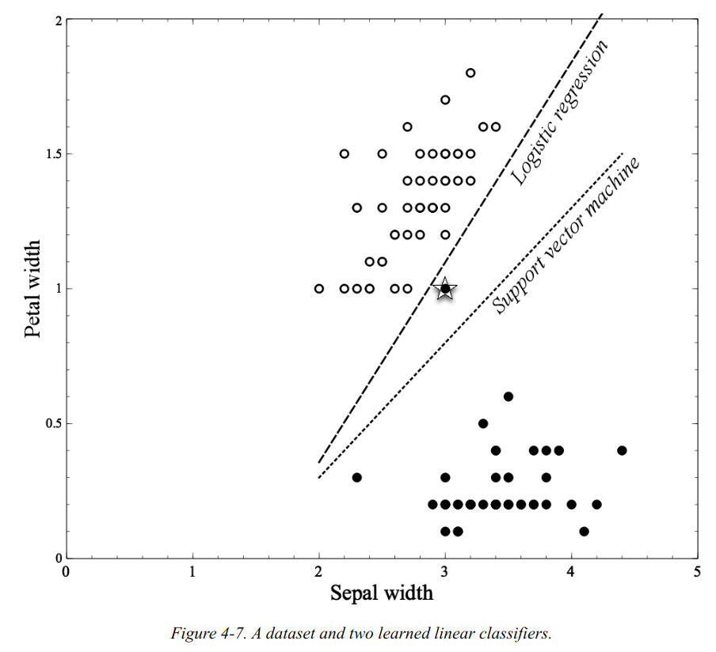
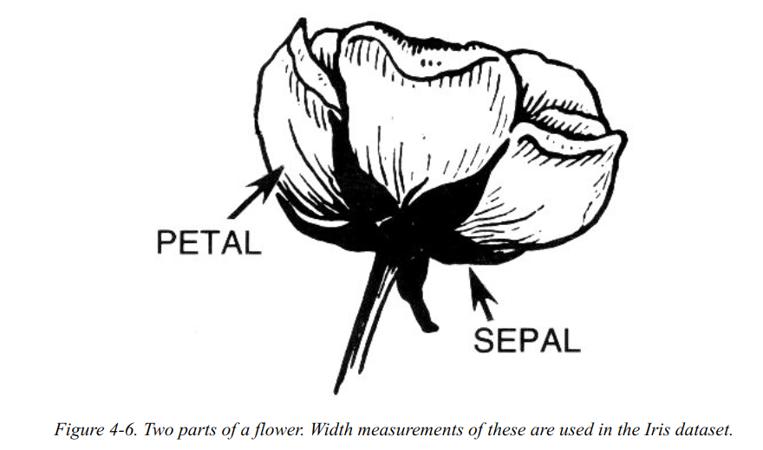
1-3 An Example of Mining a Linear Discriminant from Data
Problem: to classify each instance as belonging species based on the attributes.
- original Iris dataset includes 3 species x 4 attributes.
- here just use a simplified dataset, 2 species x 2 attributes.
- species: Setosa and Versicolor; attributes: Petal width and the Sepal width.
Which separator do you think is better?
Notes:
The famous Iris flower data set. Fisher developed a linear discriminant model to distinguish the species from each other.
The figure shows two lines separating data into clumps: one by logistic regression and another by a support vector machine (SVM).
Logistic regression fully separates the species, while SVM misclassifies one outlier.
These methods differ as they optimize different functions, which we'll explore in Chapter 5.

Slide 9
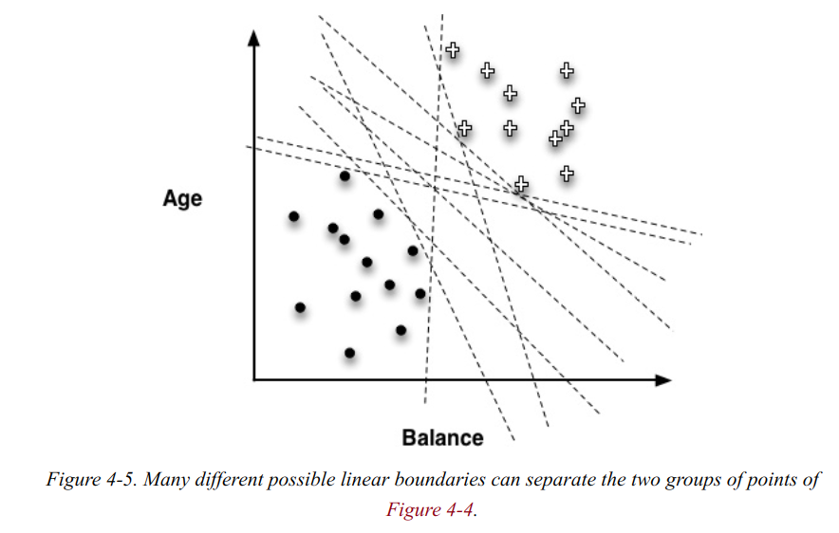

1-4 Linear Discriminant Functions for Scoring and Ranking Instances
Except TI we can do this with Linear Models as well.
If we want to know: which consumers are most likely to respond to this offer? or, Which customers are most likely to leave when their contracts expire? (Not just separated into "yes" or "no")
Where would we be most certain that x would not respond? Where would we be most uncertain?
to the decision boundary: far away=certain; near= uncertain.
f(x)=0 when x is sitting on the decision boundary.
f(x)=smaller when x is near the boundary
f(x)=larger when x is far from the boundary
'smaller-0-larger' > 'margin'
Notes:
Ranking a list by consumers' predicted likeli‐hood of responding positively to our offer, so that to find out the top of the list of the consumers.
It is good engough. Do not need a precise probability estimate.

Slide 10
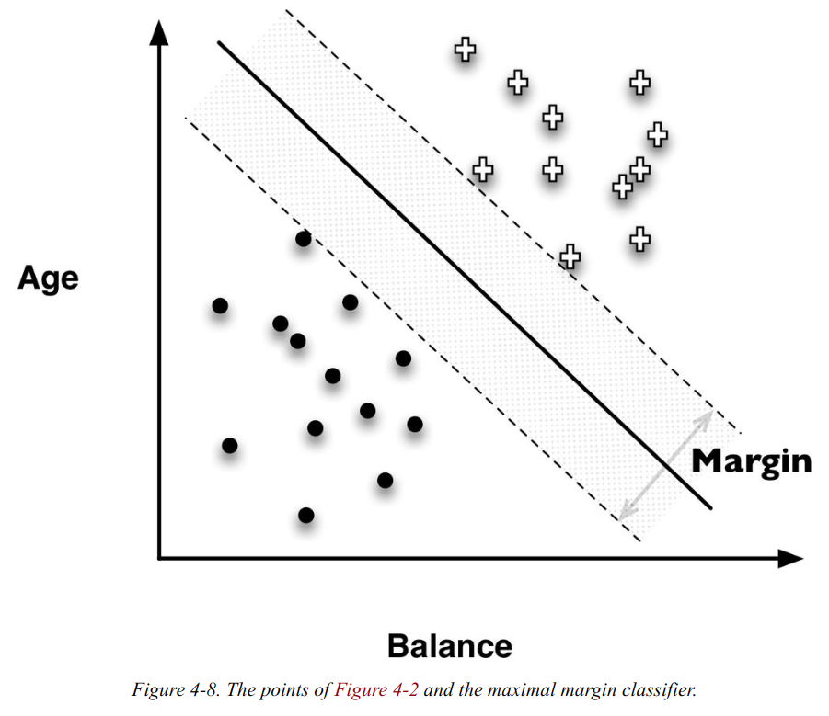
1-5 Support Vector Machines, Briefly
(SVM) support vector machines are linear discriminants
Within the infinitude of different possible linear discriminants that would separate the classes.
The asimple, elegant idea of SVMs is: fit the fattest bar between the classes.
A wider bar is better. And once the widest bar is found, the linear discriminant will be the center line through the bar.
The distance between the dashed parallel lines is called the margin around the linear discriminant, and thus the objective is to maximize.
Notes:
Ranking a list by consumers' predicted likeli‐hood of responding positively to our offer, so that to find out the top of the list of the consumers. It is good engough. Do not need a precise probability estimate.

Slide 11
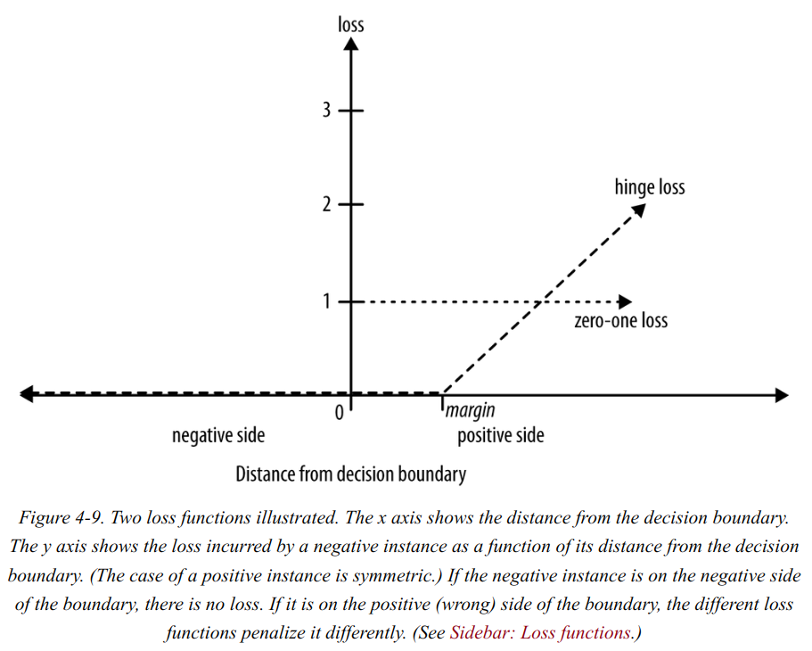
1-5 Support Vector Machines, Briefly
No perfect choice, only better choice, and try to optimize it.
The margin-maximizing boundary gives the maximal lee‐way for classifying such points.
In the objective function that measures how well a particular model fits the training points, we will simply penalize a training point for being on the wrong side of the decision boundary.
If the data are not linearly separable, the best fit is some balance between a fat margin and a low total error penalty.
SVM will make only “small” errors. Technically,this error function is known as hinge loss.
Notes:
Choosing a threshold that allows misclassification is an example of the Bias/Variance Tradeoff that plagues all of machine learning.
選擇允許錯誤分類的(閾)閥值是困擾所有機器學習的-偏差/方差-權衡的一個例子。

Slide 12
1-5 Support Vector Machines, Briefly
The Maxima margin classifiers are super sensitive to outliers in the training data and that makes them pretty lame. If we want to make it not so sensitive to outliers we must allows misclassifications.
Zero-one loss function: assigns a loss of zero for a correct decision and onefor an incorrect decision.
SVM use Hinge loss function: (because the loss graph looks like a hinge) Hinge loss incurs no penalty for an example that is not on the wrong side of the margin. The hinge loss only becomes positive when an example is on the wrong side of the boundary and beyond the margin.
Loss then increases linearly with the example’s distance from the margin, thereby penalizing points more the farther they are from the separating boundary.
As to Squared loss function, usually use for numeric value prediction (regression), rather than classification. Using squared error in classification wrongly penalizes correctly classified points far from the decision boundary, which often misaligns with business objectives, leading to alternatives like Hinge-Adjusted squared error.
Notes:
Choosing a threshold that allows misclassification is an example of the Bias/Variance Tradeoff that plagues all of machine learning.
選擇允許錯誤分類的(閾)閥值是困擾所有機器學習的-偏差/方差-權衡的一個例子。

Slide 13
2.Regression via Mathematical Functions
How far away are the estimated values from the true values on the training data?
In other words, how big is the error of the fitted model? Presumably we’d like to minimize this error.
Least Squares Regression: The most convenient and popular linear regression procedure.
Choosing an objective function like least squares regression, which is data-sensitive and skewed by outliers, may not suit automated systems or applications with limited data-cleaning resources. Instead, a robust method like absolute error may be preferred, always considering the business context.
Notes:
Linear regression, logistic regression, and support vector machines are all very similarinstances of our basic fundamental technique: fitting a (linear) model to data.
The keydifference is that each uses a different objective function

Slide 14
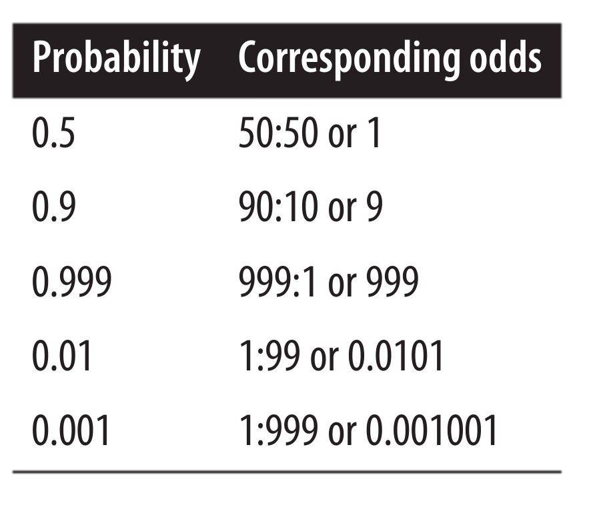
3.Class Probability Estimation and Logistic “Regression”
We often need to estimate the probability of an instance belonging to a class, factoring in decision-making elements like costs and benefits. In fraud detection used by banks, telecoms, and e-commerce, the goal is to focus on high-stakes cases, not just likely frauds, requiring actual fraud probability estimates.
If simply using our basic linear model to estimate the class probability.
The output of the linear function, f(x), gives the distance from the separating boundary, the f(x) will ranges from –∞ to ∞, however a probability should range from zero to one.
One very useful notion of the likelihood of an event is the odds. The odds of an eventis the ratio of the probability of the event occurring to the probability of the event notoccurring.

Slide 15
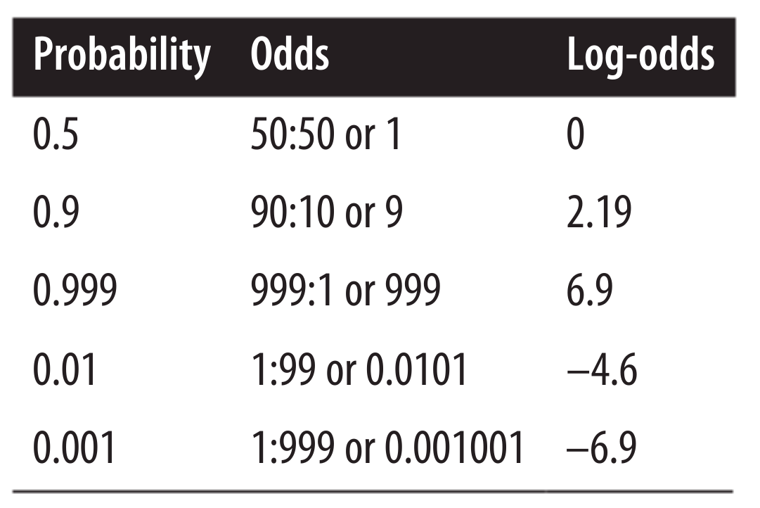
3.Class Probability Estimation and Logistic “Regression”
The distance from the boundary, ranging from –∞ to ∞, translates to odds ranging from 0 to ∞. By taking the log-odds, which span from –∞ to ∞, we align with the distance measures, as shown in [Table ->].
This isexactly a logistic regression model: the same linear function f(x) that we’ve examinedthroughout the chapter is used as a measure of the log-odds of the “event” of interest.
For probability estimation, logistic regression uses the same linear model as do ourlinear discriminants for classification and linear regression for estimating numerictarget values.
The output of the logistic regression model is interpreted as the log-odds of classmembership.
Log-odds from logistic regression directly indicate class membership probabilities, widely used to estimate default, response, fraud probabilities, and document relevance.

Slide 16
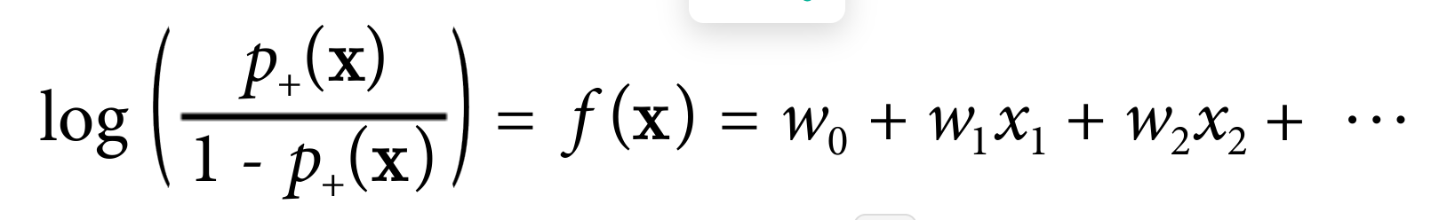
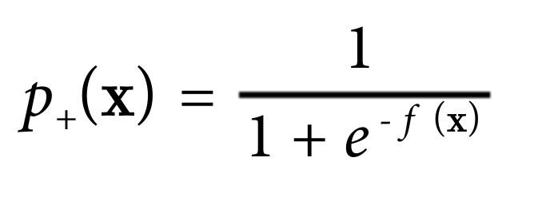
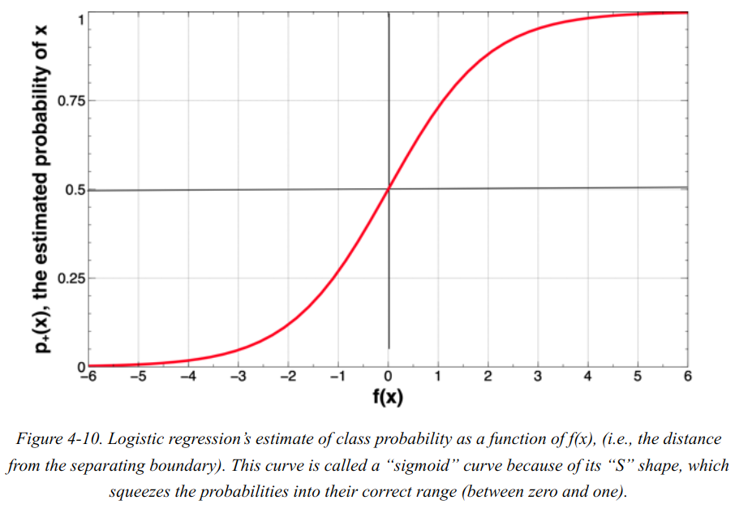
3.Class Probability Estimation and Logistic “Regression”
Thus, Equation (left-top) specifies that for a particular data item, described by feature-vector x, the log-odds of the class is equal to our linear function, f(x).
Since often we actually want the estimated probability of class membership, not the log-odds, we can solve p+(x) in Equation (left) This yields the quantity in Equation 4-4
Now we may use the f(x) and estimated probability to draw the plot (left).
This curve is called a “sigmoid” curve be‐cause of its “S” shape, which squeezes the probabilities into their correct range (between zero and one)
Notes:
Logistic regression addresses the issue of using a basic linear model for probability estimation, where the model's output, f(x), indicates distance from the decision boundary but ranges from –∞ to ∞, unlike a probability which should be between zero and one.

Slide 17
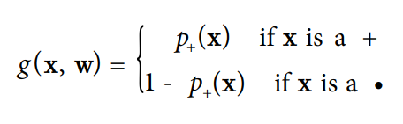
3. * Logistic Regression: Some Technical Details
The figure shows that at thedecision boundary (at distance x = 0), the probability is 0.5 (a coin toss). The probabilityvaries approximately linearly near to the decision boundary, but then approaches certainty farther away. Part of the “fitting” of the model to the data includes determining the slope of the almost-linear part, and thereby how quickly we are certain of the classas we move away from the boundary.
What is the objective function we use to fit the logistic regression model to the data?
The g function gives the model’s estimated probability of seeing x’s actual class given x’s features.
The model (set of weights) that gives the highest sum is the model that gives the highest “likelihood” to the data—the “maximum likeli‐hood” model. The maximum likelihood model “on average” gives the highest probabilities to the positive examples.
Notes:
Linen

Slide 18
4.Example: Logistic Regression versus Tree Induction
Two important differences between classification trees and linear classifiers.
1. A classification tree's boundaries are axis-perpendicular, as it selects one attribute at a time, unlike linear classifiers that use all attributes, allowing boundaries in any direction.
2. A classification tree recursively segments the instance space finely using divide-and-conquer, while a linear classifier uses one decision surface for a single, two-segment division, due to its single equation utilizing all variables.
Determining which characteristics best fit a dataset is challenging without knowing the optimal decision boundary, leading to practical implications from these differences.
In business, model comprehensibility varies among stakeholders; logistic regression is clear to statisticians but not to others, while a modest-sized decision tree is more universally understandable.
Notes:
A decision tree, if it is not too large, may be considerably more understandable to someone without a strong statistics or mathematics background.

Slide 19
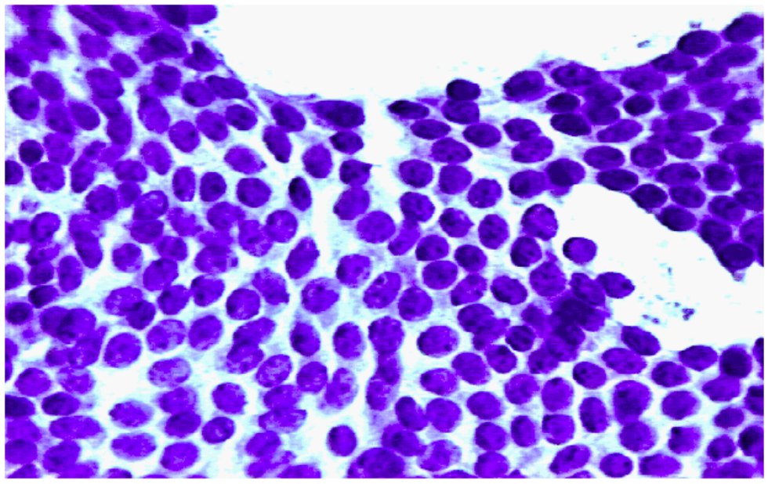
4.Example: Logistic Regression versus Tree Induction
The Wisconsin Breast Cancer Dataset, this is popular dataset from the the machine learning dataset repository at the University of California at Irvine.
Each example describes characteristics of a cell nuclei image, which has been labeled as either benign or malignant (cancerous), based on an expert’s diagnosis of the cells. A sample cell image is shown in left Figure.
Notes:
A decision tree, if it is not too large, may be considerably more understandable to someone without a strong statistics or mathematics background.

Slide 20
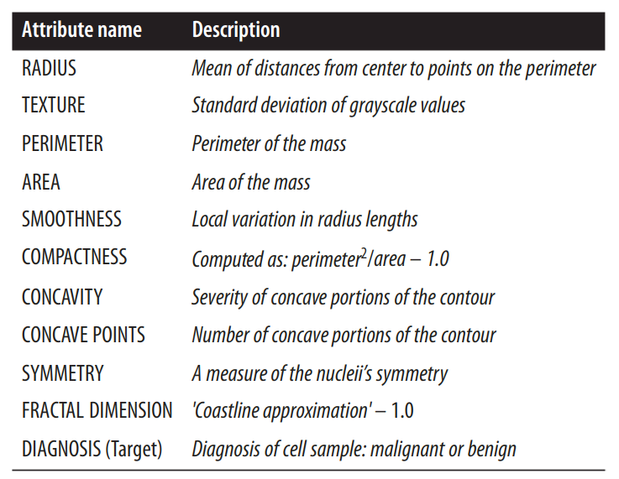
4.Example: Logistic Regression versus Tree Induction
These were “computed from a digitized image of a fine needle aspirate (FNA) of a breastmass. They describe characteristics of the cell nuclei present in the image.”
From eachof these basic characteristics, three values were computed: the mean (_mean), standard error (_SE), and “worst” or largest (mean of the three largest values, _worst).
This resulted in 30 measured attributes in the dataset.
There are 357 benign images and 212 malignant images.
Notes:
A decision tree, if it is not too large, may be considerably more understandable to someone without a strong statistics or mathematics background.

Slide 21
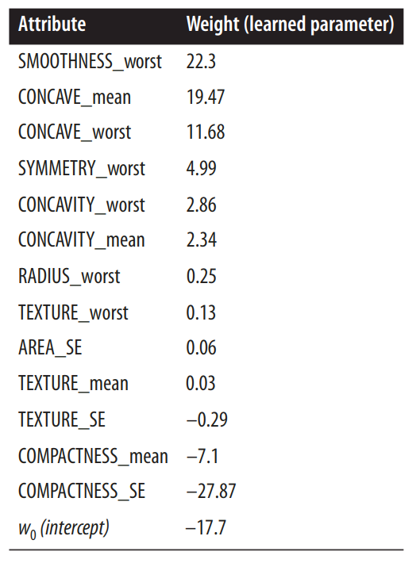
4.Example: Logistic Regression versus Tree Induction
left-Table shows the linear model learned by logistic regression to predict benign versus malignant for this dataset. Specifically, it shows the nonzero weights ordered from highest to lowest.
The model achieves 98.9% accuracy with six errors, while a 25-node classification tree reaches 99.1% accuracy, slightly outperforming logistic regression.
Notes:
A decision tree, if it is not too large, may be considerably more understandable to someone without a strong statistics or mathematics background.

Slide 22
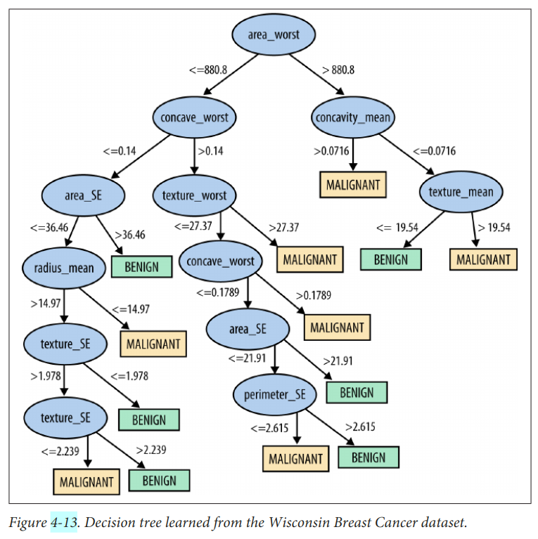
4.Example: Logistic Regression versus Tree Induction
Evaluating classifiers can be tricky, and although the tree is slightly more accurate, the difference is minimal, based on one less error in 569 examples.
How confident should we be in this evaluation?
The later content will discuss guidelines and pitfalls of model evaluation.
Notes:
A decision tree, if it is not too large, may be considerably more understandable to someone without a strong statistics or mathematics background.

Slide 23
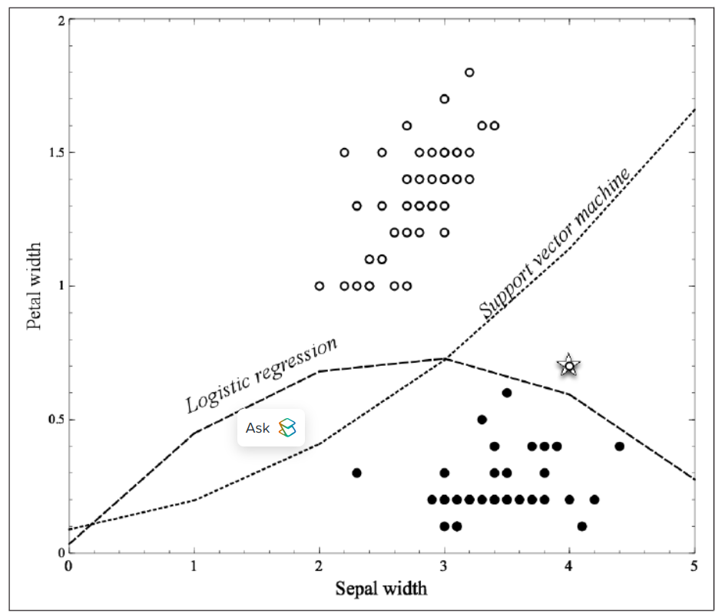
5.Nonlinear Functions, Support Vector Machines, and Neural Networks
The Iris dataset with a nonlinear feature. In this figure, logistic regressionand support vector machine—both linear models—are provided an additional feature,Sepal width^2, which allows both the freedom to create more complex, nonlinear models (boundaries), as shown.
The core idea extends beyond fitting linear functions, allowing for complex numeric functions like nonlinear support-vector machines and neural networks, where parameters are fitted to data.
Nonlinear support vector machines use a kernel function to map features into a new space, where a linear model is fit, similar to adding complex terms in our example. This includes polynomial kernels for higher-order feature combinations, with data scientists exploring various kernel options.
Notes:
L

Slide 24
5.Nonlinear Functions, Support Vector Machines, and Neural Networks
Neural networks, based on this chapter's concepts, are like model "stacks." The bottom layer uses original features for simple models, like logistic regressions, and each layer above applies a model to the previous layer's outputs. In a two-layer network, the second layer's logistic regression uses the first layer's outputs, akin to weighing opinions from "experts" on the problem.
Neural networks learn lower-layer logistic regressions, or "experts," without specific targets, unlike stacked models. They're trained as part of a big function whose parameters are optimized to fit the training data. This process simultaneously determines the best "experts" and how to combine them.
Increasing a model's flexibility to fit data can lead to overfitting, where it captures noise rather than general patterns applicable to new data. This concern, critical in data science, applies broadly, not just to neural networks, and is the focus of the next chapter.
Increasing a model's flexibility to fit data can lead to overfitting, where it captures noise rather than general patterns applicable to new data. This concern, critical in data science, applies broadly, not just to neural networks.
Notes:
L

Slide 25
6.Summary
This chapter presents function fitting or parametric modeling, where models are equations with undefined parameters, and data mining finds the "best" parameter set.
Function fitting techniques often use a linear model, weighting attribute values. The difference between techniques like SVMs, logistic regression, and linear regression lies in their definition of 'best fit', determined by varying objective functions, leading to distinct methods.
We've explored tree induction and function fitting and compared them, assessing models on predictive performance and intelligibility. Building various models from data is beneficial for insight.
If you look hard enough, you will find structure in a dataset, even if it’s just there bychance.
This chapter discusses optimizing model fit to data, which can result in overfitting—finding patterns by chance. The next chapter is dedicated to recognizing and avoiding overfitting, a key issue in data science.

Slide 26
What I learned:
• Linear regression is a technique that tries to find the best linear relationship between a dependent variable and one or more independent variables.
• Logistic regression is a technique that tries to find the best logistic function that can separate the data into two or more classes.
• Support vector machines are a technique that tries to find the best hyperplane or curve that can separate the data into two or more classes with the maximum margin.
• Neural networks are a technique that are modeled after the human brain, and consist of a network of interconnected nodes, or neurons, that can learn from data and make predictions.
Notes:
Data mining is the process of discovering patterns and insights from large and complex datasets. Linear regression, logistic regression, support vector machines, and neural networks are techniques that can be used for data mining.
Here we can make a brief description of each technique:
• Linear regression: can be used for predicting a continuous outcome, such as the price of a house, based on some features, such as the size, location, and condition of the house.
• Logistic regression: can be used for predicting a categorical outcome, such as whether a customer will buy a product or not, based on some features, such as the age, gender, and income of the customer.
• Support vector machines: can be used for solving complex and non-linear classification problems, such as image recognition, text analysis, and cancer detection.
• Neural networks: can be used for various data mining tasks, such as classification, regression, clustering, association, and anomaly detection .

