Slide 1
Chapter 01
Introduction
Dr. Chin-Hui Lai
Department of Information Management, CYCU
Email: chlai@cycu.edu.tw

Slide 2
Outline
Motivation: Why Data Mining?
What Is Data Mining?
A Multi-Dimensional View of Data Mining
Data Mining: What Kind of Data Can Be Mined?
Data Mining functionality: What Kinds of Patterns Can Be Mined?
What Technology Are Used?
What Kind of Applications Are Targeted?
Major Issues in Data Mining

Slide 3
Why Data Mining?
The Explosive Growth of Data: terabytes to yottabytes
  Data collection and data availability
    Automated data collection tools, database systems, Web, computerized society
  Major sources of abundant data
    Business: Web, e-commerce, transactions, stocks, …
    Science: Remote sensing, bioinformatics, scientific simulation, …
    Society and everyone: news, digital cameras, YouTube
We are drowning in data, but starving for knowledge!
“Necessity is the mother of invention”—Data mining—Automated analysis of massive data sets

Slide 4
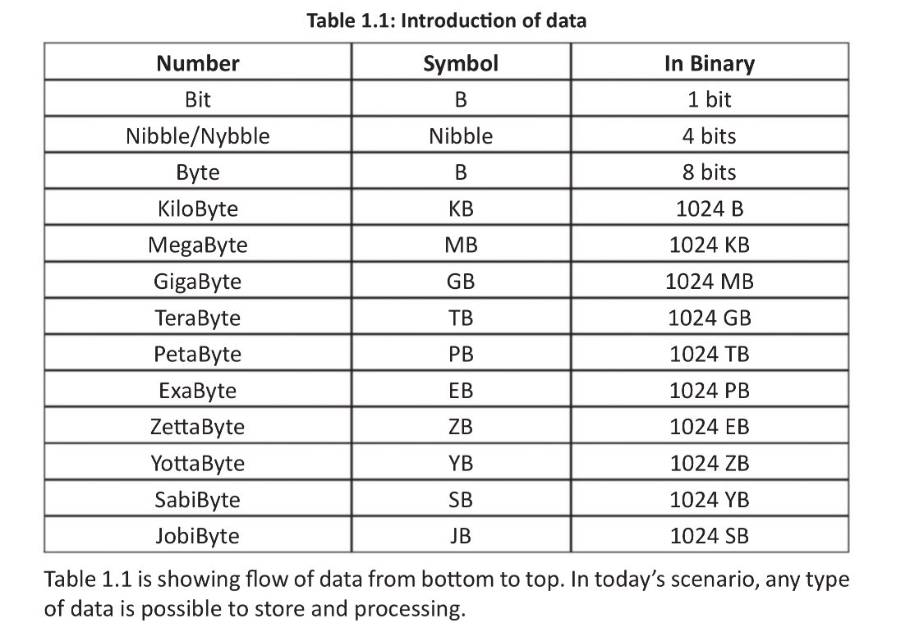
Data Volume Units

Slide 5
Evolution of Database Technology
1960s:
  Data collection, database creation, IMS and network DBMS
1970s:
  Relational data model, relational DBMS implementation
1980s:
  RDBMS, advanced data models (extended-relational, OO, deductive, etc.)
  Application-oriented DBMS (spatial, scientific, engineering, etc.)
1990s:
  Data mining, data warehousing, multimedia databases, and Web databases
2000s
  Stream data management and mining
  Data mining and its applications
  Web technology (XML, data integration) and global information systems
Notes:
Two slides should be added after this one
1. Evolution of machine learning
2. Evolution of statistics methods

Slide 6
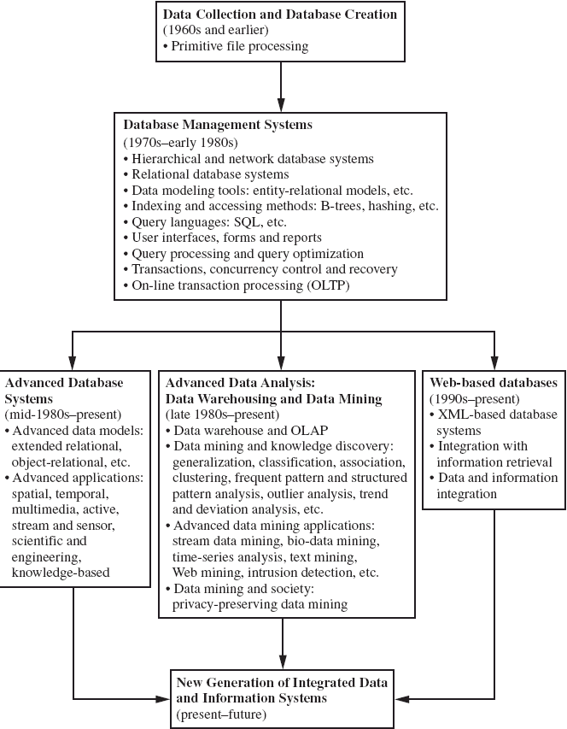

Slide 7
What Is Data Mining?
Data mining (knowledge discovery from data)
  Extraction of interesting (non-trivial, implicit, previously unknown and potentially useful) patterns or knowledge from huge amount of data
Alternative names
  Knowledge discovery (mining) in databases (KDD), knowledge extraction, data/pattern analysis, data archeology, data dredging, information harvesting, business intelligence, etc.
Watch out: Is everything “data mining”?
  Simple search and query processing
  (Deductive) expert systems

Slide 8
Potential Applications
Data analysis and decision support
  Market analysis and management
    Target marketing, customer relationship management (CRM), market basket analysis, cross selling, market segmentation
  Risk analysis and management
    Forecasting, customer retention, improved underwriting, quality control, competitive analysis
  Fraud detection and detection of unusual patterns (outliers)
Other Applications
  Text mining (news group, email, documents) and Web mining
  Stream data mining
  Bioinformatics and bio-data analysis

Slide 9
Ex.: Market Analysis and Management (1/2)
Where does the data come from?—Credit card transactions, loyalty cards, discount coupons, customer complaint calls, surveys …
Target marketing
  Find clusters of “model” customers who share the same characteristics: interest, income level, spending habits, etc.,
    E.g. Most customers with income level 60k – 80k with food expenses $600 - $800 a month live in that area
  Determine customer purchasing patterns over time
    E.g. Customers who are between 20 and 29 years old, with income of 20k – 29k usually buy this type of CD player
Cross-market analysis—Find associations/co-relations between product sales, & predict based on such association
  E.g. Customers who buy computer A usually buy software B

Slide 10
Ex.: Market Analysis and Management (2/2)
Customer requirement analysis
  Identify the best products for different customers
  Predict what factors will attract new customers
Provision of summary information
  Multidimensional summary reports
    E.g. Summarize all transactions of the first quarter from three different branches
    Summarize all transactions of last year from a particular branch
    Summarize all transactions of a particular product
  Statistical summary information
    E.g. What is the average age for customers who buy product A?
Fraud detection
  Find outliers of unusual transactions
Financial planning
  Summarize and compare the resources and spending

Slide 11
Knowledge Discovery (KDD) Process
Knowledge
This is a view from typical database systems and data warehousing communities
Data mining plays an essential role in the knowledge discovery process
Pattern Evaluation
Data Mining
Task-relevant Data
Data Warehouse
Selection
Data Cleaning
Data Integration
Databases
Notes:
Data cleaning (to remove noise and inconsistent data)
Data integration (where multiple data sources may be combined)
Data selection (where data relevant to the analysis task are retrieved from the database)
Data transformation (where data are transformed and consolidated into forms appropriate for mining by performing summary or aggregation operations)
Data mining (an essential process where intelligent methods are applied to extract data patterns)
Pattern evaluation (to identify the truly interesting patterns representing knowledge based on interestingness measures—see Section 1.4.6)
Knowledge presentation (where visualization and knowledge representation techniques are used to present mined knowledge to users)

Slide 12
KDD Process: Several Key Steps
Learning the application domain
  relevant prior knowledge and goals of application
Identifying a target data set: data selection
Data processing
  Data cleaning (remove noise and inconsistent data)
  Data integration (multiple data sources maybe combined)
  Data selection (data relevant to the analysis task are retrieved from database)
  Data transformation (data transformed or consolidated into forms appropriate for mining)
  (Done with data preprocessing)
  Data mining (an essential process where intelligent methods are applied to extract
  data patterns)
  Pattern evaluation (indentify the truly interesting patterns)
  Knowledge presentation (mined knowledge is presented to the user with
  visualization or representation techniques)
Use of discovered knowledge

Slide 13
KDD Process: A Typical View from ML and Statistics
Pattern
Information
Knowledge
Input Data
Data Pre-Processing
Data Mining
Post-Processing
Data integration
Normalization
Feature selection
Dimension reduction
Pattern discovery
Association & correlation
Classification
Clustering
Outlier analysis
… … … …
Pattern evaluation
Pattern selection
Pattern interpretation
Pattern visualization
This is a view from typical machine learning and statistics communities

Slide 14
Example: Medical Data Mining
Health care & medical data mining – often adopted such a view in statistics and machine learning
Preprocessing of the data (including feature extraction and dimension reduction)
Classification or/and clustering processes
Post-processing for presentation

Slide 15
Data Mining in Business Intelligence
Increasing potential
to support
business decisions
End User
Decision Making
Data Presentation
Business
Analyst
Visualization Techniques
Data Mining
Data
Analyst
Information Discovery
Data Exploration
Statistical Summary, Querying, and Reporting
Data Preprocessing/Integration, Data Warehouses
Data Sources
DBA
Paper, Files, Web documents, Scientific experiments, Database Systems

Slide 16
A typical DM System Architecture (1/2)
Database, data warehouse, WWW or other information
repository (store data)
Database or data warehouse server (fetch and
combine data)
Knowledge base (turn data into meaningful groups
according to domain knowledge)
Data mining engine (perform mining tasks)
Pattern evaluation module (find interesting patterns)
User interface (interact with the user)

Slide 17
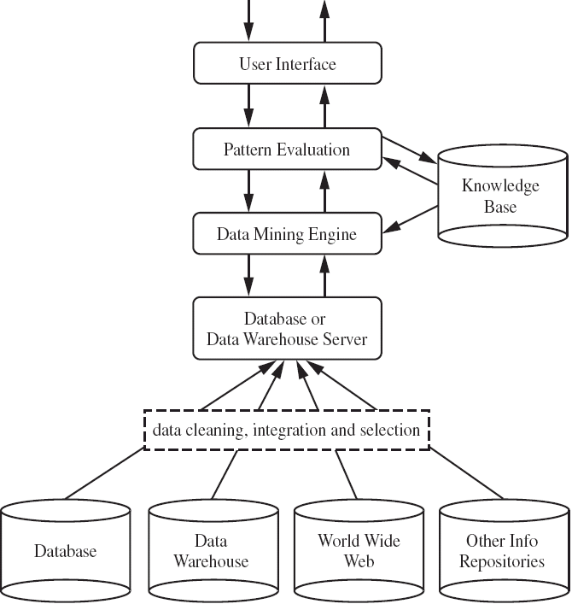
A typical DM System Architecture (2/2)

Slide 18
Multi-Dimensional View of Data Mining (1/2)
Data to be mined
  Database data (extended-relational, object-oriented, heterogeneous, legacy)
  Data warehouse
  Transactional data
  Stream
  Spatiotemporal
  Time-series, sequence
  Text and web, multi-media
  Graphs & social and information networks
Knowledge to be mined (or: Data mining functions)
  Characterization, discrimination, association, classification, clustering, trend/deviation, outlier analysis, etc.
  Descriptive vs. predictive data mining
  Multiple/integrated functions and mining at multiple levels

Slide 19
Multi-Dimensional View of Data Mining (2/2)
Techniques utilized
  Data warehouse (OLAP)
  Machine learning
  Statistics
  Pattern recognition
  Visualization … etc.
Applications adapted
  Retail, telecommunication, banking, fraud analysis, bio-data mining, stock market analysis, text mining, Web mining, etc.

Slide 20
Data Mining: On What Kinds of Data?
Database-oriented data sets and applications
  Relational database, data warehouse, transactional database
Advanced data sets and advanced applications
  Data streams and sensor data
  Time-series data, temporal data, sequence data (incl. bio-sequences)
  Structure data, graphs, social networks and multi-linked data
  Object-relational databases
  Heterogeneous databases and legacy databases
  Spatial data and spatiotemporal data
  Multimedia database
  Text databases
  The World-Wide Web
Notes:
DBMS example: Microsoft SQL server, MySQL, Access …

Slide 21
Relational Databases (1/3)
DBMS – database management system, contains a collection of interrelated databases
  e.g. Faculty database, student database, publications database
Each database contains a collection of tables and functions to manage and access the data.
  e.g. student_bio, student_graduation, student_parking
Each table contains columns and rows, with columns as attributes of data and rows as records.
Tables can be used to represent the relationships between or among multiple tables.

Slide 22
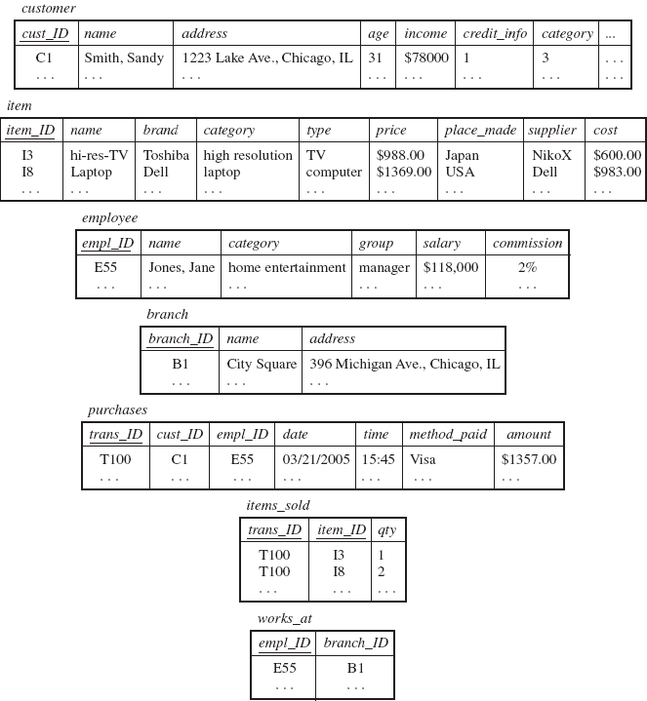
Relational Databases (2/3) – AllElectronics store

Slide 23
Relational Databases (3/3)
With a relational query language, e.g. SQL, we will be able to find answers to questions such as:
  How many items were sold last year?
  Who has earned commissions higher than 10%?
  What is the total sales of last month for Dell laptops?
When data mining is applied to relational databases, we can search for trends or data patterns.
Relational databases are one of the most commonly available and rich information repositories, and thus are a major data form in our study.
Notes:
SQL: structured query language

Slide 24
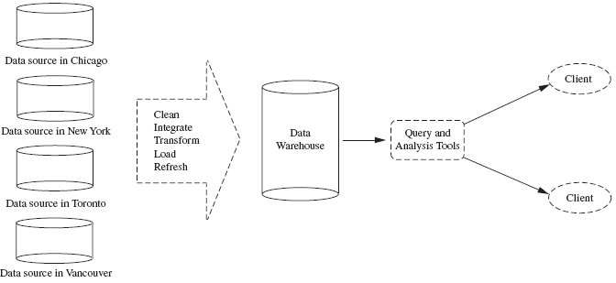
Data Warehouses (1/3)
A repository of information collected from multiple sources, stored under a unified schema, and that usually resides at a single site.
Constructed via a process of data cleaning, data integration, data transformation, data loading and periodic data refreshing.

Slide 25
Data Warehouses (2/3)
Data are organized around major subjects
  e.g. customer, item, supplier and activity.
Provide information from a historical perspective (e.g. from the past 5 – 10 years)
Typically summarized to a higher level (e.g. a summary of the transactions per item type for each store)
User can perform drill-down or roll-up operation to view the data at different degrees of summarization

Slide 26
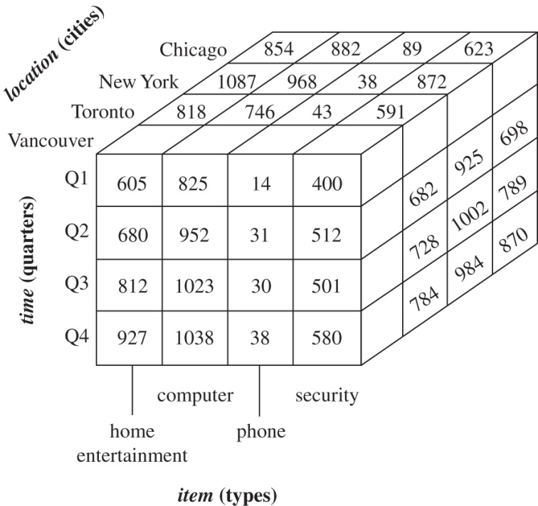
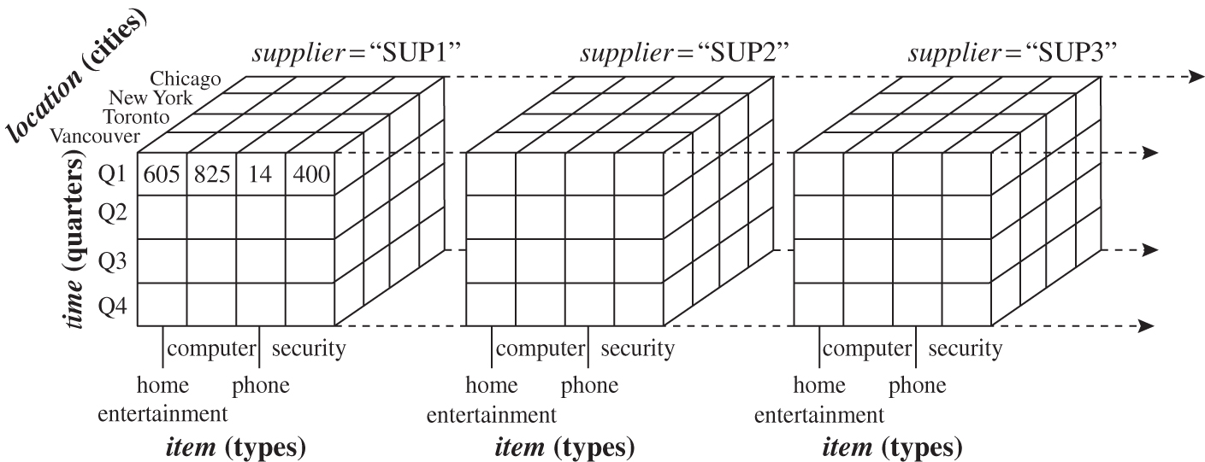
Data Warehouses (3/3)
Data cube
3D data cube
4D data cube

Slide 27
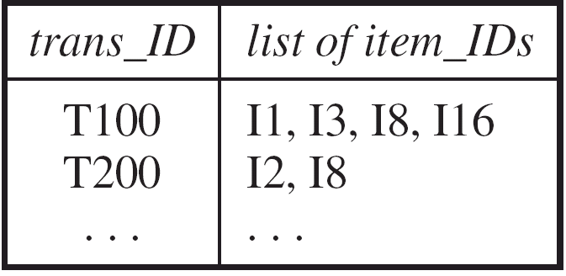
Transactional Databases
Consists of a file where each record represents a transaction
A transaction typically includes a unique transaction ID and a list of the items making up the transaction.
Either stored in a flat file or unfolded into relational tables
Easy to identify items that are frequently sold together

Slide 28
Data Mining Function: (1) Generalization
Information integration and data warehouse construction
  Data cleaning, transformation, integration, and multidimensional data model
Data cube technology
  Scalable methods for computing (i.e., materializing) multidimensional aggregates
  OLAP (online analytical processing)
Multidimensional concept description: Characterization and discrimination
  Generalize, summarize, and contrast data characteristics, e.g., dry vs. wet region
Notes:
Concept Description (or Class Description): 將一群資料，利用匯總的、簡潔的、精確的方式描述成不同的類別 (Class)或概念 (Concept)。
These descriptions can be derived via:
Data characterization (資料特性描述): Summarization of the general characteristics or features of a target class of data.
Data discrimination (資料區分): Comparison of the general features of target class data objects with the general features of objects from one or a set of contrasting classes.
Both data characterization and discrimination

Slide 29
Data Mining Function: (1) Generalization
Characterization
  Summarization of the general characteristics or features of a target class of data.
  Example: The features of customers who spend more than $1,000 (large customers) are extracted from the database
    Age in 40 - 50
    Have a job
    Good credit rating
The output of data characterization can be presented in various forms:
  Pie charts
  Bar charts
  Curve …

Slide 30
Data Mining Function: (1) Generalization
Discrimination
  Comparing the target class with one or a set of comparative classes
  Example: A comparison should be made in the database between all customers who regularly (more than 2 times per month) purchase computer products and those who occasionally (less than 3 times per year) purchase such products
  Features
    80% of frequent buyers are between 20 - 40 years old and have a college education
    60% of occasional purchasers are too old or too young and have no college education

Slide 31
Data Mining Function: (2) Association and Correlation Analysis
Frequent itemset (or Frequent patterns)
  A set of items that frequently appear together in a transactional data set (e.g. milk and bread)
Frequent subsequence
  A pattern that customers tend to purchase product A, followed by a purchase of product B
Association Analysis: find frequent patterns
  E.g. a sample analysis result – an association rule:
  buys(X, “computer”) => buys(X, “software”) [support = 1%, confidence = 50%]
  (if a customer buys a computer, there is a 50% chance that she will buy software. 1% of all of the transactions under analysis showed that computer and software are purchased together. )
  Associations rules are discarded as uninteresting if they do not satisfy both a minimum support threshold and a minimum confidence threshold.
Correlation Analysis: additional analysis to find statistical correlations between associated pairs

Slide 32
Data Mining Function: (3) Classification
Classification and label prediction
  Construct models (functions) based on some training examples
  Describe and distinguish classes or concepts for future prediction
    E.g., classify countries based on (climate), or classify cars based on (gas mileage)
  Predict some unknown class labels
  The model can be represented in classification (IF-THEN) rules, decision trees, neural networks, etc.
Typical methods
  Decision trees, naïve Bayesian classification, support vector machines, neural networks, rule-based classification, pattern-based classification, logistic regression, …
Typical applications:
  Credit card fraud detection, direct marketing, classifying stars, diseases, web-pages, …

Slide 33
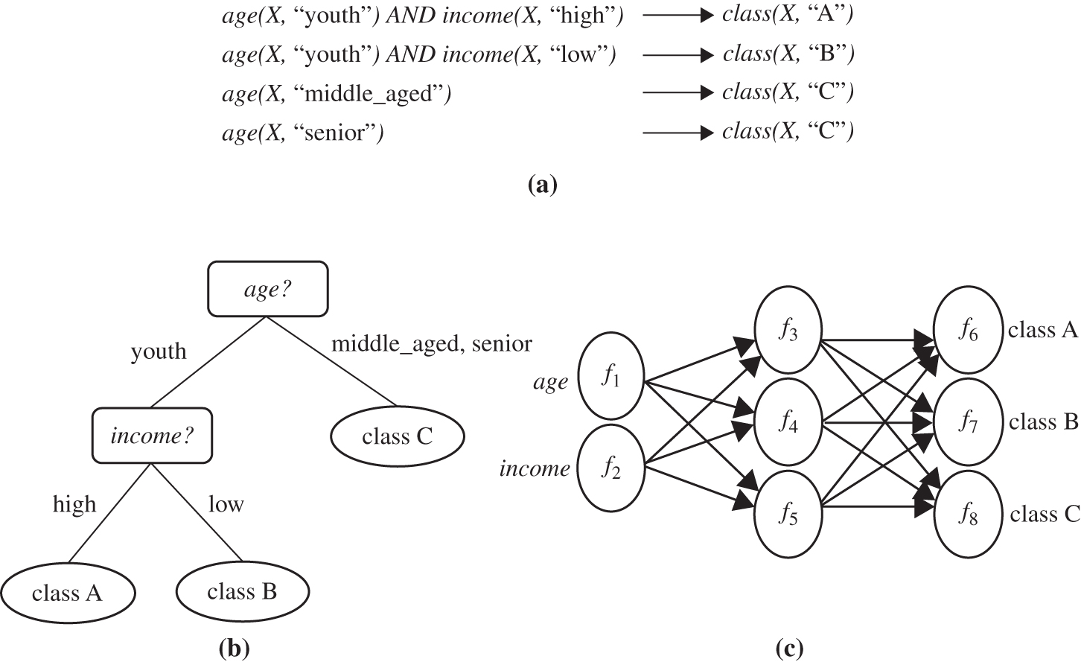
Predictive analysis
Figure 1.9 A classification model can be represented in various forms: (a) IF-THEN rules, (b) a decision tree, or (c) a neural network.

Slide 34
Data Mining Function: (4) Cluster Analysis
Unsupervised learning (i.e., Class label is unknown)
Group data to form new categories (i.e., clusters), e.g., cluster houses to find distribution patterns
Principle: Maximizing intra-class similarity & minimizing interclass similarity
Many methods and applications

Slide 35
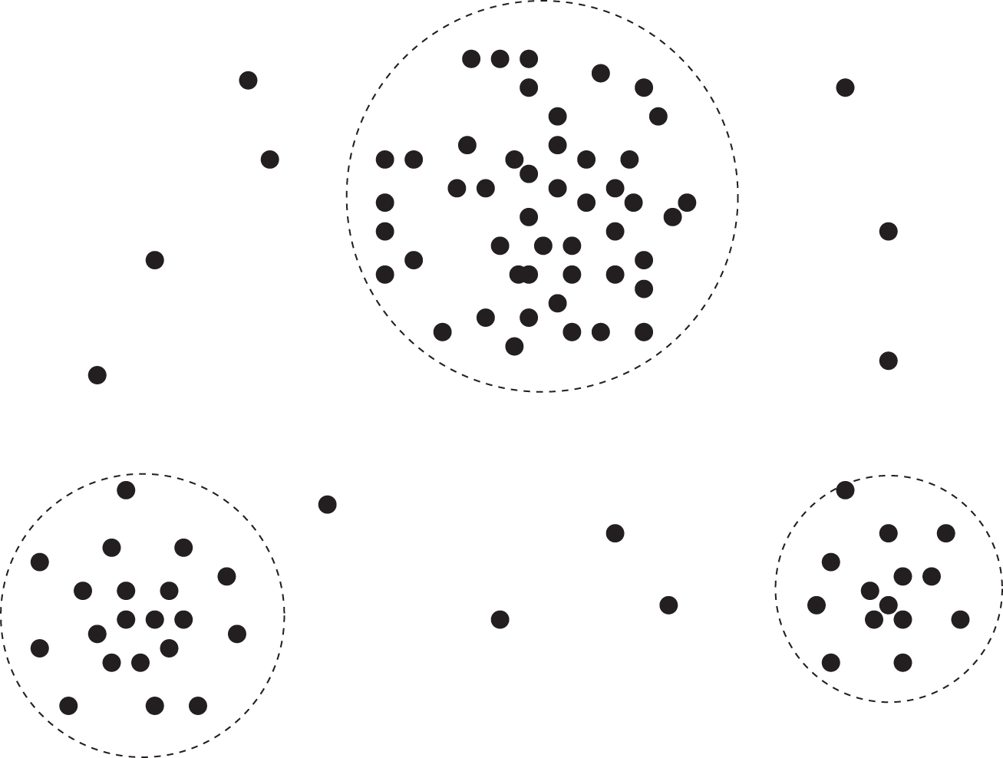
Example of cluster analysis
Figure 1.10 A 2-D plot of customer data with respect to customer locations in a city, showing three data clusters.

Slide 36
Data Mining Function: (5) Outlier Analysis
Outlier analysis
  Outlier: A data object that does not comply with the general behavior of the data
  Outliers are usually discarded as noise or exceptions.
  Methods: by product of clustering or regression analysis, …
  Useful in fraud detection, rare events analysis

Slide 37
Time and Ordering: Sequential Pattern, Trend and Evolution Analysis
Sequence, trend and evolution analysis
  Trend, time-series, and deviation analysis: e.g., regression and value prediction
  Sequential pattern mining
    e.g., first buy digital camera, then buy large SD memory cards
  Periodicity analysis
  Motifs and biological sequence analysis
    Approximate and consecutive motifs
  Similarity-based analysis
Mining data streams
  Ordered, time-varying, potentially infinite, data streams

Slide 38
Structure and Network Analysis
Graph mining
  Finding frequent subgraphs (e.g., chemical compounds), trees (XML), substructures (web fragments)
Information network analysis
  Social networks: actors (objects, nodes) and relationships (edges)
    e.g., author networks in CS, terrorist networks
  Multiple heterogeneous networks
    A person could be multiple information networks: friends, family, classmates, …
  Links carry a lot of semantic information: Link mining
Web mining
  Web is a big information network: from PageRank to Google
  Analysis of Web information networks
    Web community discovery, opinion mining, usage mining, …

Slide 39
Are All of the Patterns Interesting? (1/3)
Are all mined knowledge interesting?
  One can mine tremendous amount of “patterns” and knowledge
  Some may fit only certain dimension space (time, location, …)
  Some may not be representative, may be transient, …
Interesting patterns = knowledge
  Easily understand by humans
  Valid on new or test data with some degree of certainty
  Potentially useful
  Novel

Slide 40
Are All of the Patterns Interesting? (2/3)
Objective measures
  Based on statistics and structures of patterns, e.g., support, confidence, etc. (Rules that do not satisfy a threshold are considered uninteresting.)
Subjective measures
  Reflect the needs and interests of a particular user.
    e.g. A marketing manager is only interested in characteristics of customers who shop frequently.
  Based on user’s belief in the data.
    e.g., Patterns are interesting if they are unexpected, or can be used for strategic planning, etc.
Objective and subjective measures need to be combined.

Slide 41
Are All of the Patterns Interesting? (3/3)
Find all the interesting patterns: Completeness
  Unrealistic and inefficient
  User-provided constraints and interestingness measures should be used
Search for only interesting patterns: An optimization problem
  Highly desirable
  No need to search through the generated patterns to identify truly interesting ones.
  Measures can be used to rank the discovered patterns according their interestingness.

Slide 42
Data Mining: Confluence of Multiple Disciplines
Machine
Learning
Pattern
Recognition
Statistics
Applications
Data Mining
Visualization
Algorithms
Database
Technology
High-Performance
Computing

Slide 43
Why Confluence of Multiple Disciplines?
Tremendous amount of data
  Algorithms must be highly scalable to handle such as tera-bytes of data
High-dimensionality of data
  Micro-array may have tens of thousands of dimensions
High complexity of data
  Data streams and sensor data
  Time-series data, temporal data, sequence data
  Structure data, graphs, social networks and multi-linked data
  Heterogeneous databases and legacy databases
  Spatial, spatiotemporal, multimedia, text and Web data
  Software programs, scientific simulations
New and sophisticated applications
Notes:
Add a definition/description of “traditional data analysis”.

Slide 44
Applications of Data Mining
Web page analysis: from web page classification, clustering to PageRank & HITS algorithms
Collaborative analysis & recommender systems
Basket data analysis to targeted marketing
Biological and medical data analysis: classification, cluster analysis (microarray data analysis), biological sequence analysis, biological network analysis
Data mining and software engineering (e.g., IEEE Computer, Aug. 2009 issue)
From major dedicated data mining systems/tools (e.g., SAS, MS SQL-Server Analysis Manager, Oracle Data Mining Tools) to invisible data mining

Slide 45
Major Issues in Data Mining
Mining methodology and User interaction
  Mining different kinds of knowledge
    DM should cover a wide spectrum of data analysis and knowledge discovery tasks
    Enable to use the database in different ways
    Require the development of numerous data mining techniques
  Interactive mining of knowledge at multiple levels of abstraction
    Difficult to know exactly what will be discovered
    Allow users to focus the search, refine data mining requests
  Incorporation of background knowledge
    Guide the discovery process
    Allow discovered patterns to be expressed in concise terms and different levels of abstraction
  Data mining query languages and ad hoc data mining
    High-level query languages need to be developed
    Should be integrated with a DB/DW query language

Slide 46
Major Issues in Data Mining
Presentation and visualization of results
  Knowledge should be easily understood and directly usable
  High level languages, visual representations or other expressive forms
  Require the DM system to adopt the above techniques
Handling noisy or incomplete data
  Require data cleaning methods and data analysis methods that can handle noise
Pattern evaluation – the interestingness problem
  How to develop techniques to access the interestingness of discovered patterns, especially with subjective measures bases on user beliefs or expectations

Slide 47
Major Issues in Data Mining
Performance Issues
  Efficiency and scalability
    Huge amount of data
    Running time must be predictable and acceptable
  Parallel, distributed and incremental mining algorithms
    Divide the data into partitions and processed in parallel
    Incorporate database updates without having to mine the entire data again from scratch
Diversity of Database Types
  Other database that contain complex data objects, multimedia data, spatial data, etc.
  Expect to have different DM systems for different kinds of data
  Heterogeneous databases and global information systems
    Web mining becomes a very challenging and fast-evolving field in data mining

Slide 48
Summary
Data mining: Discovering interesting patterns and knowledge from massive amount of data
A natural evolution of database technology, in great demand, with wide applications
A KDD process includes data cleaning, data integration, data selection, transformation, data mining, pattern evaluation, and knowledge presentation
Mining can be performed in a variety of data
Data mining functionalities: characterization, discrimination, association, classification, clustering, outlier and trend analysis, etc.
Data mining technologies and applications
Major issues in data mining

