Slide 1
From open business model to ecosystem business model: A processes view
Advisor：Cheng-Wen, Lee Ph. D
Presenter：Tzu-I, Jou (Student ID：11104603）
Present date：09 Apr, 2024

Slide 2
Content
1. Introduction
2. Literature review
3. Methodology
4. Results analysis
5. Discussion and implications

Slide 3
1. Introduction
●Nowadays, many firms want to how firms pursuing platformization transform their open business models to create an ecosystem-based business model and ecosystem business model. While an open business model focuses mainly on searching and integrating external knowledge to address key aspects of a firm’s value proposition and offerings, an ecosystem-based business model refers to how a firm adjusts the critical components of its business model according to its position, role, and links in the ecosystem.
●However, an ecosystem business model involves activities and offerings from ecosystem actors that should be aligned to materialize a general value proposition. This platformization requires a profound yet little understood view on how firms transform business models through cognitive and managerial processes. To address this research gap, we employ a multiple-case study approach in four large firms.
●This study identifies a new business model transformation process consisting of three phases: (1) broadening view, (2) integrating, and (3) orchestrating. Our findings contribute to the literature by demonstrating the unique cognitive and managerial processes related to shaping the emergence of the ecosystem business model while simultaneously transforming the firm’s business model to operate in ecosystems.

Slide 4
2. Literature review
The theoretical background for this study is organized into three sections. First, we present the links between open innovation and ecosystem management. Then, we discuss the BM, notably the differences between the OBM, EBBM, and EBM. Finally, we discuss BM processes.

Slide 5
2.1. From open innovation to ecosystem management
Definition
●Chesbrough and Bogers (2014) Open innovation comprises “a distributed innovation process based on purposefully managed knowledge flows across organizational boundaries, using pecuniary and non-pecuniary mechanisms in line with the organization’s business model”.
●McGahan et al. (2021) External sources of knowledge and resources are combined with internal innovation efforts.
●Recently, scholars have begun to differentiate open innovation from ecosystem management (Adner, 2017; Gomes et al., 2021). First, although both deal with external actors (Adner, 2017), ecosystem management refers to ecosystems’ creation, management, and renewal (Gomes et al., 2021). Second, while open innovation tends to focus on searching for and integrating external knowledge into a particular firm’s standalone innovations (Gomes et al., 2021), ecosystem management focuses on generating a pool of complementary innovations from external partners (Datt´ee et al., 2018).

Slide 6
●The focus of this chapter is on exploring how businesses transition from open innovation to ecosystem management, and examining the relationship and differences between the two. Research indicates that open innovation emphasizes the decentralized innovation process of managing knowledge flows across organizational boundaries, while ecosystem management focuses on obtaining a range of complementary innovations from external partners. Furthermore, ecosystem management requires businesses to consciously create and manage ecosystems, facing the challenge of coordinating multiple participants for successful operation.
●Past research, there was a lack of understanding of how internal activities performed by ecosystem leaders interrelate with BM and ecosystem management (e.g., Stonig et al., 2022), notably in the face of platformization.
● In the following subsection, we discuss that, although the three types of BMs share some commonalities, they also differ substantially.

Slide 7
2.2. Business model (BM)
Definition
●A pivotal definition was proposed by Teece (2018): a BM corresponds to the “architecture of how a firm creates and delivers value to customers and the mechanisms employed to capture a share of this value”.
●Foss and Saebi (2018) explained that “an architecture is not a list of the firm’s mechanisms for creating, delivering, and capturing value”.

Slide 8
●The focus of this chapter is on exploring the definition, importance, and application of business models in value creation and strategic management within enterprises. This section will discuss the concept, structure, and function of business models, as well as how businesses utilize them to create value, attract customers, and generate profits. Additionally, it will delve into the evolution and transformation of business models, and how to adapt to the constantly changing market environment.
●Despite the vast and rich literature on a BM, current scholarship on an OBM is limited (Foss and Saebi, 2018). These studies leave open how the ecosystem structure modifies a BM.

Slide 9
2.3. Business model processes
This section explores how businesses rethink their business models in response to external factors, adjusting and reconstructing existing components to adapt to environmental changes. Past research has indicated that companies are more likely to adjust their business models when facing threats rather than opportunities, closely tied to the concept of disruptive innovation. Additionally, factors such as digitization and the COVID-19 crisis have prompted businesses to make adjustments to their business models. Therefore, business model adaptation is at the core of actively aligning business models to the ever-changing environment.

Slide 10
3. Methodology
3.1. Case selection and data collection
●This study used qualitative interview method
●Our starting point was to list companies that were market leaders and engaged in transforming their BMs. Then, from a raw list of 30 companies, we identified four representative cases in which the phenomenon to be studied was observable and rich enough to identify patterns within and between cases .
●The four corporations pertain to different industrial sectors, allowing us to simultaneously analyze whether critical particularities (e. g., barriers or alternative strategies employed during the BM transformation processes) can be attributed to a given sector (consistent with Eisenhardt and Graebner, 2007; Yin, 2009). More specifically, our sample comprises a multinational software company (CorpSoft), a multinational company in the beverage sector (MultiBev), a multinational company in the energy sector (EnerCorp), and a business group in the financial industry (FinanCorp). This sample allows us to explore possible variations between cases in which firms are highly regulated (EnerCorp and FinanCorp), cases of production and distribution of consumer goods (MultiBev), and cases of legacy digital products (CorpSoft).
●Data collection was carried out between 2019 and 2022, which helped enrich the data collection and allowed us to observe the evolution of the transition of firms to EBMs.

Slide 11
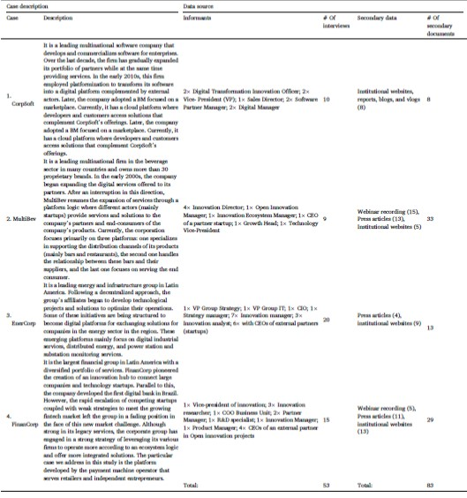
Table 1 Description of cases and summary of data collection.

Slide 12
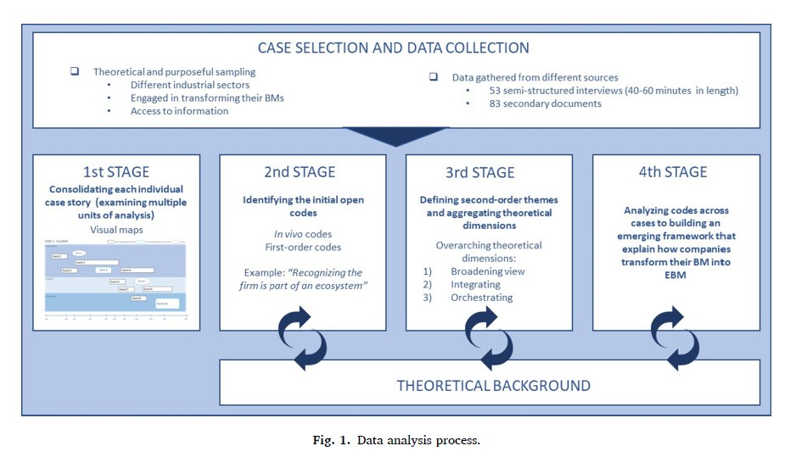
3.2. Data analysis
●This study combines the visual mapping strategy ,Gioia’s method and Thematic
analysis.
●In this study, we analyzed the empirical data in four stages, as suggested by prior research (e.g., Corbin and Strauss, 2015; Eisenhardt and Graebner, 2007), namely: (1) consolidating each individual-case story. (2) identifying the initial open codes. (3) defining second-order themes and aggregating theoretical dimensions. (4) analyzing codes across cases to build an emerging framework that explains how companies transform their BM into an EBM.

Slide 13
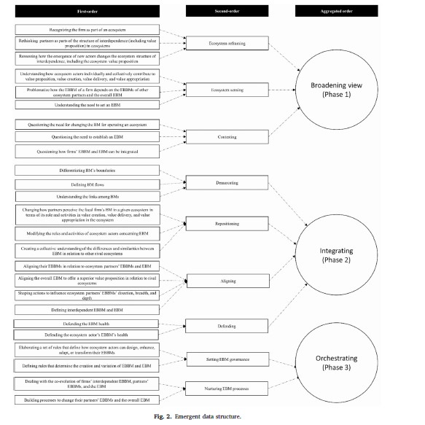

Slide 14
3.3 Methodology quality assessment
This study aims to ensure the reliability and validity of the data. It utilizes multiple sources of evidence to support the research findings, conducts interviews and collects secondary data, and employs triangulation to ensure data consistency. Additionally, it establishes a chain of evidence to confirm the accuracy of events and verifies the results with relevant stakeholders and independent researchers. Finally, it enhances the reliability of the study through a rigorous coding process.

Slide 15
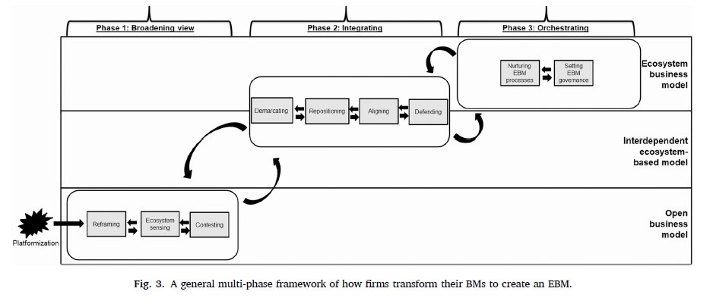
4. Results analysis
4.1 Findings: a multi-phase framework of how firms shift from open business model (OBM) to ecosystem business model (EBM)

Slide 16
4.1. Phase 1: broadening view
The focus of this chapter is to explore how businesses recognize the need to transform from an open business model to an ecosystem business model and establish the process of developing an ecosystem business model. This includes businesses acknowledging their participation in an ecosystem and initiating activities such as ecosystem reframing, ecosystem sensing, and competition within the ecosystem.

Slide 17
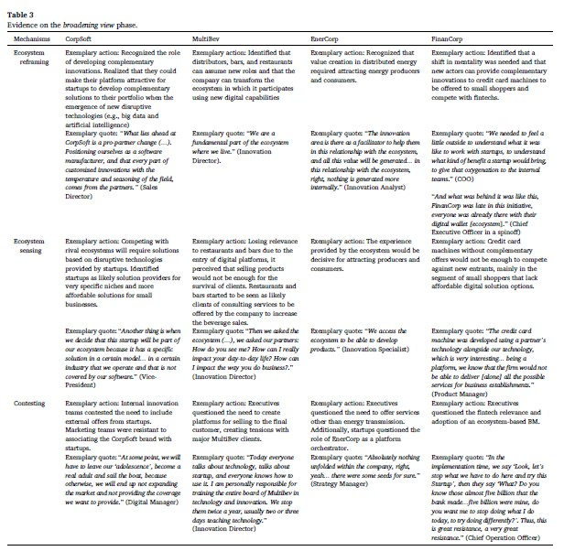

Slide 18
4.2. Phase 2: integrating
The focus of this chapter is to explore how businesses establish coherence in the ecosystem business model, including defining the overall business model of the ecosystem, repositioning their own business model, and establishing alignment with the business models of other participants in the ecosystem.

Slide 19
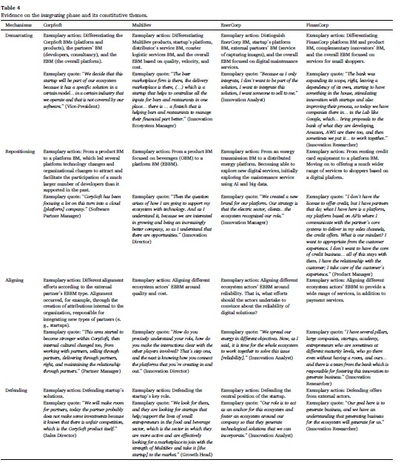

Slide 20
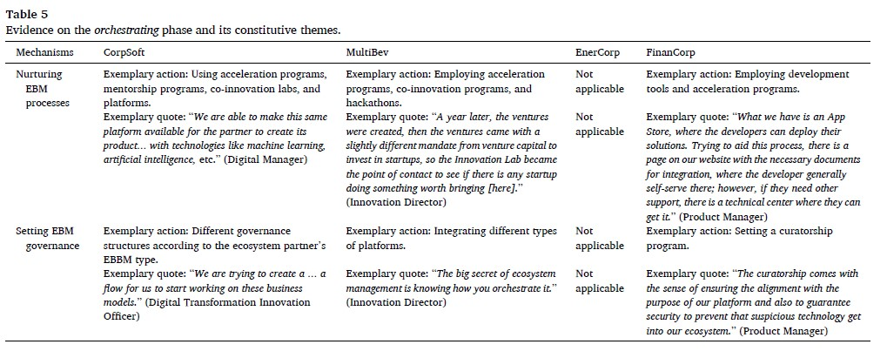
4.3. Phase 3: orchestrating
The focus of this chapter is to explore how businesses coordinate and organize various elements within the ecosystem to achieve overall value creation and value capture.

Slide 21
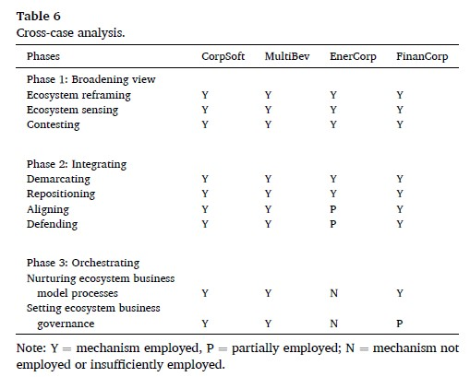
5. Discussion and implications
5.1. Proposing a new theoretical framework

Slide 22
5.1.1. Phase 1: broadening view
The BMT process of shifting from an OBM into an interdependent EBBM and EBM via platformization initiates with the broadening view. In this phase, the main mechanisms involve ecosystem reframing, ecosystem sensing, and contesting. The ecosystem reframing mechanism corresponds to the process by which executives and managers recognize that their firm belongs to one or more ecosystems. In this respect, organizational actors identify how their firm contributes to an ecosystem value proposition. It is an ongoing process in which new actors, roles, value propositions, and links can trigger reframing again.
5.1.2. Phase 2: integrating
Engaging in ecosystem settings also brings about new dilemmas, such as balancing and achieving health among a firm’s EBBM, ecosystem partners’ EBBMs, and EBM. For example, focusing on capturing value can damage the health of ecosystem partners and, consequently, the overall ecosystem. Likewise, approaching primary value creation opportunities and avoiding sharing them with partners can also affect the overall ecosystem. Therefore, a fundamental mechanism that emerged from our data is defending, in which managers focus on the health of a firm’s BM, ecosystem partners, and EBM.

Slide 23
5.1.3. Phase 3: orchestrating v
Successful transformation of OBM does not finish with an interdependent EBBM and EBM. Therefore, some firms in our sample reached a third phase, focusing on co-evolution. The main mechanisms identified in this phase are setting EBM governance and nurturing EBM processes. While setting EBM governance involves defining a set of rules regarding how ecosystem actors can design, enhance, adapt, and transform their EBBMs and consequently generate variations in EBM, nurturing EBM processes focuses on managing the co-evolution of a focal firm’s EBBM, ecosystem partners’ BMs, and EBM to preserve health.
5.2. Implications for theory
In reviewing scholarship on BM and ecosystem, scholars (Foss and Saebi, 2018; Gomes et al., 2021) have argued that there is a need to improve the understanding of BMs within ecosystems. Accordingly, Andreini et al. (2022) highlighted the call for more research on how firms change their BMs. While prior literature offers initial insights into how firms adapt their BMs to operate in ecosystems (e.g., Rong et al., 2018), our study extends the current knowledge by making a fundamental theoretical distinction: the locus of EBM is the ecosystem (related to digital platforms), and not the firm.

Slide 24
5.3. Implications for practice
Our research findings suggest that firms undergoing transformation may need to transition their OBM into interdependent EBBM and EBM. This holds significant implications for understanding the role and competition of organizations within ecosystems.
●Firstly, we observed that certain roles within organizations may encounter difficulties during such transformational processes, as they struggle to recognize their company's place within the ecosystem. It is crucial to acknowledge that cognitive recognition of EBM is not automatic but requires active engagement from managers and organizational members.
● Secondly, we argue that establishing connections and synergies among the firm's BM, ecosystem partners' BM, and EBM is paramount. Merely recognizing and defining differences among these BMs is insufficient; instead, efforts should be made to foster mutual interdependencies. This entails careful examination by managers to align the BMs and consider the health of EBM.
●Lastly, we emphasize the importance of continuous innovation and transformation of the firm's BM, ecosystem partners' BM, and EBM. In dynamic environments, new opportunities and challenges may necessitate significant changes, requiring proactive actions, incentives, and resource allocation to manage the co-evolution of BMs. Additionally, we offer preliminary yet valuable guidance on setting rules to promote variations in EBM.

Slide 25
In conclusion, this research provides valuable insights for teams and managers undergoing enterprise transformation.
I appreciate your attention
Thank you！！

