Slide 1
SEMINAR IN INTERNATIONAL OPERATIONS MANAGEMENT AND TRADE
Does ESG affect stock market dependence? An empirical exploration of S&P 1200 companies shows the divergent nature of E–S–G pillars
INSTRUCTOR: PROFESSOR CHENG-WEN LEE
STUDENT: Benjamin Lee(10904603)

Slide 2
PRESENTATION OUTLINE
. INTRODUCTION
THEORETICAL FRAMEWORK
METHODS AND MATERIALS
RESULTS AND DISCUSSION
CONCLUSION

Slide 3
INTRODUCTION
Environmental, social, and governance (ESG) investing plays a crucial role in today’s financial markets. The application of non-financial factors within the standard financial decision-making process is growing (Amel-Zadeh and Serafeim, 2018; Van Duuren et al., 2016), and the value of ESG integrated investments could reach $53 trillion by 2025 (Bloomberg, 2021). Sustainability became a necessity rather than an opportunity, and the Covid-19 pandemic fixed its position next to standard financial measures (Pástor and Vorsatz, 2020). Not only institutions but also retail investors and households focus on social responsibility now (Bauer et al.,2021).
The main drivers of the growing investor demand are the societal pressure that shifts investors’ preferences to utilize the social returns (Lagerkvist et al., 2020; Hartzmark and Sussman, 2019) or pushes them to fulfill their customers’ or stakeholders’ expectations (Amel-Zadeh and Serafeim, 2018) and regulatory (performance and disclosure) requirements (Renneboog et al., 2008; Ramelli et al., 2021), which, to certain extent, reflect the fight against climate change.
As for the investors’ view, hope for reduction of risks (Becchetti et al., 2015a) or the potential profit emerging from the new market paradigm play roles. Moreover, based on the standard portfolio theory, the restriction based on sustainability performance set on the market should lead to the penalization of returns (Pedersen et al., 2021).
Although the question of sustainability’s (or ESG’s) effect on the risk-return profile of assets is widely researched, and many studies point to a positive relationship between sustainability and financial performance (Friede et al., 2015), no clear and concise answer has yet been given (Coqueret, 2021). The same opalescent situation prevails in the risk management area. Within the literature, ESG was found to be both risk reducing (Oikonomou et al., 2012; Drempetic et al., 2020; Khan et al., 2024) and risk enhancing, influencing implied volatility (Patel et al., 2021) or downside risks (Nofsinger et al., 2019).

Slide 4
INTRODUCTION
To efficiently manage portfolio risks, knowledge of how ESG affects stock behavior in times of market upturns and downturns, as well as the dependence structure of assets, is needed. ESG investments are usually driven by more than financial performance (Bollen, 2007), which sheds light on the element of investor’s loyalty. It was already shown that socially responsible investment (SRI) funds flows are less sensitive to past returns (Renneboog et al., 2011; Benson and Humphrey, 2008). Moreover, social responsibility lowers risks within the SRI cash flow volatility (Bollen, 2007), and firms with a high ESG profile are perceived by investors as more resilient (Roselle, 2016).
Nevertheless, the diversification properties focusing on the stocks’ tail risk connectedness while considering ESG received growing attention only recently and still do not achieve coverage that would enable a proper answer. Assessing the connectedness between ESG indices and a set of influential macroeconomic and financial variables by applying the approach of Diebold and Yılmaz (2014), Umar et al. (2020) conclude that the portfolio diversification opportunities of ESG investments tend to diminish during market downturns.
Czado et al. (2022) focused on the companies comprising the S&P index, applied vine copula models to capture cross-sectional dependence within ESG class indices based on the Refinitiv ESG data, and showed assets with moderate (middle-) ESG scores tend to show weaker dependence to the U.S. market compared to assets with extremely high or low ESG scores, and that the dependence becomes stronger in times of crisis.

Slide 5
INTRODUCTION
With a similar approach and results but focusing on risk dependence, Bax et al. (2023) looked on the individual E–S–G pillars and suggested that the E-pillar has a similar dependence as ESG in times of crisis, while in the case of high ESG class, the S-pillar provides strong risk dependence, and the G-pillar provides weak risk dependence. Pedini and Severini (2022) employed a cross-quantilogram approach to check safe haven and diversifier properties of ESG stock and bond indices and suggest ESG assets have a strong diversification potential. The micro-level research focusing on the relationship between individual stocks and the market is lagging behind, as the mainstream approach uses an individual ESG assessment of companies to build a portfolio that is later analyzed as a homogeneous unit.
In this context, our study addresses the above two issues: ESG effect on assets’ dependence properties and the ESG data heterogeneity critical view. In contrast to other papers, we focus our analysis directly on the individual stocks. We empirically analyze the stock market co-movements in extreme quantiles while accounting for their sustainability performance in various perspectives by employing the bi-variate cross-quantilogram by Han et al. (2016), which enables us to avoid any distributional or parametrical assumptions (Uddin et al., 2019; Baumöhl and Lyócsa, 2017) while being intuitive and easy to interpret.
Moreover, to address the issue of unreliable ESG data, we used a unique data set and employed 20 various scores from seven major ESG data providers to cover the aggregate ESG level as well as separate E–S–G pillars. In addition, as Serafeim and Yoon (2022) suggest, the closer the scores between different providers, the higher the power to predict future ESG news.

Slide 6
INTRODUCTION
As proposed by Gyönyörová et al. (2021), we applied principal component analysis (PCA) to derive a structural combination of these scores on the aggregate and dimensional level, which reflects the value of shared information between all providers.
In our empirical study for the period from 2015 to 2021, we show evidence for the ESG effects on the co-movement intensity between stocks in the S&P Global 1200 index and the market. We prove graphically and statistically significant differences between E–S–G scores effect with the Governance pillar having the opposite effect to the Environment and Social pillars. Aggregate ESG scores incorporate conceptual discrepancies and thus, in general, have the weakest differentiating effect.
From the perspective of ESG classes, we suggest the middle class has interesting but often overlooked properties. The differentiation effect is strongest during market downturns, as the overall level of tail connectedness increases. We also found significant differences between providers’ data that point to the core information of disclosure within the Governance pillar and an increased power of structurally shared information.
Our study contributes to the literature by uncovering unique insights into the co-movements of ESG classes and their implications for risk management in financial markets. From a practical point of view, we provide evidence for investors to improve their portfolio management by considering the distinct nature of E–S–G dimensions, the importance of their current market understanding and the diversification opportunities of ESG middle-class stocks. Regulators and policymakers should be aware of the uncertainty in ESG investing and help reduce blind use of ESG scores, enabling stakeholders to make informed decisions and promote sustainable investment practices.

Slide 7
Theoretical framework
The stakeholder theory offers the basic framework for the argumentation in favor of the negative relationship between Corporate Social Performance (CSP) and firm risks (Jensen, 2002). The value maximization approach based on the long-term company’s financial performance should motivate managers to take into account all of the interests of the firm’s stakeholders.
High-CSP engagement acts as an insurance protection mechanism. In general, it reduces the probability of negative shock occurrence and lowers the volatility of performance measures (e.g. cash flow) in contrast to low-CSP engaged firms (Bouslah et al., 2013). Also, CSP contributes to damage mitigation and faster recovery after negative operational, environmental and social event occurrence (Godfrey, 2005; Godfrey et al., 2009; Klein and Dawar, 2004).
High CSP engagement reduces the litigation risk and strengthens the stakeholders’ trust in the company, reducing agency and transaction costs (Becchetti et al., 2015b; Lins et al., 2017). Thus, high CSP reduces financial risk giving stable relationships with stakeholders, such as loyal customers, satisfied employees, lenders, government, and supportive community (McGuire et al., 1988; Hong and Kacperczyk, 2009; Bouslah et al., 2013).
Good management theory (Waddock and Graves, 1997) also supports this view but focuses more on good corporate governance. Effective and clear CSR strategy and emphasizing stable relationships with the company’s stakeholders signal a quality risk-management system and financial stability (Orlitzky and Benjamin, 2001; El Ghoul et al., 2011; Bouslah et al., 2013).

Slide 8
Theoretical framework
Besides, the investors’ perspective plays its role. As non-financial criteria may drive investors, the high CSP may attract them and create a crisis-resistant loyalty amongst its investors base (Bollen, 2007; Lee and Faff, 2009).
Moreover, the relative size of the investor base is considered another argument for lowering risks (Hong and Kacperczyk, 2009; El Ghoul et al., 2011). Heinkel et al. (2001) assume that a company’s CSP may determine the attractiveness of stocks, which leads to higher risk for non-CSR stocks. High CSP indicates a transparent information environment and, thereby, reduces the company’s idiosyncratic risk by boosting analysts, thus investors, attention (Liu et al., 2023).
On the other hand, several arguments exist proposing the positive relationship between high-CSP engagement and financial risk. The managerial opportunism theory deems CSR expenditures as unnecessary costs. High costs reduce resources, lead to over investments and decrease the net worth of the company (Barnea and Rubin, 2010).
Another issue is the different effects of sustainable practices across industries and the company’s age (Peloza, 2006). Besides, CSR consists of various activities perceived differently by stakeholders and shareholders (Peloza and Shang, 2011).

Slide 9
Theoretical framework
In this paper, we build on this theoretical framework and explore the relationship between CSP (ESG) and financial risk from another perspective. Globalization and advanced technologies consistently integrate already highly intertwined financial markets across various asset classes, regions, and industries, making unexpected market events an immediate universal threat or opportunity.
A stream of literature that focuses on the ESG and SRI specifics during crises suggests that SRI and ESG funds perform better (such as (Nofsinger and Varma, 2014) during the global financial crisis period or (Pástor and Vorsatz, 2020; Omura et al., 2021; Singh, 2020) during the period of the Covid-19 pandemic) and perform worse during economic downturns (Fiordelisi et al., 2020) or when controlling for other factors that have little or no hedging power (Demers et al., 2020; Mahmoud and Meyer, 2021; Demers et al., 2021; Folger-Laronde et al., 2022).
Given the importance of portfolio diversification, we focus on the micro-level analysis of interconnections between stocks and the market. Moreover, the market dependency structure is influenced by market development, the openness of the economy, and financial or economic crises. We mainly focus on developed and opened markets, but we must incorporate the time dynamics within our research.
In general, the stock market dependence intensifies during crisis periods due to contagion effects (Karanasos et al., 2016; Mokni and Mansouri, 2017). We can follow this presumption by employing the data covering the Covid-19 pandemic and exploring the effect of ESG on this relationship.

Slide 10

Methods and materials
We investigate the interdependence between stocks in the S&P 1200 Global index and the market represented by the values of this index by implementing the cross-quantilogram method of Han et al. (2016). The method is appealing because it measures the conditional dependence and directional predictability between pairs of variables at stationary levels for different quantiles (lower, middle, and upper) of the distributions. It provides a complete picture of the relationship between the variables under varying market conditions.
Cross-quantilogram
Given a specific sample of data, we consider a strictly stationary time series 𝑥_{𝑖,𝑡,} 𝑡 ∈ Z, 𝑖 = 1, 2, where, in our context, 𝑥_{1,𝑡} represents the index S&P 1200 Global and 𝑥_{2,𝑡} represents each of the 1,220 S&P 1200 Global constituents. The density and distribution functions of series 𝑥_{𝑖,𝑡} are labeled as 𝑓_{𝑖} and 𝐹_{𝑖} . The quantile of 𝑥_{𝑖,𝑡} is given as and the expressions of the two-dimensional series of quantiles are represented by To measure and test for the directional predictability between 𝑥_{1,𝑡} and 𝑥_{2,𝑡} for different quantiles, Han et al. (2016) propose the cross-quantilogram for 𝛼-quantile with lag k as,
                (1)
where 𝑘 = 0,±1,±2, …, and 𝛹_{𝑎} (𝜇) ≡ 1 [𝜇 < 0] − 𝑎, 1 [] denotes the indicator function, and 1 [ 𝑥_{𝑖,𝑡} ≤_{𝑖} ( 𝛼_{𝑖} )] is the quantile exceeding process.

Slide 11
Methods and materials
According to Eq. (1), the cross-quantilogram measures the serial dependence between a pair of variables at different quantiles when𝑘 = 1, 𝜌_{𝛼} (1) indicates the cross-dependence between the quantile 𝑞₁ (𝛼₁ ) of an index S&P 1200 Global 𝑥_{1,𝑡} at time 𝑡 and the quantil 𝑞₂ ( 𝛼₂ ) of one of its constituents 𝑥_{2,𝑡} at time 𝑡 + 1.
Therefore, this measures the one-day lead–lag effect between 𝑥_{1,𝑡} and 𝑥_{2,𝑡}, and in the case of 𝜌_{𝛼} (1) = 0 , there is no predictability from the quantile 𝛼₁ of index S&P 1200 to the quantile 𝛼₂ of its constituent, which means that 𝑥_{2,𝑡} is not dependent on the market represented by the S&P 1200. Contrary to this, 𝜌_{𝛼} (1) ≠ 0 means that 𝑥_{2,𝑡} depends on the market conditions, that is, it follows its ups and downs to some extent. In Eq. (2), the cross-quantilogram of the sample counterpart is estimated as:
where is the unconditional sample quantile.

Slide 12
Methods and materials
Materials
We use daily data from 2015-01-01 to 2021-12-31 for log returns on the S&P Global 1200 index and all its constituent stocks separately (descriptive statistics shown in Table 1). We used 1,220 stocks in the full sample and ensured global coverage as the index covers 31 countries, all 11 industry sectors (GICS methodology) and approximately 70% of global stock-market capitalization.
We gathered the ESG data for these companies from seven major ESG data providers. We set the time period at 2016–2020 to include part of the Covid-19 pandemic while fighting the limited data accessibility. We gathered the data from three sources: (i) Bloomberg Terminal provided the majority of our ESG data, (ii) Yahoo Finance API provided the returns data, and (iii) the Thompson Reuters ESG data were obtained from Refinitiv. The majority of data was gathered during June and July 2022, except for the TR data set (collected in 2021) and the Sustainalytics data set, which was unavailable at Bloomberg due to a change in the methodology; we used the limited data set obtained in early 2021 (descriptive statistics shown in Table A.1).

Slide 13
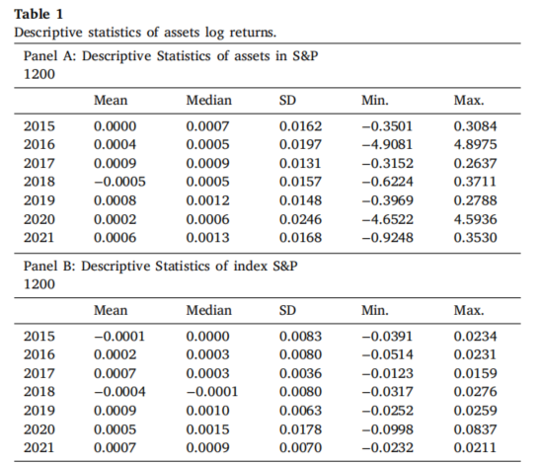
Methods and materials

Slide 14
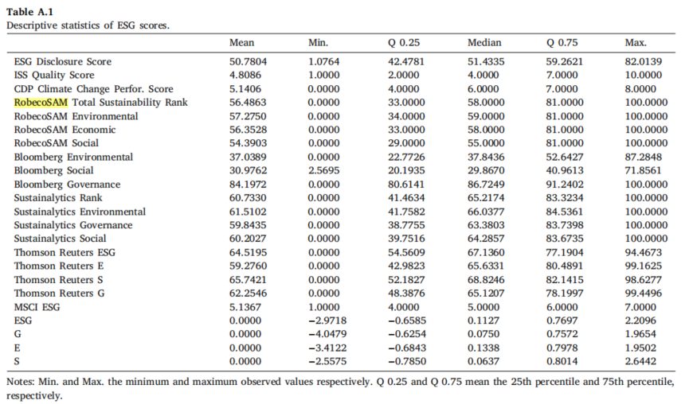
Methods and materials

Slide 15
Methods and materials
The ESG ratings for each dimension E, S, and G, as well as the aggregate ESG ratings, were chosen for the research. Also, to address the ESG data heterogeneity issue (Avetisyan and Hockerts, 2017; Chatterji et al., 2016; Semenova and Hassel, 2015; Dorfleitner et al., 2015), we incorporated another ESG indicator that could embody the shared information between different data providers.
The heterogeneity plays a significant role in the non-conclusive state of the ESG-financial performance relationship. Average ESG scores based on data from several ESG rating providers have been found to have the ability to predict future ESG news. However, this ability decreases the further away the ratings are from each other (Serafeim and Yoon, 2022).
To this end, we were inspired by Gyönyörová et al. (2021), who proposed applying extracted factorial structures. Therefore, the new score represents the part of the information that all the data providers agree on. For this reason, it is not only a simple combination, but it can also be observed as a hidden but fairly objective ESG evaluation. Thus, the level of ESG data used can be seen according to three levels: aggregate ESG scores, individual E–S–G pillar scores, and synthetic cumulative ESG and dimensional E–S–G scores.
We employ principal component analysis (PCA) to construct the composite ESG rating together and separately for the E, S, and G dimensions. We standardized all inputs to have zero mean and unit variance before performing the PCA to account for the input data scale differences on a provider basis. We applied the same process on both the level of ESG ratings and on the E–S–G dimensions, leaving us with four brand-new scores.

Slide 16
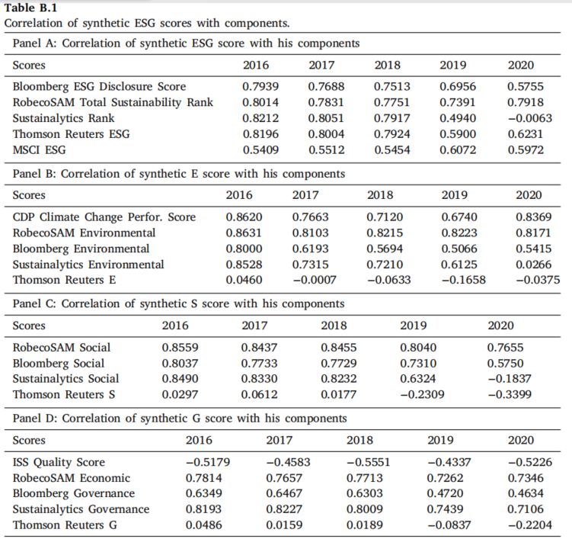
Methods and materials
The correlation matrix of synthetic and original scores in Table B.1 further clarifies the synthetic scores’ accuracy.

Slide 17
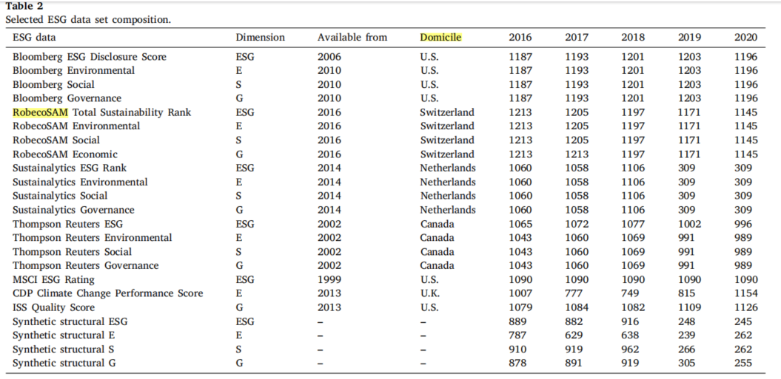
Methods and materials
The number of extracted cases is thus directly dependent on the coverage overlap and shrinks for some years, as can be seen in Table 2.

Slide 18
Methods and materials
In the next step, we transformed all 23 ESG-related indicators – 19 from ESG data providers and four synthetically made – from scales to classes. As most of the employed ESG data scores the company on the best-in-class approach, we do not account for industry specifics or regional affiliation, although we check the industry and region representation as a part of robustness checks.
The stocks are repeatedly divided into quantiles based on every single used ESG score. We focus on the quantile (0.0–0.2; 0.4–0.5; 0.8–1.0), further named as low-, medium- and high-ESG stocks and ignore the rest. This way, we can check the proposed dependencies differentiation on the three mentioned levels without ignoring the middle ones, which may perform differently (Czado et al., 2022; Harjoto et al., 2017).
To account for the time dynamics and proper time setting of ESG data, we run the analyses for ESG as a precedent, as a concurrent and as an antecedent to the financial data. For all analyses, we work with the same ESG data set from 2016–2020, but we shift the period for financial data. Because this approach leads us to a large number of results, we then aggregate them according to the original ESG classes (high-, medium- and low-ESG stocks) using their average and we calculate the unpaired t-test, also known as the independent samples t-test, to compare the means of two independent groups: the high-ESG and low-ESG stock groups in our case. The 𝑡 statistic to test whether the means are different is calculated as given in Eq. (3), where is mean of the quantilograms of high-ESG, is mean of the quantilograms of low-ESG, with the estimate of the variance 𝑠 ² of each of the group and the number of observation 𝑛.

Slide 19
Methods and materials
The unpaired t-test allows us to assess whether a significant difference exists between the means of these two groups. It takes into consideration the variability within each group and the sample sizes. In the following figures, we present the 𝑝-value, which indicates the probability of obtaining the observed difference if the null hypothesis is true. A small 𝑝-value suggests a significant difference between the means of the two groups.

Slide 20
Results and discussion
Because we focus on micro-level connectedness structure and our cross-quantilogram approach consists of many sub-analyses, we present them graphically in an aggregated form. Figs. 1, 2, 3, C.1 and C.2 present the results for quantile 0.1 (meaning the 10% of the worst trading days), while Figs. C.3–C.5 show the results for the quantile 0.9 (10% of the best trading days), both with a lag k = 0 (representing simultaneity).
Results
Aggregated ESG scores, in general, have mixed and not very persuasive results. Most of the middle-ESG (Bloomberg, synthetic ESG) or high-ESG (RobecoSAM, MSCI) scored companies are less connected to the market than the low-ESG ones. Several interesting cases were explored: for Sustainalytics, no pattern was identified; for Thompson Reuters, 2020 is the only year when the middle-ESG class companies are significantly more strongly connected to the market than other classes. For MSCI, the pandemic year caused a shift from a previously unclear situation, but for the case of the financial data of 2021, the middle-ESG companies based on 2020 scores were the least connected to the market in 2021. In the case of Bloomberg in 2020, the middle-ESG companies showed the lowest connectedness to the market. Lastly, the synthetic ESG represents the most powerful indicator compared to other aggregated scores in the perspective of the best differentiation effect, with middle-ESG stocks showing the weakest co-movement with the market.

Slide 21
Results and discussion
The overall effect of the Environment pillar can be described similarly to the aggregated ESG with significantly more robust results and prevailing effects of high-E stocks. All explored scores point to the lower co-movements of high-E stocks with the market with some variations: for CDP, the only significant year was 2019, and the middle-ESG stock connectedness was close to the connectedness of high-E stocks; Sustainalytics provides mixed results to some extent, and synthetic E also favored the middle-E companies, which had for several cases similarly weak co-movements as high-E stocks.

Slide 22
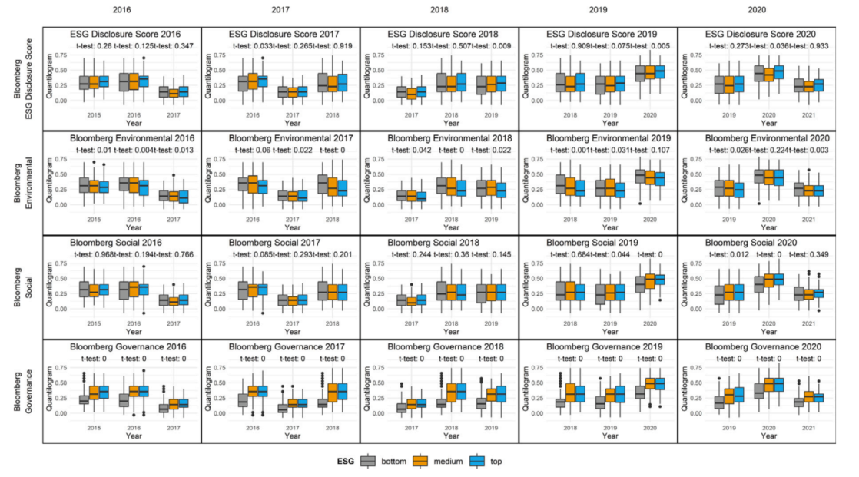
Results and discussion
Fig. 1. The cross-quantilogram for quantile 0.1 output aggregation: Bloomberg data.

Slide 23
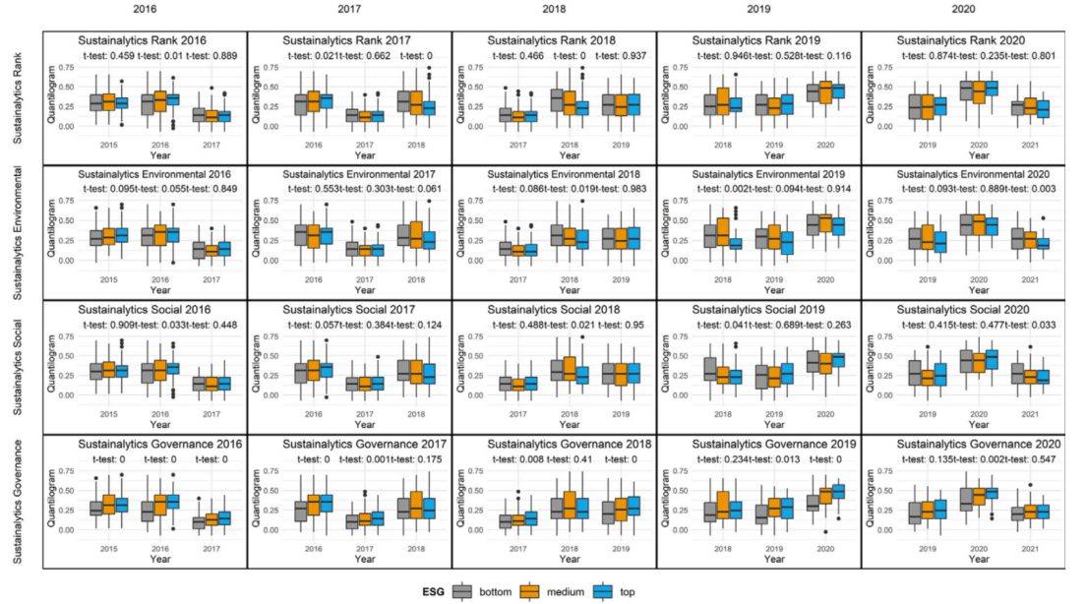
Results and discussion
Fig. 2. The cross-quantilogram for quantile 0.1 output aggregation: Sustainalytics data.

Slide 24
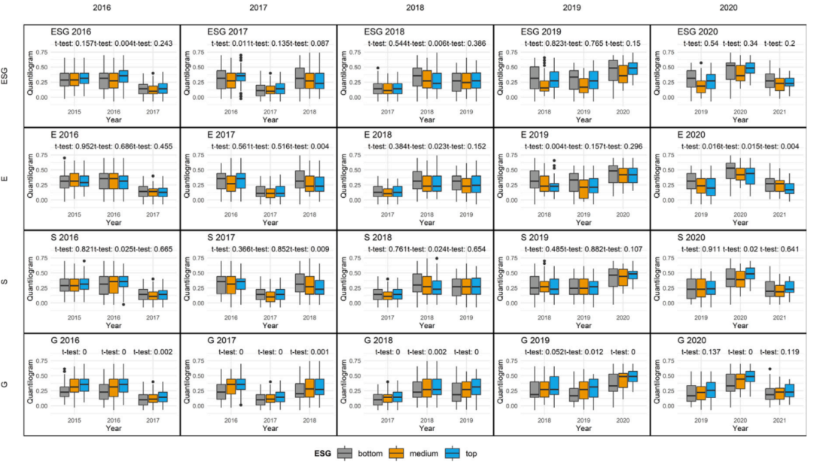
Results and discussion
Fig. 3. The cross-quantilogram for quantile 0.1 output aggregation of synthetic structural scores.

Slide 25
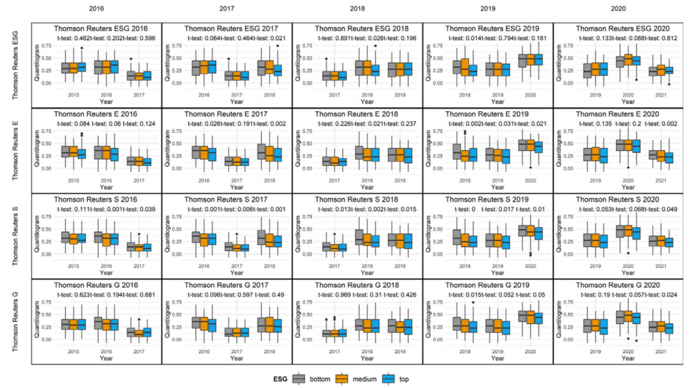
Results and discussion
output aggregation: RobecoSAM.
Fig. C.2. The cross-quantilogram for quantile 0.1 output aggregation: Thompson Reuters data.

Slide 26
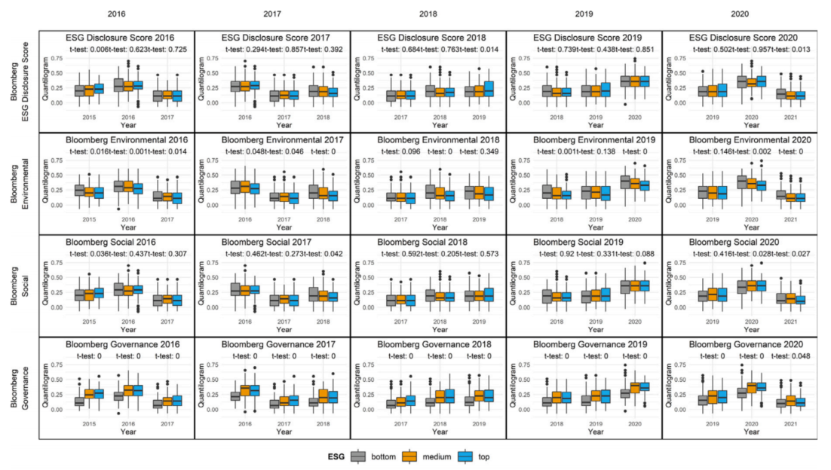
Results and discussion
Fig. C.3. The cross-quantilogram for quantile 0.9 output aggregationn: Bloomberg data.

Slide 27
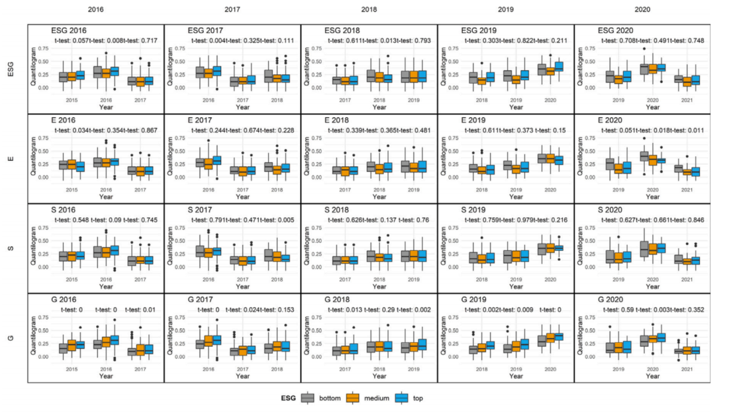
Results and discussion
Fig. C.4. The cross-quantilogram for quantile 0.9 output aggregation: synthetic data.

Slide 28
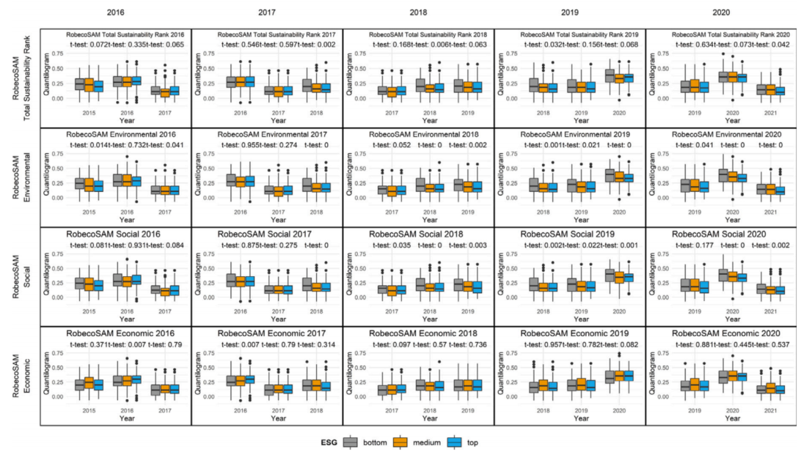
Results and discussion
Fig. C.4. The cross-quantilogram for quantile 0.9 output aggregation: RobecoSAM data.

Slide 29
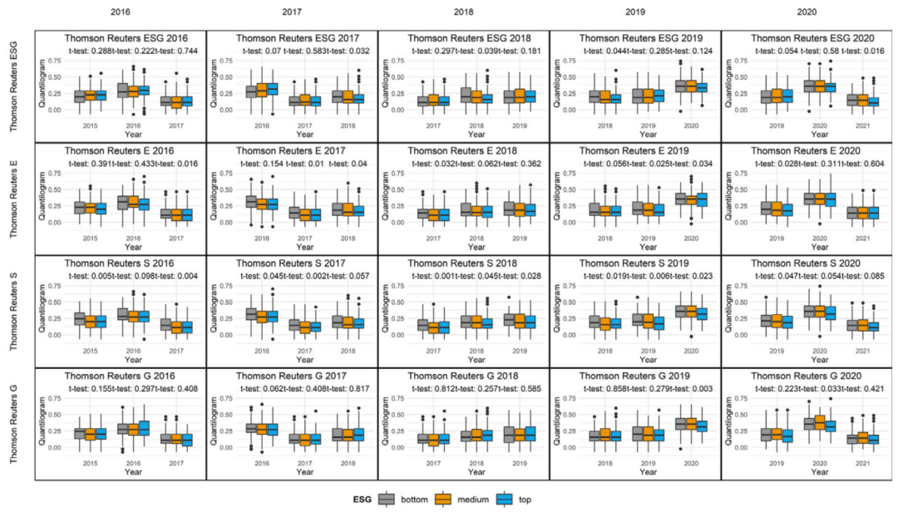
Results and discussion
Fig. C.5. The cross-quantilogram for quantile 0.9 output aggregation: Thompson Reuters data.

Slide 30
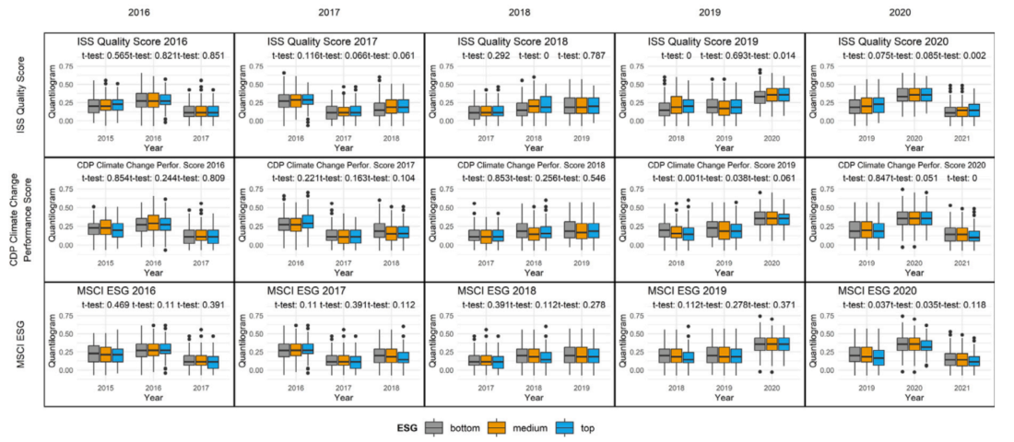
Results and discussion
Fig. C.5. The cross-quantilogram for quantile 0.9 output aggregation: ISS, CDP and MSCIdata.

Slide 31
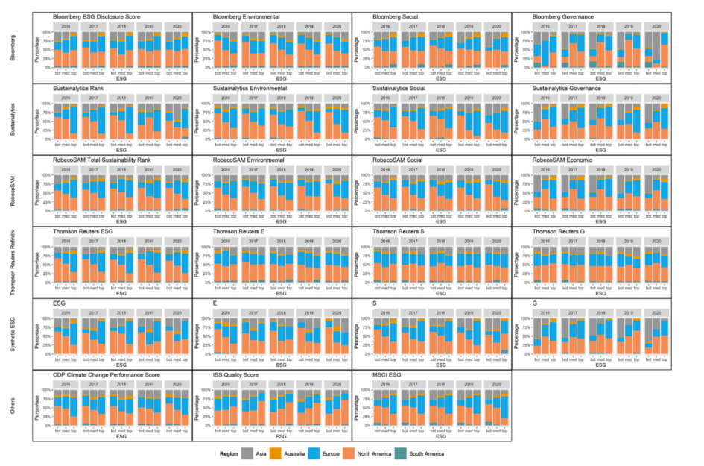
Results and discussion
Fig. D.1. The companies’ distribution over regions using all employed ESG scores and years.

Slide 32
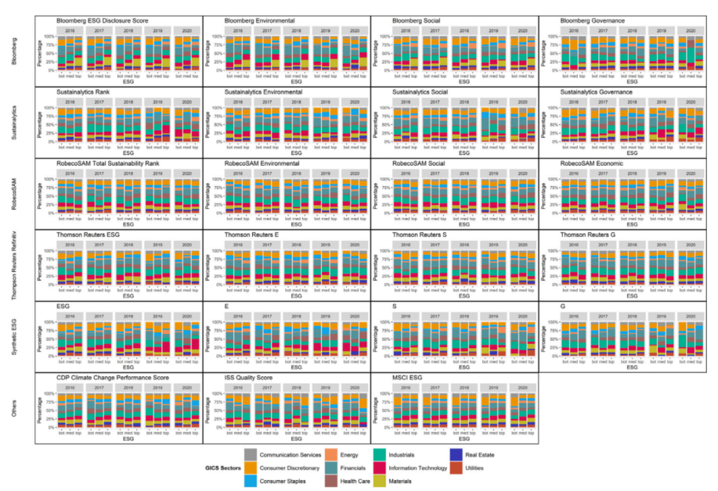
Results and discussion
Fig. D.2. The companies’ distribution over industries using all employed ESG scores and years.

Slide 33
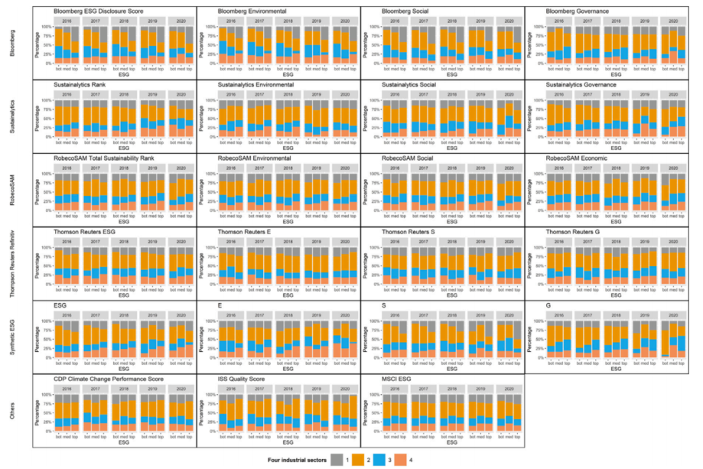
Results and discussion
Fig. D.3. The companies’ distribution over industries using all employed ESG scores and years.
Notes: The figure shows industries based on the four-sector model of the economy.

