Slide 1

SEMINAR ON INTERNATIONAL OPERATIONS AND TRADE
THE DEEP ROOTS OF CROSS-CULTURAL DIFFERENCES IN ORGANIZATIONAL BEHAVIOUR: DO HUMAN RESOURCE MANAGEMENT EDUCATION HAS TO RESPECT THEM?
BY: Petr Houdek
Faculty of Business Administration, Prague University of Economics and Business, Czech Republic
KEY WORDS:
Deep roots, Cultural differences, Path dependence, Human Resource Management, Cross cultural Training.
Student Name: Augustine Sanyang
Lecturer: Prof. Cheng Wen Lee
April 16, 2024

Slide 2
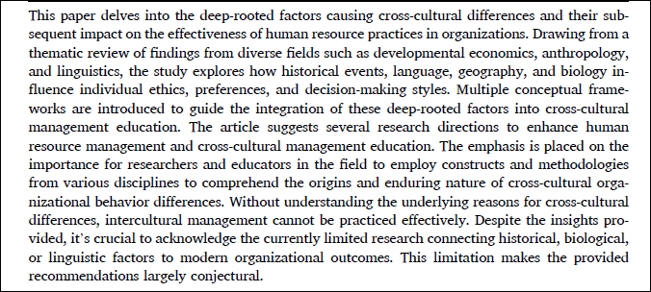
ABSTRACT

Slide 3
INTRODUCTION
.
In todays globalized world, understanding cross-cultural management is important and relevant
For effective interactions and diversity, it is important to understand the complex relationship between CULTURE AND WORK MOTIVATION; TEAM DYNAMICS, GENDER ROLES; LEADERSHIP AND BUSINESS ETHICS
There is cornucopia of research examining – “ lack of cross- cultural competence and intercultural human resource management failures”, “ how they train and develop employees’ skills and knowledge for effective intercultural interactions, cultural intelligence, and diversity management training , “ the components and causes for effective cross-cultural education or training, etc

Slide 4
Introduction cont’d
However, all these studies fall short of analyzing the REASON(S) for emergence of the said differences (Hofstede & McCrae, 2004; Taras, Kirkman, & Steel, 2010)
Although a minority studies attempt to find out “ WHY and “ HOW” cross-cultural differences emerge, they only focus on CULTURAL VALUE DIFFERENCE (Gelfand et al., 2007).
This might be the reason(s) why intercultural training programs are perceived as ineffective or sometimes they are even suspected of increasing the barriers between groups from varied cultural backgrounds ( Chang 2017)

Slide 5
RESEARCH APPROACH
Several coveted theories in Organizational Science vividly emphasize the importance of the initial historical or background conditions for the subsequent decision, and sense making of managers or organizational functioning in the long run (e.g Klüppel, Pierce, & Snyder, 2018).
In particular, the path dependence theory emphasizes how small historical events can become magnified by positive feedback; thus, organizations tend to lock themselves in a specific state that is neither guaranteed to be efficient nor easily changeable. An unpredictable historical event or solitary action of individual gains more prominence as the future unfolds (Powell, 1991; Schrey¨ogg & Sydow, 2011;
Sydow, Schrey¨ogg, & Koch, 2009)
The resource dependence theory suggests that organizations adapt their strategies based on their dependence on external resources and the environment in which they operate. The theory shows how unique historical events, such as technological changes or governmental actions, produce persisting management models and influence companies’ long-run strategies (Bodroˇzi´c & Adler, 2017; Christensen & Bower, 1996).
Notes:
Path Dependence:

Slide 6
RESEARCH APPROACH
The imprinting theory focuses on the strong influence of environmental conditions during sensitive periods. The theory posits that early experiences or exposures can have a lasting impact on an organization’s or individual’s behavior and characteristics. The theory describes how organizations incorporate elements of their founding environment, how individuals take on attributes of their early-career jobs, and how elements developed during this formative period persist over time (Houdek, 2016; Marquis & Tilcsik, 2013)
The person-environment fit theory states that the nature of the company culture selects the individuals who will best thrive in it, thereby cementing the initial conditions in the long run (Houdek, Bahník, Hudík, & Vranka, 2021; Vleugels, Verbruggen, De Cooman, & Billsberry, 2023)
The study combined these traditions of organizational sciences with new quantitative studies on the border of developmental economics, cognitive psychology, anthropology, cliometrics (the quantitative studies of economic history), and linguistics, which have moved beyond testing whether there are cross-cultural differences and attempt to identify exactly why they exist.

Slide 7
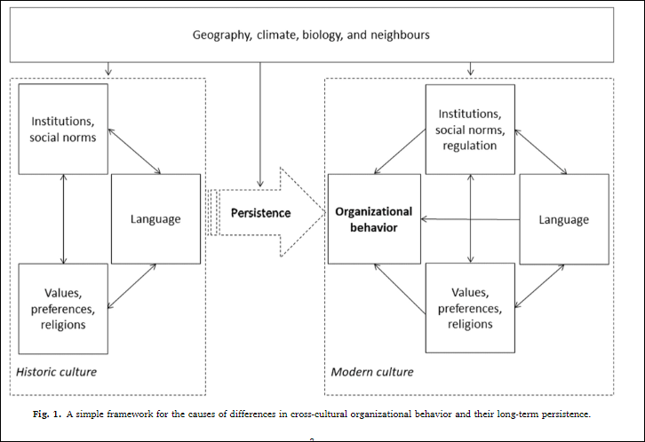
Culture as a persistence of historic environment and events
Notes:
This image depicts a conceptual framework to explain the causes of differences in cross-cultural organizational behavior and their long-term persistence. The framework consists of two parallelogram-shaped diagrams, one labeled "Historic culture" and the other "Modern culture," both connected by the central concept of "Persistence." The diagram is attempting to illustrate how various factors can have enduring effects on organizational behavior over time.
In the "Historic culture" diagram on the left, we see three contributing factors : "Institutions, social norms," "Language," and "Values, preferences, religions." These factors are suggested to interact and influence each other, culminating in an overarching "Organizational behavior" which is then carried forward in time due to "Persistence." Similarly, the "Modern culture" diagram mirrors this structure with the same components, emphasizing that the historic cultural factors continue to exert their influence on modern organizational behavior. The framework suggests a complex interplay between geography, climate, biology, and neighbors as external influencers on both historic and modern cultural elements, demonstrating the multi-faceted nature of cultural influences on organizational practices.

Slide 8
Culture as a persistence of historic environment and events
For a long time, culture persists through spontaneously formed informal social norms, values, and beliefs; and deliberately created formal institutions such as law, regulations, or state organizations, and religious and civil communities or NGOs. Logically, culture also differs between states, nations, or ethnicities.
In short, the evolution of societal functions and forms are characterized by slowness and long-time persistence
Proposition 1a. Deep historical events creating both trauma and/or flourishing lead to culturally specific norms, preferences, or behaviors. These norms specifically influence constructs relevant to HR management, such as trust or hostility, learning, motivation, creativity, or compliance.
Notes:
Studying historical events can help understand how specific institutional or cultural elements are responsible for the observed heterogeneity of cross-cultural organizations’ and individuals’ behavior. Moreover, focusing on why and how institutional or cultural elements came into being could help find discrete channels of how they affect organizations’ functions and peoples’ behavior. One of the leading causes of the country’s wealth is human capital, innovativeness, and entrepreneurship

Slide 9
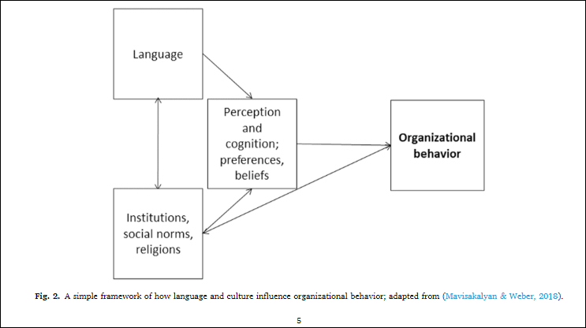
HISTORY MATTERS: IMPLICATIONS FOR HRM EDUCATION
Notes:
This diagram suggests that language shapes our perception and cognition; that is, the way we interpret and understand the world around us, as well as our preferences and beliefs. These perceptions and beliefs are influenced by broader societal factors such as institutions, social norms, and religions. These influences then converge to affect organizational behavior, implying that the culture within which an organization operates – as well as the language used within that context – will notably shape how that organization behaves in terms of its internal processes, decision-making, and interactions within and outside the organization. The arrows indicate the flow of influence from these cultural aspects towards organizational behavior, underscoring that organizational behavior is not only determined by internal factors and policies but is also deeply embedded within the larger cultural and linguistic context.

Slide 10
History matters: implications for HRM education
This emphasizes the significance of historical events and their impact on human resource management (HRM) education. Understanding the historical context of cultural norms, behaviors, and practices is crucial for effectively managing and leading diverse workforces in today's globalized world. These can be looked in the context of:
Cultural Sensitivity
Conflict Resolution
Diversity and Inclusion
Organizational Culture
Learning from the Past
Suffice it to say, recognizing the importance of history in HRM education enables professionals to navigate the complexities of managing diverse workforces, promoting inclusivity, and fostering a positive organizational culture. By integrating historical perspectives into HRM education, practitioners can develop a deeper understanding of the cultural nuances that influence employee behavior and organizational dynamics.
Proposition 1b. Historical events shaping cultural patterns (norms, preferences, behaviors) influence what organizational processes evolve and how employee relations, interpersonal conflict management, compliance, and other HR practices are managed.

Slide 11
History matters: implications for HRM education
Proposition 1c. The influence of historical events on culture has a different impact on the same management practices in different cultures. Incorporating the knowledge into (intercultural) human resource management or intercultural training will lead to more effective practices.
Notes:
Decentralised supply chain

Slide 12
Languages: speaking a different language means perceiving a somewhat different (organizational) world
Languages: speaking a different language means perceiving a somewhat different (organizational) world" highlights the profound impact that language has on shaping individuals' perceptions and interpretations of the world, including the organizational environment.
It underscores the idea that language is not merely a tool for communication but a fundamental aspect of how individuals construct their understanding of the organizational world. Speaking different languages can result in varied cognitive frameworks, cultural perspectives, communication challenges, and perceptual filters that shape individuals' experiences and interactions within the organizational context. Recognizing the influence of language on organizational perceptions is essential for promoting effective communication, fostering cultural understanding, and enhancing collaboration in diverse workplace settings.
Proposition 2a. The features of language grammar are associated with culturally specific norms, preferences, or behaviors. They influence constructs relevant to HR management such as gender roles, perception of sustainability, respect for others, preference for hierarchical or nonhierarchical
HR management.

Slide 13
Language matters: implications for HRM education
Implications for HRM education" emphasizes the critical role that language plays in the field of Human Resource Management (HRM) education. Understanding the implications of language in HRM education is essential for effectively managing diverse workforces and creating inclusive organizational environments. The key points to explain the significance of language in HRM education can be deduced in the Communication Skills, Cultural Competence, Diversity and Inclusion etc
Proposition 2b. The understanding that a specific language creates a different mental model by which people perceive reality can be used to study the different impacts of the same management practices in different cultures. Incorporating obtained knowledge into (intercultural) HRM education or intercultural training will lead to more effective practice.

Slide 14
Geography and biology as a destiny
This concept suggests that geographical factors and biological influences have a significant impact on shaping human behavior, societal norms, and organizational dynamics.
The concept underscores the interconnectedness of geographical, biological, and cultural factors in shaping human behavior and organizational dynamics. By recognizing the impact of geography and biology on individual and collective outcomes, organizations can develop strategies that leverage diversity, promote cultural sensitivity, and enhance organizational performance in a rapidly changing global landscape.
Notes:
For instance in geographical factor like: Geography and Cultural Norms, Biology and Behavior, Adaptation and Resilience, Cultural Evolution:,

Slide 15
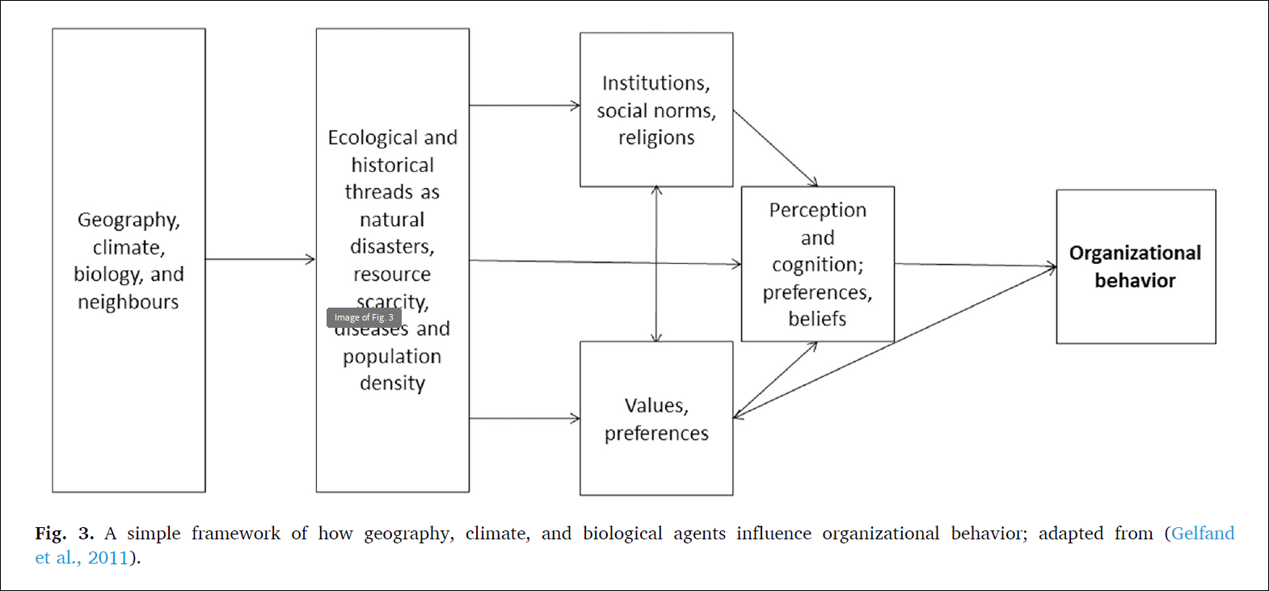
HOW GEOGRAPHY,CLIMATE AND BIOLOGY INFLUENCE BEHAVIOUR
Notes:
This diagram depicts a framework that explains how various external factors can influence organizational behavior. The framework suggests that geographic, climatic, biological factors, and the presence of neighbors all contribute to ecological and historical threats such as natural disasters, resource scarcity, and population density. These environmental pressures, in turn, shape a community's or society's institutions, social norms, and religious beliefs.
The bottom of the framework contains a box labeled "Values, preferences," indicating that the combination of all these factors — from geography to societal institutions — shapes the values and preferences of individuals within a society. Moving to the upper right of the diagram, these collective values and preferences are shown to influence organizational behavior through perception, cognition, preferences, and beliefs. The arrows indicate that this influence is directional, suggesting a flow from the environmental and societal factors through individual values and perceptions, ultimately impacting the behavior of organizations. This sort of framework highlights the interconnectedness of natural and social systems and their collective influence on how organizations operate and behave.

Slide 16
HOW GEOGRAPHY,CLIMATE AND BIOLOGY INFLUENCE BEHAVIOUR
The above figure emphasizes the multifaceted nature of how geography, climate, and biological agents interact to influence organizational behavior. By considering the complex interplay between external environmental factors and organizational dynamics, businesses can develop strategies that promote adaptability, sustainability, and resilience in the face of diverse challenges and opportunities. Understanding the impact of geography, climate, and biological agents on organizational behavior is essential for effective decision-making, strategic planning, and human resource management in today's dynamic and interconnected business environment.
Proposition 3a. (As well as deep historical events) Geography and biological factors lead to culturally specific norms, preferences, or behaviors. They influence constructs relevant to HR management, such as trust or hostility, learning, motivation, creativity, or compliance

Slide 17
Geography and biology matter: implications for HRM education
This suggests the significance of considering geographical and biological factors in the field of Human Resource Management (HRM) education. Understanding the implications of geography and biology in HRM education is essential for preparing HR professionals to navigate diverse workplace environments and effectively manage human resources. To better understand, we consider some of the key point such as: Environmental Sustainability, Biological Diversity, Cultural Sensitivity etc
Proposition 3b. The influence of geography and biology on culture has a different impact on the same management practices in different cultures. Incorporating obtained knowledge into (intercultural) HRM education or intercultural training will lead to more effective practice

Slide 18
CONCLUSION
In academia, to establish a new theory or empirical evidence in one field, It is prudent to allow other schools of thought to decipher your findings from a different perspective, formulate innovative research questions and think about developing more complex theories and richer ways of testing them. This is the approach taken by this paper. In the process, it can be concluded that:
By utilizing various empirical traditions and datasets, researchers can delve into historical events, linguistic variations, and environmental conditions to uncover the origins and persistence of specific cultural traits. This deeper analysis goes beyond mere correlations between organizational behavior and national culture, offering a more nuanced understanding of how cultural differences emerge and evolve.
By exploring the historical, linguistic, geographical, and biological factors that shape cultural norms and behaviors, researchers can enhance the effectiveness of intercultural training and cross-cultural management education. This knowledge allows training designers to develop programs that address the fundamental causes of cross-cultural differences, rather than relying solely on surface-level observations or generalizations based on national culture.
understanding the origins of cultural differences enables training designers to create more effective intercultural management practices that are grounded in a thorough analysis of the factors influencing organizational behavior across different cultures. By examining the underlying causes of cross-cultural differences, HRM education can foster greater sensitivity, awareness, and adaptability in managing diverse workforces and promoting successful cross-cultural interactions at a fundamental level.

Slide 19
CONTRIBUTION
Undoubtedly, the paper exudes the transformative potential of integrating deep rooted factors into intercultural training and cross-cultural management education
By understanding the underlying origins of cultural differences, training designers and educators can develop more nuanced and effective programs that address the complexities of managing diverse teams in a globalized workforce. This can be done in line with the following:
Revolutionizing Intercultural Training and Management Education
Enhancing Effectiveness and Empowering Organizations
Enriching Research Methods in HRM
Paving the Way for Effective Intercultural Training
In essence, by integrating deep-rooted factors into intercultural training and management education, organizations can develop more effective strategies for managing cultural diversity, fostering collaboration, and achieving success in a global context.

Slide 20
LIMITATIONS
Inevitably, as applicable to every research, this paper has its own limitations. These are thus:
Experimental Replication and External Validity: The passage notes the limitations in replicating experimental results and ensuring external validity, especially in studies involving variables like historical shocks, geographic locations, or infection stress. It highlights the difficulty of conducting experiments with adequate external validity for certain variables due to ethical and practical constraints.
Complexity of Developing Management Practices: The passage acknowledges the complexity of developing simple management practices, leadership styles, and cultural intelligence training that can be universally applied in context-dependent environments. It suggests that the findings presented in the paper may lead to the conclusion that effective management education requires a nuanced understanding of the deep-rooted factors influencing cross-cultural organizational differences.
Persistence of Cultural Components in New Environments: The passage acknowledges that cultural components tend to persist even in new environments, as evidenced by studies on second-generation immigrants. These studies show that individuals often reflect cultural elements from their country of origin, impacting their preferences and behaviors even when living in a different cultural context. This suggests that indigenous cultural elements may influence behaviors in strong corporate cultures and HR practices.

Slide 21
THANK YOU

