Slide 1
The role of experience and innovation characteristics in the adoption and continued use of e-learning websites
Computers & Education 51(4), 2008, 1405–1416
Hsiu-Li Liao *, Hsi-Peng Lu

Slide 2
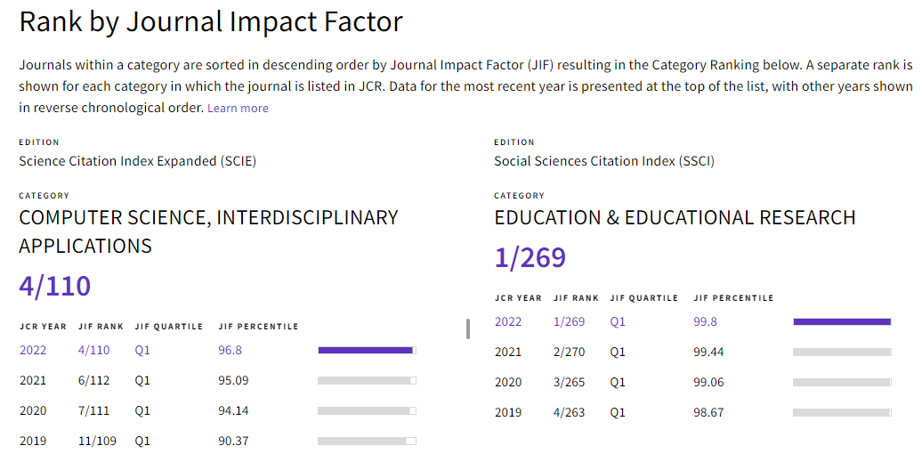
Rank by Journal Impact Factor (JIF=12)

Slide 3
Abstract
With the advent of e-learning technologies in the past decade, the accessibility of training, teaching, and learning has drastically increased.
The challenge for the education enterprise now is how to attract learners to their e-learning services.
In this study, a technology adoption model is developed to predict the users’ intention of adoption and their continued use behavior.
The findings indicate that perceptions of relative advantage and compatibility are significantly related to users’ intention to use e-learning.
The intention is significantly related to their actual use of e-learning.
The technology adoption of learners with prior e-learning experience is different from those without prior e-learning experience.

Slide 4
1. Introduction
E-learning has grown into a revolutionary way of learning due to the rapid development of information and communication technologies (Cappel & Hayen, 2004).
The technological innovations have made training, teaching, and learning over the Internet possible, which is so-called Web-based instruction (WBI) in education and training fields (Lee, 2001).
E-learning has received considerable attention as a means of providing alternatives to traditional face-to-face, instructor-led education (Douglas & Van Der Vyver, 2004).
IDC, the IT intelligence analyst puts the total global e-learning market at $8 billion and set to grow to $13 billion in the next five years (Flood, 2006).
In Taiwan, the Institute for Information Industry (III) reported that the domestic market for e-learning services has grown from $17 million in 2001 to $209 million in 2005 (UDN, 2006).
With the continuous growth of the e-learning market, however, there is a lack of discussion on the individuals’ behavior in the adoption and continued use of e-learning.

Slide 5
1. Introduction (cont.)
E-learning, by this definition, can be considered an information technology (IT) innovation for many learners. According to Tornatzky and Fleischer’s (1990) definition, innovation is ‘‘the situationally new development and introduction of knowledge-derived tools, artifacts, and devices by which people extend and interact with their environment” (p. 10).
Colleges, universities, and private training companies are converting more and more courses online.
With a PC connected to the Web, e-learning allows students to attend courses anywhere at any time.
For interactivity, learners would have to mail back the assignments to receive feedback from the instructor or go to the tutoring center for face-to-face interaction experience.
Today, e-learning (or Web-based learning) has made distance learning highly interactive.

Slide 6
1. Introduction (cont.)
Many of the prior research on e-learning are concerned with learning effectiveness and performance.
David and Glen described the results of a designed experiment to measure the learning effectiveness of making all the text’s multiple choice questions with answers, available to off-campus students enrolled in the database unit in an e-learning environment. The approach improves performance on the final examination not only on the multiple choice questions but also on the theory questions (Douglas & Van Der Vyver, 2004).
James and Roger investigated the users’ previous online learning experiences, satisfaction, perceived effectiveness and quality of the online learning units in an online self-paced independent study courses as a project within a traditional, instructor-led graduate course (Cappel & Hayen, 2004).
Robert, Kimberly, and Jean sought to examine the effects of cognitive load on performance outcomes of students using computer-based instruction. The performance of students in a cooperative group interacting in a computer-based instructional environment was compared to the performance of students working alone (Fuller, Vician, & Brown, 2006).
However, few previous studies have investigated how the users’ perceptions of innovation characteristics influence the use of e-learning.

Slide 7
1. Introduction (cont.)
This study focuses on individual users’ perceptions of innovation characteristics (PCI) of e-learning as explanatory and predictive variables for their adoption and continued use behavior.
Two specific questions therefore guided this research:
  First, can the perception variables of innovation characteristics (PCI) predict individual’s intention to use an e-learning website? While some studies have used innovation characteristics to explain users’ acceptance behavior in specific contexts successfully (Jurison, 2000; Van Slyke, Belanger, & Comunale, 2004; Ilie, Van Slyke, Green, & Lou, 2005; Lin & Lee, 2006), few research have been done in relation to e-learning adoption factors.
  The second research question is whether the technology adoption model of learners experienced in e-learning is different from inexperienced learners. While PCI variables are examined against the adoption of e-learning of inexperienced users and the continued use of the experienced users, it is expected that perceptions differ or change with experience (Fazio, 1989).

Slide 8
2. Theoretical background and research model
For research in technology adoption, the technology acceptance model (TAM) has received considerable attention.
This model proposes two key beliefs in the adoption of technology: perceived usefulness (PU) and perceived ease of use (PEU).
While TAM focuses on the technology adoption process, later innovation research further distinguish between initial adoption of innovation and continued/sustained use of innovation (Rogers, 1983).
This study proposes a theoretical framework for user adoption behavior of e-learning based on the theory of perceptions of innovation characteristics (PCI).
Both e-learning adoption behavior and continued use will be discussed.

Slide 9
2.1. Perceptions of innovation characteristics
Rogers (1983) identified attributes of innovation that are key to acceptance behavior including relative advantage, complexity, compatibility, trialability, and observability.
Based on the work of Rogers and others, Moore and Benbasat (1991) expanded the innovation characteristics into seven constructs and developed an instrument to measure the perceptions.
The constructs include relative advantage, ease of use, compatibility, image, result demonstrability, visibility and trialability.
Rogers’ and Moore and Benbasat’s first construct of PCI, relative advantage, is similar to the concept of perceived usefulness of TAM (Davis, Bagozzi, & Warshaw, 1989).
Relative advantage presents the degree to which a potential adopter views the innovation as offering an advantage over previous ways of performing the same task.
The second construct, ease of use, which is also part of the TAM, is similar to definition to Rogers’ concept of complexity (Rogers, 1983) and captures the degree to which a potential adopter considers use of the target system to be relatively free of effort (Davis, 1993).

Slide 10
2.1. Perceptions of innovation characteristics (cont.)
Moore and Benbasat’s construct of compatibility is inline with Rogers’: ‘‘the degree to which an innovation is perceived as being consistent with the existing values, needs, and past experiences of potential adopters.”
Moore and Benbasat (1991) indicated that the image construct, which is as part of relative advantage in Rogers’ framework, can independently predict innovation use. The image construct refers to the perception when using an innovation in terms of enhancing the social status of the potential adopter.
Rogers’ attribute of observability is divided into two constructs of result demonstrability and visibility, which refers to ‘‘the tangibility of the results of using an innovation” and ‘‘the extent to which potential adopters see the innovation as being visible in the adoption context” respectively.
Finally, trialability indicates the perception of potential adopters of an opportunity to try the innovation before committing to its use.

Slide 11
2.2. Perceptions of innovation characteristics and intention of use
Researches in PCI indicate that individuals’ perceptions about the characteristics of an innovation significantly affect their acceptance behavior. Such discussion on perceptions has been persistent in research literature in system use (Moore & Benbasat, 1991; Davis, 1993) and use intentions (Agarwal & Prasad, 1997; Van Slyke, Lou, & Day, 2002; Van Slyke et al., 2004; Lin & Lee, 2006; Ilie et al., 2005)
Tornatzky and Klein (1982), in a meta-analysis of innovation characteristics research, found that only three innovation characteristics - perceived relative advantage, perceived complexity, and perceived compatibility – are consistently related to innovation adoption.
Few studies have addressed the adoption of e-learning in the perspective of perceived innovation characteristics. As an innovative learning method, the adoption of e-learning involves the adoption of information technology and change of learning approach.
Therefore, this research represents an attempt to use diffusion of innovation perspective (2003) to understand factors that may impact the intention to use online e-learning.

Slide 12
2.3. Prior experience, Perceptions of innovation, and Intention to use
Studies have shown that prior experience can change intention of adoption or continued use of innovation. For example, Web shoppers’ intention to continue shopping online is affected by past Web-shopping experience and past experience with the Web (May So, Danny Wong, & Sculli, 2005).
Agarwal and Prasad (1997) focused on individual perceptions as explanatory and predictive variables of users’ World Wide Web acceptance and continued use behavior.
  Their study results indicated that the innovation characteristics of visibility, compatibility, and trialability are relevant in explaining acceptance behavior. For continued use behavior, their study suggested that only advantage and result demonstrability were relevant innovation characteristics.
  Agarwal and Prasad also suggested that there were differences in perceived characteristics between acceptance and continued use of innovation.

Slide 13
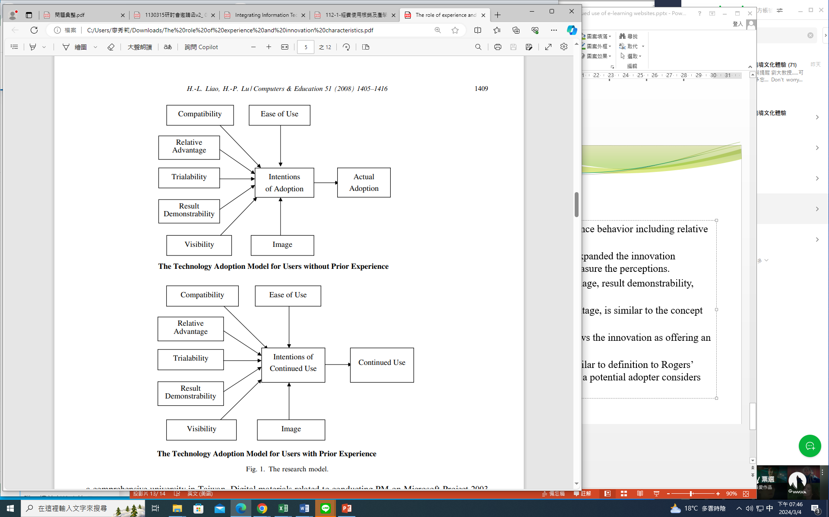
2.4. The research model

Slide 14
3. Research methodology
3.1. Characteristics of the sample and study context
A survey was conducted on students who were enroa comprehensive university in Taiwan. Digital materials related to conducting PM on Microsoft Project 2003 were developed and students can refer to them on the e-learning website.
The system used in the experiments was designed explicitly for this research. It ran on a Pentium IV PC with a 15” monitor. Subjects used Internet Explorer 6 to browse the teaching materials stored on a university server.
With this configuration, retrieval of information, including video clips, was almost instantaneous. The e-Learning website development was using the Wisdom Master. Developed by SUN NET Technology Corporation, Wisdom Master is one of the most popularly used platforms of Learning Management System (LMS) in Taiwan. Wisdom Master is also the first software in Taiwan that meets the highest standard (RTE3) of the SCORM 1.2.

Slide 15
3.1. Characteristics of the sample and study context (cont.)
The synchronous mode of teaching is not always superior to the asynchronous mode (Palvia, 2000).
A majority of e-learning is conducted in an asynchronous mode (Douglas & Van Der Vyver, 2004).
Therefore, we developed e-learning system with the asynchronous mode.
With the high-resolution monitor employed, subjects could clearly see the facial expressions of the people in the video clips on the e-learning website.
Subjects received a one-hour, hand-on demonstration on using e-Learning website before the course actually began.
Subjects can use the e-learning web system free through connecting Internet from anlled in a project management (PM) course at any time.
After they finished the 4-week course free, the students were asked to complete a questionnaire survey.

Slide 16
3.1. Characteristics of the sample and study context (cont.)
Completion of the survey was voluntary and could be done outside class.
A total of 137 surveys were completed. The age range of the sample was 20–30 years old.
Of the 137 respondents, 59 were females (43%) and 78 were males (57%). Among these respondents, 41 did not have any previous e-learning experience.

Slide 17
3.2. Instrument development
The survey questionnaire included a combination of items derived from earlier studies and newly developed items.
Moore and Benbasat’s (1991) questionnaire of scales of perceptions of innovation characteristics was used as the foundation for the development of the survey instrument.
It included a total of 25 items with each scale consists of a minimum of two items.
Additionally, the intention of adoption and intention of continued use were assessed using two items constructed following the recommendations of Davis et al. (1989).
The actual adoption and continued use were measured using two items similar to those in Davis (1993). As indicated by Davis, such self-reported measures are reasonable indicators of relative system use.
Respondents scored on a seven-point Likert-type scale with the end points being ‘‘strongly disagree” and ‘‘strongly agree”, except for items intended to collect demographic data.

Slide 18
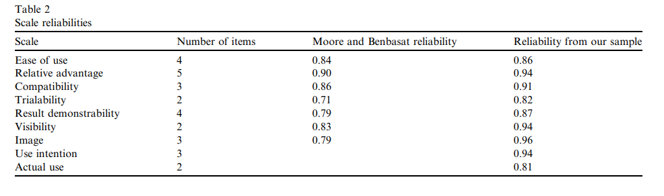
3.3. Measures
Factor reliabilities, as represented by Cronbach’s alpha in Table 2, were between 0.81 and 0.94 for each factor. Reliability from the sample showed a reasonable level of reliability (a > 0.70) (Cronbach, 1970).

Slide 19
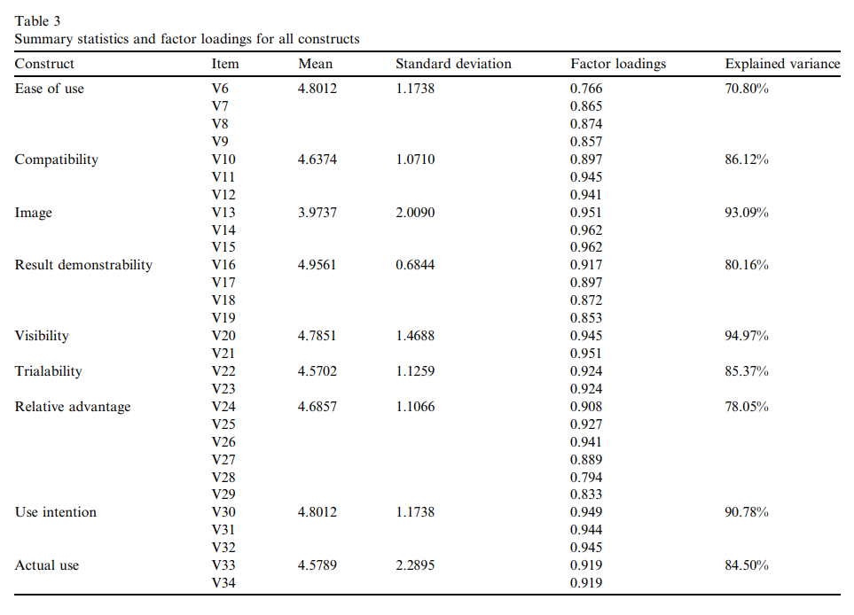
3.3. Measures (cont.)
Using the principal components method with varimax rotation, construct validity was examined.
Bagozzi and Yi (1988) suggested that factor loadings for each item should be over 0.6 to be valid.
The factor loadings for all items exceeded 0.7 in this study, which indicated that the individual items had discriminant validity

Slide 20
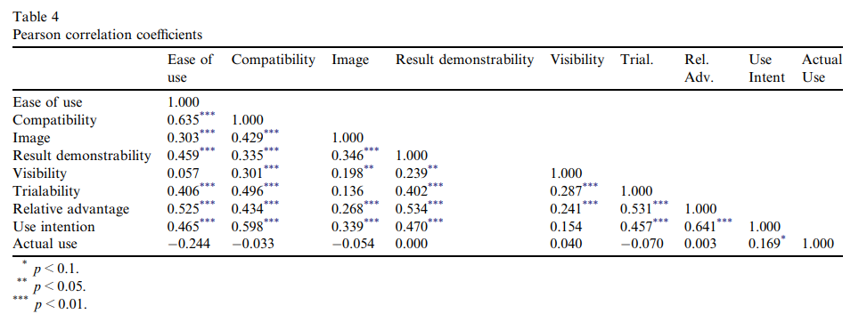
4. Analysis and results
Pearson correlation coefficients for all research variables are shown in Table 4. Although Table 4 indicates that most user perceptions are significantly correlated with each other, an examination of the variance inflation factors indicated that the multicollinearity was not significant (Meuter, Jo Bitner, Ostrom, & Brown, 2005).

Slide 21
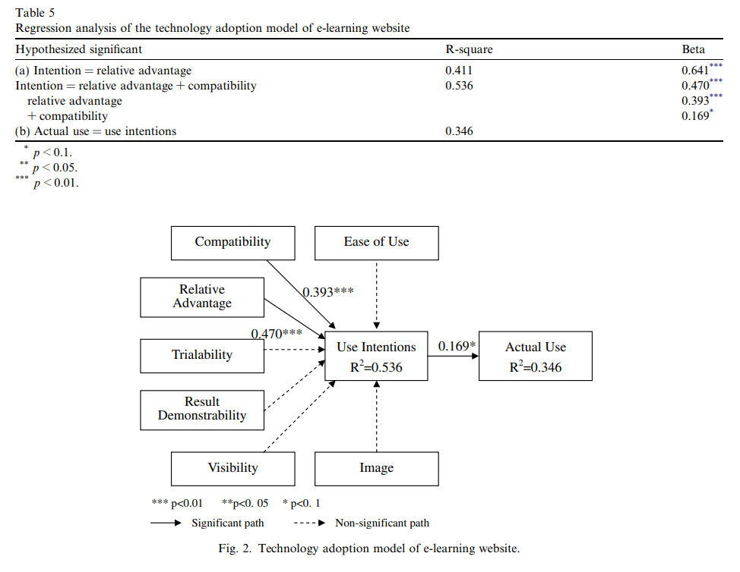
4. Analysis and results (cont.)
Stepwise regression enters independent variables into the regression equation one at a time, starting with the independent variable that best predicts the dependent variable.
Independent variables are entered into the equation until adding the next best predictor does not significantly improve the explanatory power of the equation.
All assumptions were confirmed.

Slide 22
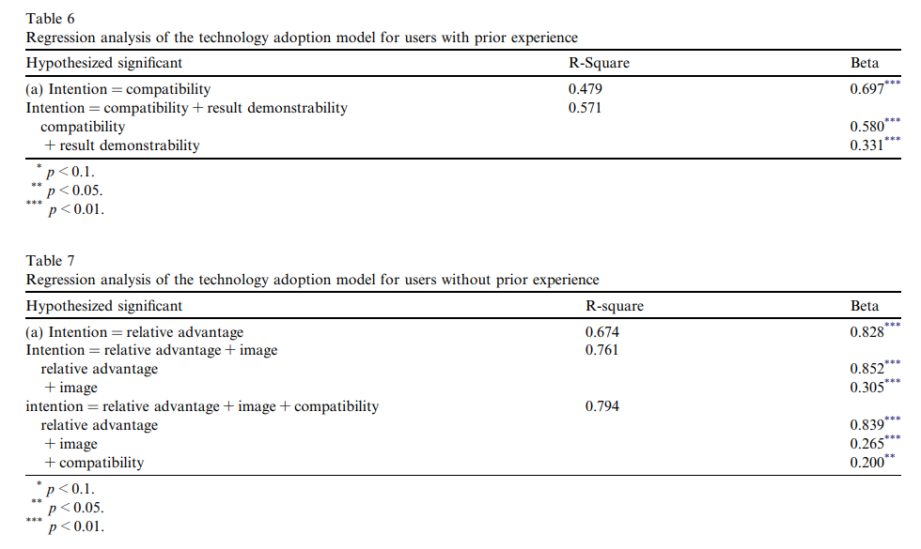
4. Analysis and results (cont.)

Slide 23
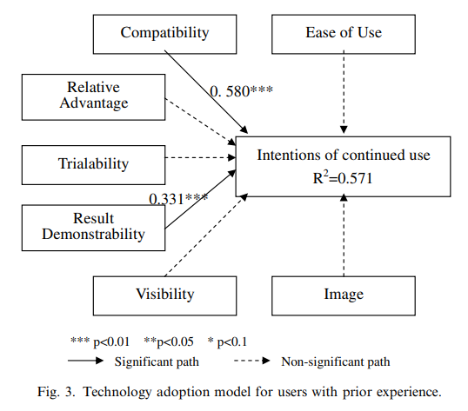
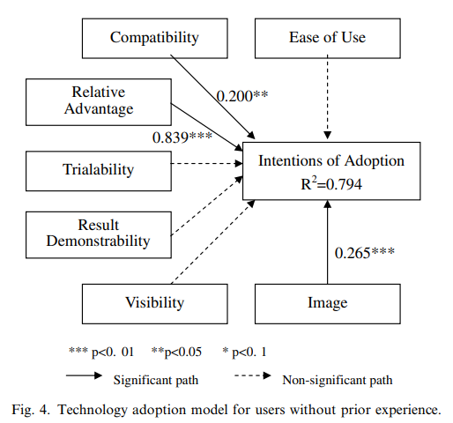
4. Analysis and results (cont.)

Slide 24
5. Conclusion and discussion
The results of the investigation indicate a relationship between user perceptions of the characteristics of the e-learning website and their intention to use the technology.
More specifically, users’ perceptions of the relative advantage and compatibility of the e-learning website exhibit significant relationships with their adoption intention.
The results are generally consistent with prior research about other technology adoption.
Relative advantage and compatibility have received the most consistent support as factors that influence adoption and use of an innovation in other contexts (Van Slyke et al., 2002; Van Slyke et al., 2004; Lin & Lee, 2006).
Notably, examination of the relative strengths of the associations between the individual perception variables and adoption intention clearly indicate that perceived relative advantage and compatibility can explain much of the variation in adoption intention.
In other words, for web-learning learners, the perceptions of the relative advantage and compatibility of web learning are better predictors than other perception constructs.

Slide 25
5. Conclusion and discussion (cont.)
The differences in the perceptions–intention relationship for learners with and without experience in e-learning website make an argument for the consideration of an experience component associated with the technology use model.
In this study, previous e-learning experiences, compatibility and result demonstrability have a significant, direct effect on user’s intention of continued use.
However, for users without previous experience of using e-learning, compatibility, image and relative advantage have a significant, direct effect on user’s intention of adoption.
When learners have more experience with e-learning, the impact of perceived innovation characteristics on intentions to use web learning are different from that of inexperienced learners.
Information obtained from experience over a period of time undoubtedly has the potential to modify future intentions of using web learning.

Slide 26
5. Conclusion and discussion (cont.)
The current research can lead to several further studies.
  First, the dependent construct here represents behavioral intention of initial adoption and continued use. It would be valuable that studies can be conducted to understand potential implications experience gained over time has for the technology use model.
  A second concern is that the model tested here has been empirically assessed in only one conducting context.
  The gereralizability of the results reported here is not known beyond the current sample, e-learning context and richness antecedents.
However, the proposed research model provides explanations and predictions to understand learners’ behavior.
Based on this understanding, system platform manager and education institution can determine how to improve the learners’ initial intention and continued use of e-learning websites.

