Slide 1

Prepared by:
Tifany - 11204614
Corporate social responsibility or CEO narcissism?
CSR motivations and organizational performance
Special Topics on Business Ethics Gloria Chen, PhD
September 19th, 2024

Slide 2
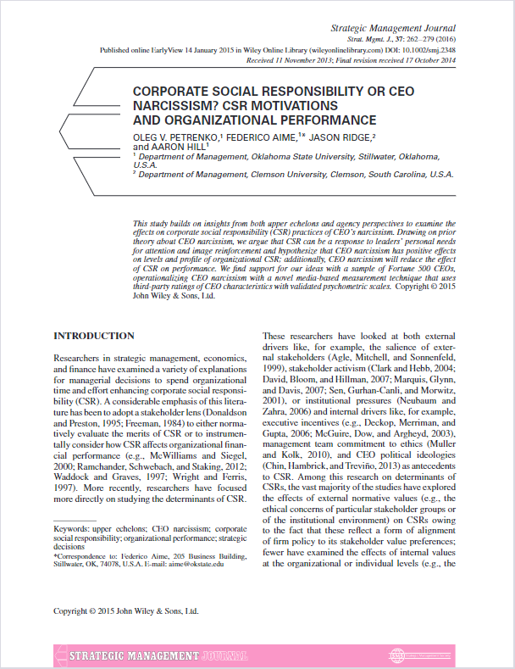
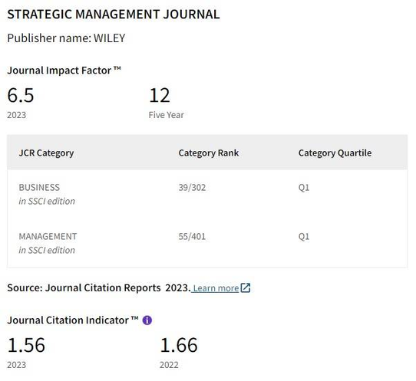
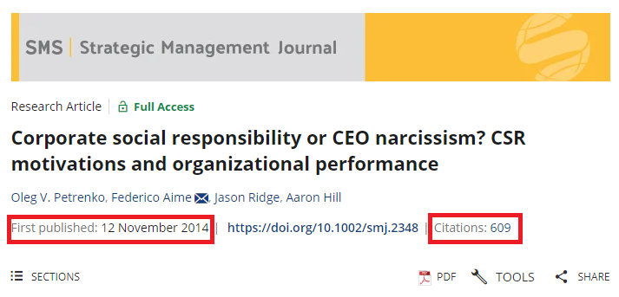
Article Requirements
Impact Factor
Published Year & Citation

Slide 3



Writing Plan
Why do I chose this article?
How will this impact my writing?
My Topic’s Plan
It challenges the traditional idea that CSR were driven by genuine desire to improve the social welfare, but what if its driven by the narcisstic desire of the CEO?
Offer a more critical view of CSR, questioning its ethical foundation when its motivated by narcisism
Title:
Narcissistic Leadership and Corporate Social Responsibility: Examining CEO Motivations and CSR Impact in Indonesian Corporations.
Case Example: Lapindo Brantas
this article help me to explore ethical reasons behind CSR’s program in companies
This article help me to explore the potential self-serving motives behind every CSR’s idea

