Slide 1


THE ROLE OF ETHICAL PERCEPTIONS IN CONSUMERS’ PARTICIPATION AND VALUE CO-CREATION ON SHARING ECONOMY PLATFORMS
AHMATANG
YE JUN PIN
11304608

Slide 2
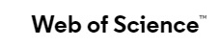
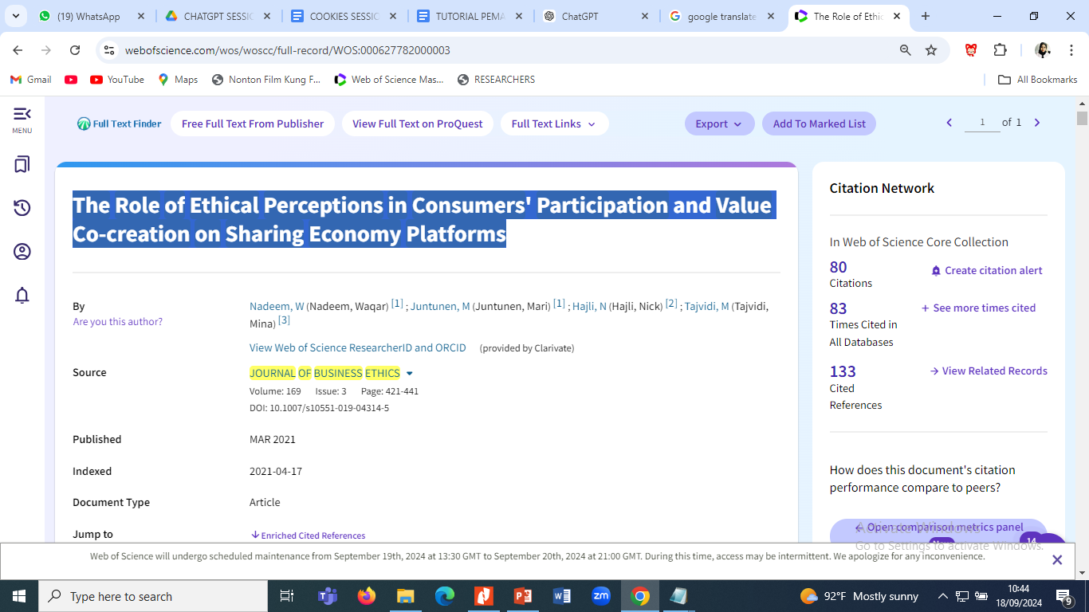

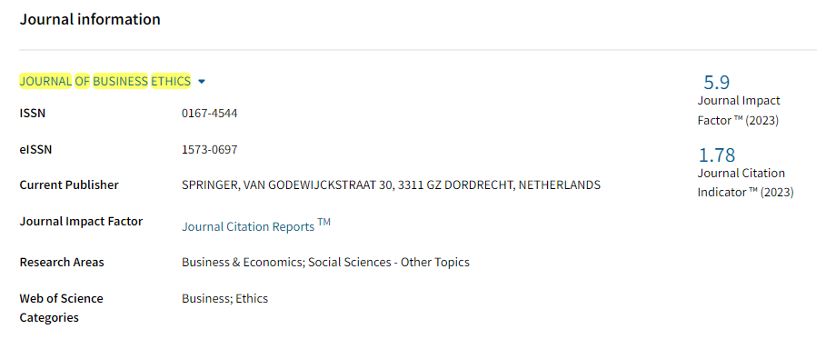


Journal Information

Slide 3


01.
Directly related to my research plan on Marketing
Why Choosing the Article
02.
Focus on Digital Business and the Sharing Economy
03.
Practical Implications for Digital Business
04.
Relevance to Consumer Decision-Making on Digital Platforms
05.
Strong Empirical Data - strong empirical analysis with relevant data from digital platform users

Slide 4



What Can I learn From Article
1
Impact of Consumers' Ethical Perceptions
3
Loyalty and Consumer Decision-Making
The journal discusses how consumers ethical perceptions, such as privacy, security, honesty, and transparency, influence their participation in sharing economy platforms
Positive ethical perceptions not only increase consumer participation but also foster loyalty. Consumers who feel safe and trust the platform's ethics are more likely to continue using its services or products and recommend them to others
2
Consumer Participation and Engagement
4
Implications for Digital Business Development
The journal highlights the role of ethical perceptions in encouraging consumer participation in value co-creation
The journal also offers insights into how digital companies can use ethical principles as a business strategy. By improving transparency, security, and honesty, digital platforms can enhance customer loyalty and attract more users.

Slide 5
Future Writing
Topic
Customer loyalty in online shopping: The moderating effects of online shopping experience
Method
Data analysis using the PLS application

Slide 6




Thank You

