Slide 1
Empirical Study towards Corporate Social Responsibility Practices and Company Financial Performance. Evidence for Companies Listed on the Bucharest Stock Exchange
Muhammad Tharmizi Junaid
11304614

Slide 2
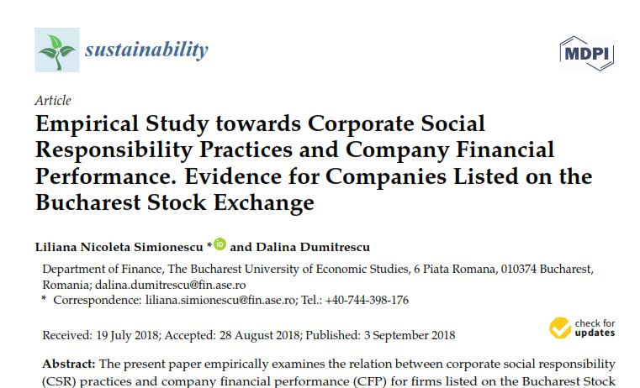
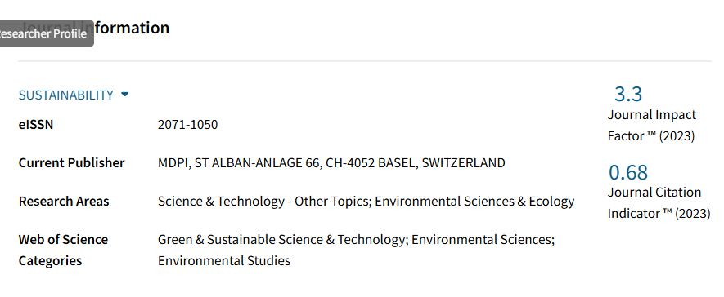

Slide 3
Why This Article Is Interisting?
The research offers an empirical analysis of the connection between corporate social responsibility (CSR) practices and financial performance (CFP) in companies listed on the Bucharest Stock Exchange. By concentrating on this particular market, the study provides valuable insights that may be relevant to other emerging markets as well.
The authors utilized Principal Component Analysis (PCA) to create a CSR global index (CSRGI) along with specific indices for CSR practices. This methodical approach strengthens the credibility of the results and showcases an advanced technique for analyzing complex data.
The article explores CSR policies directed at six distinct stakeholder groups, expanding the research’s breadth. This diverse approach provides a thorough understanding of how CSR influences multiple areas of a company’s operations and its financial performance.

Slide 4
Next . . .
literature review emphasizes the varied findings from previous studies on the CSR-CFP relationship, providing context for the current research. By addressing these discrepancies, the article adds to ongoing debates in the field and aims to clarify the nature of this relationship.
The study presents evidence of a positive connection between CSR and CFP, especially when companies adopt CSR policies focused on employees, environmental protection, and ethics. This result is important, as it indicates that CSR can serve as a strategic advantage for companies, potentially impacting their long-term success.
The insights from this research can guide corporate strategies, motivating companies to embrace CSR practices that not only meet ethical responsibilities but also boost financial performance. This practical significance makes the findings useful for both business leaders and policymakers.

Slide 5
Writing a Research Paper Based on This Article
Introduction
I would start by explaining the importance of Corporate Social Responsibility (CSR) and its influence on Company Financial Performance (CFP). The introduction would emphasize the article's goal, which is to examine the connection between CSR practices and CFP in companies listed on the Indonesian Stock Exchange.
Literature Review
This section would explore existing literature on CSR and CFP, covering different definitions of CSR and previous research that shows positive, negative, or no relationship between CSR and CFP. I would highlight the difficulties in defining CSR and how these challenges influence research in the field.
Methodology
I would explain the methodology used in the article, which includes applying principal component analysis (PCA) to create a CSR index and using regression models to analyze the data. Additionally, I would describe the variables considered, such as company size, leverage, and profitability indicators.

Slide 6
Next . . .
Empirical Findings
This section would outline the research findings, showing a positive connection between CSR practices and CFP, especially when companies focus on employees, environmental protection, and ethical practices in their CSR policies. I would discuss how CSR can increase company value and improve stakeholder perceptions.
Discussion
In this section, I would analyze the implications of the findings, discussing how companies can incorporate CSR into their business strategies to enhance financial performance and competitiveness. I would also address the challenges companies encounter in successfully implementing CSR practices.
Conclusion and Recommendations
I would wrap up by summarizing the main findings and offering recommendations for future research. The significance of CSR in corporate strategy and its role in promoting sustainability and long-term growth would be highlighted.

Slide 7
Thank You !

