Slide 1
A Study of The Link Between a Corporation's Financial Performance and Its Commitment to Ethics
aan digita malik
11304618

Slide 2
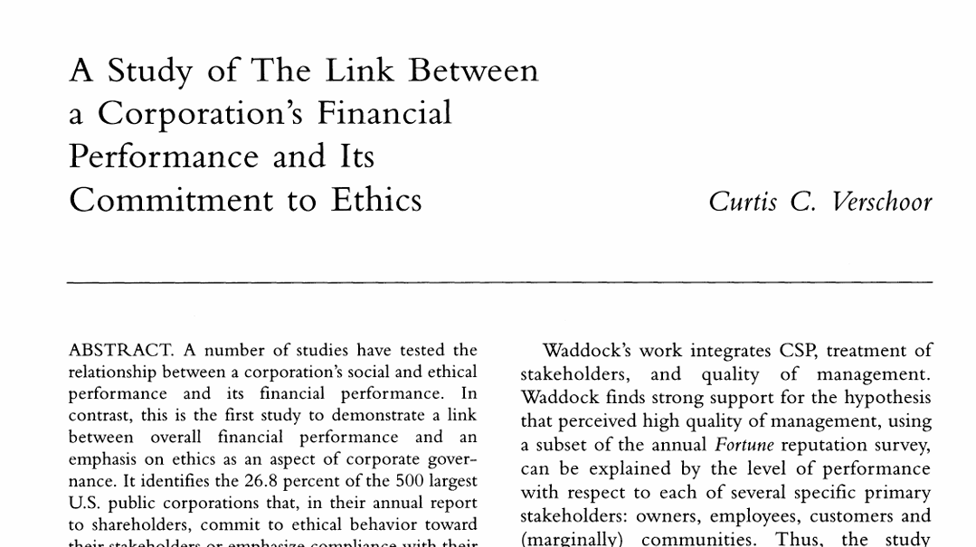
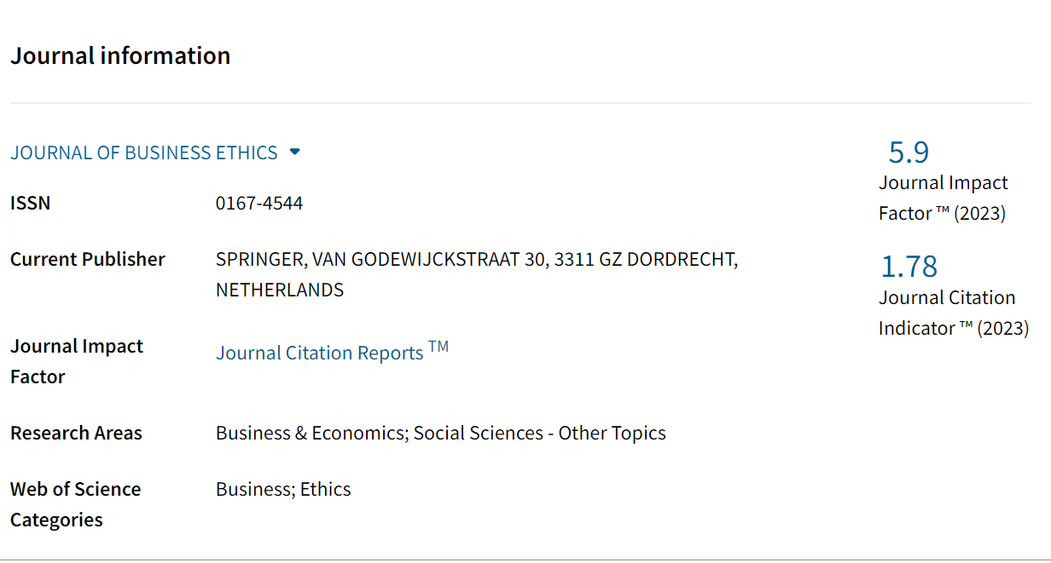

Slide 3
So why the article interesting?
Unique Focus on Ethics and Financial Performance:
This article is notable for being the first study to directly connect a corporation's overall financial performance with its dedication to ethics within corporate governance. This relationship is important as it broadens the perspective from just social performance to encompass how ethical practices can impact financial results
Empirical Evidence:
The study offers empirical evidence by examining 500 of the largest public corporations in the U.S. It reveals that 26.8% of these companies prioritize ethical behavior in their annual reports. This measurable data enhances the credibility of the findings and underscores the significance of ethics in business practices
Statistical Significance:
The research shows that corporations dedicated to ethical practices achieve better financial performance than those that aren't, with a significance level of p < 0.005. This robust statistical evidence indicates that ethical commitments are not merely a moral decision but can also result in improved financial outcomes.

Slide 4
Next . . .
Implications for Corporate Governance:
The findings urge corporations to embrace the principles of Social and Ethical Accounting, Auditing, and Reporting (SEAAR). This implies a practical use of the research, inspiring businesses to incorporate ethical considerations into their governance structures, potentially resulting in enhanced financial performance.
Relevance in Today's Business Environment:
In a time when corporate scandals and ethical violations are often spotlighted in the media, this article is especially pertinent. It offers a counter-narrative that highlights the advantages of ethical behavior, making it a timely addition to conversations about corporate responsibility and governance.
Encouragement for Future Research:
By connecting ethics to financial performance, the study paves the way for further research in this field. It encourages scholars and practitioners to investigate how ethical practices can be systematically woven into business strategies for sustained success. Overall, this article is intriguing as it merges ethical considerations with financial outcomes, offering a new perspective that could impact both academic research and practical business approaches.

Slide 5
Writing a research paper based on this article
Introduction
I would begin by clearly defining the research objective, which would involve examining the relationship between corporate financial performance and ethical commitment. This aligns with the article's findings, indicating that companies prioritizing ethics tend to perform better financially.
Literature Review
Next, I would conduct a literature review to compile relevant prior research on corporate social and ethical performance and its effects on financial outcomes. This would provide context and strengthen my arguments.
Methodology
I would develop a methodology that incorporates data analysis from corporate annual reports, similar to the approach taken in this article, which identifies that 26.8% of the 500 largest U.S. public corporations prioritize ethical behavior. Additionally, I would consider using the same financial performance metrics as those in the Business Week rankings.

Slide 6
Data Collection
I would gather data from annual reports and other sources to assess corporate ethical commitments and their financial performance, including both quantitative and qualitative information.
Data Analysis
I would analyze the collected data to identify any significant relationship between ethical commitment and financial performance, employing appropriate statistical techniques. The article suggests a significant link at a p-value of < 0.005.
Discussion and Implications
I would discuss my findings in relation to existing literature and outline the implications for corporations and stakeholders. I would also emphasize the importance of the principles of Social and Ethical Accounting, Auditing, and Reporting (SEAAR) as highlighted in the article.
Conclusion
Finally, I would summarize the key findings and offer recommendations for future research and corporate practices. By following this framework, I aim to produce a thorough research paper that enhances the understanding of the connection between ethics and corporate financial performance.

Slide 7
THANKYOU ☺

