Slide 1
The effect OF CONSUMER PERCEPTIONS OF THE ETHICS OF RETAILERS ON PURCHASE BEHAVIOR AND WORD-OF-MOUTH: THE MODERATING ROLE OF ETICHAL BELIEFS
ERWIN MANGATUR SIBURIAN
11304621

Slide 2
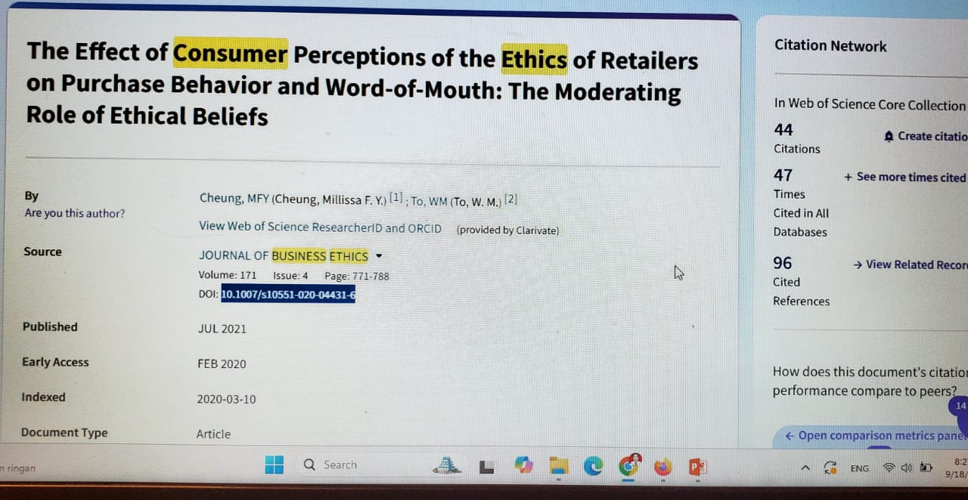
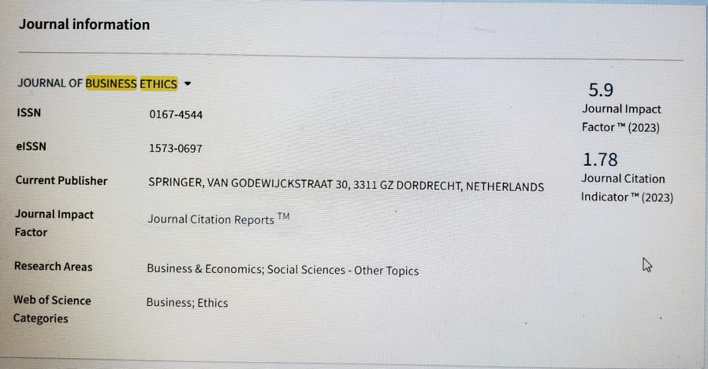
JOURNAL INFORMATION

Slide 3
Why did I choose this article?
In the future, my research aligns perfectly with this article which is about marketing.
The relationship with consumer behavior
The relevance of context means that this study is conducted within the context of collectivist societies, particularly in Asia, which provides a new perspective on how culture and ethical values influence consumer purchasing decision in the market.
Practical implications for management.

Slide 4
The impact of this article
A strong conceptual framework
Taking a multidimensional approach
Application of social theory
Emperical data
The influence of culture in research
Systematic article structure

Slide 5
Analysis of Factors Affecting Online Shopping Decisions
TOPIC
I am using smartPLS to conduct exploratory factor analysis
Method

Slide 6


