Slide 1
Regression basics-1.3
Residual Plot
Anyone who has performed ordinary least squares (OLS) regression analysis knows that you need to check the residual plots in order to validate your model. Have you ever wondered why? There are mathematical reasons, of course, but I’m going to focus on the conceptual reasons. The bottom line is that randomness and unpredictability are crucial components of any regression model. If you don’t have those, your model is not valid.

Slide 2
Why? To start, let’s breakdown and define the 2 basic components of a valid regression model:
Response = (Constant + Predictors) + Error
Another way we can say this is:
Response = Deterministic + Stochastic

Slide 3
The Deterministic Portion
This is the part that is explained by the predictor variables in the model. The expected value of the response is a function of a set of predictor variables. All of the explanatory/predictive information of the model should be in this portion.

Slide 4
The Stochastic Error
Stochastic is a fancy word that means random and unpredictable. Error is the difference between the expected value and the observed value. Putting this together, the differences between the expected and observed values must be unpredictable. In other words, none of the explanatory/predictive information should be in the error.

Slide 5
The idea is that the deterministic portion of your model is so good at explaining (or predicting) the response that only the inherent randomness of any real-world phenomenon remains leftover for the error portion. If you observe explanatory or predictive power in the error, you know that your predictors are missing some of the predictive information. Residual plots help you check this!
Statistical caveat: Regression residuals are actually estimates of the true error, just like the regression coefficients are estimates of the true population coefficients.

Slide 6
Using Residual Plots
Using residual plots, you can assess whether the observed error (residuals) is consistent with stochastic error. This process is easy to understand with a die-rolling analogy. When you roll a die, you shouldn’t be able to predict which number will show on any given toss. However, you can assess a series of tosses to determine whether the displayed numbers follow a random pattern. If the number six shows up more frequently than randomness dictates, you know something is wrong with your understanding (mental model) of how the die actually behaves.

Slide 7
If a gambler looked at the analysis of die rolls, he could adjust his mental model, and playing style, to factor in the higher frequency of sixes. His new mental model better reflects the outcome.
The same principle applies to regression models. You shouldn’t be able to predict the error for any given observation. And, for a series of observations, you can determine whether the residuals are consistent with random error. Just like with the die, if the residuals suggest that your model is systematically incorrect, you have an opportunity to improve the model.

Slide 8
So, what does random error look like for OLS regression? The residuals should not be either systematically high or low. So, the residuals should be centered on zero throughout the range of fitted values. In other words, the model is correct on average for all fitted values. Further, in the OLS context, random errors are assumed to produce residuals that are normally distributed. Therefore, the residuals should fall in a symmetrical pattern and have a constant spread throughout the range.

Slide 9
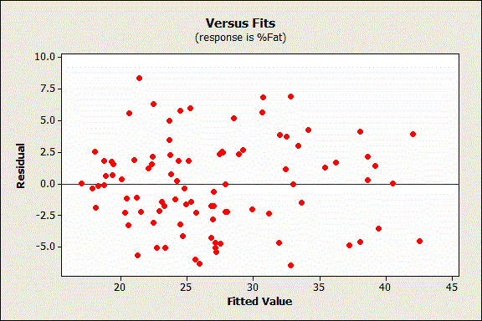
Here's how residuals should look:

Slide 10
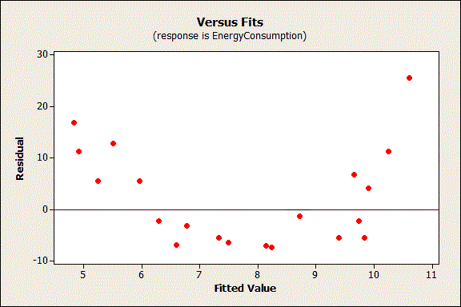
Now let’s look at a problematic residual plot. Keep in mind that the residuals should not contain any predictive information.
In the graph above, you can predict non-zero values for the residuals based on the fitted value. For example, a fitted value of 8 has an expected residual that is negative. Conversely, a fitted value of 5 or 11 has an expected residual that is positive.

Slide 11
The non-random pattern in the residuals indicates that the deterministic portion (predictor variables) of the model is not capturing some explanatory information that is “leaking” into the residuals. The graph could represent several ways in which the model is not explaining all that is possible. Possibilities include:
*A missing variable
*A missing higher-order term of a variable in the model to explain the curvature
A missing interaction between terms already in the model

Slide 12
Identifying and fixing the problem so that the predictors now explain the information that they missed before should produce a good-looking set of residuals!
In addition to the above, here are two more specific ways that predictive information can sneak into the residuals:

Slide 13
(1)The residuals should not be correlated with another variable.
If you can predict the residuals with another variable, that variable should be included in the model. In R-Web, you can plot the residuals by other variables (scatter plot) to look for this problem.
(2) Adjacent residuals should not be correlated with each other (autocorrelation).
If you can use one residual to predict the next residual, there is some predictive information present that is not captured by the predictors. Typically, this situation involves time-ordered observations. For example, if a residual is more likely to be followed by another residual that has the same sign, adjacent residuals are positively correlated. You can include a variable that captures the relevant time-related information, or use a time series analysis. In Minitab’s regression, you can perform the Durbin-Watson test to test for autocorrelation.

Slide 14
How Do I Interpret R-squared and Assess the Goodness-of-Fit?
After you have fit a linear model using regression analysis, ANOVA, or design of experiments (DOE), you need to determine how well the model fits the data. To help you out, R-web presents a variety of goodness-of-fit statistics. In this post, we’ll explore the R-squared (R² ) statistic, some of its limitations, and uncover some surprises along the way. For instance, low R-squared values are not always bad and high R-squared values are not always good!

Slide 15
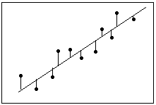
What Is Goodness-of-Fit for a Linear Model?
Definition: Residual = Observed value - Fitted value
Model Y=α+βX₁+γX₂; observations (Y_{i}, X_{1i}, X_{2i}),i=1,…,n
Fitted value for the ith observation Y_{i}^=α+βX_{1i}+γX_{2i}
ith Residual e_{i}^=Y_{i}- Y_{i}^
Linear regression calculates an equation that minimizes the distance between the fitted line and all of the data points. Technically, ordinary least squares (OLS) regression minimizes the sum of the squared residuals.
In general, a model fits the data well if the differences between the observed values and the model's predicted values are small and unbiased.

Slide 16
Before you look at the statistical measures for goodness-of-fit, you should check the residual plots. Residual plots can reveal unwanted residual patterns that indicate biased results more effectively than numbers. When your residual plots pass muster, you can trust your numerical results and check the goodness-of-fit statistics.

Slide 17
What Is R-squared?
R-squared is a statistical measure of how close the data are to the fitted regression line. It is also known as the coefficient of determination, or the coefficient of multiple determination for multiple regression.
The definition of R-squared is fairly straight-forward; it is the percentage of the response variable variation that is explained by a linear model. Or:
R-squared = Explained variation / Total variation
R-squared is always between 0 and 100%:

Slide 18
*0% indicates that the model explains none of the variability of the response data around its mean.
*100% indicates that the model explains all the variability of the response data around its mean.
In general, the higher the R-squared, the better the model fits your data. However, there are important conditions for this guideline that I’ll talk about.

Slide 19
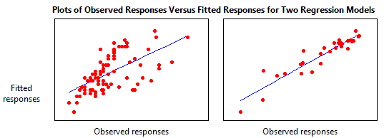
Graphical Representation of R-squared
Plotting fitted values by observed values graphically illustrates different R-squared values for regression models.
The regression model on the left accounts for 38.0% of the variance while the one on the right accounts for 87.4%.

Slide 20
The more variance that is accounted for by the regression model the closer the data points will fall to the fitted regression line. Theoretically, if a model could explain 100% of the variance, the fitted values would always equal the observed values and, therefore, all the data points would fall on the fitted regression line.

Slide 21
Key Limitations of R-squared
R-squared cannot determine whether the coefficient estimates and predictions are biased, which is why you must assess the residual plots.
R-squared does not indicate whether a regression model is adequate. You can have a low R-squared value for a good model, or a high R-squared value for a model that does not fit the data!

Slide 22
Are Low R-squared Values Inherently Bad?
No! There are two major reasons why it can be just fine to have low R-squared values.
In some fields, it is entirely expected that your R-squared values will be low. For example, any field that attempts to predict human behavior, such as psychology, typically has R-squared values lower than 50%. Humans are simply harder to predict than, say, physical processes.
Furthermore, if your R-squared value is low but you have statistically significant predictors, you can still draw important conclusions about how changes in the predictor values are associated with changes in the response value. Regardless of the R-squared, the significant coefficients still represent the mean change in the response for one unit of change in the predictor while holding other predictors in the model constant. Obviously, this type of information can be extremely valuable.

Slide 23
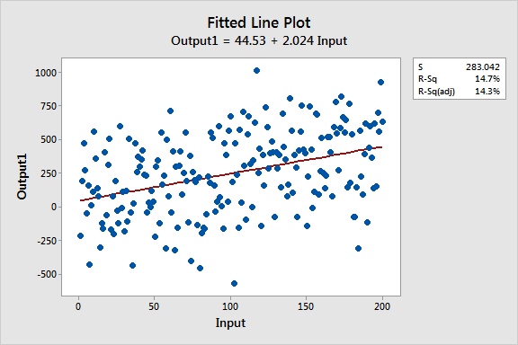
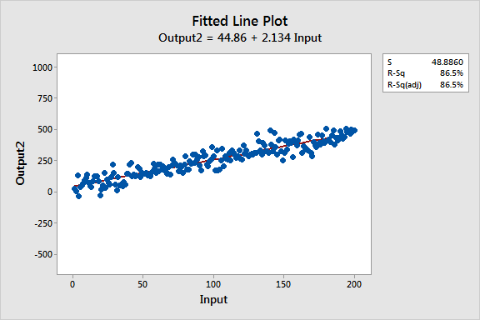

Slide 24
A low R-squared is most problematic when you want to produce predictions that are reasonably precise (have a small enough prediction interval). How high should the R-squared be for prediction? Well, that depends on your requirements for the width of a prediction interval and how much variability is present in your data. While a high R-squared is required for precise predictions, it’s not sufficient by itself, as we shall see.

Slide 25
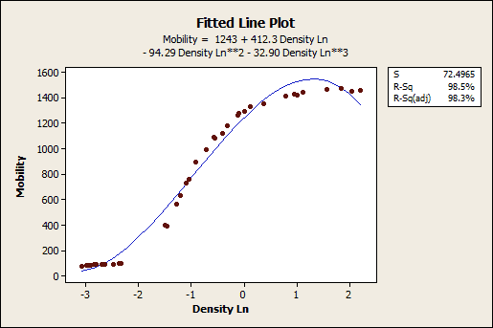
Are High R-squared Values Inherently Good?
No! A high R-squared does not necessarily indicate that the model has a good fit. That might be a surprise, but look at the fitted line plot and residual plot below. The fitted line plot displays the relationship between semiconductor electron mobility and the natural log of the density for real experimental data.

Slide 26
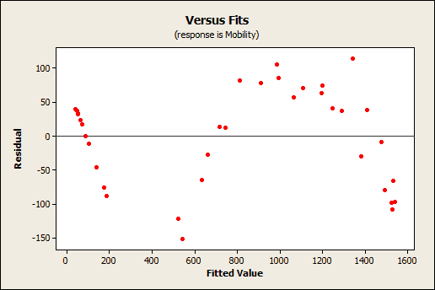
The fitted line plot shows that these data follow a nice tight function and the R-squared is 98.5%, which sounds great. However, look closer to see how the regression line systematically over and under-predicts the data (bias) at different points along the curve. You can also see patterns in the Residuals versus Fits plot, rather than the randomness that you want to see. This indicates a bad fit, and serves as a reminder as to why you should always check the residual plots.

Slide 27
Closing Thoughts on R-squared
R-squared is a handy, seemingly intuitive measure of how well your linear model fits a set of observations. However, as we saw, R-squared doesn’t tell us the entire story. You should evaluate R-squared values in conjunction with residual plots, other model statistics, and subject area knowledge in order to round out the picture (pardon the pun).
While R-squared provides an estimate of the strength of the relationship between your model and the response variable, it does not provide a formal hypothesis test for this relationship. The F-test of overall significance determines whether this relationship is statistically significant.

Slide 28
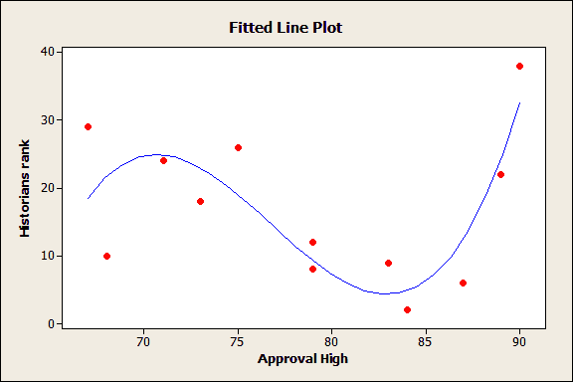
Multiple Regression Analysis: Use Adjusted R-Squared to Include the Correct Number of Variables
Multiple regression can be a beguiling, temptation-filled analysis. It’s so easy to add more variables as you think of them, or just because the data are handy. Some of the predictors will be significant. Perhaps there is a relationship, or is it just by chance? You can add higher-order polynomials to bend and twist that fitted line as you like, but are you fitting real patterns or just connecting the dots? All the while, the R-squared (R²) value increases, teasing you, and egging you on to add more variables!

Slide 29
What Is the Adjusted R-squared?
The adjusted R-squared compares the explanatory power of regression models that contain different numbers of predictors.
Suppose you compare a five-predictor model with a higher R-squared to a one-predictor model. Does the five predictor model have a higher R-squared because it’s better? Or is the R-squared higher because it has more predictors? Simply compare the adjusted R-squared values to find out!

Slide 30
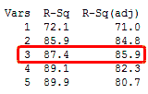
The adjusted R-squared is a modified version of R-squared that has been adjusted for the number of predictors in the model. The adjusted R-squared increases only if the new term improves the model more than would be expected by chance. It decreases when a predictor improves the model by less than expected by chance. The adjusted R-squared can be negative, but it’s usually not. It is always lower than the R-squared.
In the simplified Best Subsets Regression output below, you can see where the adjusted R-squared peaks, and then declines. Meanwhile, the R-squared continues to increase.

Slide 31
You might want to include only three predictors in this model. We saw how an under-specified model (one that was too simple) can produce biased estimates. However, an overspecified model (one that's too complex) is more likely to reduce the precision of coefficient estimates and predicted values. Consequently, you don’t want to include more terms in the model than necessary. Finally, a different use for the adjusted R-squared is that it provides an unbiased estimate of the population R-squared .

Slide 32
Data dictionary
1. ALB（白蛋白Albumin, normal range: 3.5~5.7）
2. ALT（肝指數Alanine Aminotransferase, normal range：0~41）
3. CHOL(總膽固醇Total cholesterol , normal range
：＜200)
4. CREB(肌酸酐Creatinine, normal range: 0.6~1.3)
5. GLU(飯前血糖 Blood sugar before meals, normal range: 70~100)
6. GLU2(飯後 2 小時血糖 blood sugar 2hrs after meals, normal range＜140)
7. HDLC(高密度脂蛋白High-density lipoprotein, normal range：正常範圍＞40)
8. LDLC(低密度脂蛋白low-density lipoprotein, normal range：正常範圍＜130)
9. TRIG(三酸甘油酯Triglycerides
, normal range ：＜150)

