Slide 1

CYCU Special Topics on Research
Instructor：Professor LIN, SHIH-MO
Student： 陳明勇 11204612

Slide 2
Cloud Under Fire:
An Empirical Study on Attack Frequency, Defense Performance, and Strategic Hardening
01
Introduction
02
Literature Review
03
Research Methodology
04
Research Results and Discussion
05
Conclusion and Future Research

Slide 3

01 Introduction
Background and Motivation
Research Purpose
Research Questions

Slide 4

Background and Motivation
Cloud computing brings great flexibility and speed to businesses. But at the same time, it also increases the chance of being attacked. Because cloud systems are open and shared by many users, they are often targeted by hackers.
However, there are not many studies that directly compare cloud systems with regular IT systems in terms of how often they are attacked and how well they defend.
This study tries to fill that gap.

Slide 5
Research Purpose
This study wants to understand how using cloud services changes cybersecurity risks. It used system data to compare cloud teams and non-cloud teams.
We looked at how often each group gets attacked and how well they stop the attacks.
The study is to help companies find weak points and improve their cloud protection.

Slide 6
Research Questions
Is there a significant difference in the number of attacks between cloud division and other division?
Do cloud services show significant differences in defense success rates when facing different types of cyberattacks?
How can the overall defense capability of cloud division be enhanced?

Slide 7
02 Literature Review

Slide 8

Review, identify gaps & position the research
Ransomware and EDoS highlight cloud risks from shared infrastructure (Suryateja, 2018). Cloud defenses often miss low-rate or cost-driven DDoS attacks (Agrawal & Tapaswi, 2019). Ransomware is also moving to the cloud, exposing gaps in current protections (Oz et al., 2022).
Prior studies lack comparative analysis of cloud vs. non-cloud risks and overlook defense performance by attack type.
The paper address this gap with empirical data on attack frequency and defense success, offering targeted recommendations for cloud security improvement.

Slide 9
03 Research Methodology
Data Source and Key Variables
Analytical Methods

Slide 10
Data Source and Key Variables
Dataset: De-identified monitoring data (2024.09~2024.12)
Variables:
  • Division (e.g., cloud, regional DCs)
  • Region (e.g., APAC, Americas)
  • Attack Type (DDoS, ransomware, phishing, etc.)
  • Attack Source (internal/external)
  • DefenseRate (defense success percentage)
  Complies with GDPR, CCPA, and ISO 27001
  Tools used: Stata/IC 15.1

Slide 11

Analytical Methods: T-Test
Objective: Test if attack counts differ between cloud and non-cloud divisions.
Equation: $T=\frac{(X̄₁ − X̄₂)}{\sqrt{(s₁²/n₁ + s₂²/n₂) }}$
  Terms:
  •$\text{X}\text{̄}\text{₁}\text{, }\text{X}\text{̄}\text{₂}$: Average attack counts for cloud and non-cloud divisions
  • s₁², s₂²: Sample variances
  • n₁, n₂ : Sample sizes
  A significant T value(p < 0.05)indicates a meaningful difference in attack frequency.

Slide 12

Analytical Methods: ANOVA
Objective: Test if cloud divisions receive more attacks than others.
Model:
Y_{ij} = μ + τ_{i} + ε_{ij}
Terms:
    • Y_{ij}: Number of attacks in division type i, observation j
    • $μ$: Overall mean of attack counts
    • $τ$: Effect of division type (Cloud vs. Non-cloud)
    •ε_{ij}: Random error, assumed N(0, σ²)
    F-test checks if attack volumes differ across division types.

Slide 13

Analytical Methods: Regression
Objective: Prioritize high-impact attacks in cloud security planning.
Model: $DefenseRate_{i}= β_{0}+ \sum_{k=1}^{k}{β_{k}}⋅AttackType_{ik}+ ε_{i}$
Terms:
  β: Effect of each attack type (e.g. Phishing, Ransomware) on cloud division's defense performance
  $ε_{i}$: Error term
  K: Total number of attack types (here: 5 types)
Interprets R², F-statistic, and p-values helps identify critical attack types and guides strategic enhancements for cloud defense.

Slide 14
Research Framework
Research Question | Method | Independent Variable (IV) | Dependent Variable (DV) | Purpose
1. Is there a significant difference in the number of attacks between cloud division and other divisions? | T-Test ANOVA | Division Type (Cloud vs. Non-cloud) | Attack Counts | To determine if cloud divisions face more attacks than others
2. Do cloud services show significant differences in defense success rates when facing different types of cyberattacks? | Regression | Attack Type (e.g., Ransomware, DDoS, etc.) | Defense Success Rate(Cloud Division) | To compare defense effectiveness across different attack types
3. How can the overall defense capability of cloud division be enhanced? | Regression | Attack Type | Defense Success Rate(Cloud Division) | To identify high-impact attack types and support targeted defense strategies

Slide 15
04 Research Results:
Results
Summary of Findings

Slide 16
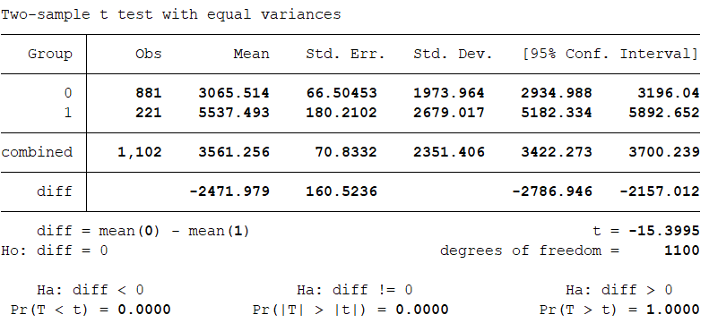
T-Test Result
• Cloud Division shows significantly higher attack volumes
  • Mean attack count: 5,537 (vs. 3,065 for the non-cloud group)
  • Highly significant statistical result
    • p-value < 0.001, Null hypothesis rejected — the difference between groups is statistically significant
    • Conclusion: Cloud environments are primary targets
      • Priority should be given to strengthening cloud security mechanisms

Slide 17
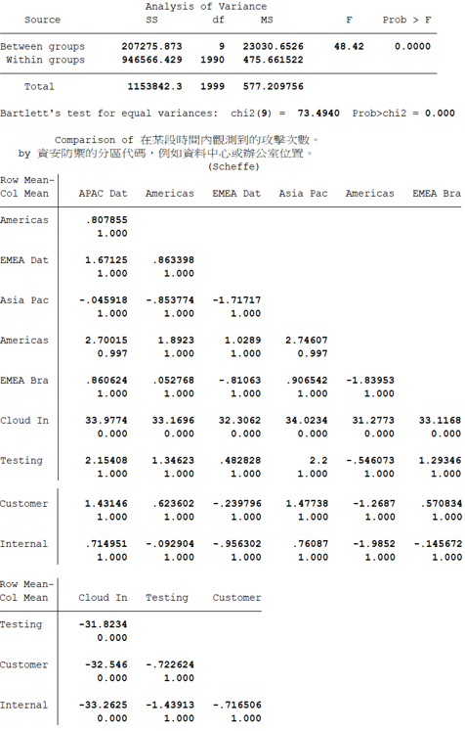
One-way ANOVA
• One-way ANOVA revealed that cloud infrastructure faced significantly more attacks than other divisions (p < 0.05), with all comparisons showing statistical significance. Differences between internal development networks and customer support networks were minimal and not significant. This highlights the need to prioritize cybersecurity strategies for cloud infrastructure.

Slide 18
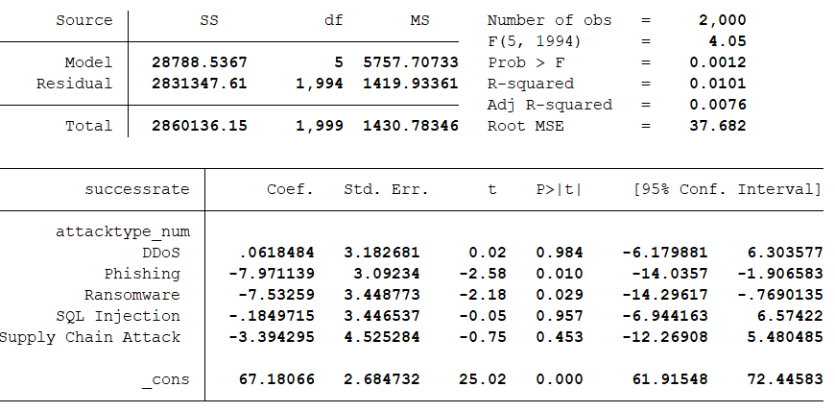
Multiple Regression
The model explains only 1% of the variance in defense success (R² = 0.0101).
Phishing and Ransomware significantly reduce success rates (p < 0.05).
Other attack types show no significant effect.
Conclusion: Focus on improving defenses against Phishing and Ransomware.

Slide 19
Summary of Findings
  Cloud infrastructure faces significantly more attacks.
  Defense success rates are similar overall, except for phishing and ransomware.
  Prioritize cloud security and strengthen defenses against phishing & ransomware.

Slide 20
05 Conclusion and Future Research

Slide 21
Conclusion
Cloud infrastructure is a prime target for cyberattacks, demanding prioritized investment in its protection.
Phishing and ransomware continue to undermine defense effectiveness, suggesting the need for specialized detection and rapid response mechanisms tailored to these threats.
Broad defense strategies are insufficient; organizations should adopt threat-specific, adaptive cloud security frameworks with a focus on phishing and ransomware resilience.

Slide 22
Future Research
Cross-industry validation of cloud attack patterns to generalize findings across sectors.
Assess the cost-effectiveness of tailored defense mechanisms, especially for ransomware and phishing mitigation.
Explore the integration of AI-driven anomaly detection to address low-rate or stealthy attack types (e.g., EDoS)

Slide 23
Q & A

